Slide 1
6.5

Slide 2
6.5

Slide 3
6.5

Slide 4
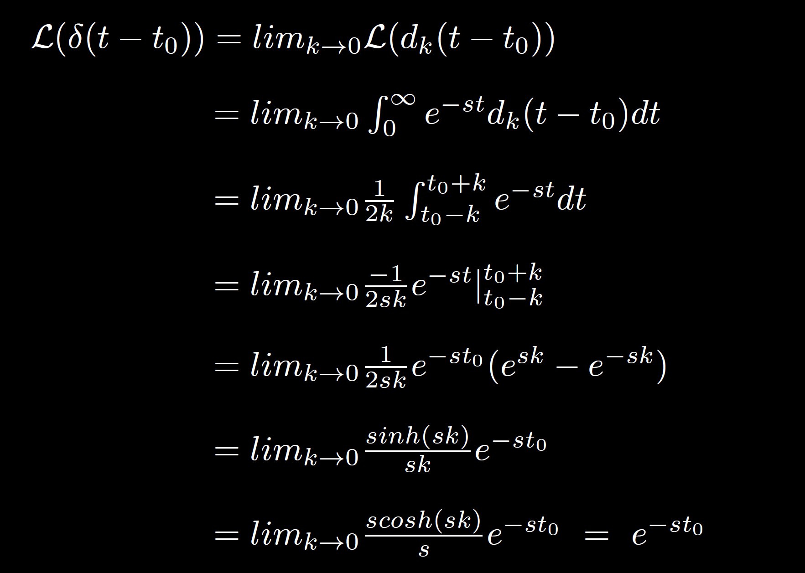
6.5

Slide 5
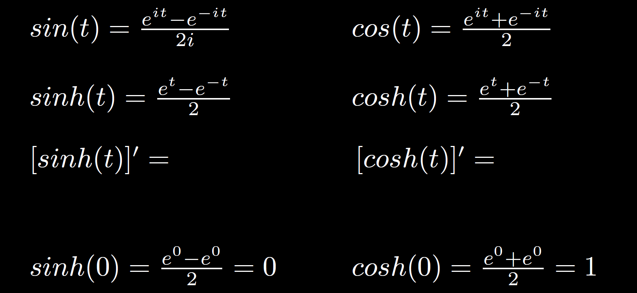
6.5

Slide 8
What you should know about the convolution integral for this class:
The definition.
How to calculate f*g using this definition.
There are many applications in engineering where the convolution integral is very useful.
The convolution integral can be used instead of partial fractions when computing the inverse LaPlace transform.
6.6

Slide 9
6.6

Slide 10
6.6

Slide 11
6.6

Slide 12
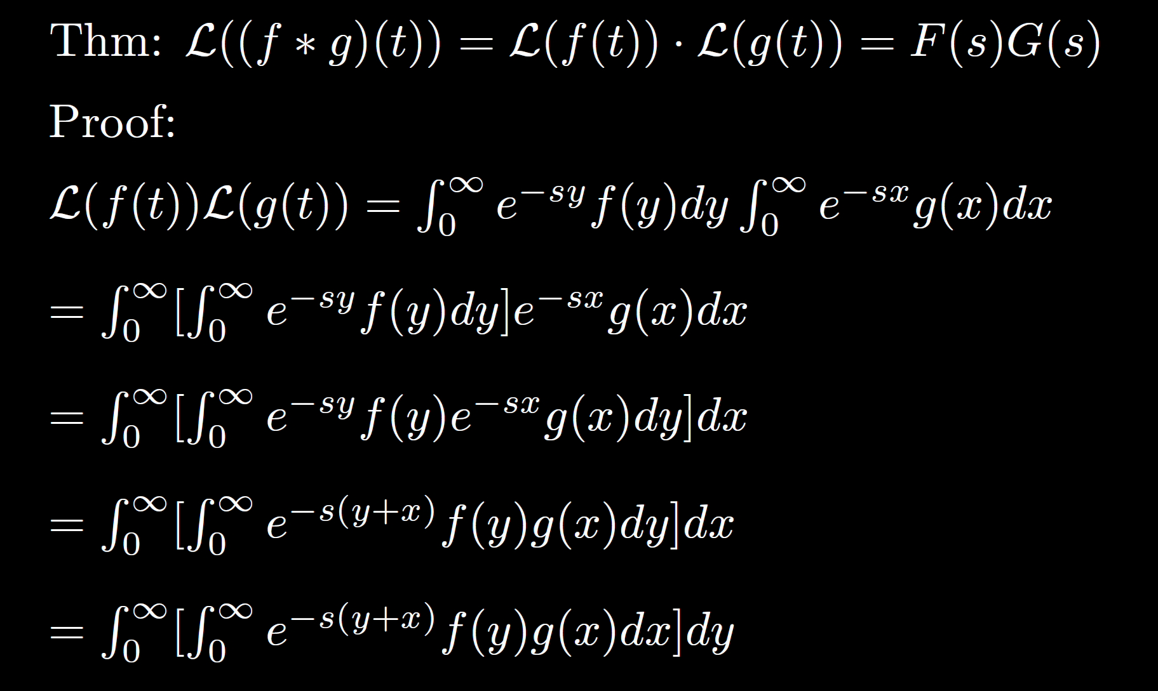
6.6

Slide 13
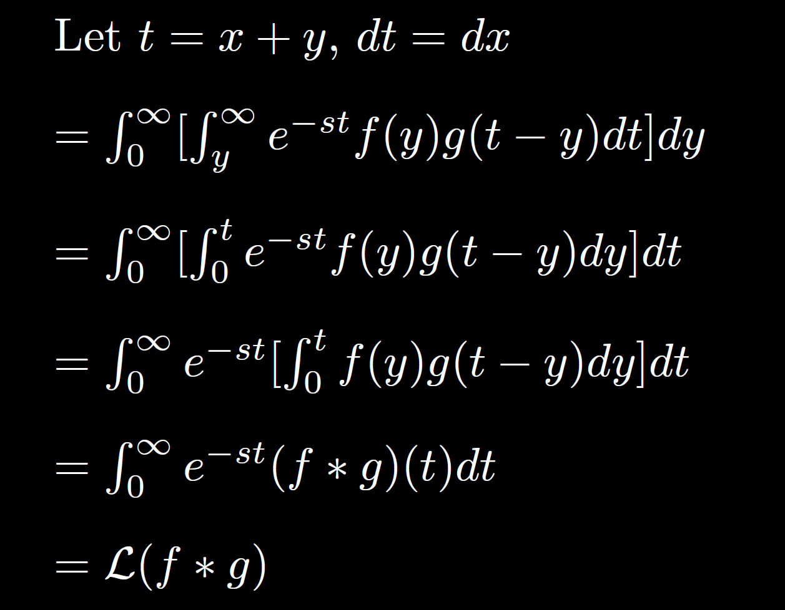
6.6

Slide 14
For HW problems 6.6: 3 and 4: Express the non-homogeneous part of the solution as a convolution integral.
Use partial fractions for the homogeneous part.

Slide 15
x
x
x
6.6

Slide 16
x
x
x
6.6

