Slide 1
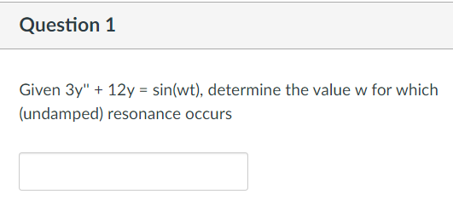

Slide 2
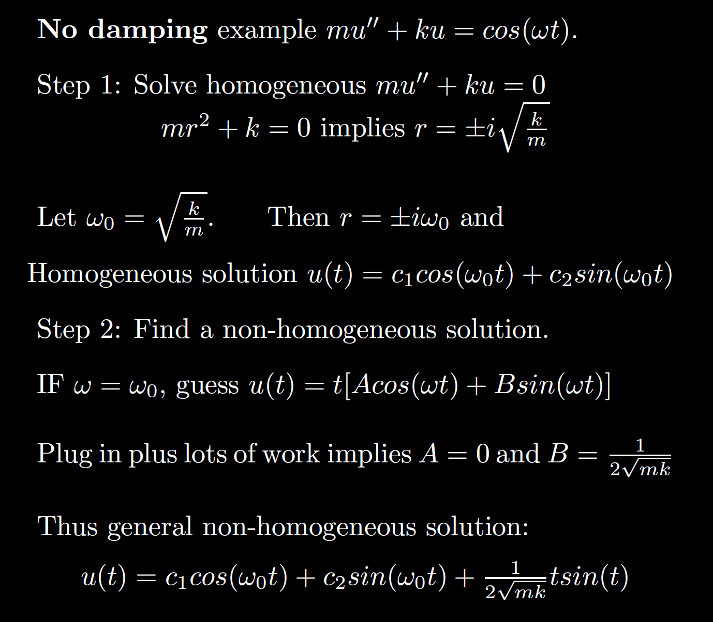
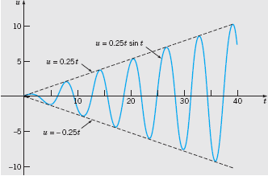
Boyce/DiPrima/Meade 11th ed, Ch 3.8: Forced Periodic Vibrations

Slide 4
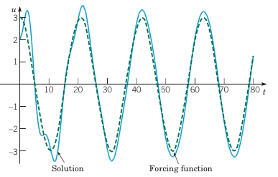
Example 2: Forced Vibrations with Damping (2 of 4)
Graphs of the solution and external force for .
Boyce/DiPrima/Meade 11th ed, Ch 3.8: Forced Periodic Vibrations

Slide 5
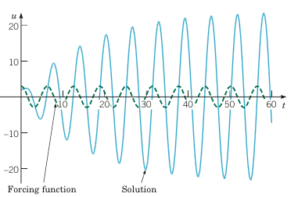
Example 2: Forced Vibrations with Damping (3 of 4)
Graphs of the solution and external force for
Boyce/DiPrima/Meade 11th ed, Ch 3.8: Forced Periodic Vibrations

Slide 6
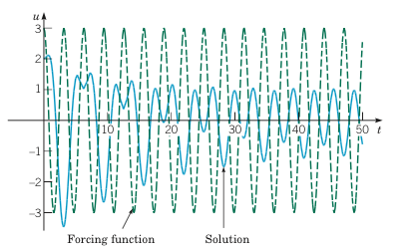
Example 2: Forced Vibrations with Damping (4 of 4)
Graphs of the solution and external force for
Boyce/DiPrima/Meade 11th ed, Ch 3.8: Forced Periodic Vibrations

Slide 7
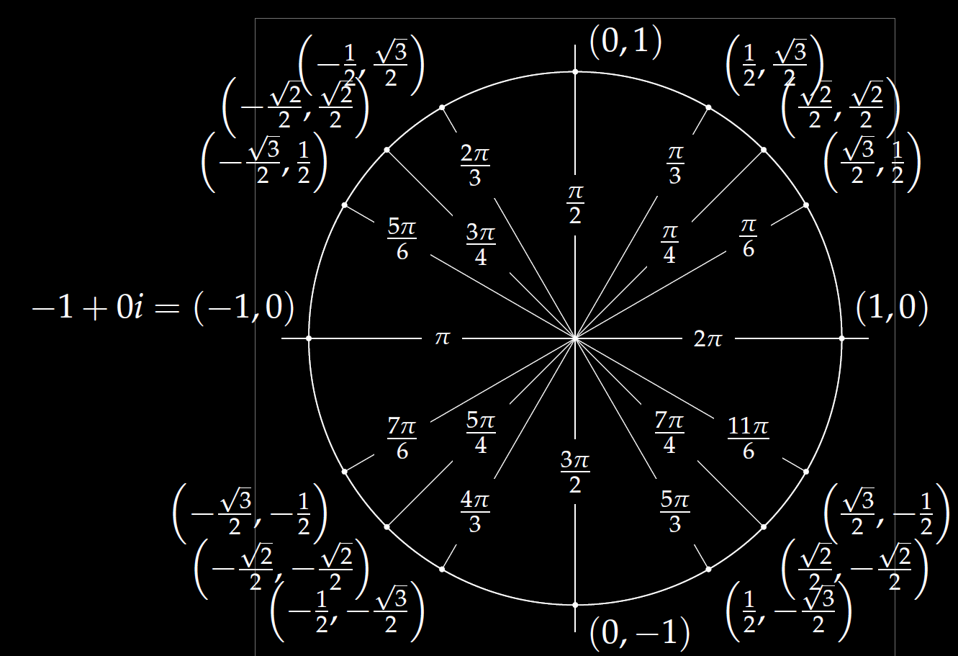
(a, b) = a + ib
= ( Rcos(x), R sin(x) )
= R [cos(x) + i sin(x)]
= R e^{ix}
Compare to Rcos(wt – x)

Slide 8
Examples:
$$1=ⅇ^{ⅈ0}$$
$$−1=ⅇ^{ⅈπ}$$
$$−2=2ⅇ^{ⅈπ}$$
$$3+3ⅈ=\sqrt{18}ⅇ^{iπ/4}$$

Slide 9
All your problems will involve special factoring cases, so you don’t need to know how to factor higher order polynomials in general.
Thus you don’t need to know how to factor the characteristic equation for the DE above.

Slide 11
FYI

Slide 12
FYI

Slide 14
General solution:
$$y=c_{1}ⅇ^{−2t}+c_{2}ⅇ^{t/2}\sin\left(\frac{\sqrt{19}}{2}t\right)+c_{3}ⅇ^{{t/2}^{}}\cos\left(\frac{\sqrt{19}}{2}t\right)$$

Slide 15
Be able to factor the following:
$$ar4 − b = 0$$
$$ar4+ br2+ c = 0$$
$$kar3+ kbr2+ nar + nb =kr2(ar + b)+ n\left(ar + b\right)$$
$= (kr2+ n)(ar + b)$

Slide 16
Solve $y^{′′}′′ – 16y = 0$

Slide 17
Solve $y’’’’ – 16y = 0$
$$r^{4}−16=0\left(r^{2}−4\right)\left(r^{2}+4\right)$$
$r^{2}=4⇒r=±2 r^{2}=−4⇒r=±$2i

Slide 18
Solve $y^{′′}′′–3y^{′′}−4y = 0$

Slide 23
General solution:
$$y=c1cos\left(\sqrt{3}t\right)+c_{2}\sin\left(\sqrt{3}t\right)+c_{3}ⅇ^{−10t}$$

Slide 24
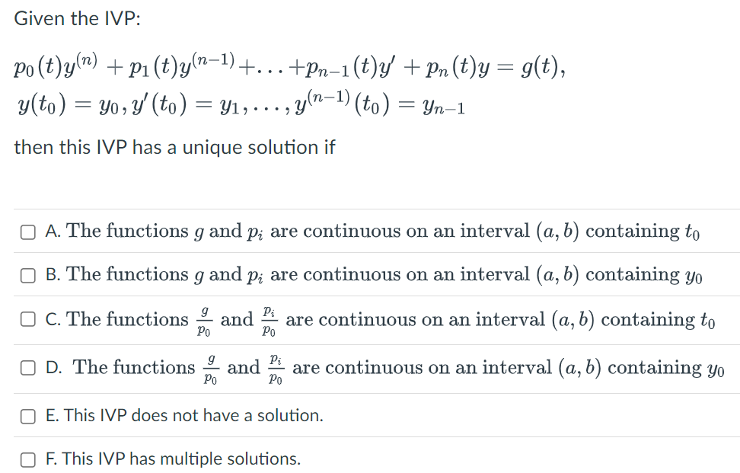
Attendance Quiz 20

Slide 25
Attendance Quiz 20

Slide 26
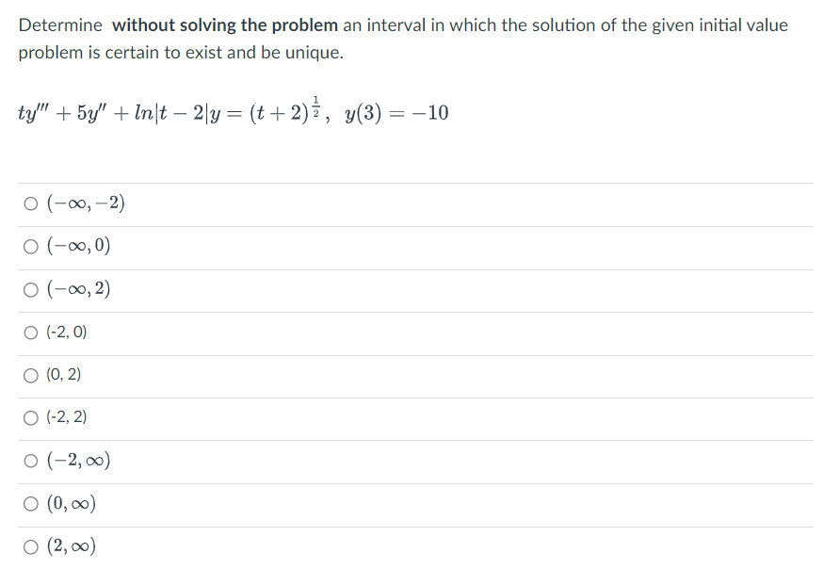
Attendance Quiz 20

Slide 27
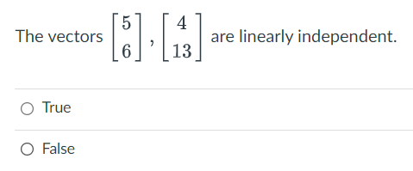
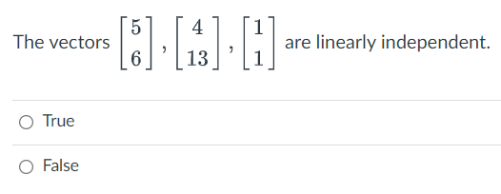
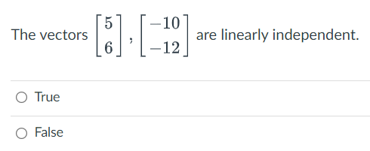
Attendance Quiz 21

Slide 31
Determine (without solving the problem) an interval in which the solution of the given initial value problem is certain to exist and be unique.
$$\left(1 − t\right)\left(1 + t^{2}\right)y^{′′′}+\ln\left|t − 5\right|y^{′}+2y = \sqrt{t+4} y(0) = 3$$

Slide 32
Determine (without solving the problem) an interval in which the solution of the given initial value problem is certain to exist and be unique.
$$\left(1 − t\right)\left(1 + t^{2}\right)y^{′′′}+\ln\left|t − 5\right|y^{′}+2y = \sqrt{t+4} y(0) = 3$$
( )( )(
-4 1 5

Slide 33
Determine (without solving the problem) an interval in which the solution of the given initial value problem is certain to exist and be unique.
$$1y^{′′′}+\ln\left|t − 5\right|{ y}^{′} + 2 y = \sqrt{t+4} y\left(t0\right)= ?$$
$\left(1 − t\right)\left(1 + t^{2}\right)$ $\left(1 − t\right)\left(1 + t^{2}\right)$ $\left(1 − t\right)\left(1 + t^{2}\right)$
( )( )(
-4 1 5
t = 0, thus domain is (-4, 1) for the solution to this initial value problem.

Slide 34
Determine (without solving the problem) an interval in which the solution of the given initial value problem is certain to exist and be unique.
$$1y^{′′′}+\ln\left|t − 5\right|{ y}^{′} + 2 y = \sqrt{t+4} y\left(t0\right)= ?$$
$\left(1 − t\right)\left(1 + t^{2}\right)$ $\left(1 − t\right)\left(1 + t^{2}\right)$ $\left(1 − t\right)\left(1 + t^{2}\right)$
( )( )(
-4 1 5
Unique solution exists if $t_{0}∈\left(−4,1\right)∪\left(1,5\right)∪\left(5,∞\right)$
If $t_{0}∈\left(−4,1\right)$, domain of solution is $\left(−4,1\right)$.
If $t_{0}∈\left(1,5\right)$, domain of solution is $\left(1,5\right)$.
If $t_{0}∈\left(5,∞\right)$, domain of solution is $\left(5,∞\right)$.

Slide 35
Linear Independence and the Wronskian

Slide 38
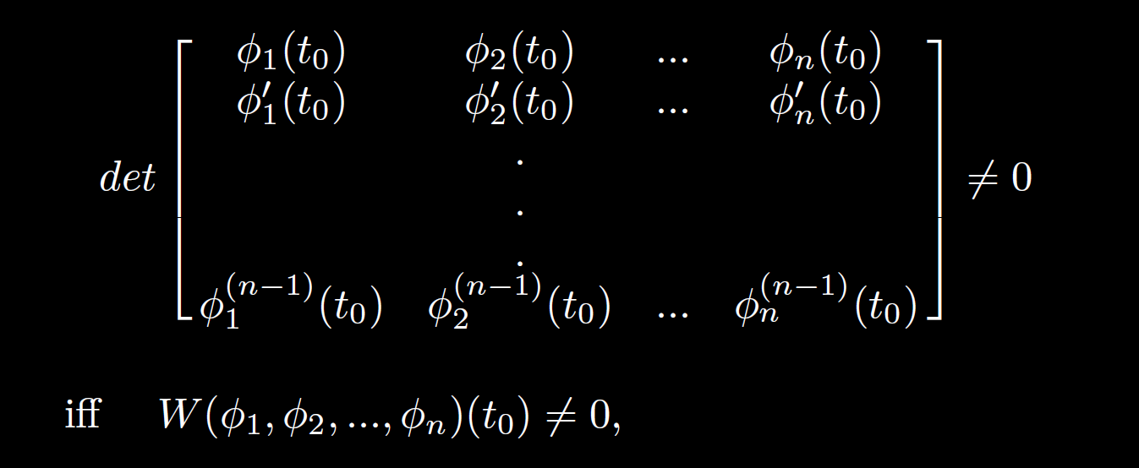

Slide 49
0
0
k
= C

