Slide 1
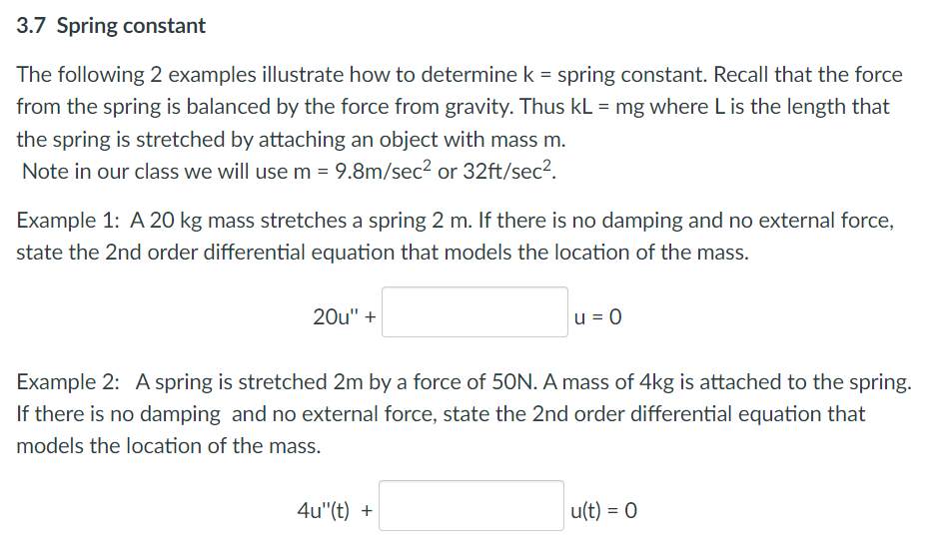

Slide 2
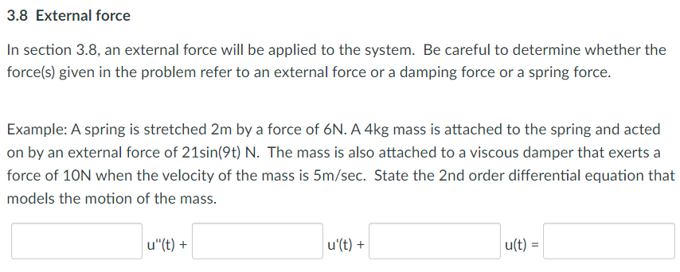

Slide 3
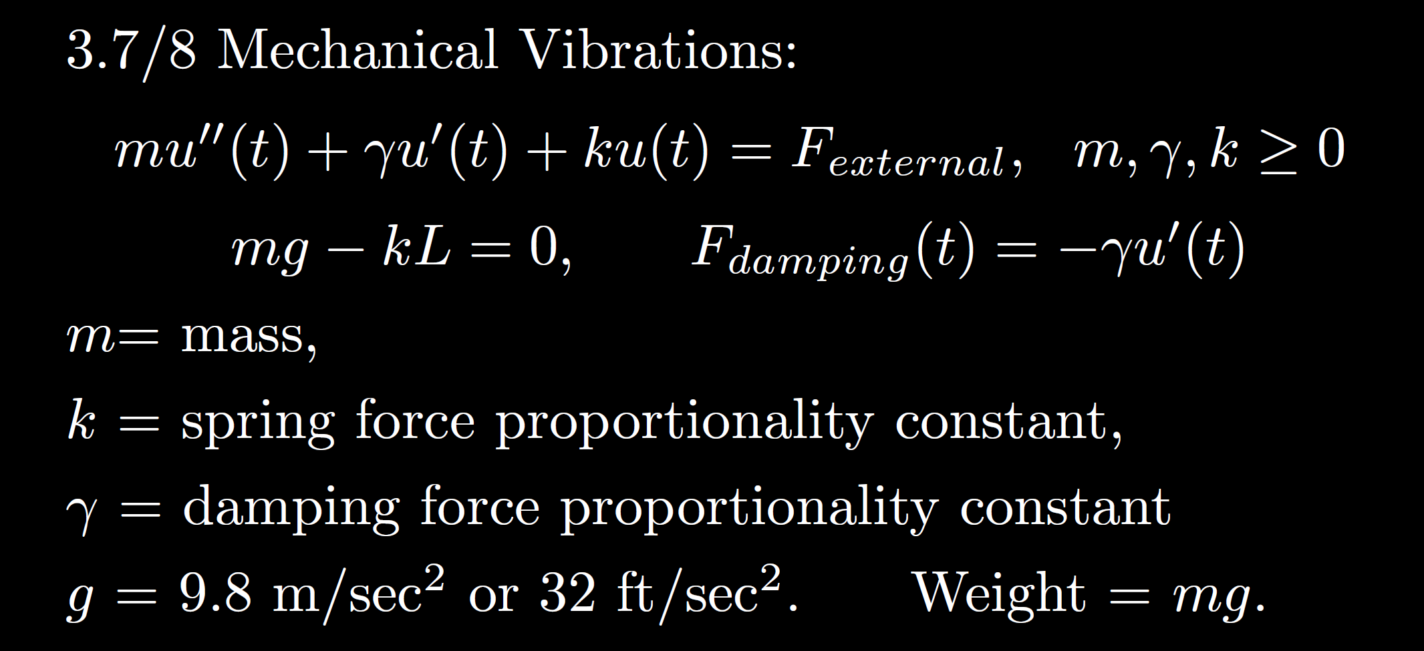
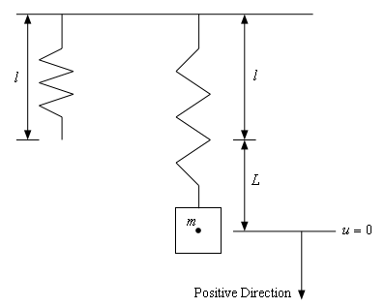
https://tutorial.math.lamar.edu/Classes/DE/Vibrations.aspx

Slide 4
3.1
3.3
3.4

Slide 5
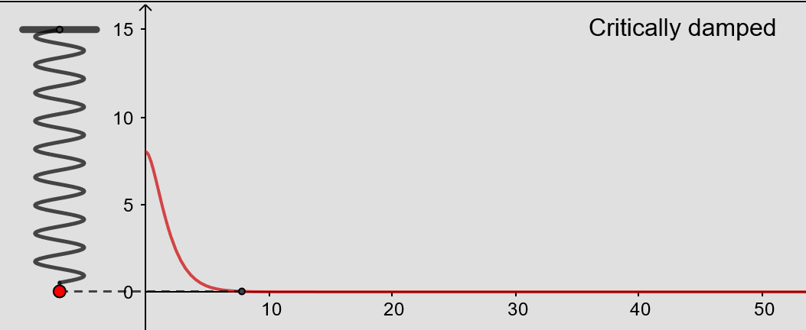
From https://www.geogebra.org/m/ZzKbkvnz
Note: Sign convention is opposite our convention

Slide 6
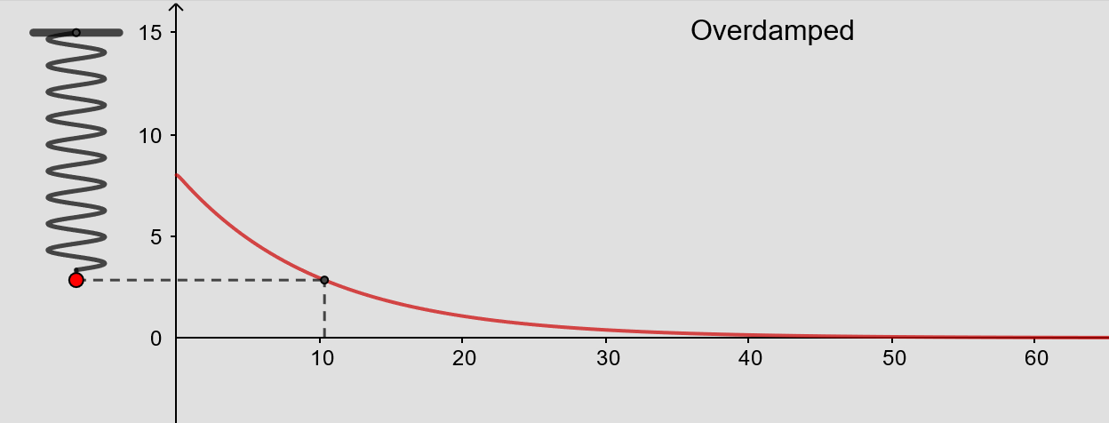
From https://www.geogebra.org/m/ZzKbkvnz
Note: Sign convention is opposite our convention

Slide 7
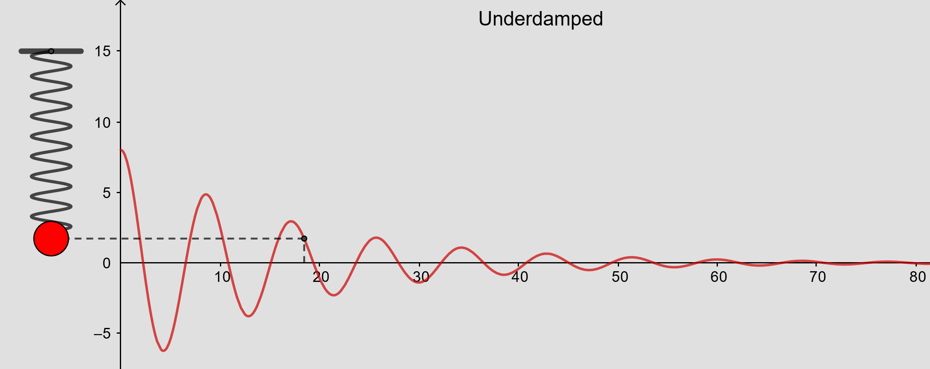
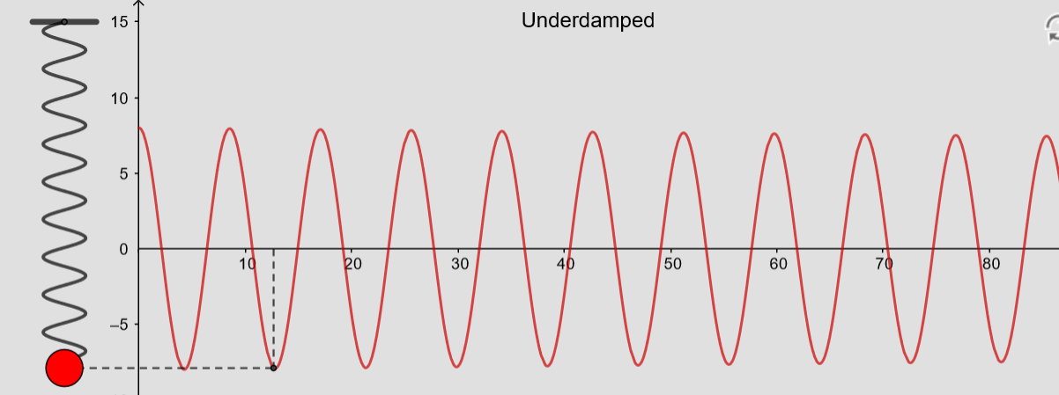
From https://www.geogebra.org/m/ZzKbkvnz
Note: Sign convention is opposite our convention

Slide 8
From https://www.geogebra.org/m/ZzKbkvnz
Note: Sign convention is opposite our convention

Slide 9
Overdamped
3.1
3.3
Underdamped or no damping if d = 0
3.4
Critically damped

Slide 10
is the steady state response when

Slide 20
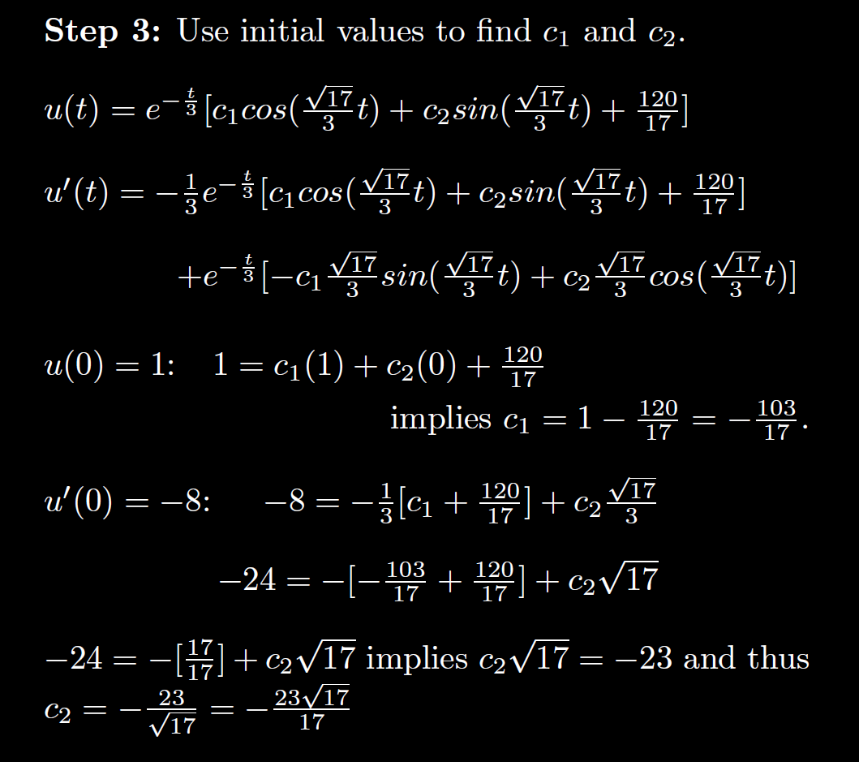

Slide 24
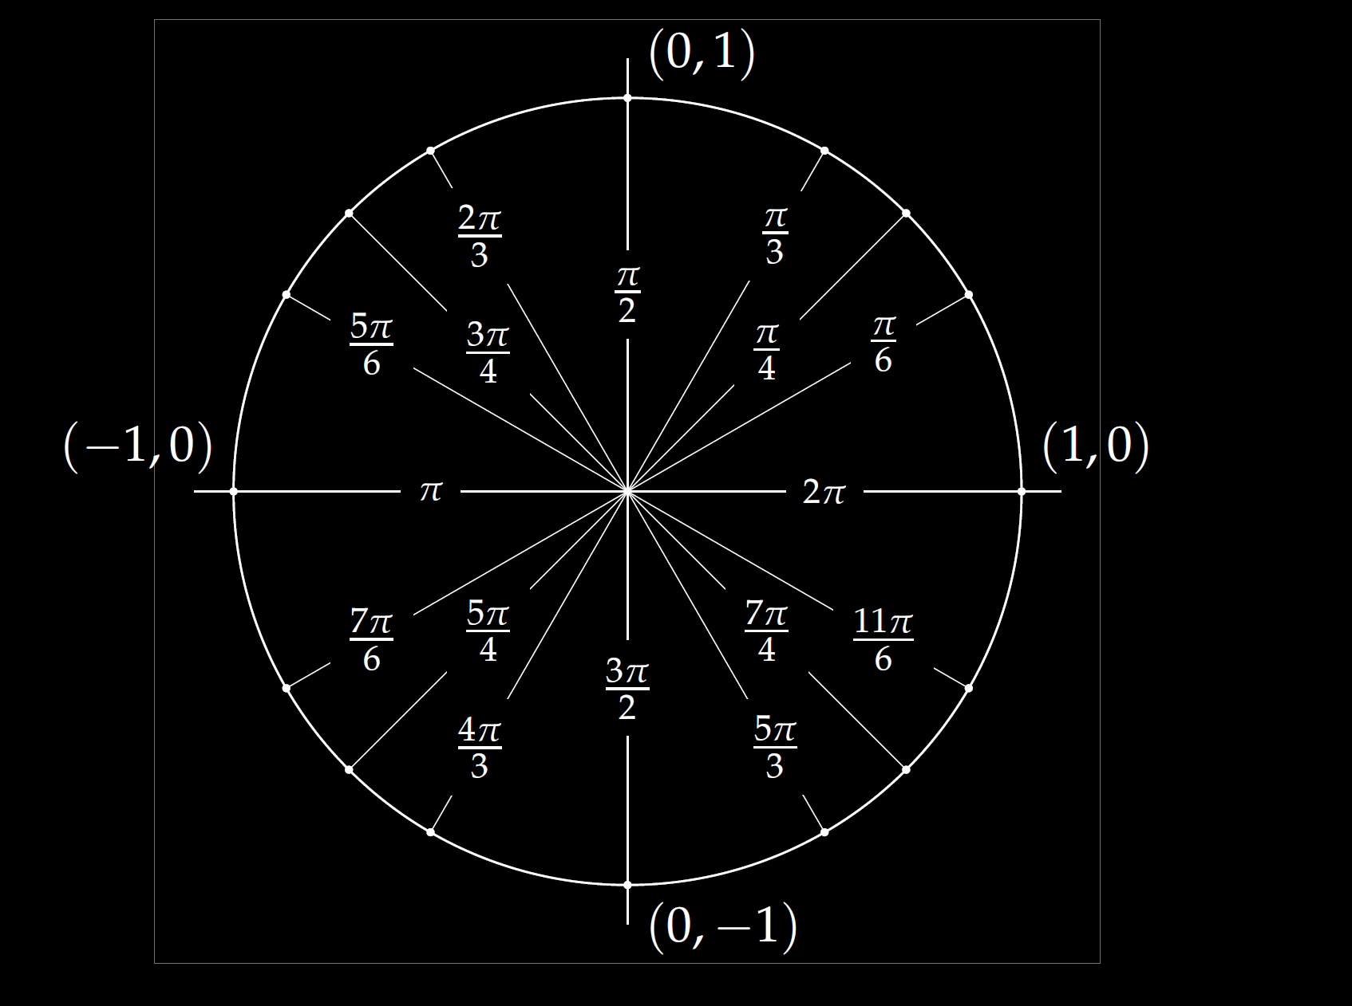

Slide 27
