Slide 1
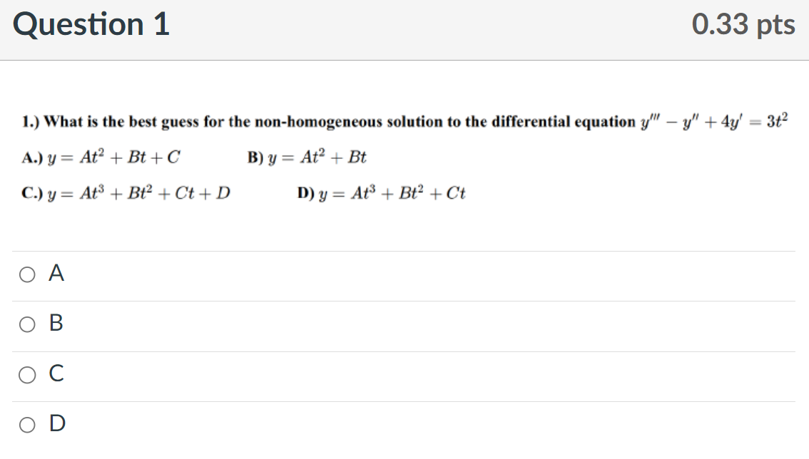

Slide 2
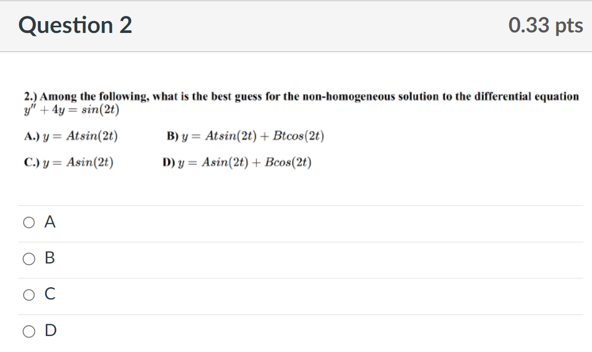

Slide 3
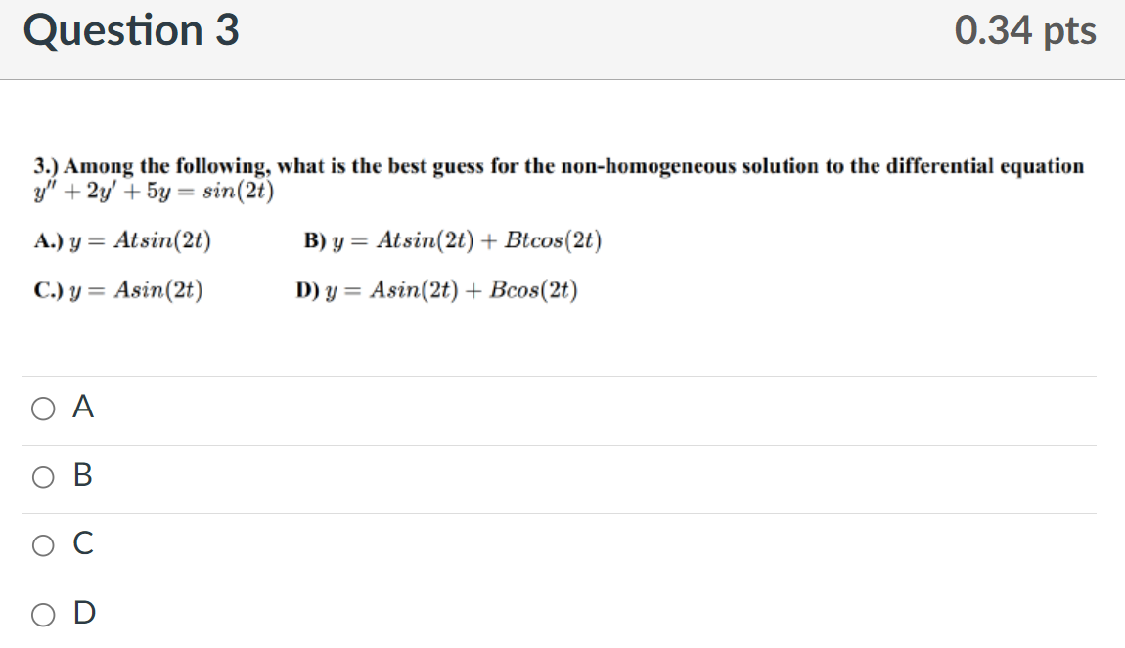

Slide 4
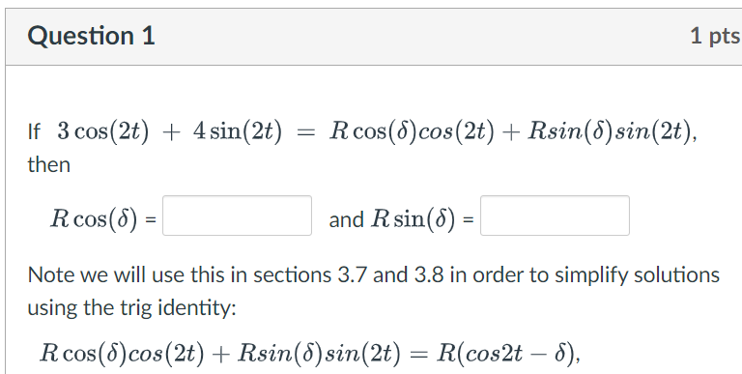

Slide 5
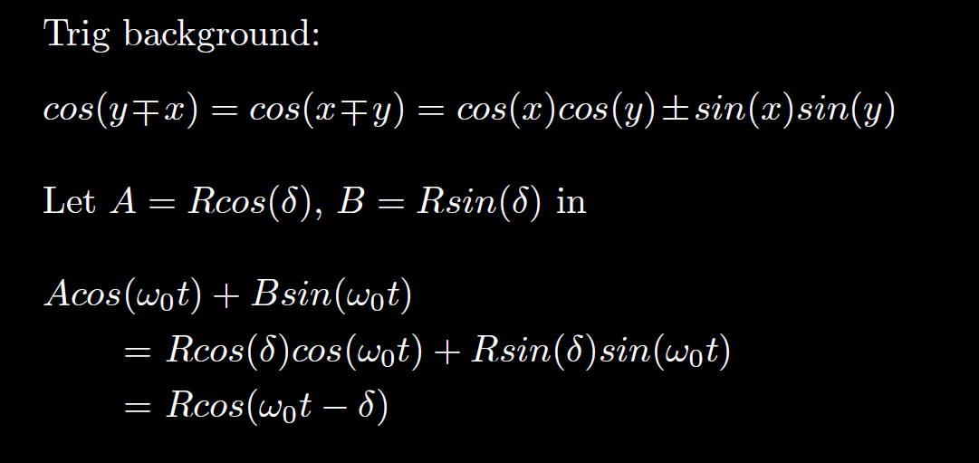

Slide 6
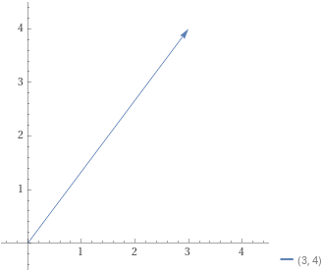
(3, 4)
R
$$δ$$

Slide 7
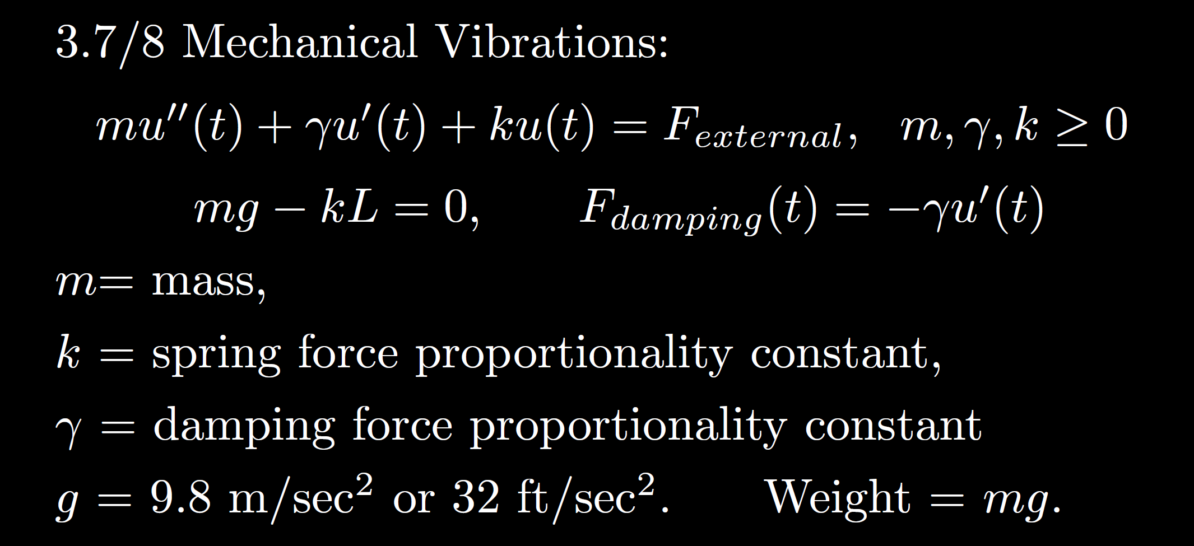
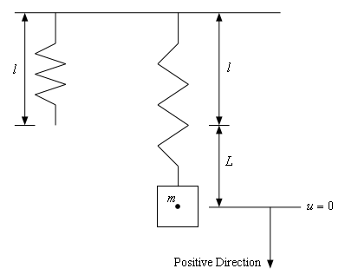
Total force
F= ma
Spring force Acts in negative upward direction
External force
Sec 3.8
Gravitational force
Acts in positive downward direction
Viscous or damping force
Acts in direction opposite of movement (velocity)
https://tutorial.math.lamar.edu/Classes/DE/Vibrations.aspx

Slide 12
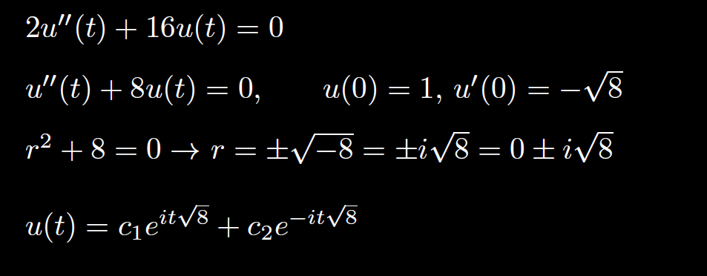
Not simplified, not acceptable.

Slide 13
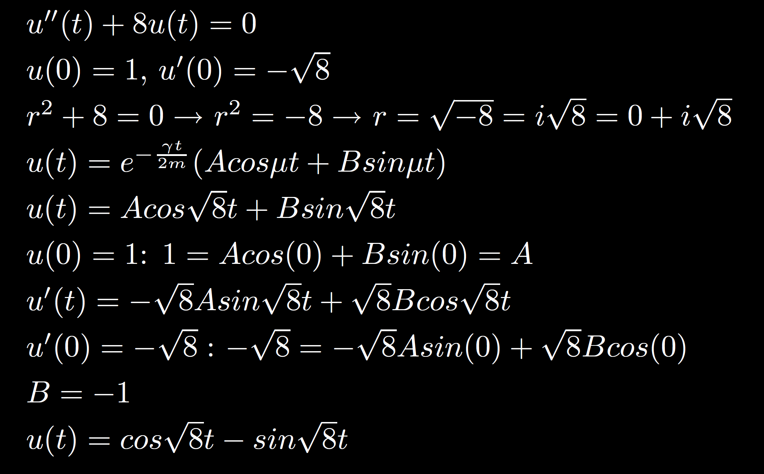

Slide 16
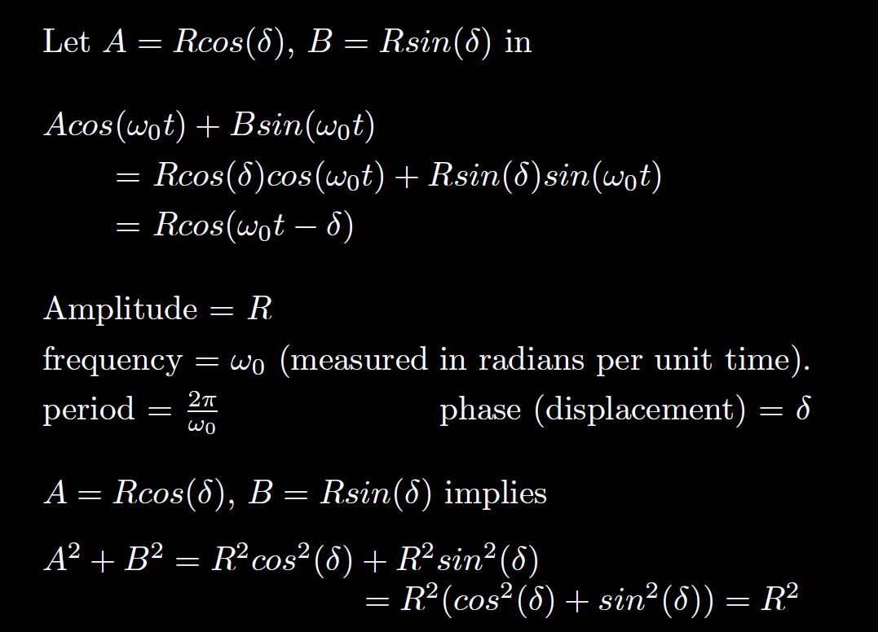

Slide 19
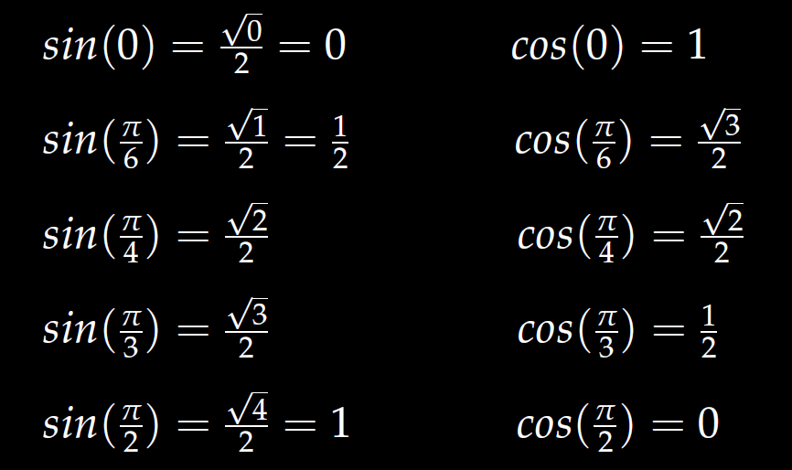

Slide 20
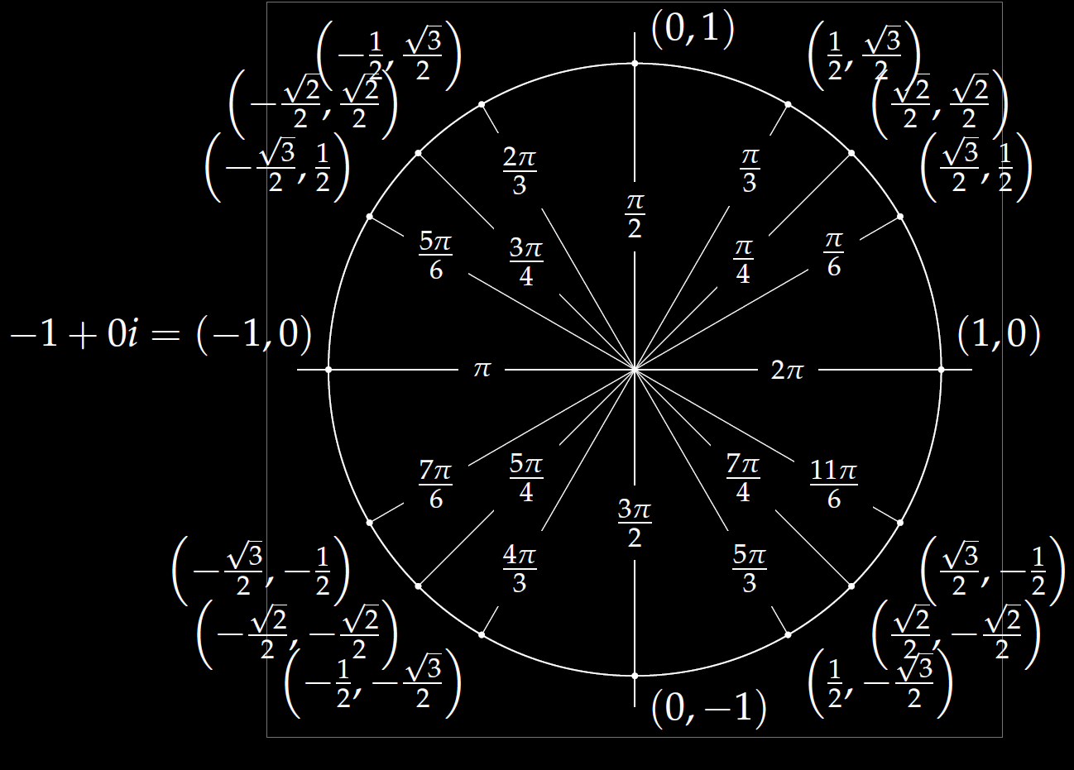

Slide 21
