Slide 4
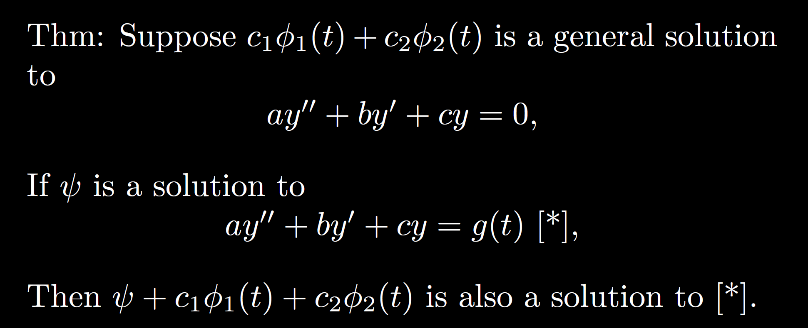

Slide 8
Possible exam question: Explain why y = Asin(3t) is a “bad” guess.
For partial credit, plug in.

Slide 9
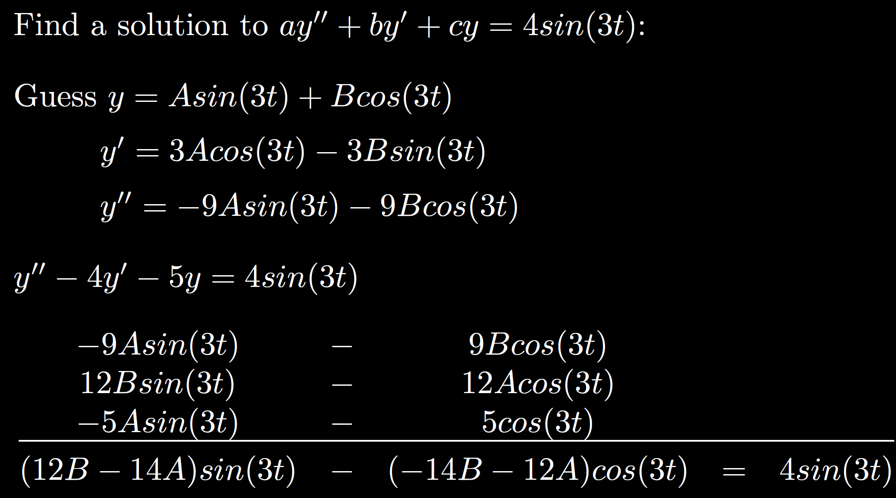

Slide 20
Possible exam question: Explain why you don’t need constant term.
For partial credit, plug in y = At + B and/or y = At.
Explain difference for full credit.

Slide 22
Possible exam question: Explain why

Slide 23
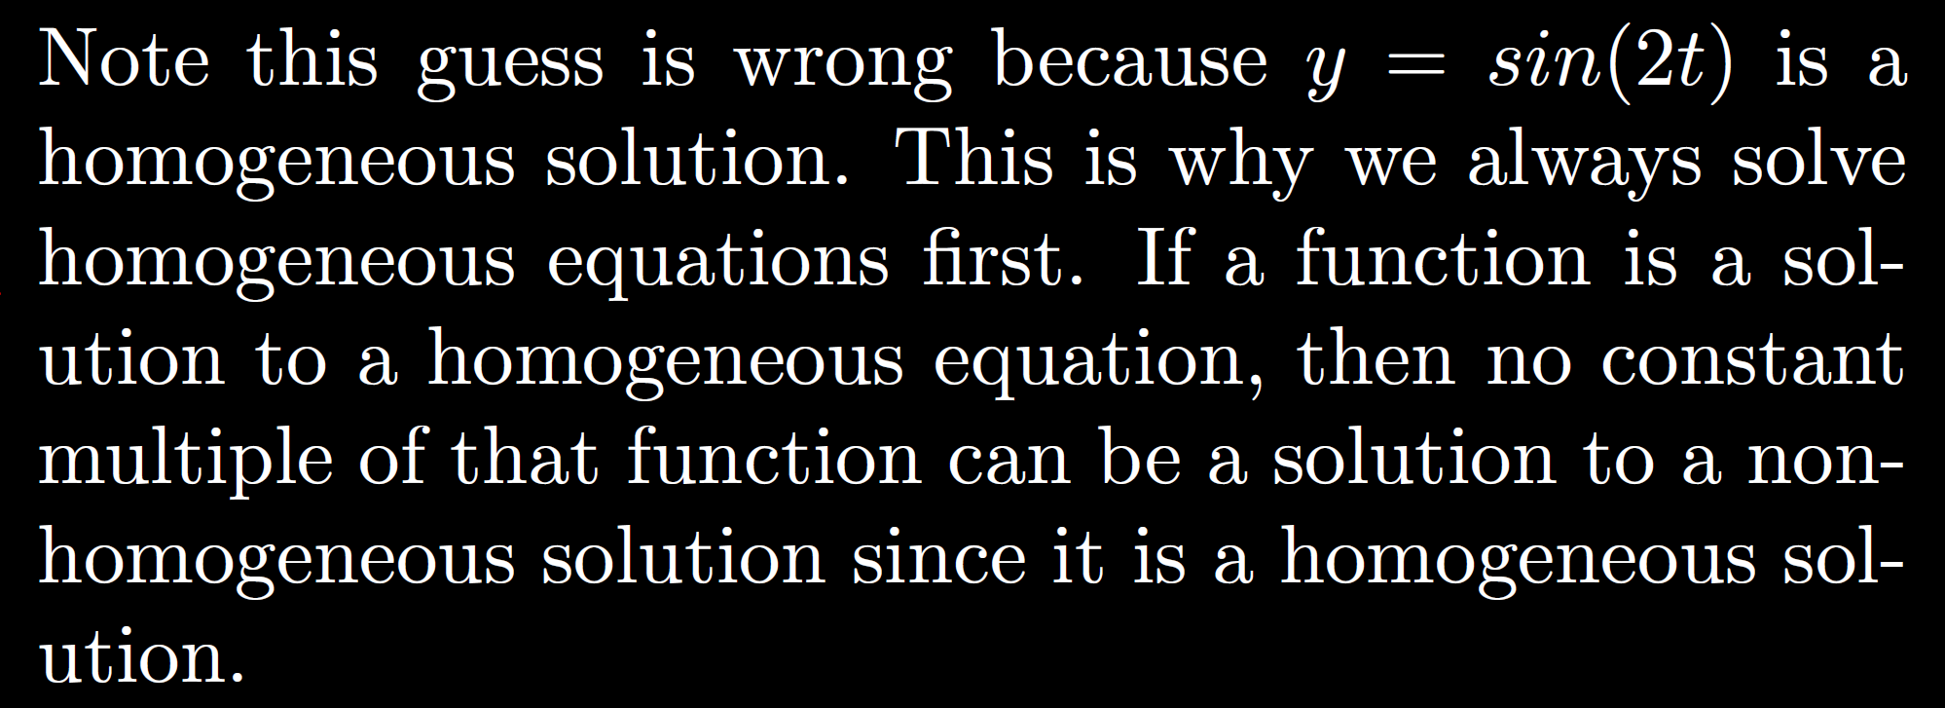

Slide 29
