Slide 1
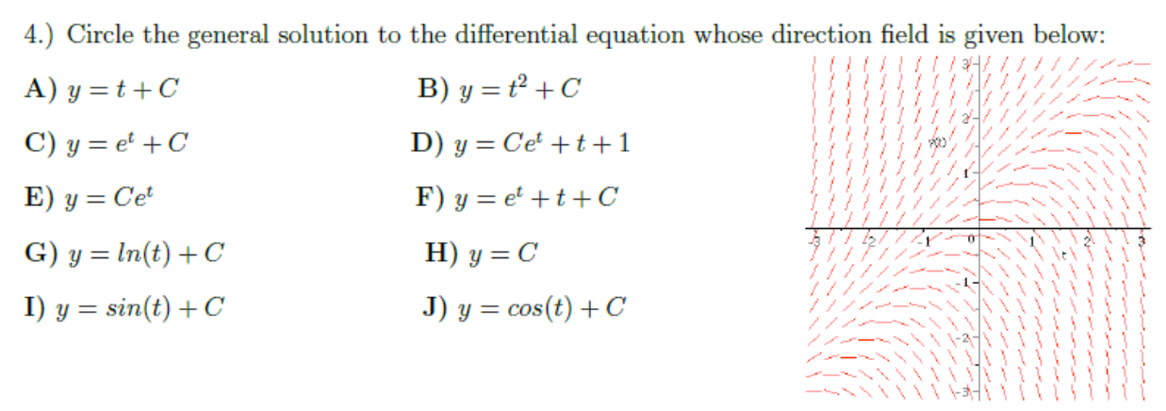

Slide 7
Look for patterns. For example:
Powers: 2^{k} or 2^{2k+1} if you want only odd powers of 2, (-1)^{k} if alternating, etc
Factorials: k! or
9*7*5*3*1 implies (2k-1)(2k-3)…(1) or
a shifted version such as (2k+5)(2k+3)(2k+1)(2k-1)(2k-3)…(1) or
33*28*23*18*13*8*3 implies
or a shifted version

Slide 8
Proving Convergence
https://tutorial.math.lamar.edu/Classes/CalcII/RatioTest.aspx

Slide 9
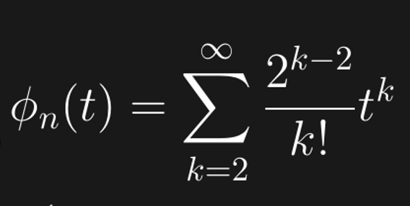
Prove converges.

Slide 11
Proving Convergence
https://tutorial.math.lamar.edu/Classes/CalcII/RatioTest.aspx

Slide 16
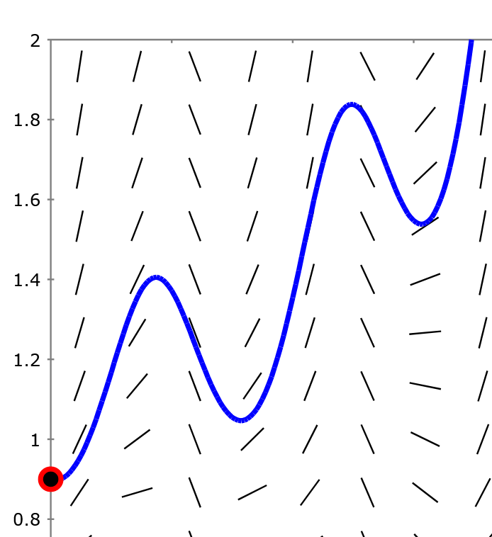
Section 2.7 Euler’s method: Using tangent lines to
approximate a
function.
http://slopefield.nathangrigg.net

Slide 17
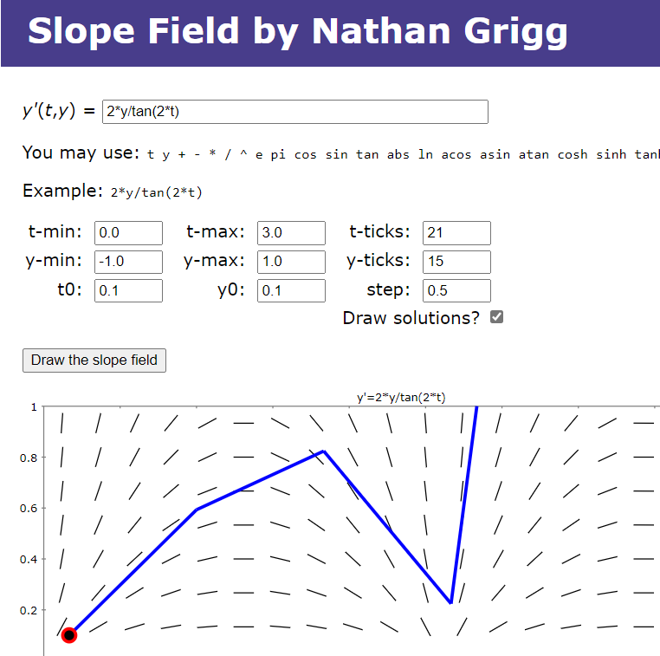

Slide 18
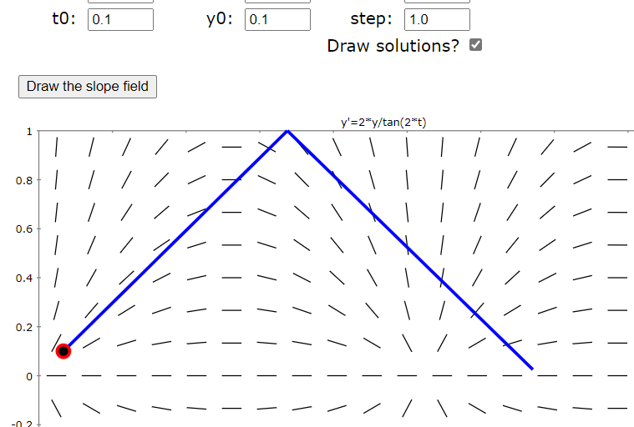
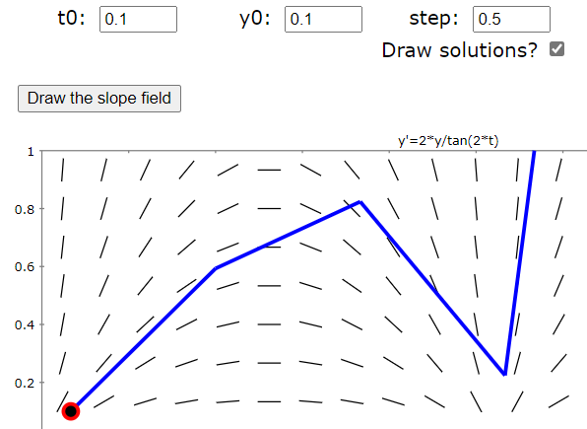
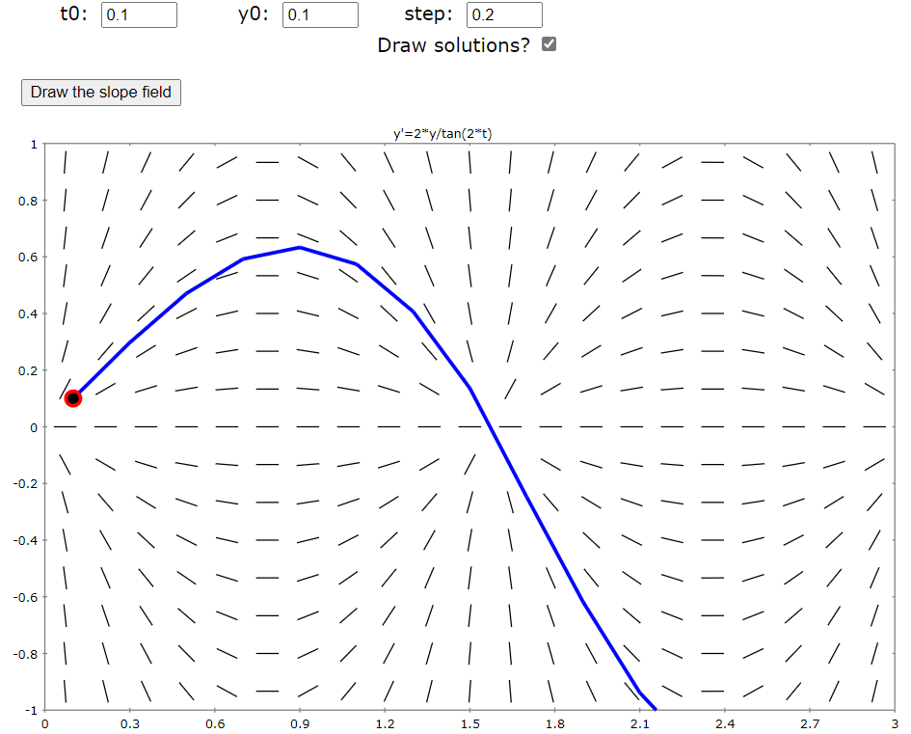
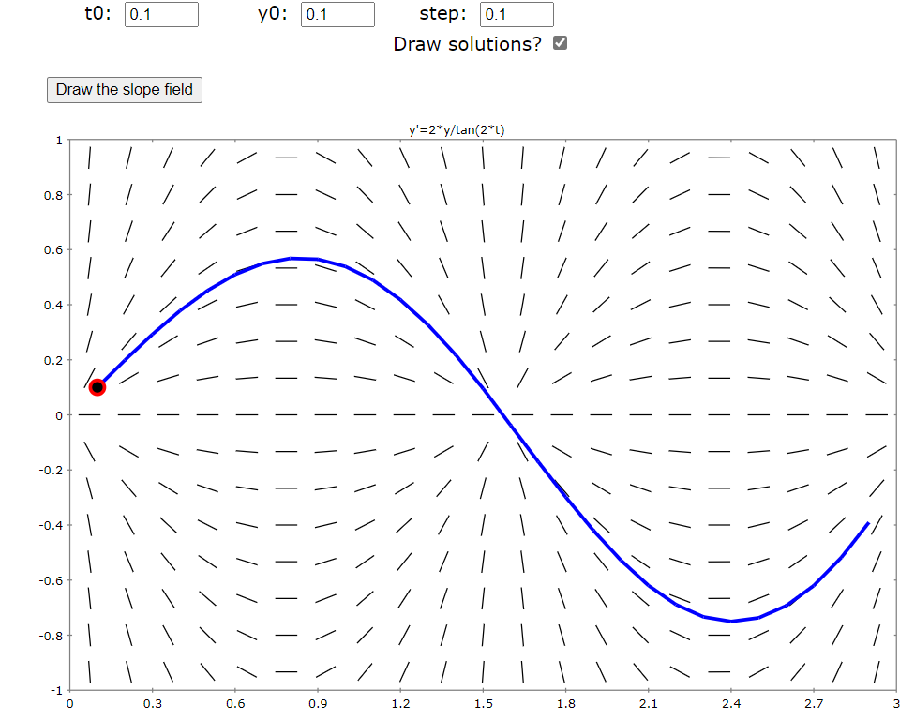

Slide 19
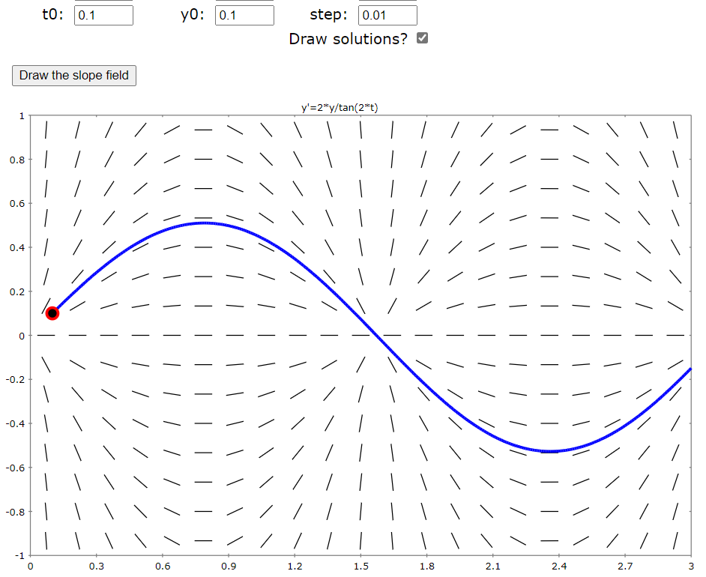
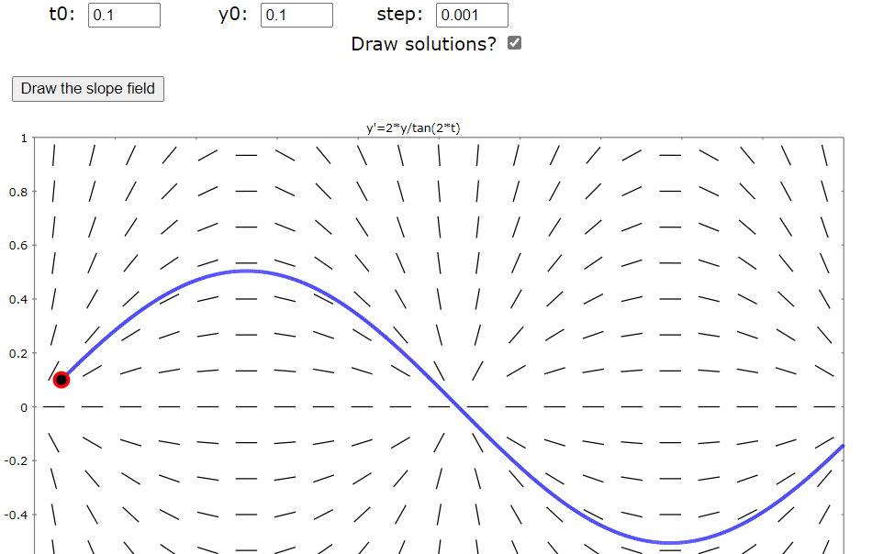

Slide 20
Estimate y(0.3) using h = Step size = Δt = 0.1

Slide 21
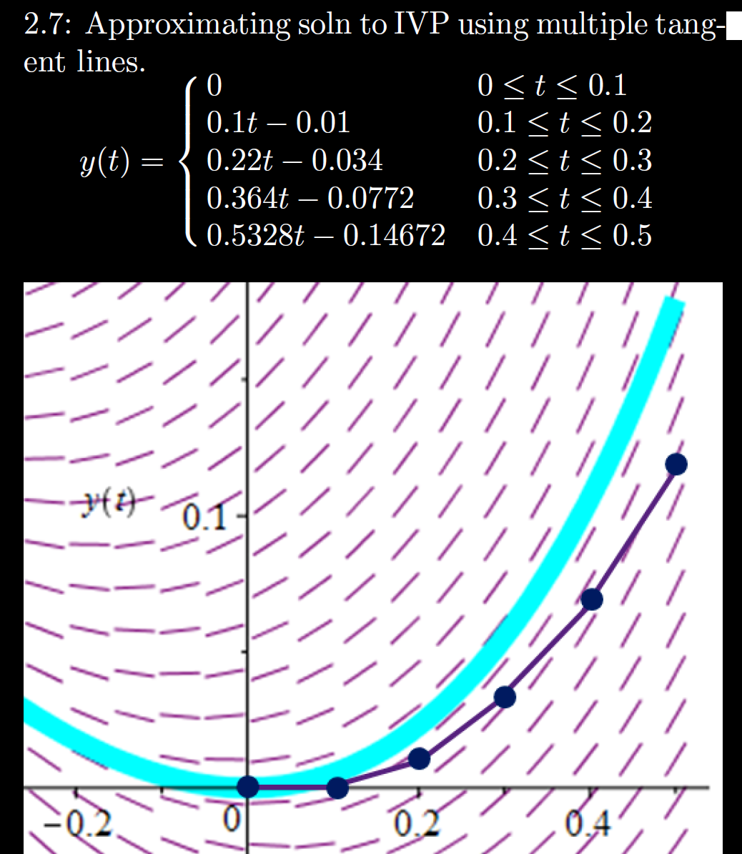
h = Step size
= Δt = 0.1

Slide 22
h = Step size
= Δt = 0.1

