Slide 19
Proving Convergence
https://tutorial.math.lamar.edu/Classes/CalcII/RatioTest.aspx

Slide 20
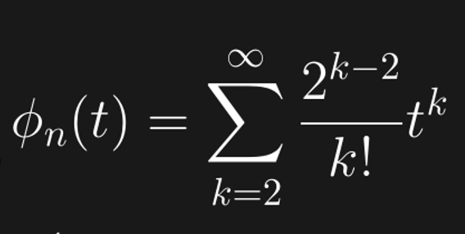
Prove converges.

Slide 24
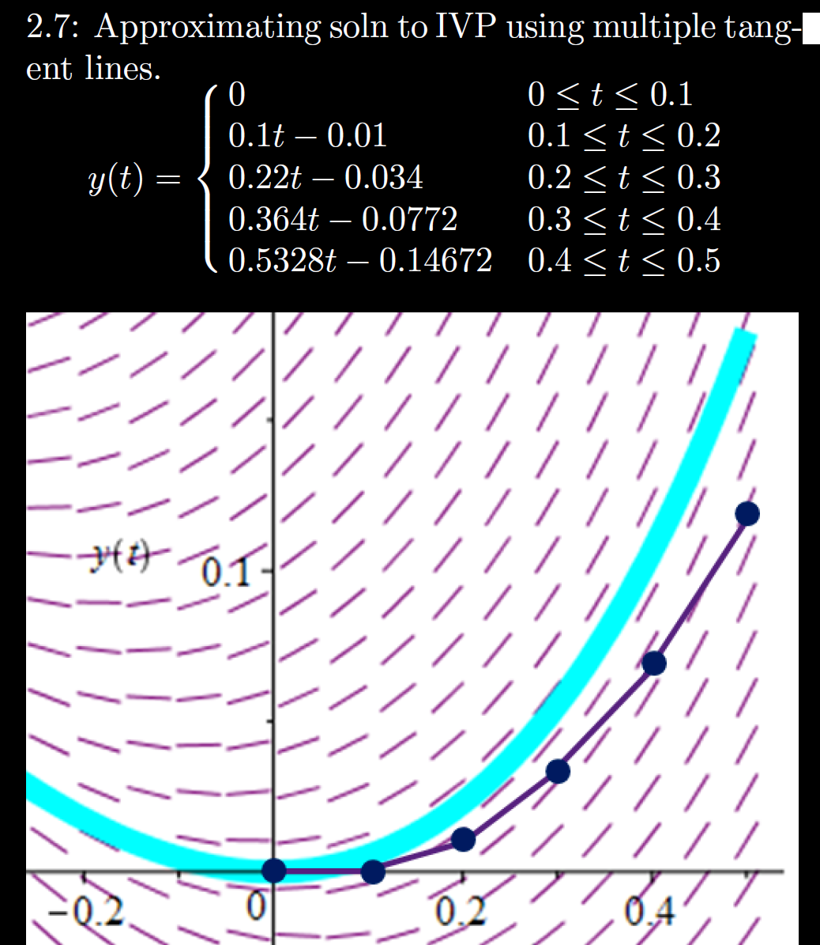
h = Step size
= Δt = 0.1

Slide 25
h = Step size
= Δt = 0.1

Slide 26
Numerical answer question:

Slide 27
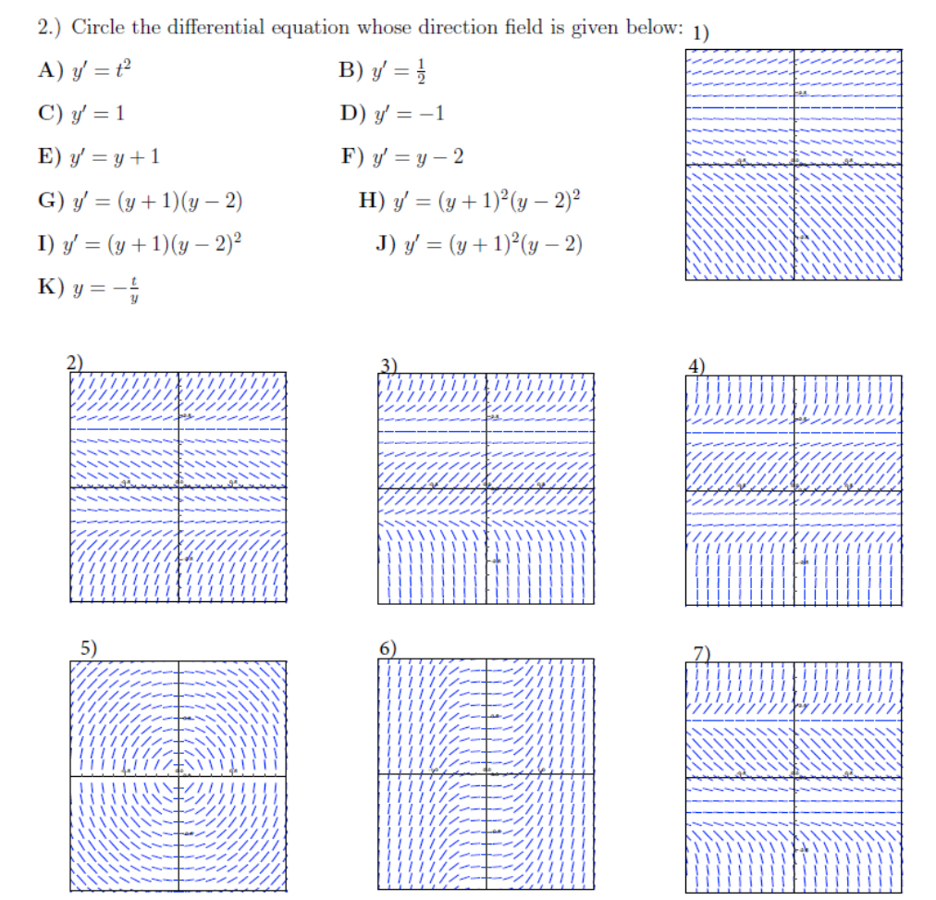
Matching:

