Slide 1
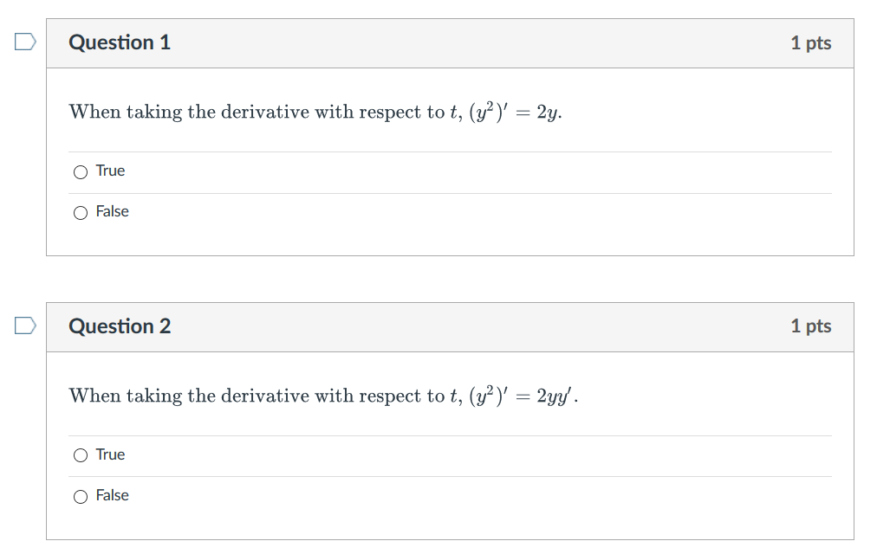

Slide 2
IF DE is linear, to find a domain, choose one longest interval containing t₀ where p and g are continuous.

Slide 3
Linear
NOT
Linear
If NOT linear, to find domain, solve the IVP and find the domain of the solution just like you did in pre-calculus, BUT in DE’s, your domain must be a single open interval as illustrated in the following example.

Slide 8
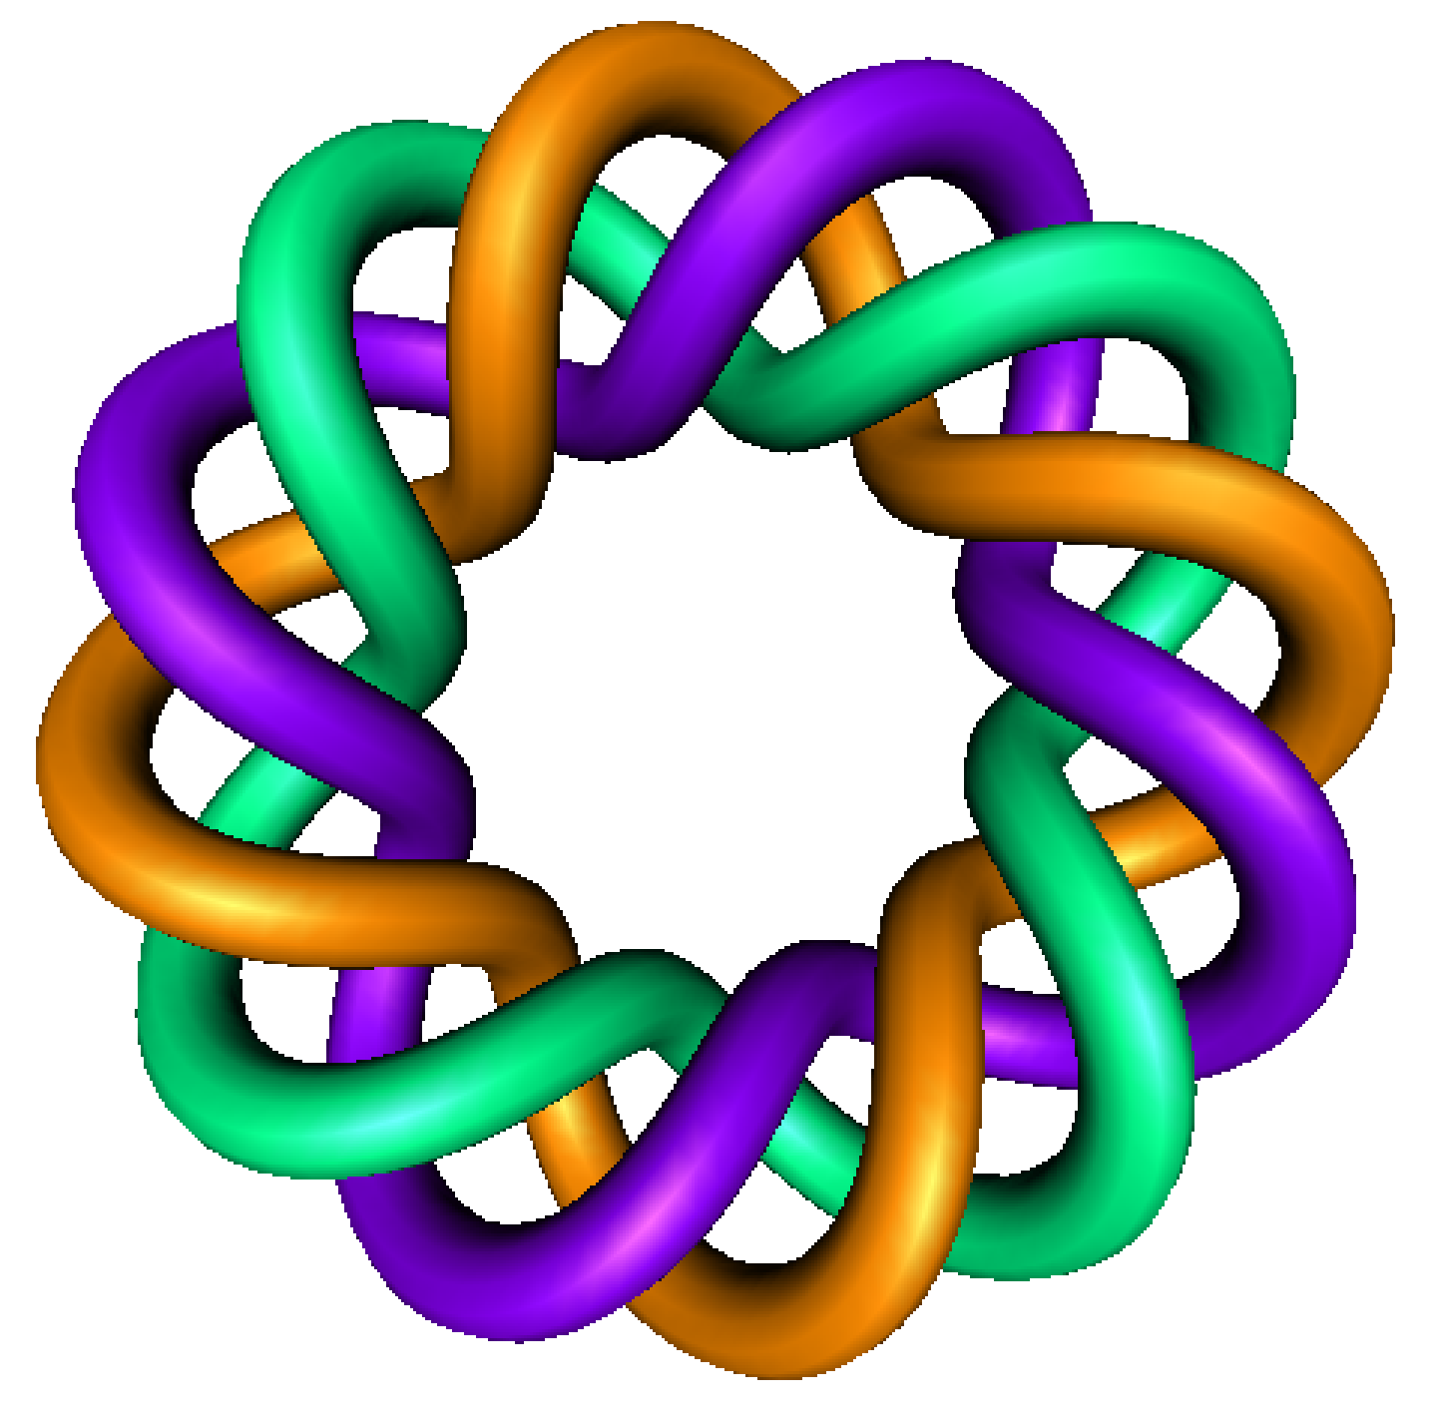
https://homepage.math.uiowa.edu/~idarcy/COURSES/100/SPRING22/videos.html
Existence and Uniqueness
+
Precalculus: Finding domain
By Dr. Isabel Darcy,
Dept of Mathematics and AMCS,
University of Iowa

Slide 9
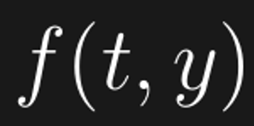

Slide 10
To find domain for nonlinear DE, canNOT use theorem 2.4.2 as it doesn’t give you a domain. Thus you would need to solve the DE.

Slide 11
Domain will be a single open interval.

Slide 12
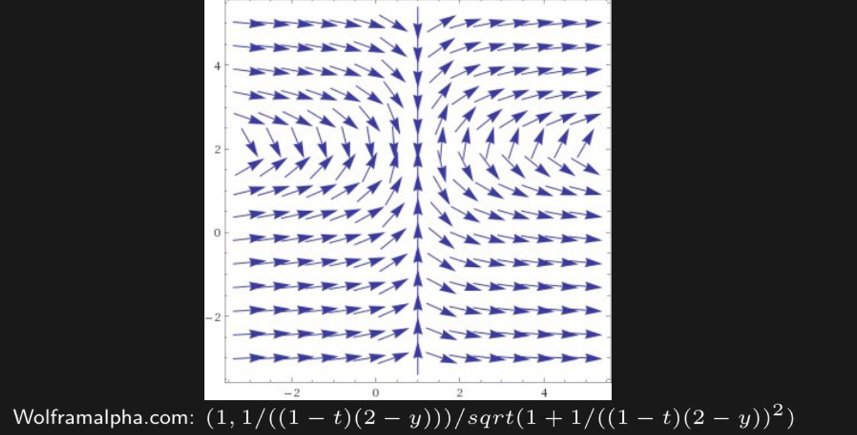
Domain will be a single open interval.

Slide 17
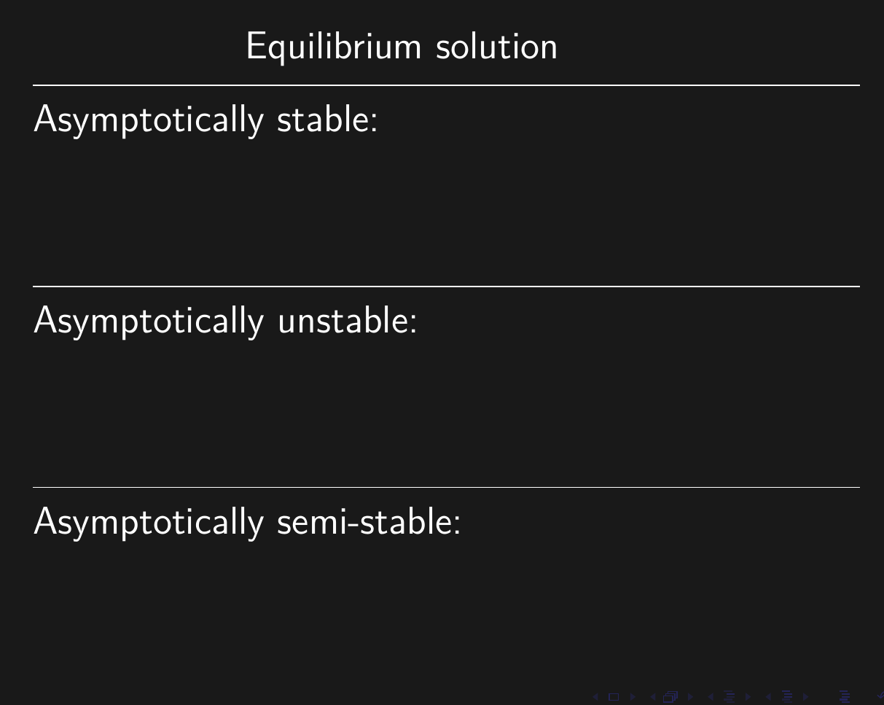
Asymptotically stable = Solutions that start “near” the equilibrium solution move toward the equilibrium solution
Unstable = Solutions that start “near” the equilibrium solution move away from the equilibrium solution

Slide 19
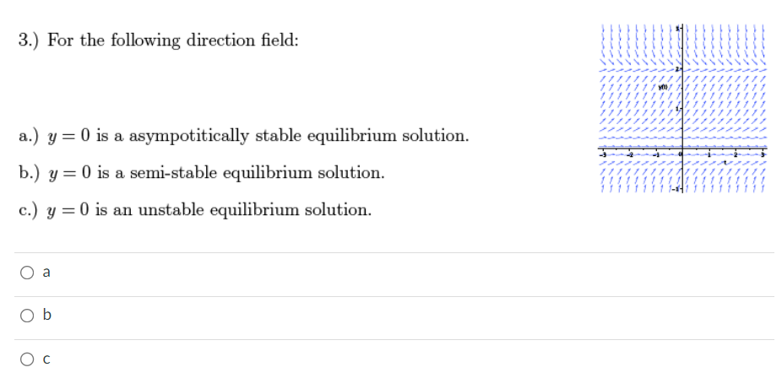
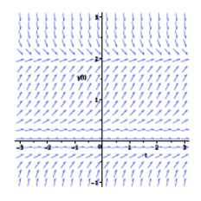
2
2
2

Slide 21
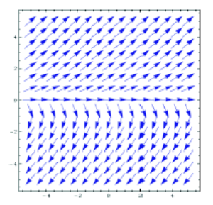

Slide 22
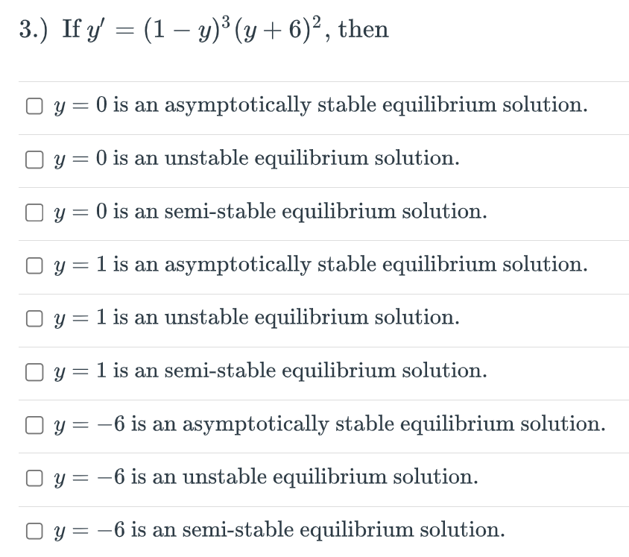

Slide 24
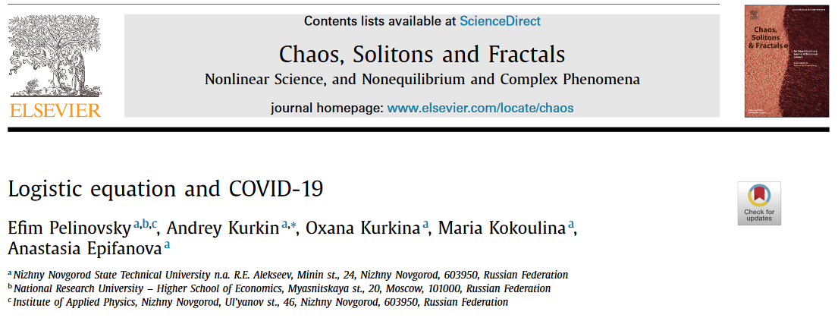
Differential equations and Covid:
Section 2.5: https://www.ncbi.nlm.nih.gov/pmc/articles/PMC7444956/

Slide 25
Phase line

Slide 26
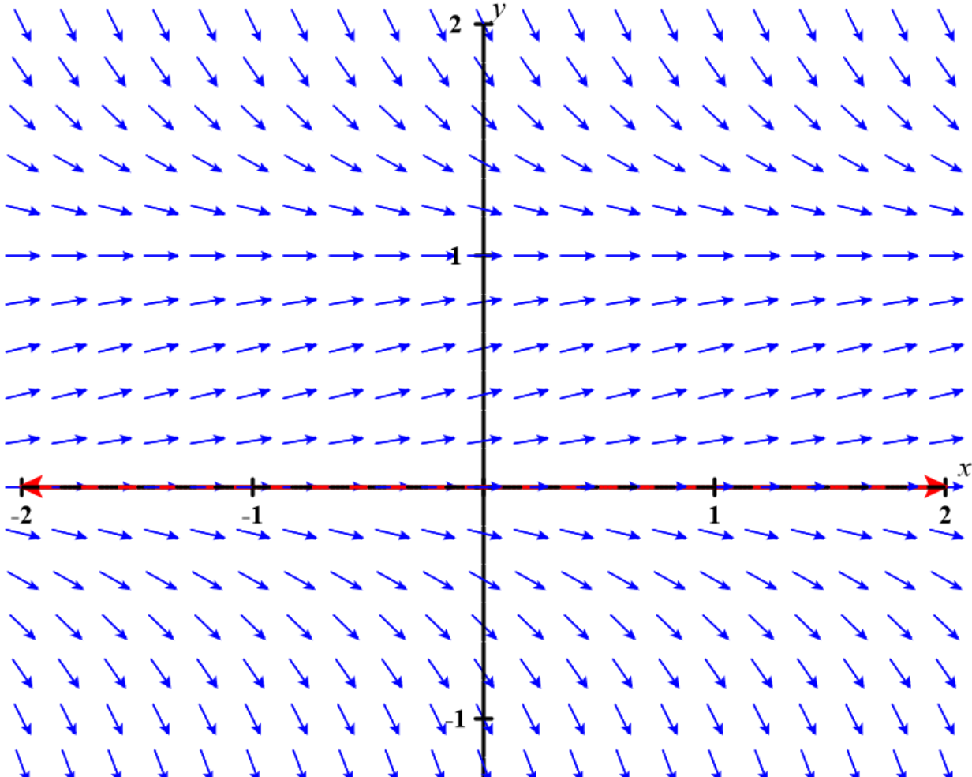
https://c3d.libretexts.org/DirectionField/index.html

Slide 27
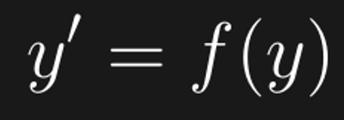
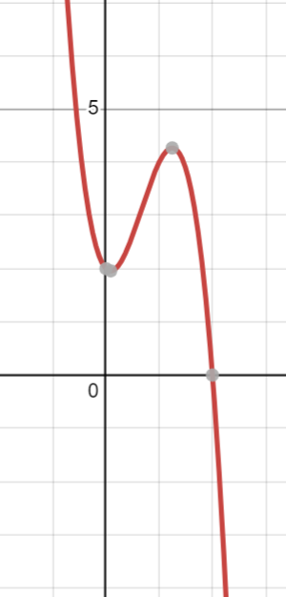
Example: $y^{′}={−(3y}^{2}+1)\left(y−2\right)$
Graph of $y$ versus $f(y)$
https://www.desmos.com/calculator

Slide 28
Example: $y^{′}={−(3y}^{2}+1)\left(y−2\right)$
slope
y
y
slope
slope
y
Graph of $y$ versus $f(y)$
https://www.desmos.com/calculator

Slide 29
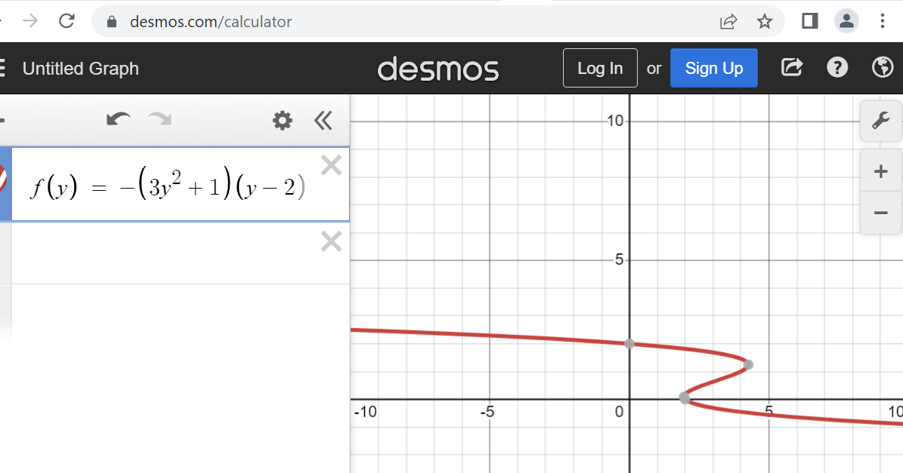
https://www.desmos.com/calculator

Slide 30
y-axis
y
2
Slope = y’ = f(y)_
https://www.desmos.com/calculator

Slide 31
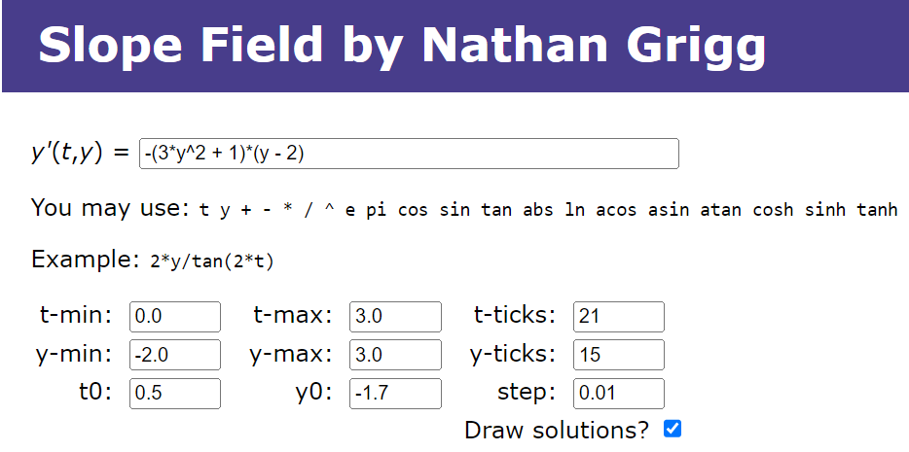
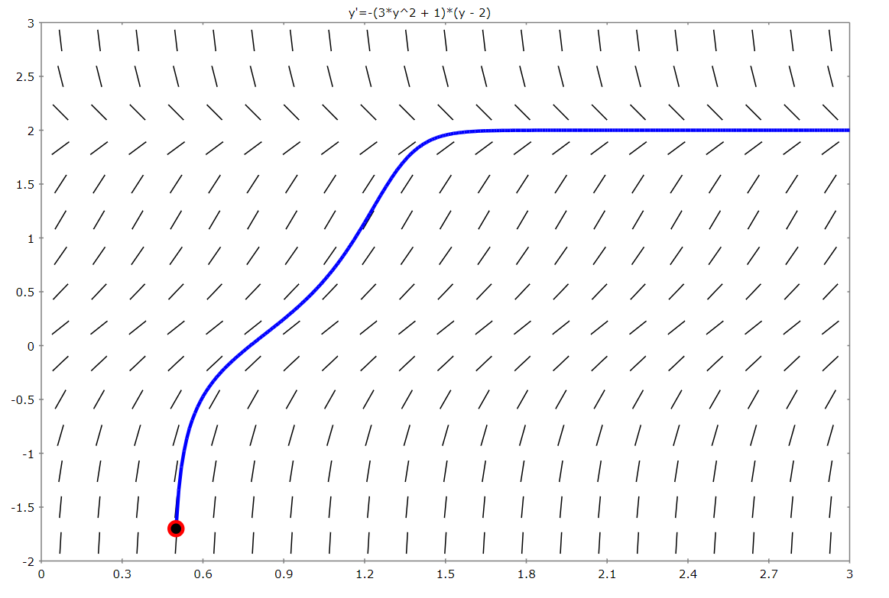
y-axis
y = 2 is an asymptotically stable equilibrium solution.
2
http://slopefield.nathangrigg.net/?fn=-%283*y%5E2+%2B+1%29*%28y+-+2%29&tmin=0.0&tmax=3.0&tticks=21&ymin=-2.0&ymax=3.0&yticks=15&t0=0.5&y0=-1.7&step=0.01&drawsol=on

