Slide 1
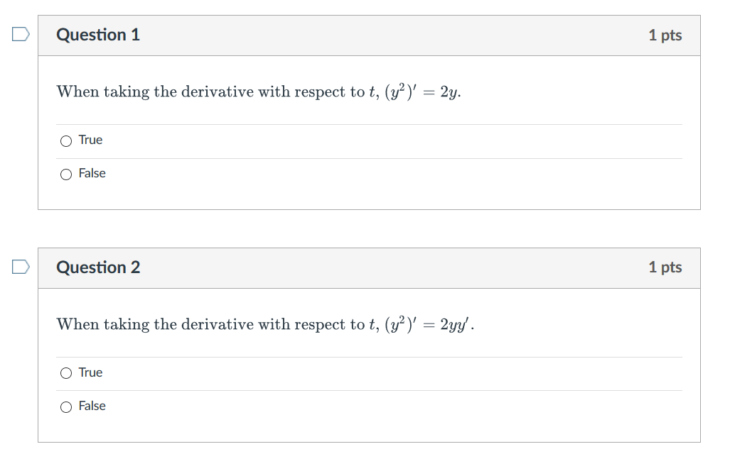

Slide 2
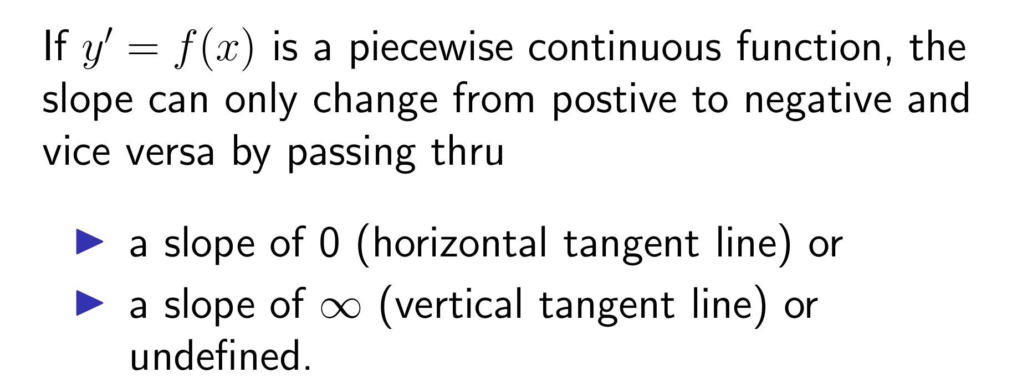
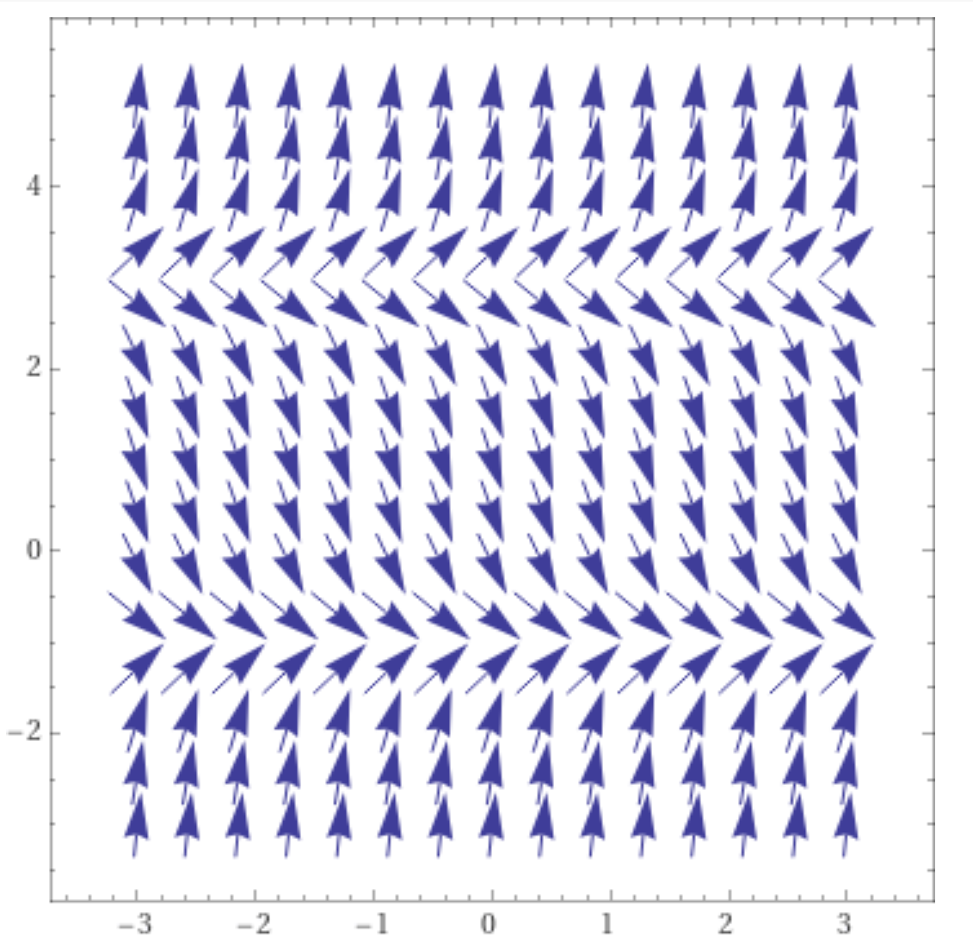
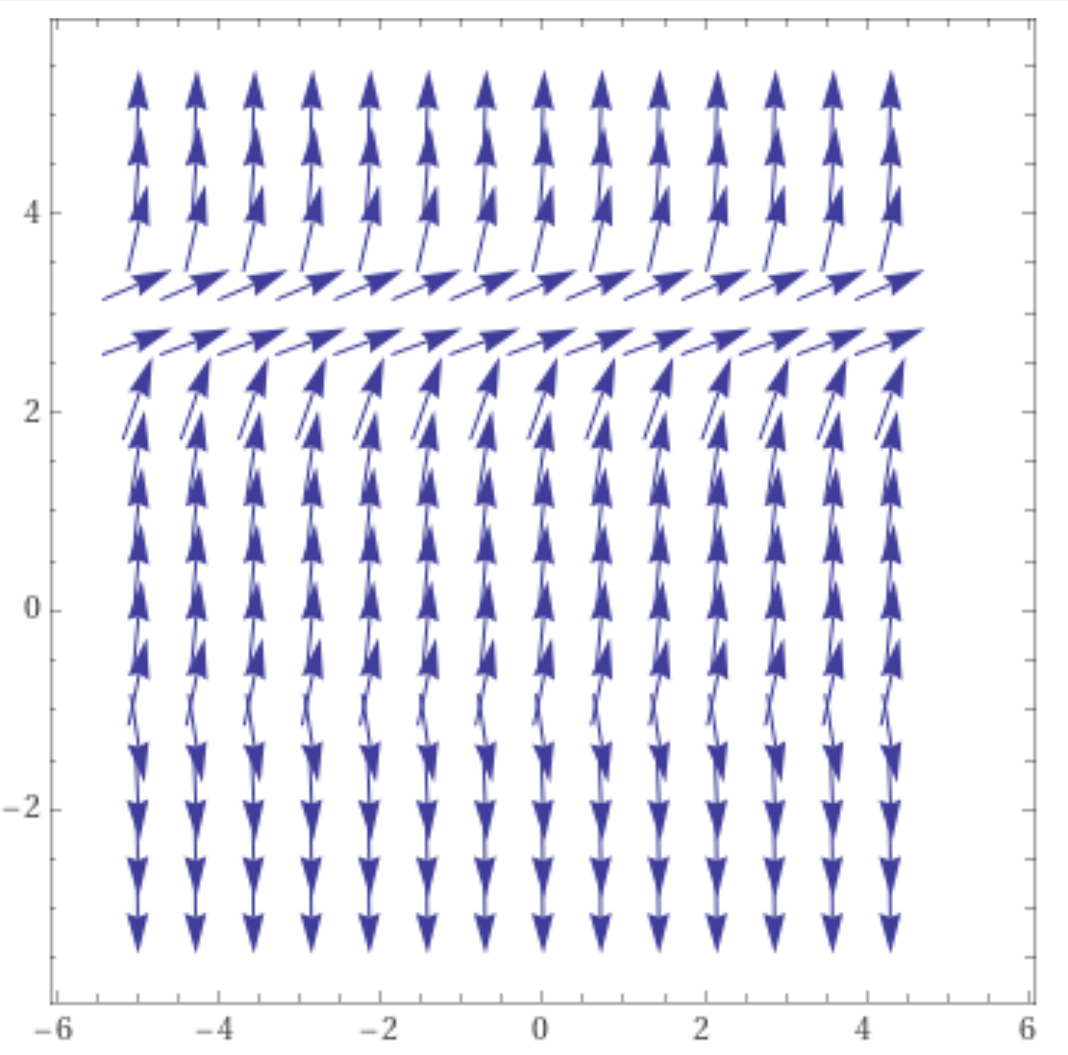
https://www.wolframalpha.com/input/?i=slope%20field

Slide 3
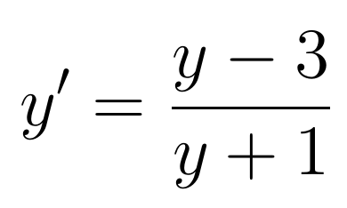
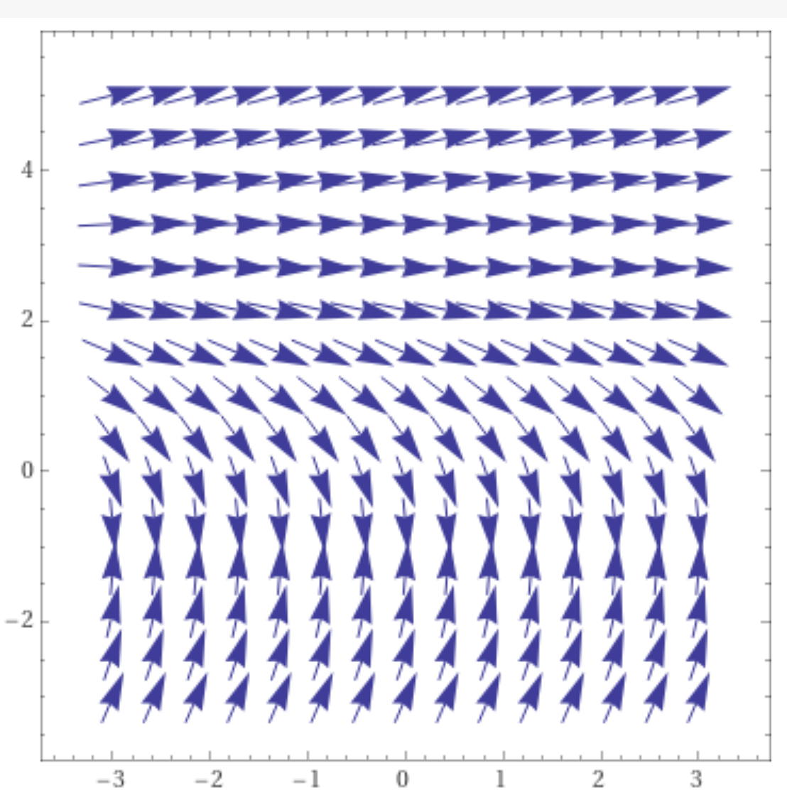
y = 3 is a
equilibrium solution,
But y = -1 is not an
equilibrium solution
for the graph on the
right.
https://www.wolframalpha.com/input/?i=slope%20field

Slide 5
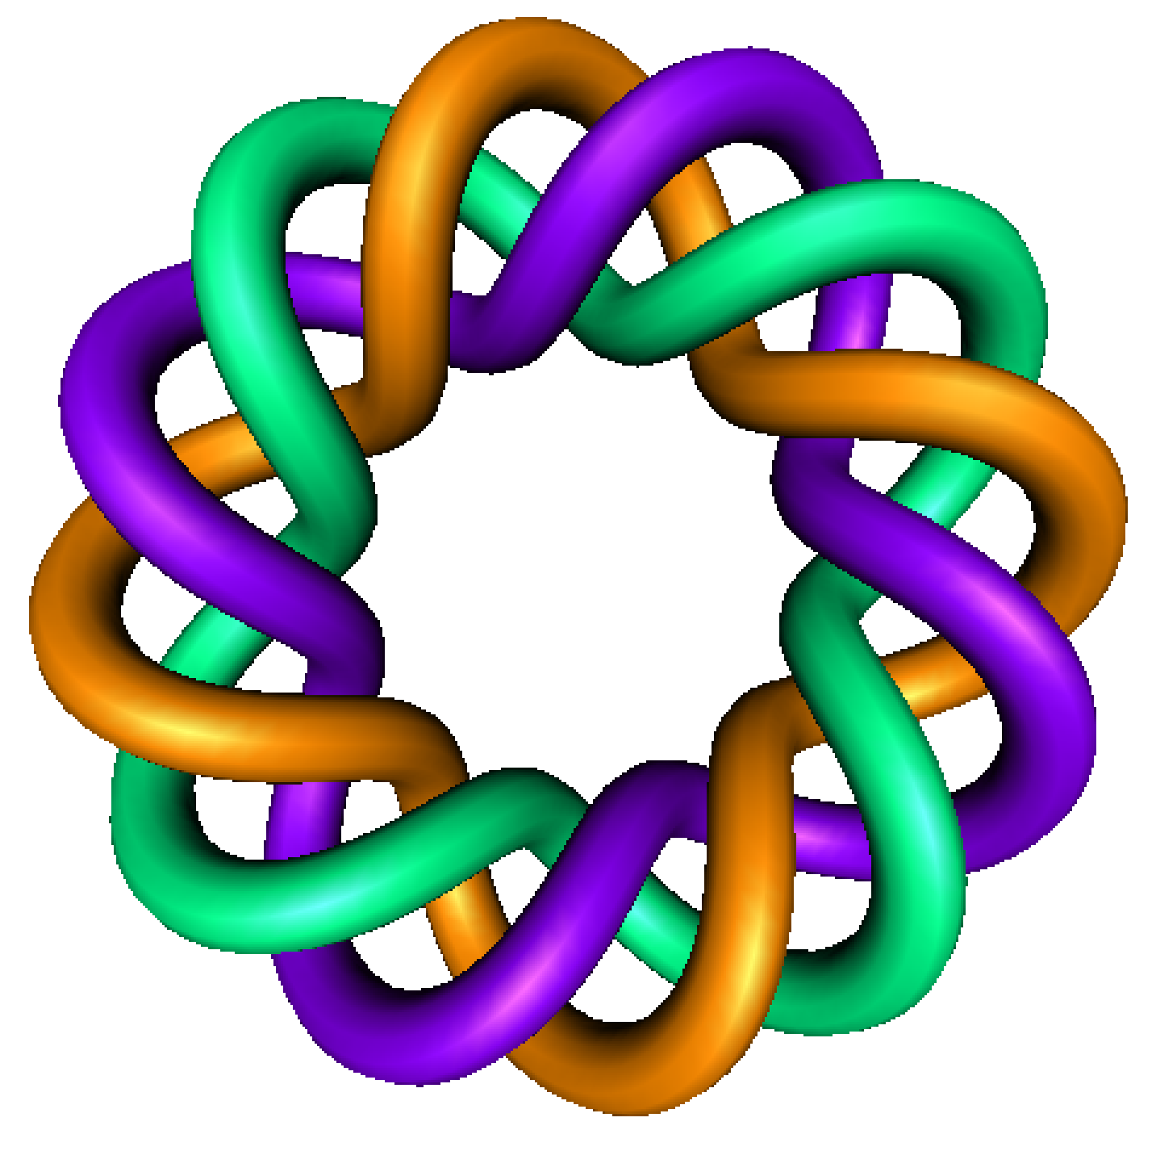
Existence and Uniqueness
By Dr. Isabel Darcy,
Dept of Mathematics and AMCS,
University of Iowa

Slide 10
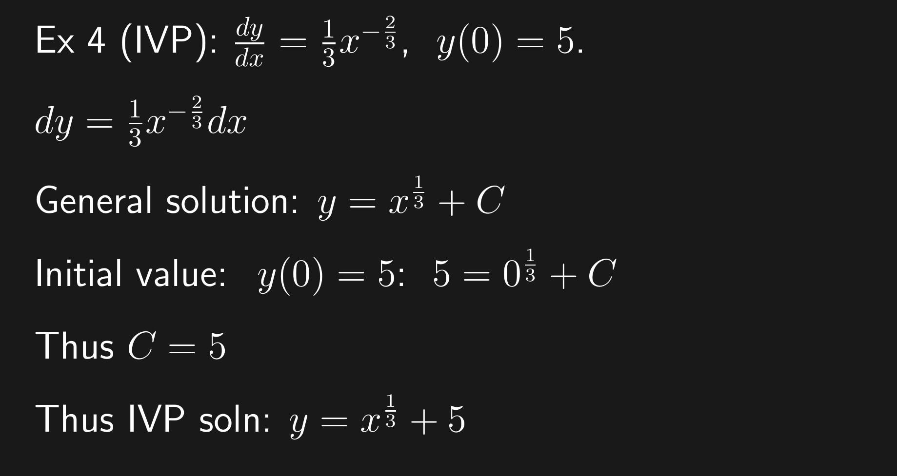

Slide 19
If

Slide 22
Special cases:
When do we know a unique solution exists?

Slide 23
Calculus 1 problem:

