Slide 1
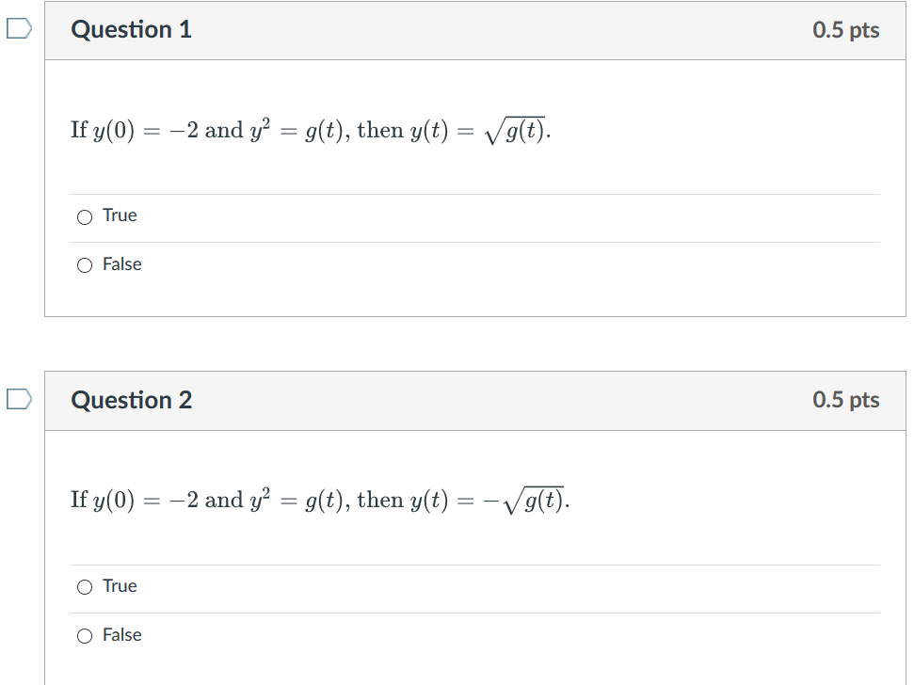
Week 3 Video
Theorem 2.4.2/domain (28:41 min video) slides, annotated slides: View after 2.4 in class lecture and before doing 2.4 HW Thm 2.4.2 can sometimes be used to determine if an IVP has a unique solution, but it cannot be used to determine the domain of that solution. In this video, we first use Thm 2.4.2 to determine when y′=1/[(1−t)(2−y), y(t0)=y0 is guaranteed to have a unique solution. We then use a lot of algebra and a little bit of calculus to solve this DE and determine the domain of this solution when the initial value is the point (0, 1).

Slide 2
Example from Theorem 2.4.2/domain video

Slide 6
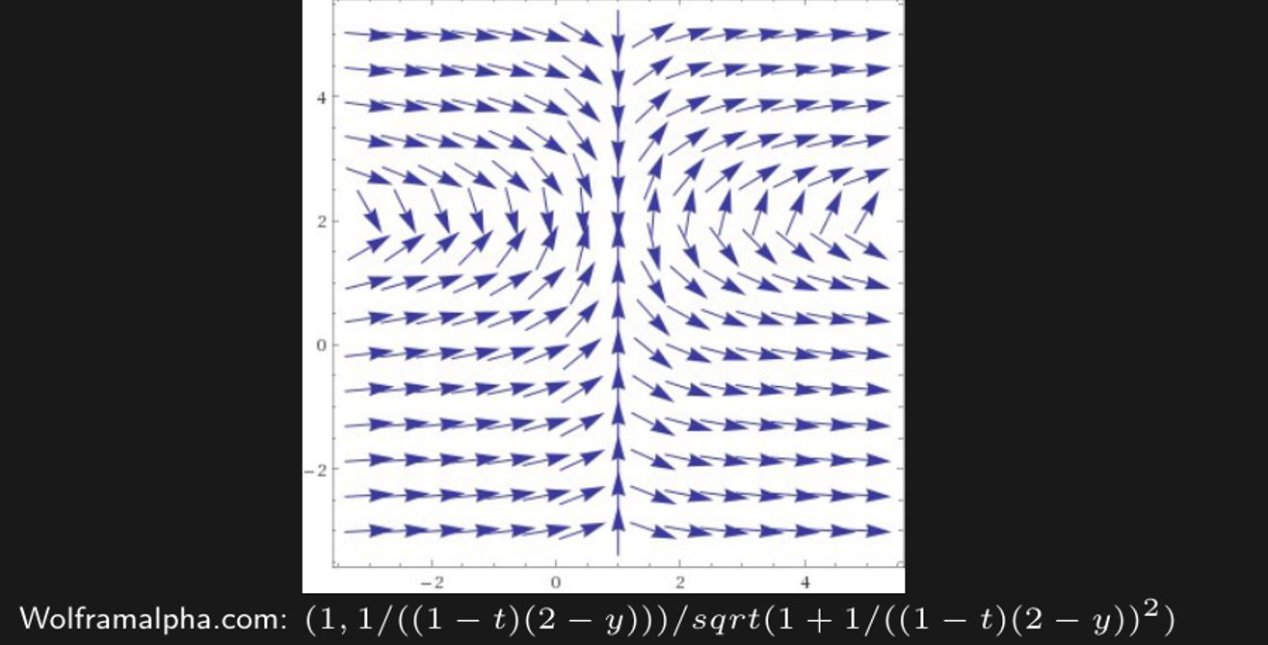
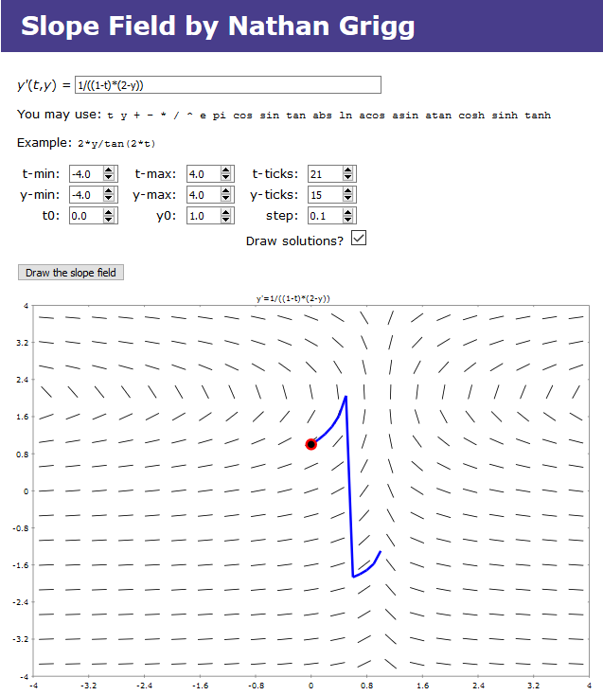
Note: Domain will always be a single open interval.
http://slopefield.nathangrigg.net

Slide 8
Note: Domain will always be a single open interval.

Slide 12
Note: Domain will always be a single open interval.

Slide 13
HW hint: For one of your HW problems, to find domain:
Determine where tangent line is vertical. For this
particular problem, this will occur at certain y-values.
Plug these y-values into solution and solve for x to find potential boundary of domain.
Note: Domain will always be a single open interval.

