Slide 1
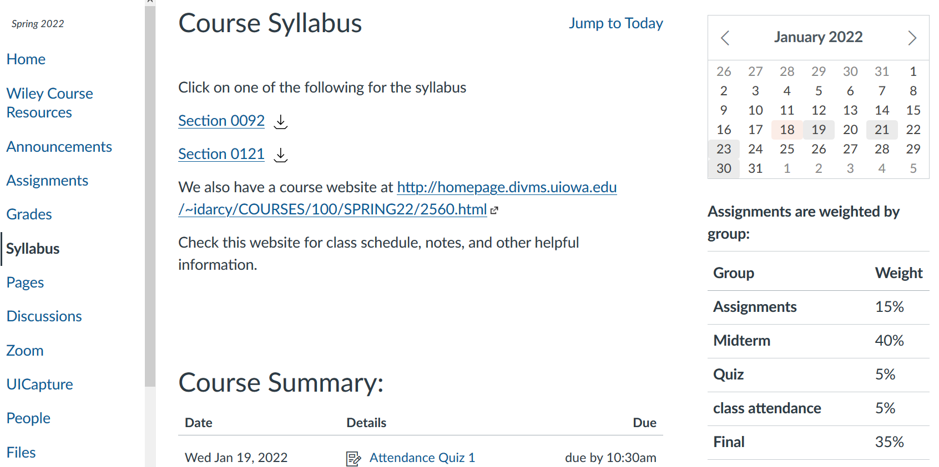
Please log into ICON now and take attendance quiz

Slide 2
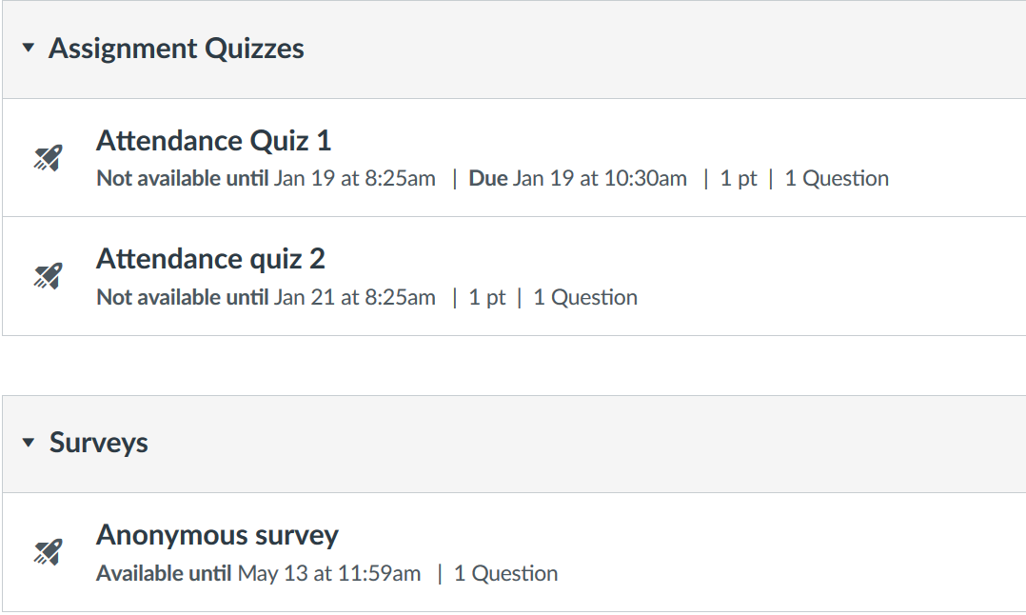

Slide 3
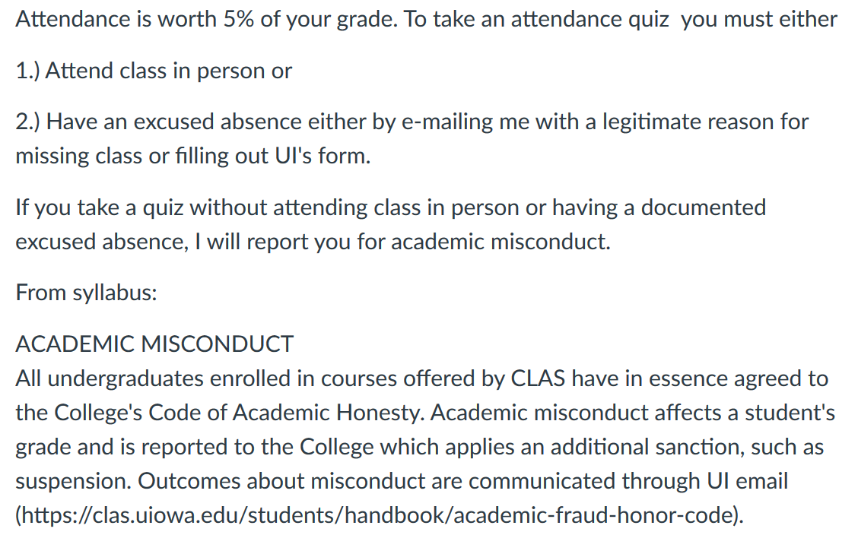

Slide 4
I will usually also be available before my 8:30am class, between classes, and after 10:20am class.

Slide 5
http://homepage.divms.uiowa.edu/~idarcy/COURSES/100/SPRING22/2560.html

Slide 6
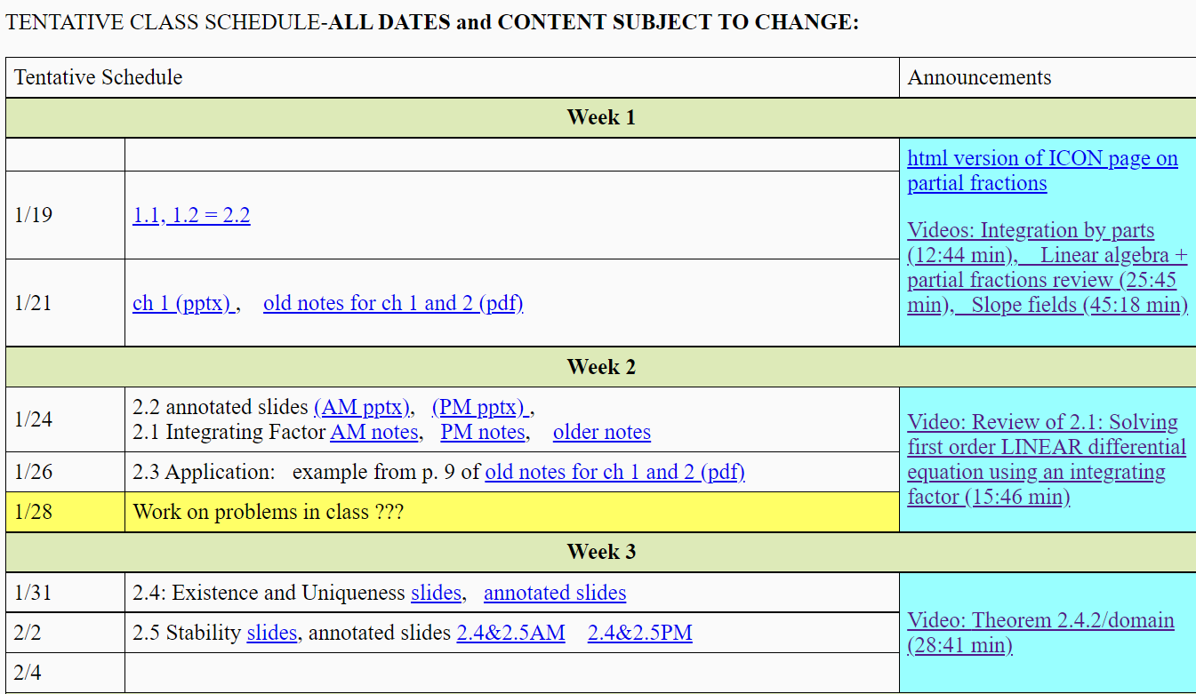

Slide 8
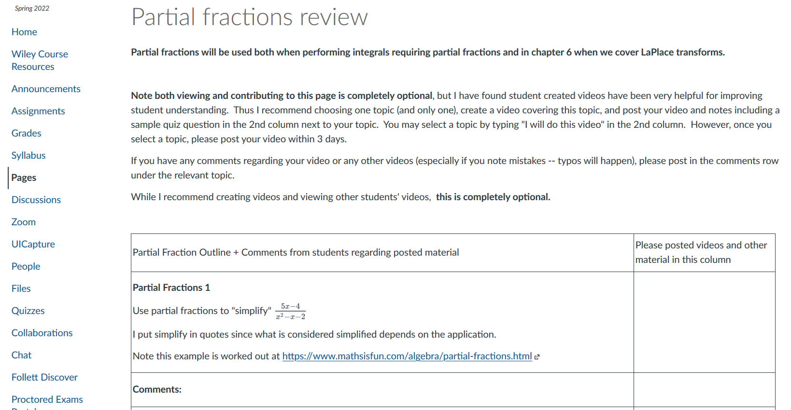

Slide 9
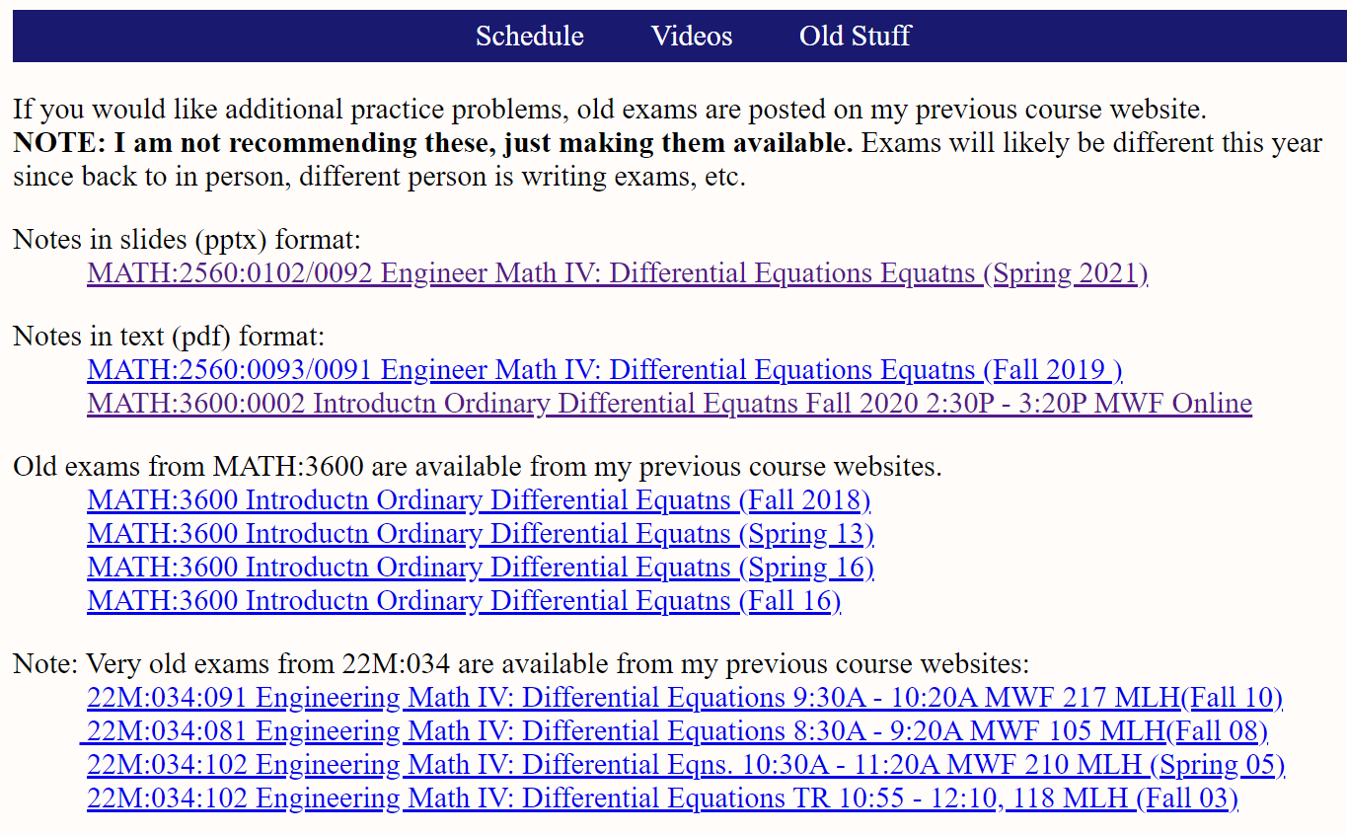

Slide 10
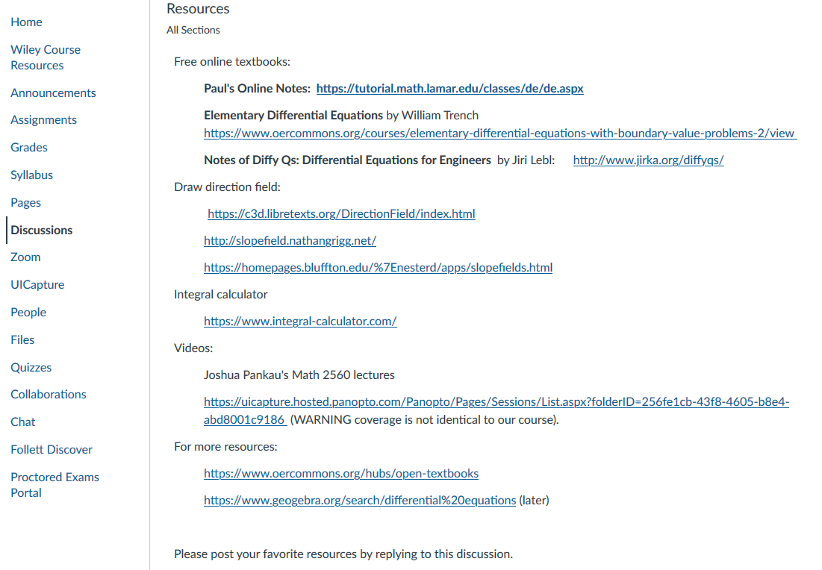

Slide 11
https://www.npr.org/sections/health-shots/2022/01/13/1072902744/ers-are-overwhelmed-as-omicron-continues-to-flood-them-with-patients
https://dailyiowan.com/2022/01/13/university-of-iowa-hospitals-and-clinics-system-is-under-stress-calls-for-community-covid-19-compliance/#photo

Slide 12
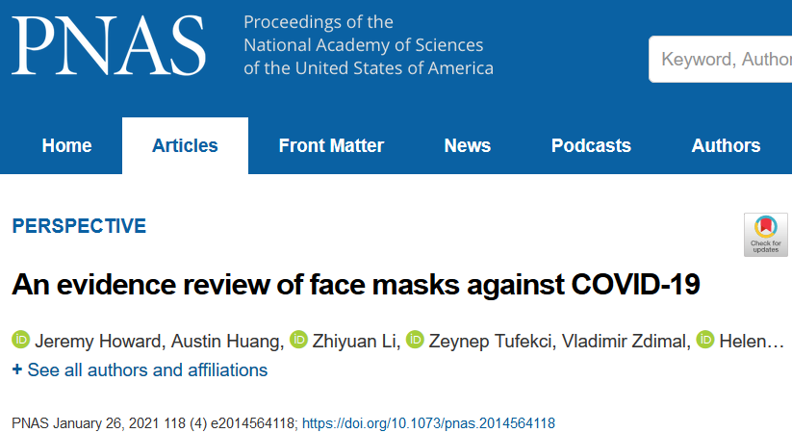
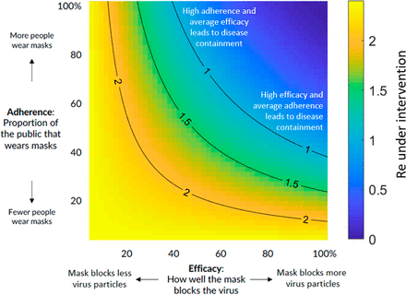
https://www.pnas.org/content/118/4/e2014564118
“There are two considerations when looking at efficacy: 1) the filtration of the material and 2) the fit of the design. “
If your glassed fog, fit can be improved.
I have ordered a mask fitter (badger seal) that will arrive next week.

Slide 13
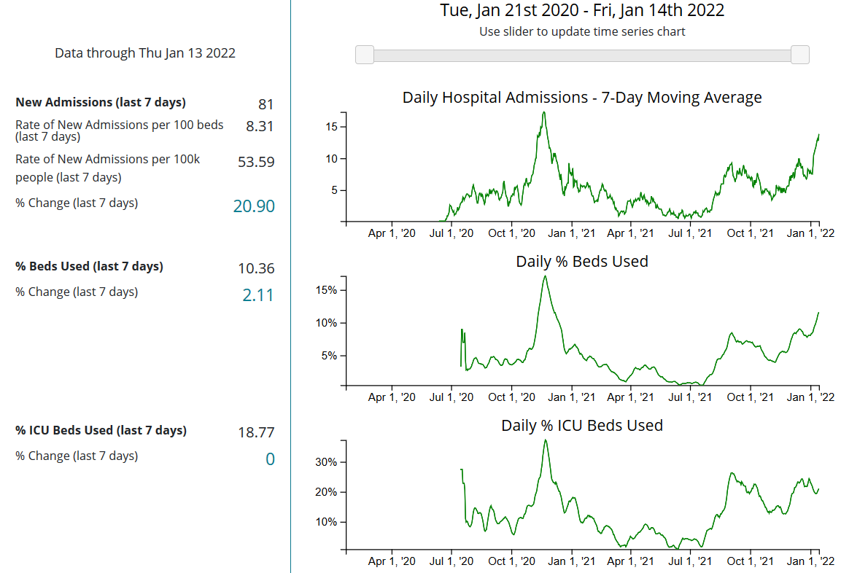
https://covid.cdc.gov/covid-data-tracker/#county-view?list_select_county=19103

Slide 14
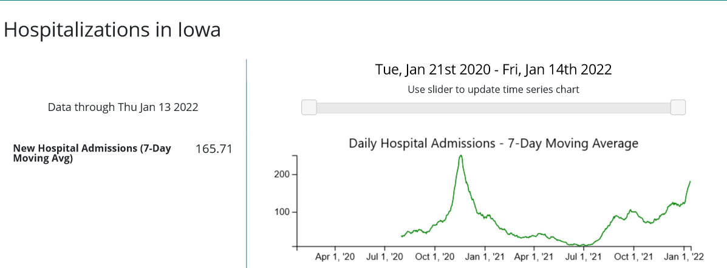
https://covid.cdc.gov/covid-data-tracker/#county -view
https://covid19.healthdata.org/united-states-of-america/iowa?view=resource-use&tab=trend&resource=all_resources
Hospitals are overwhelmed, so please be kind to medical professionals and those needing their help and wear a mask and get vaccinated if you haven't already.

Slide 15
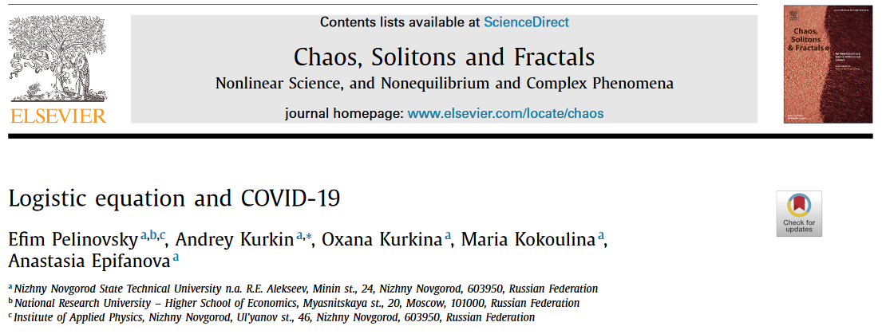
Differential equations and Covid:
Section 2.5: https://www.ncbi.nlm.nih.gov/pmc/articles/PMC7444956/

Slide 16
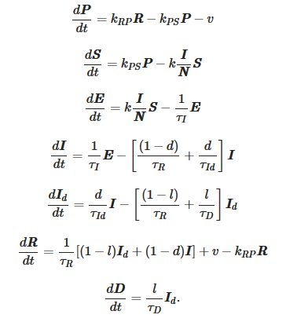
Differential equations and Covid:
Ch 7 and 9: https://www.nature.com/articles/s41598-021-95494-6
Systems of differential equations:

Slide 17
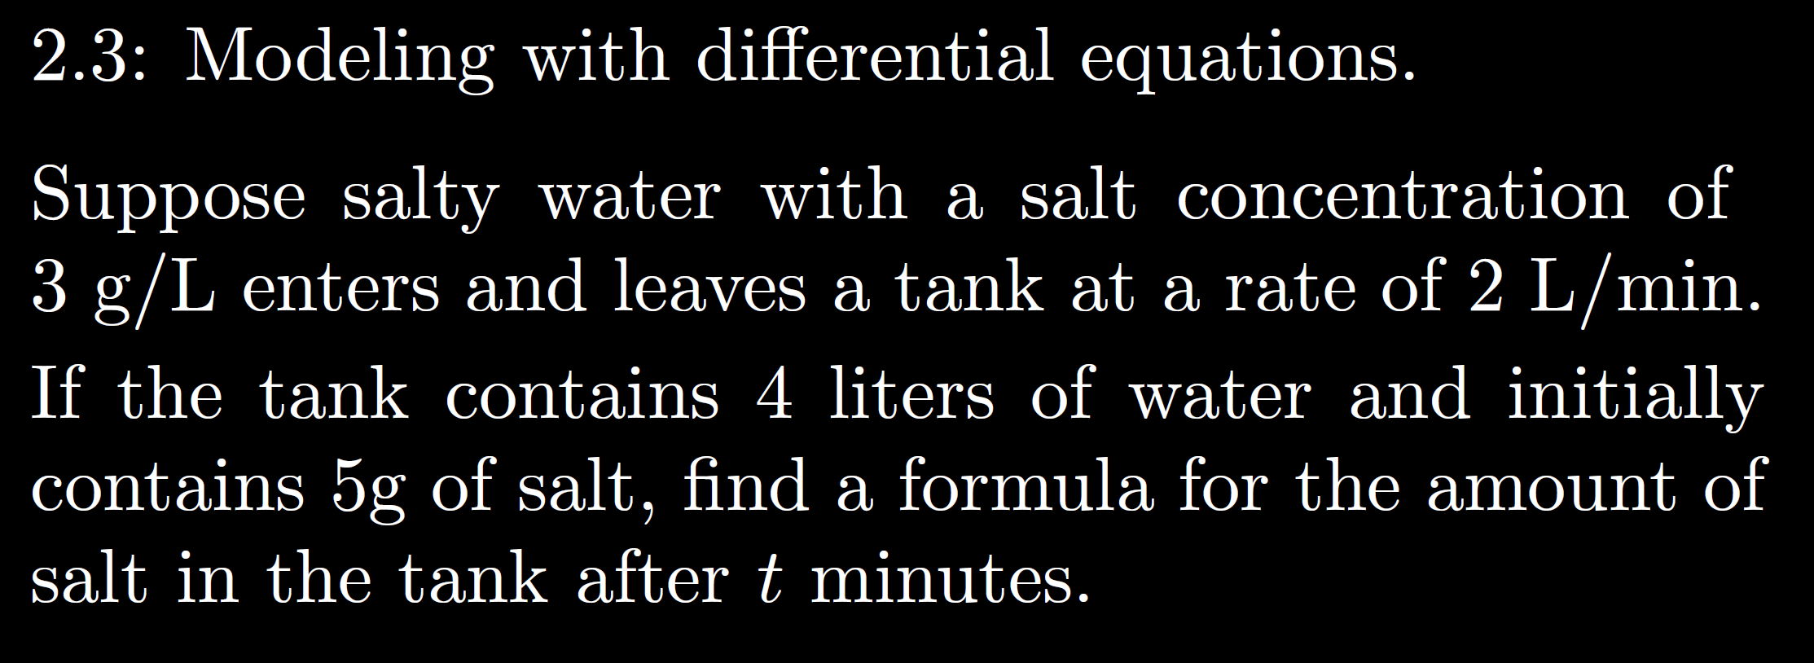

Slide 23
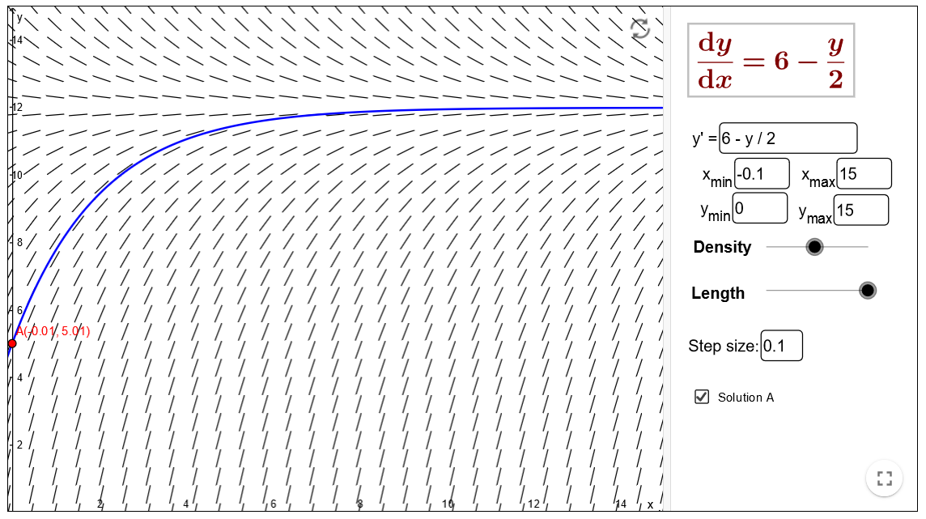
https://www.geogebra.org/m/Pd4Hn4BR

Slide 36
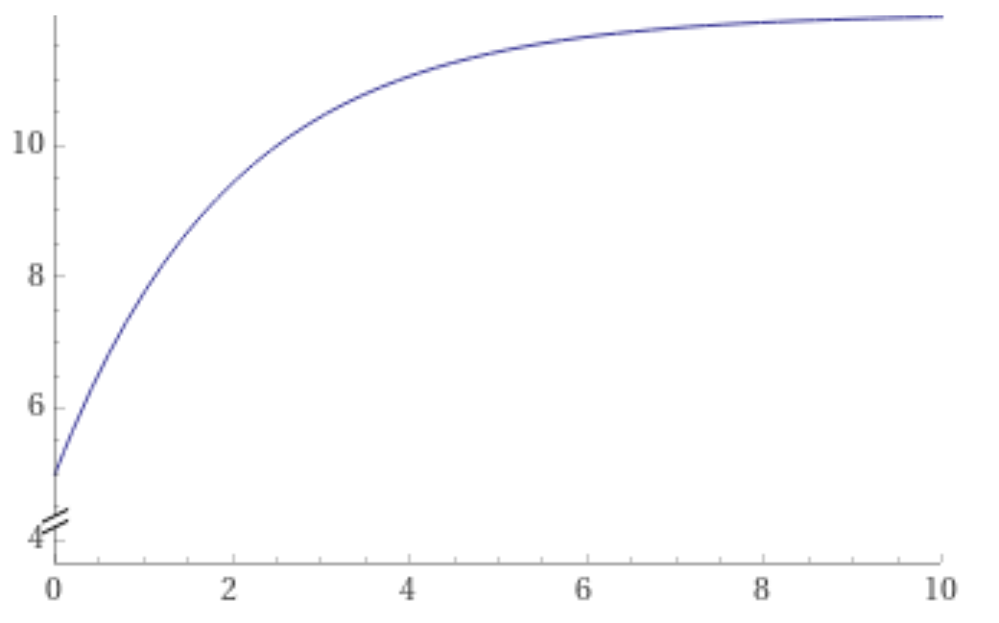
https://www.wolframalpha.com/input/?i=plot+-7+e%5E%7B-x%2F2%7D+%2B+12+from+x%3D0+to+10

Slide 40
