Slide 3
The Wronskian evaluated at t₀ is the coefficient matrix used to solve for the constants c_{i} for the IVP y(t₀) = y₀.

Slide 20
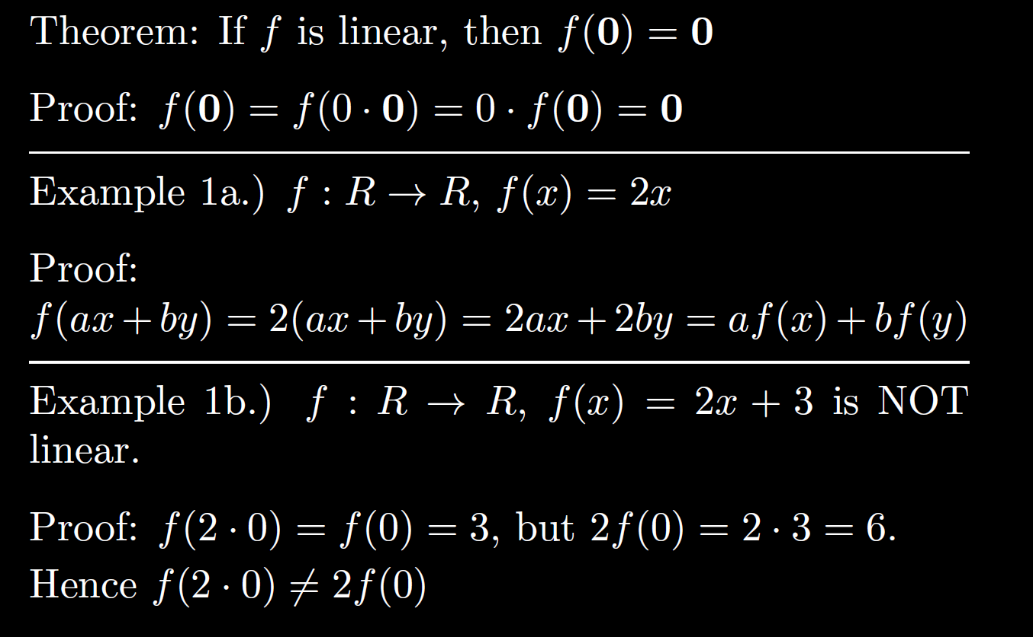

Slide 23
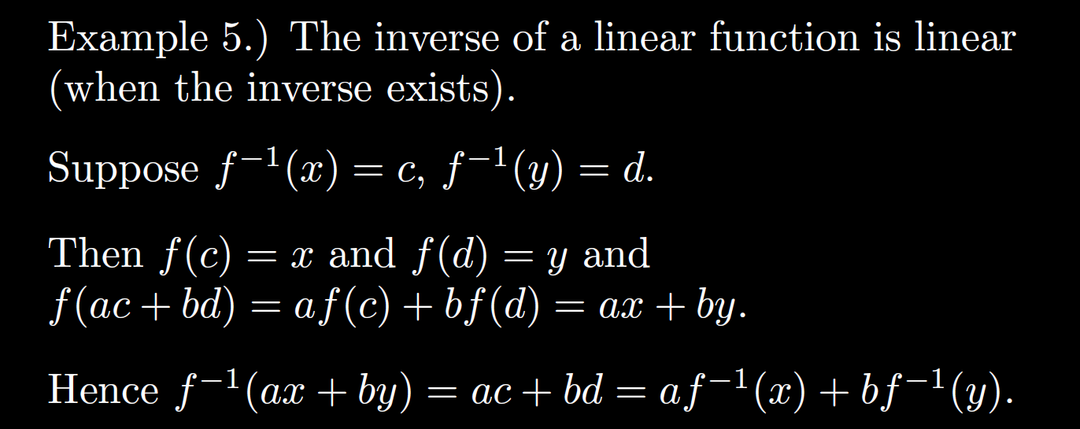

Slide 25
Ch 6: Use linearity of the LaPlace transform to turn a DE into an algebra problem

Slide 29
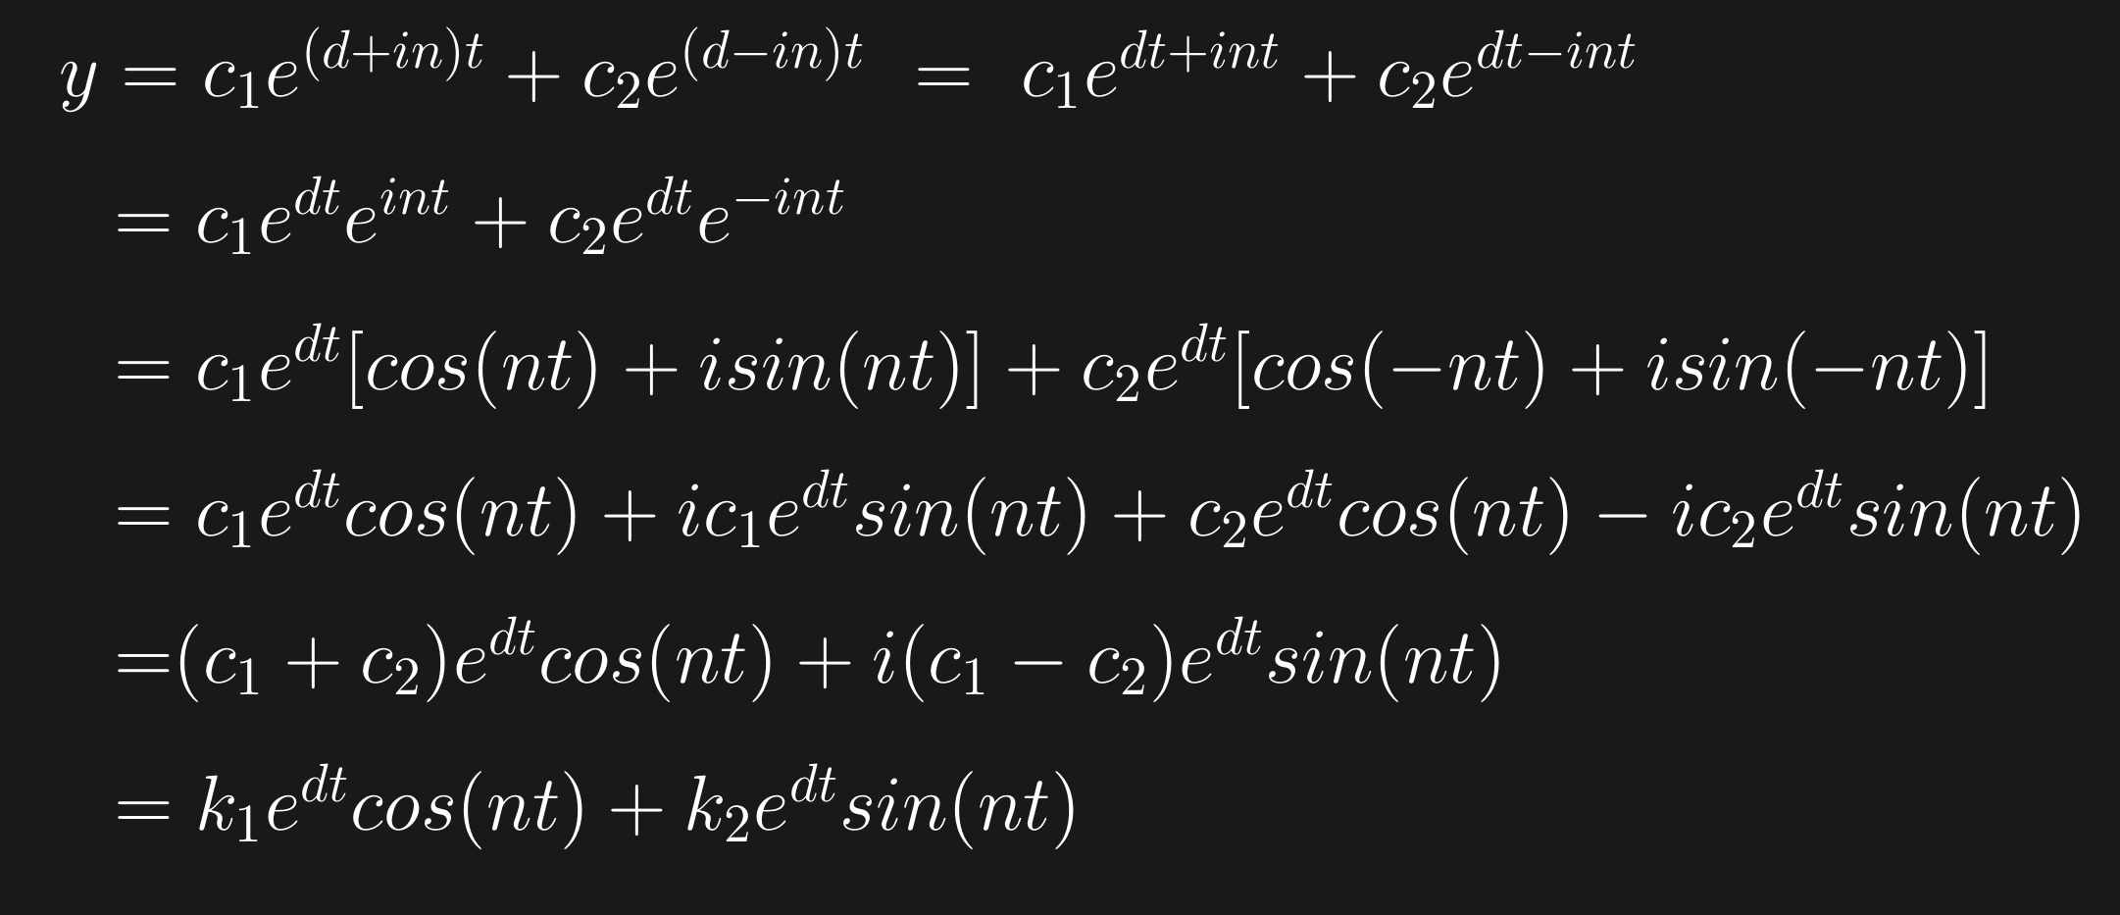

Slide 34
