Slide 1
Exam 3 is this Friday during class. Exams will be graded by Sunday.
Problem session Thursday at 5pm. Zoom link will be posted on ICON.
Similar format to last exam except as discussed in the next few slides.
E-mail me your exam if you would like me to check it (sometimes uploads are corrupted). I can quickly check and respond to e-mails. Checking uploads on ICON takes much longer.
If you don’t get an e-mailed response from me, there are no guarantees that your upload is readable. Unreadable upload = 0 points on written part

Slide 2
Exam 3 is this Friday during class. Exams will be graded by Sunday.
Problem session Thursday at 5pm. Zoom link will be posted on ICON.
Similar format to last exam except as discussed in the next few slides.
E-mail me your exam if you would like me to check it (sometimes uploads are corrupted). I can quickly check and respond to e-mails. Checking uploads on ICON takes much longer.
If you don’t get an e-mailed response from me, there are no guarantees that your upload is readable. Unreadable upload = 0 points on written part
E-mail: isabel-darcy@uiowa.edu

Slide 3
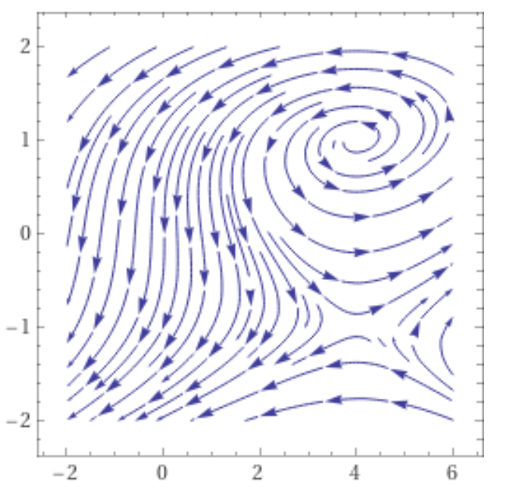

Slide 4
The next 3 problems all involve the following graph.:
Choose the best answer
1. The point (0, 0) is
a.) asymptotically stable.
b.) stable.
c.) unstable.
d.) Not a critical point.
2. The point (0, 0) is a
a.) node.
b.) saddle.
c.) spiral.
d.) center.
e.) Not a critical point.
3. The eigenvalues are ….

Slide 5
The next 3 problems all involve the following graph.:
Choose the best answer
1. The solution x(t) = (0, 0) is
a.) asymptotically stable.
b.) stable.
c.) unstable.
d.) Not an equilibrium solution.
2. The solution x(t) = (0, 0) is a
a.) node.
b.) saddle.
c.) spiral.
d.) center.
e.) Not an equilibrium solution.
3. The eigenvalues are ….

Slide 6
1. The solution x(t) = (0, 0) is
a.) asymptotically stable.
b.) stable.
c.) unstable.

Slide 7
1. The solution x(t) = (0, 0) is
a.) asymptotically stable.
b.) stable.
c.) unstable.

Slide 9
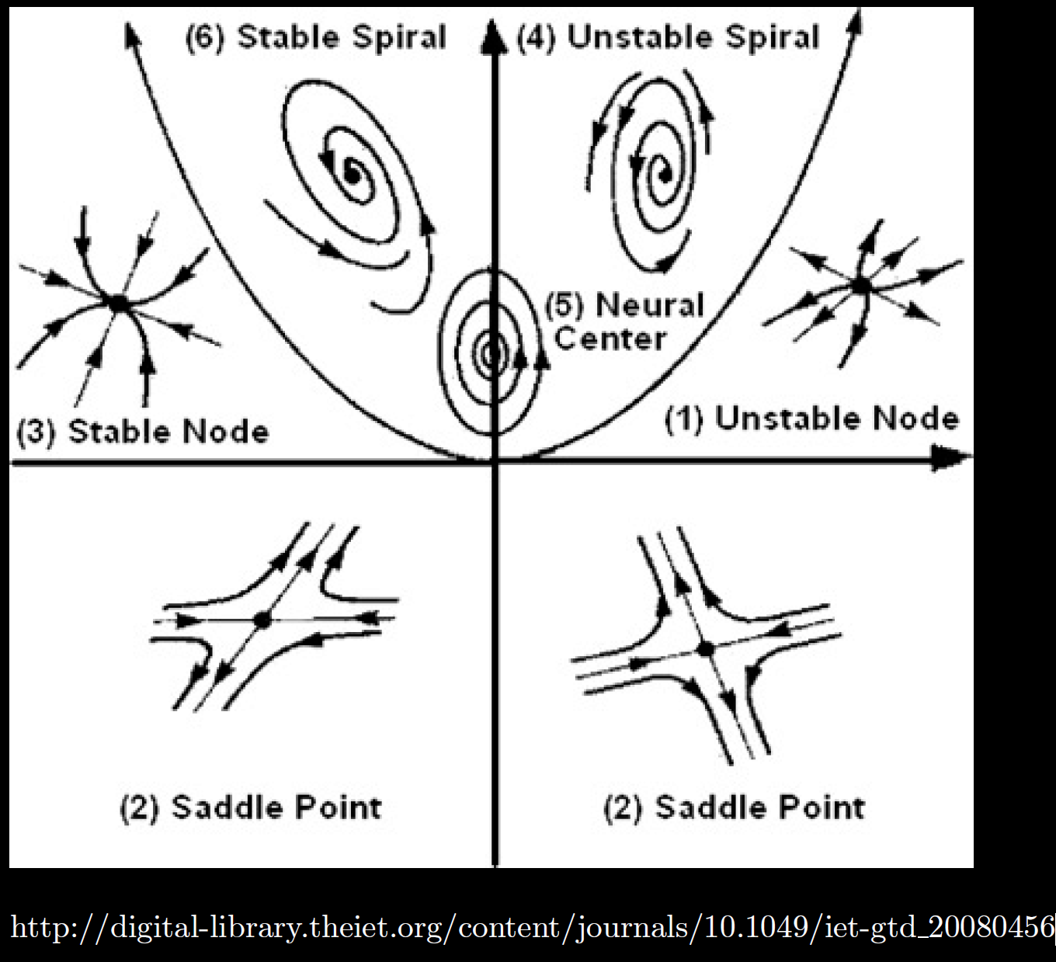

Slide 11
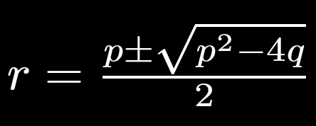
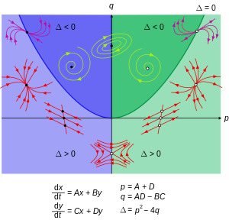
https://en.wikipedia.org/wiki/Phase_plane

Slide 12
https://en.wikipedia.org/wiki/Phase_plane

Slide 13
https://en.wikipedia.org/wiki/Phase_plane

Slide 14
https://en.wikipedia.org/wiki/Phase_plane

Slide 15
https://en.wikipedia.org/wiki/Phase_plane

Slide 18
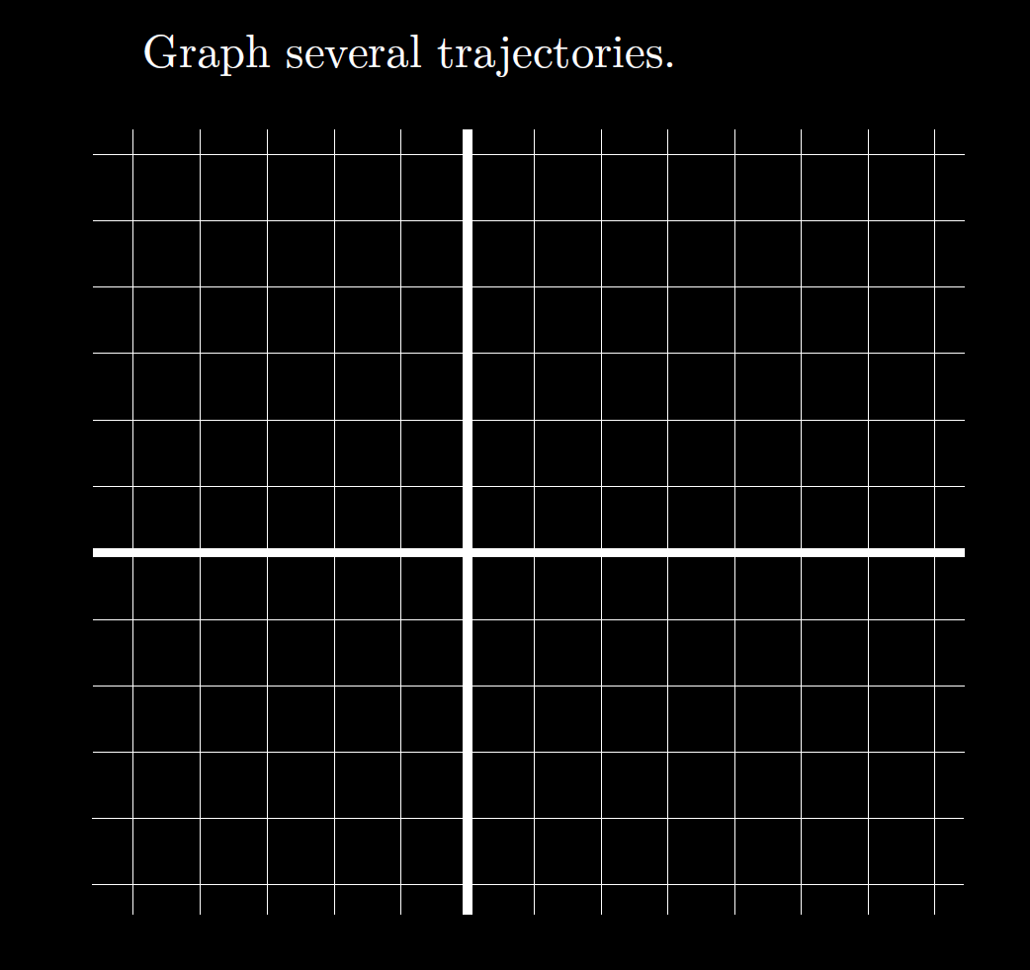

Slide 19
Graph

Slide 21
Slope field:
In chapter 2: usually autonomous
arrows are not required.
In chapter 7, 9: usually not autonomous
arrows are required.

Slide 23
6.1: LaPlace transform

Slide 24
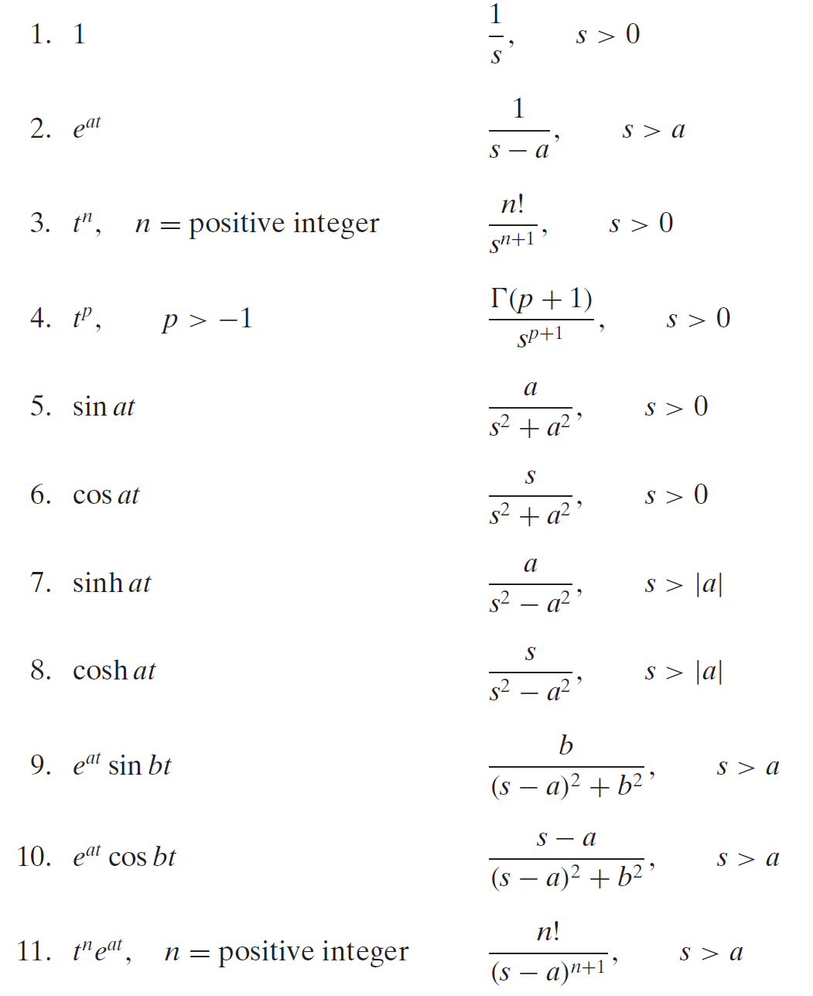

Slide 25
6.4

Slide 26
6.3

Slide 27
6.3

Slide 28
6.4

Slide 29
6.2

Slide 32
