Slide 1
6.1: Define LaPlace transform including review improper integrals,
Derive formulas 1 – 11, 18 in LaPlace transform table.
6.2: Use LaPlace transform to solve linear DE.
6.3: Derive formulas 12 – 14 including algebra review.
****** Formulas 13 and 13’ ******
6.4 Use formulas 13 and 13’ to solve linear DE.
6.5: Derive formula 17 including intro to impulse function which is a
“generalized function”.
6.6: Formula 16 including brief intro to convolution integral.

Slide 2
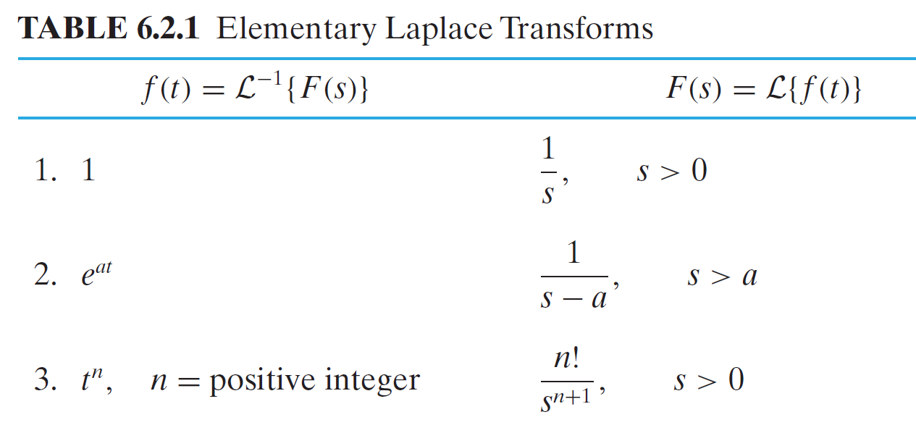
6.1: LaPlace transform

Slide 5
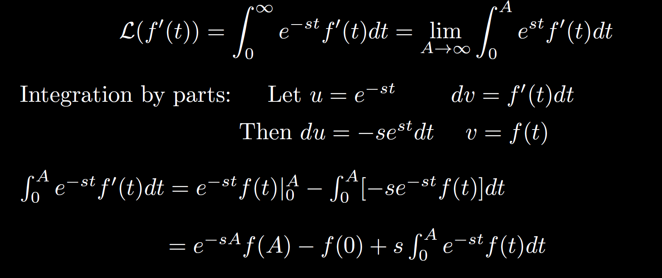

Slide 6
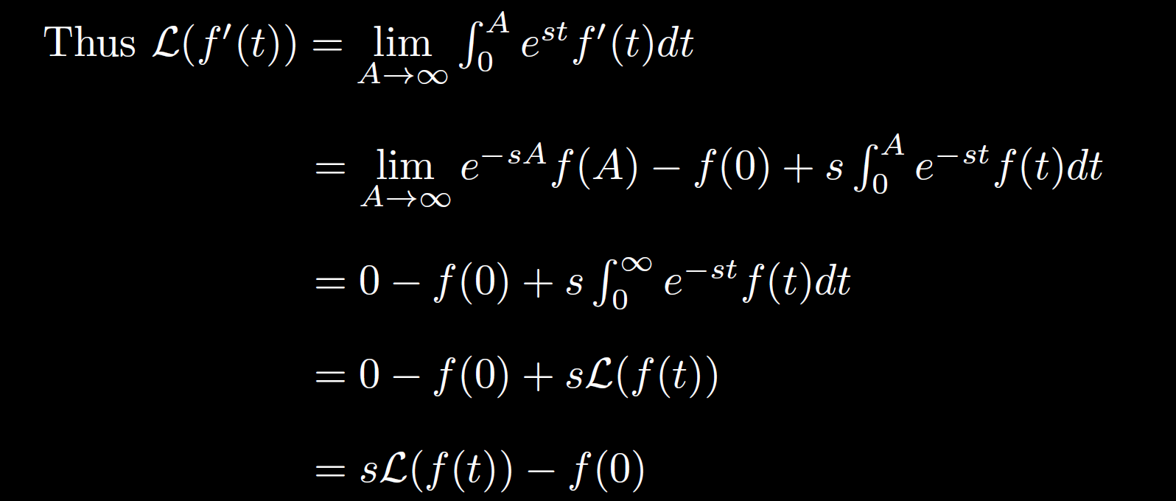

Slide 7
For higher order derivative, use recursion:

Slide 8
For higher order derivative, use recursion:

Slide 10
6.1: Define LaPlace transform including review improper integrals,
Derive formulas 1 – 11, 18 in LaPlace transform table.
6.2: Use LaPlace transform to solve linear DE.
6.3: Derive formulas 12 – 14 including algebra review.
****** Formulas 13 and 13’ ******
6.4 Use formulas 13 and 13’ to solve linear DE.
6.5: Derive formula 17 including intro to impulse function which is a
“generalized function”.
6.6: Formula 16 including brief intro to convolution integral.

Slide 17
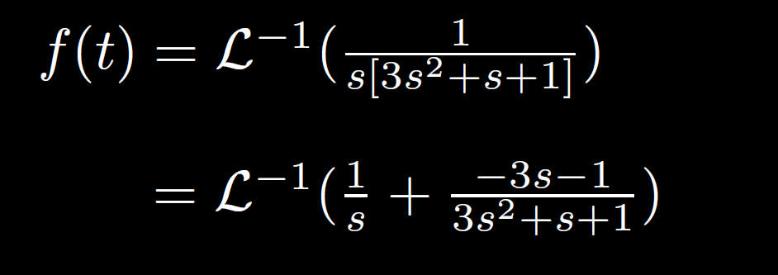

Slide 18
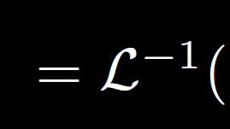
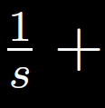
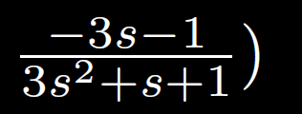

Slide 32
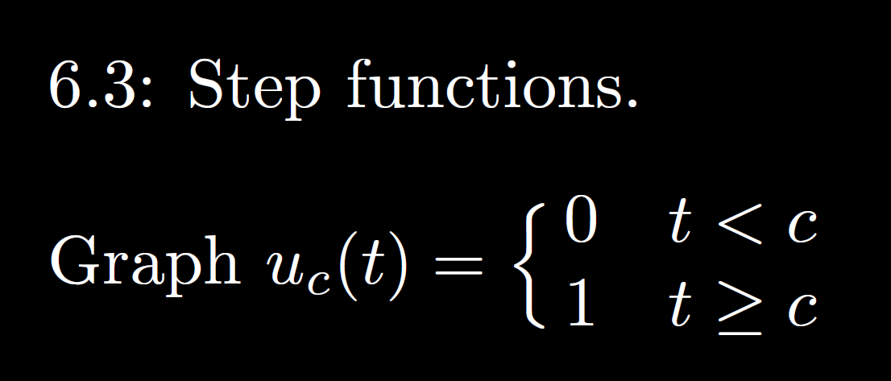

Slide 33
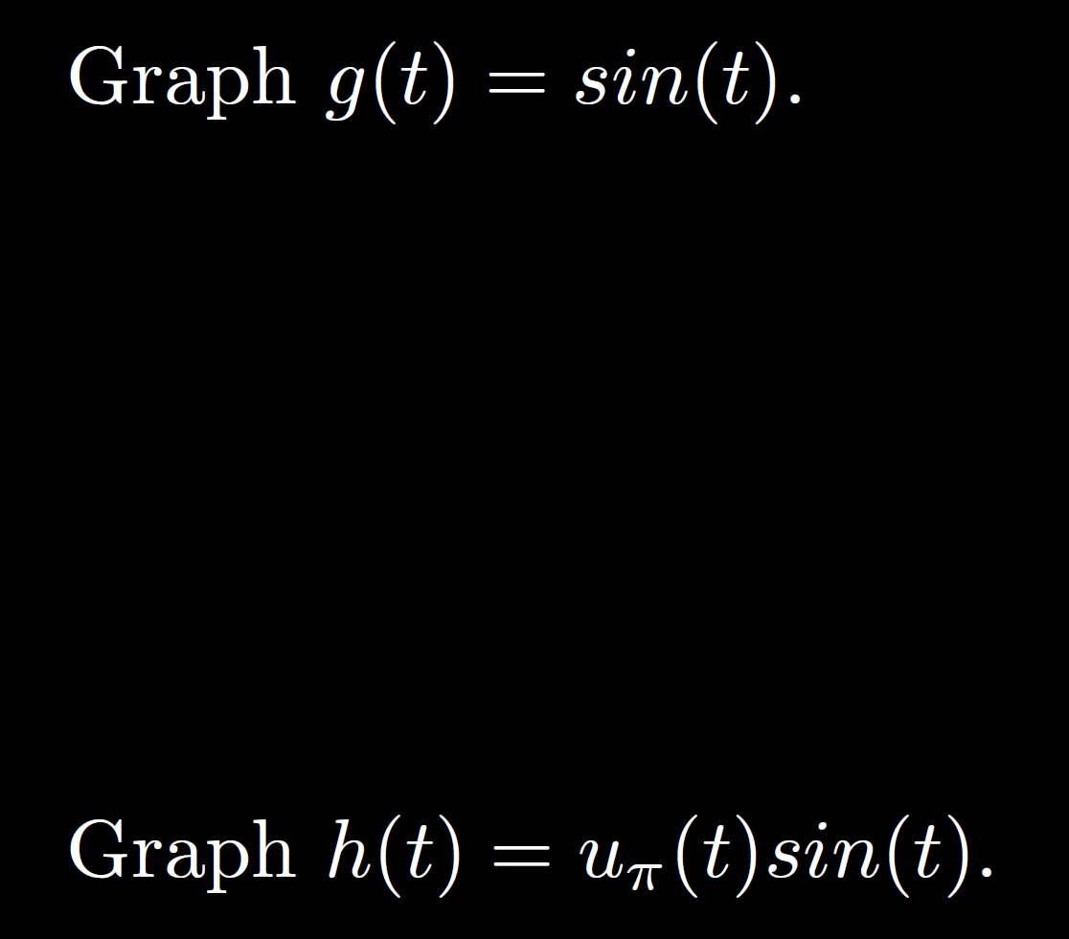

Slide 35
