Slide 1
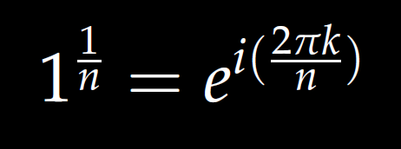
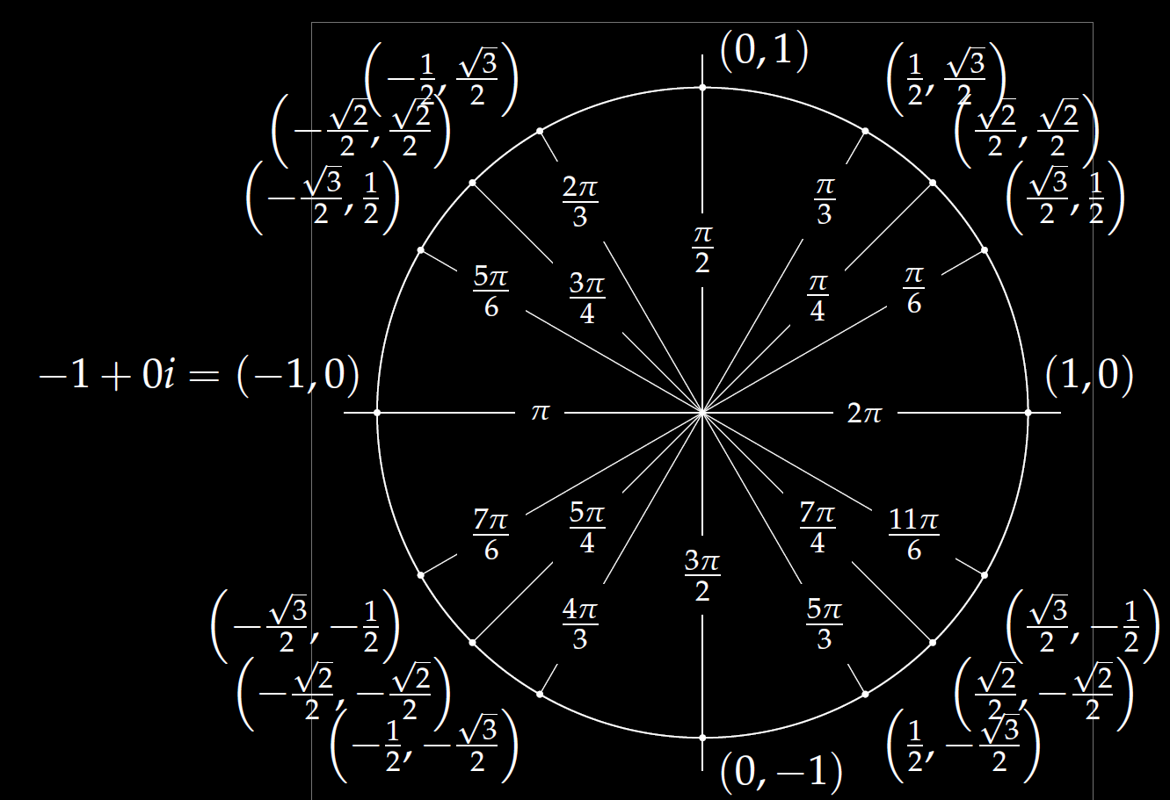
Roots of unity
r^{n} = 1

Slide 2
$r^{2}=$ 1 implies r =
$$1^{1/2}=ⅇ^{ⅈ\left(2πk/2\right)}$$
Roots of unity
r^{n} = 1

Slide 3
$r^{3}=$ 1 implies r =
$$1^{1/3}=ⅇ^{ⅈ\left(2πk/3\right)}$$
Roots of unity
r^{n} = 1

Slide 4
$r^{4}=$ 1 implies r =
$$1^{1/4}=ⅇ^{ⅈ\left(2πk/4\right)}$$
Roots of unity
r^{n} = 1

Slide 5
$r^{5}=$ 1 implies r =
$$1^{1/5}=ⅇ^{ⅈ\left(2πk/5\right)}$$
Roots of unity
r^{n} = 1

Slide 6
We will also solve
r^{n} = -1

Slide 7
$r^{2}=$ -1 implies r =
$${(−1)}^{1/2}=ⅇ^{ⅈ\left(1+2k\right)π/2}$$

Slide 8
$r^{3}=$ -1 implies r =
$${(−1)}^{1/3}=ⅇ^{ⅈ\left(1+2k\right)π/3}$$

Slide 9
$r^{4}=$ -1 implies r =
$${(−1)}^{1/4}=ⅇ^{ⅈ\left(1+2k\right)π/4}$$

Slide 10
$r^{5}=$ -1 implies r =
$${(−1)}^{1/5}=ⅇ^{ⅈ\left(1+2k\right)π/5}$$

Slide 11
$r^{4}=$ -1 implies r =
$${(−1)}^{1/4}=ⅇ^{ⅈ\left(1+2k\right)π/4}$$

Slide 12
$r^{5}=$ -1 implies r =
$${(−1)}^{1/5}=ⅇ^{ⅈ\left(1+2k\right)π/5}$$

Slide 13
$r^{4}=$ -1 implies r =
$${(−1)}^{1/4}=ⅇ^{ⅈ\left(1+2k\right)π/4}$$

Slide 21
Determine (without solving the problem) an interval in which the solution of the given initial value problem is certain to exist and be unique.
$$\left(1 − t\right)\left(1 + t^{2}\right)y^{′′′}+\ln\left|t − 5\right|y^{′}+2y = \sqrt{t+4} y(0) = 3$$

Slide 30
Linear Independence and the Wronskian

Slide 33
