Slide 1


Exam 2 is next Wednesday March 31, covering Ch 3, Ch 4, and finding eigenvalues for 2 x 2 matrices. Format will be similar to last exam.
If you wish me to postpone some material to exam 3, please let me know by 10am Friday. For other feedback, anonymous survey is still available on ICON.
NOTE: We will use concepts from Ch 3 and 4 thru the rest of the semester, so please overstudy for this exam. It will make the rest of this course much easier
I will submit midterm D/F grades today. However, we are dropping your lowest midterm grade, so even if you get a midterm report, you can still earn an A/B in this class. In pre-pandemic times, I have seen many students improve their exam grade significantly.
HW/quizzes: Wednesdays are a soft deadline. HW grader will grade over weekend, so on rare occasions, you can submit your HW by Friday with no penalty.

Slide 2
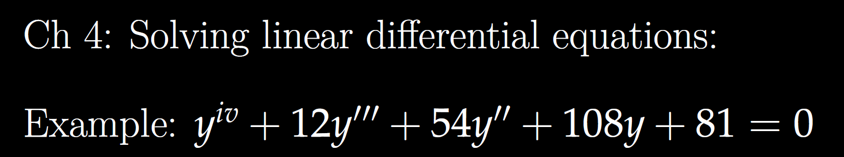
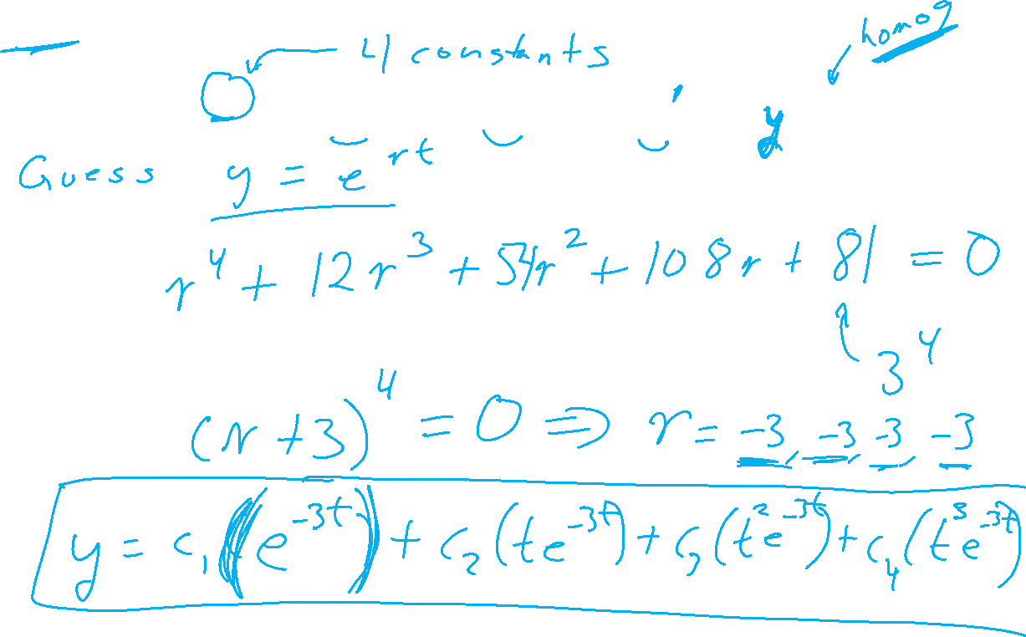

Slide 3
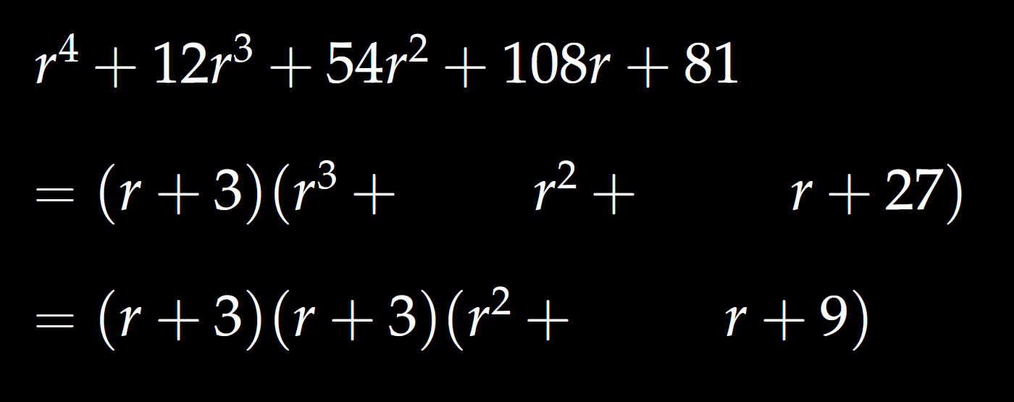
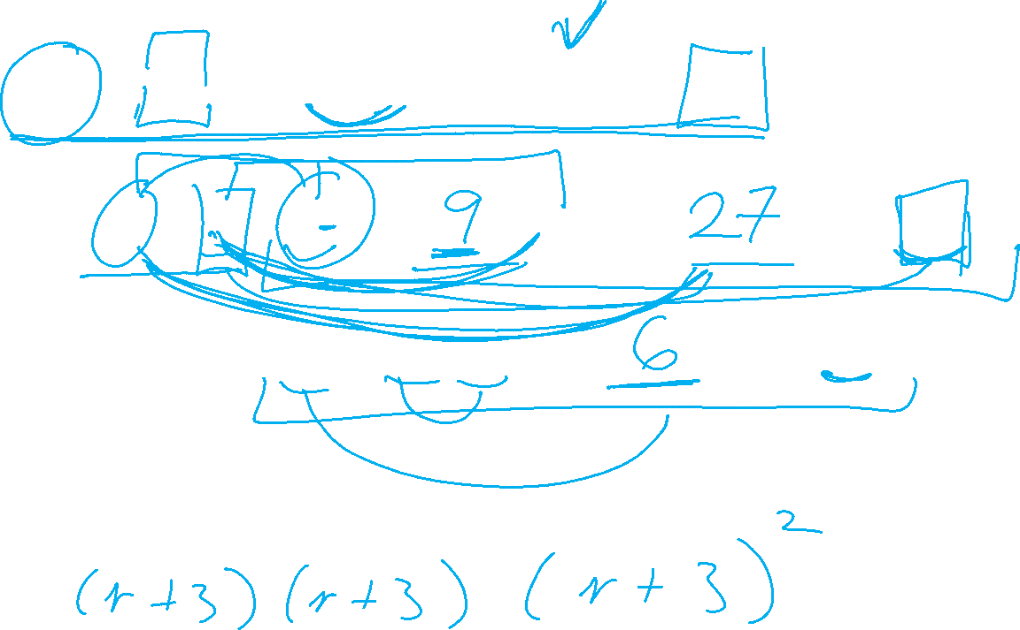

Slide 4
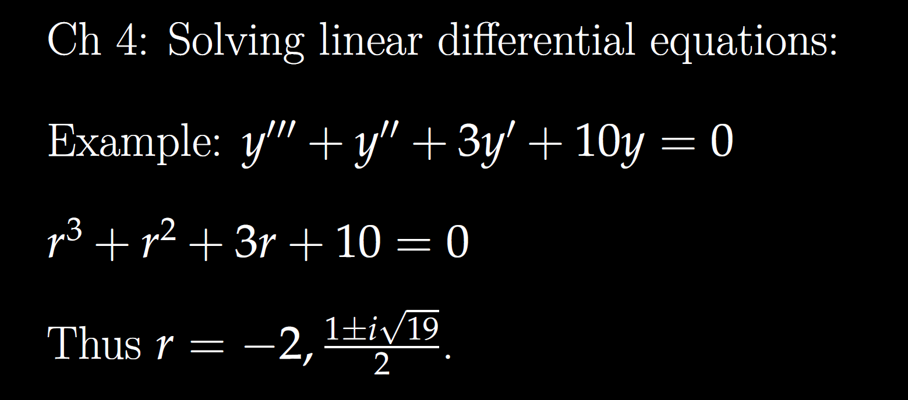

Slide 5
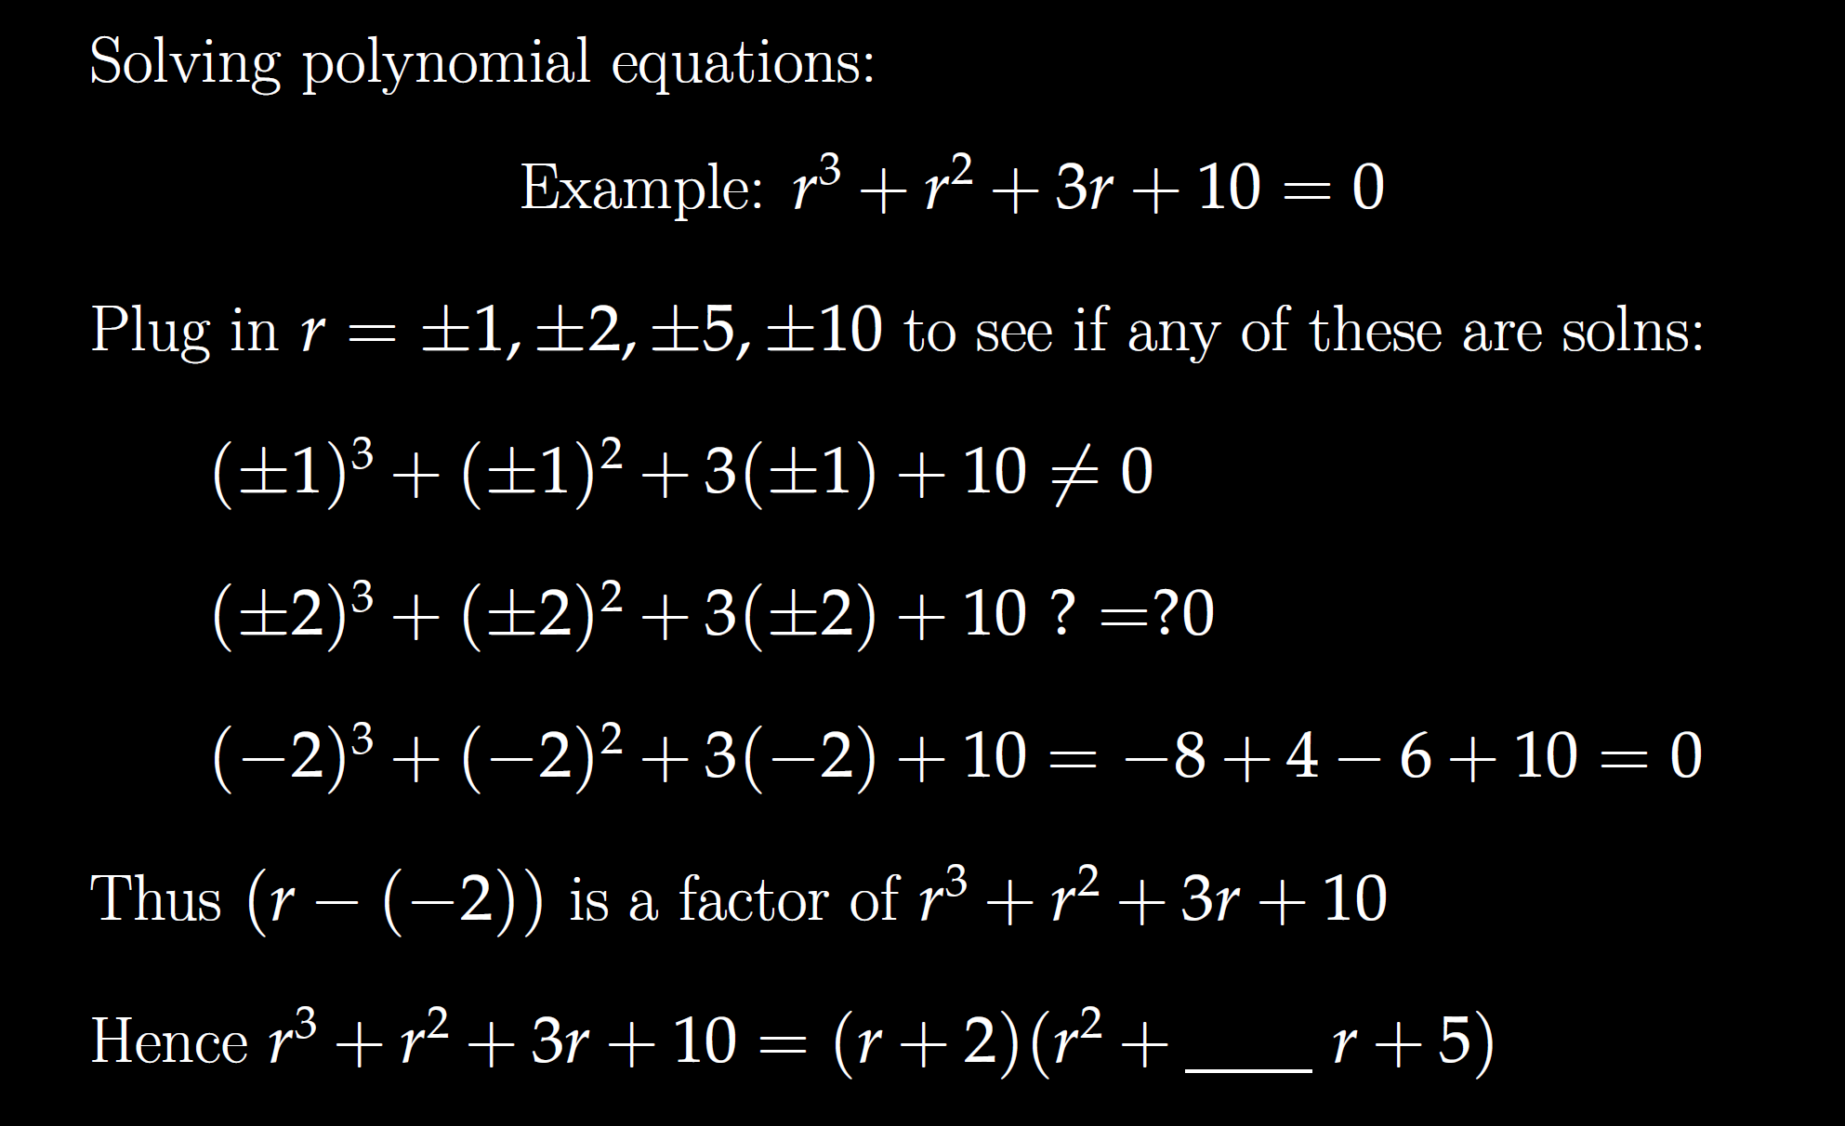

Slide 7
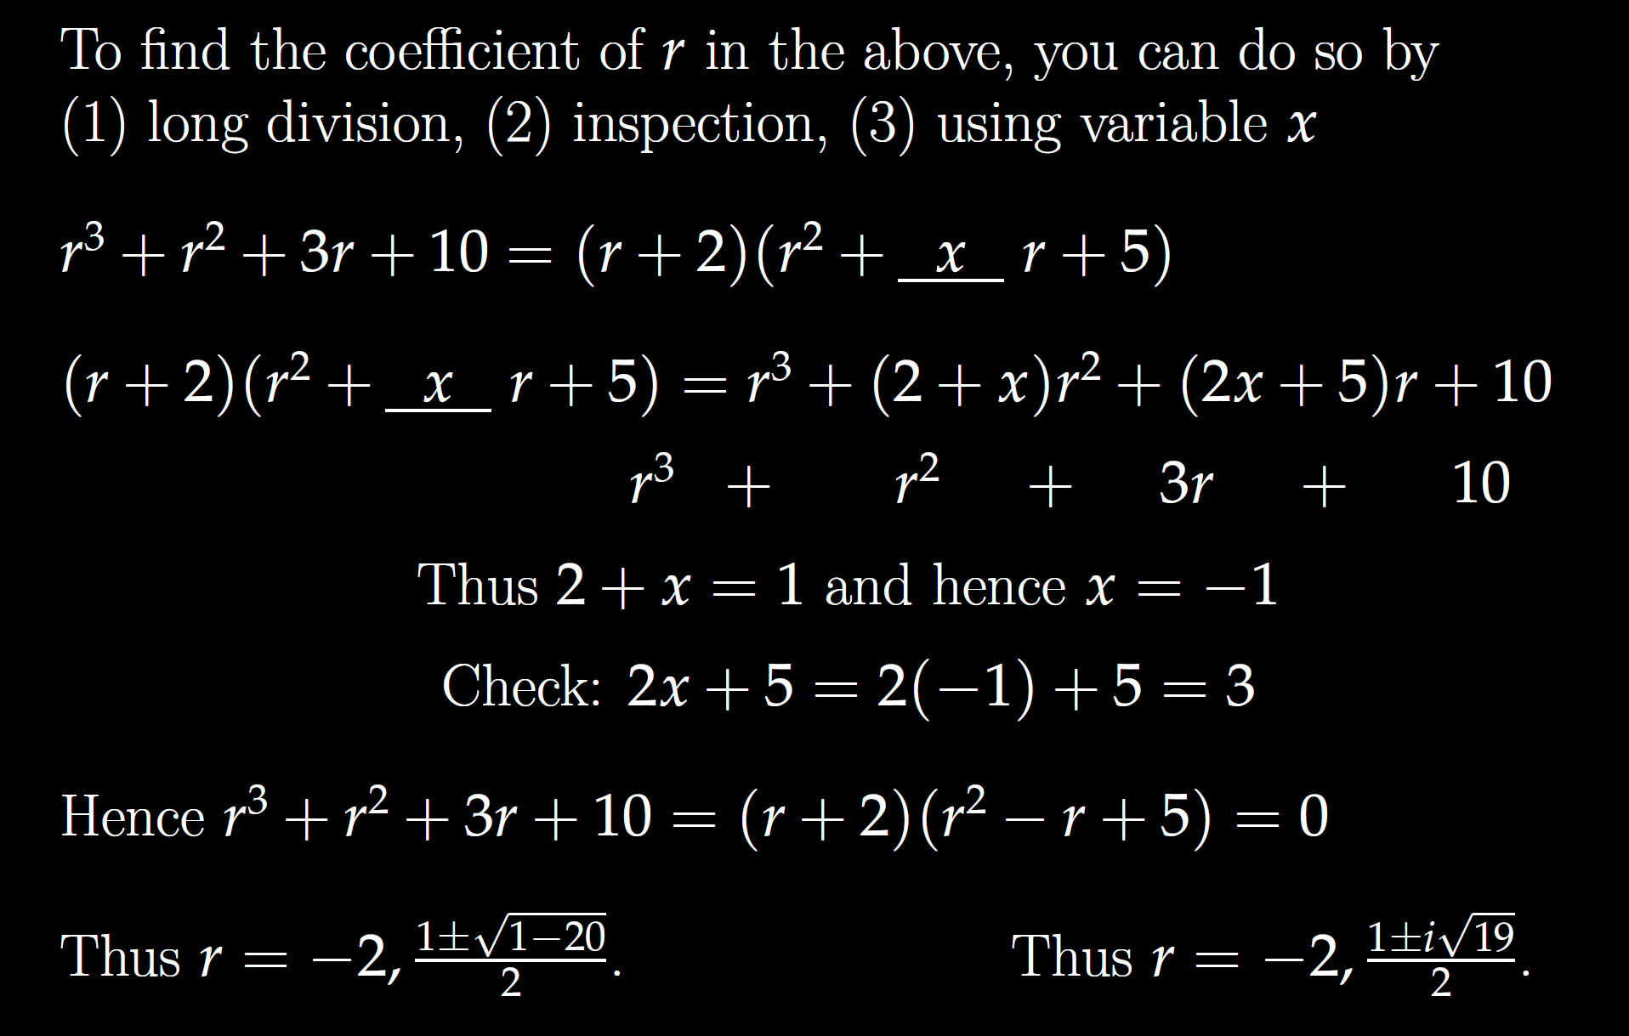

Slide 9
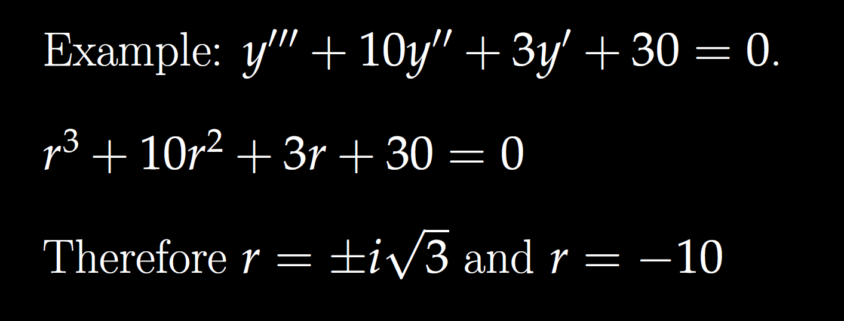

Slide 10
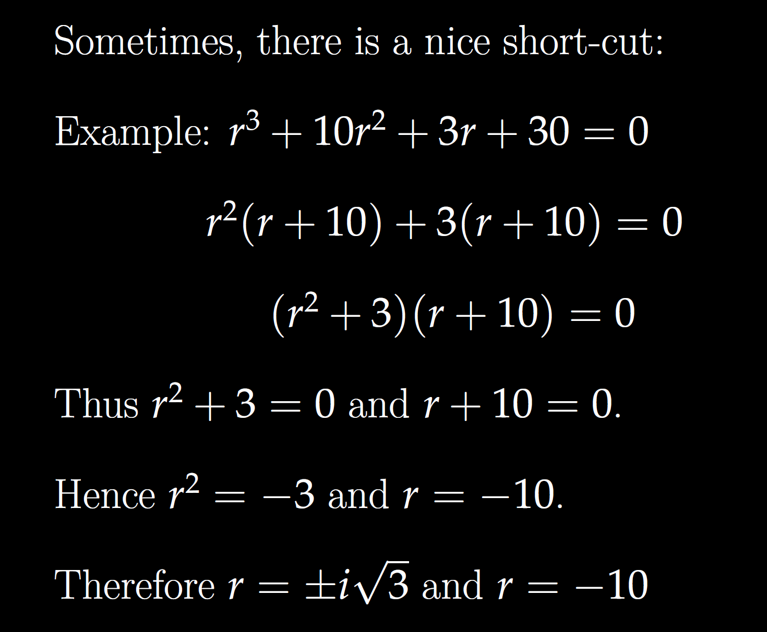

Slide 11


Slide 13
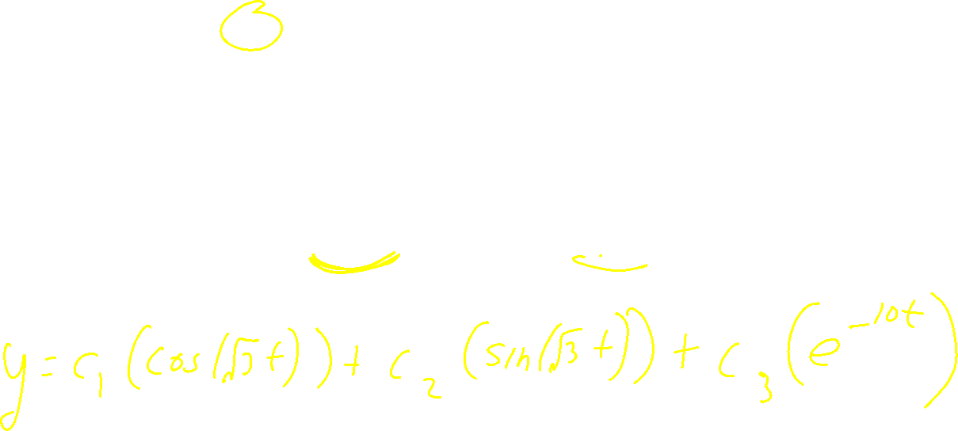

Slide 14
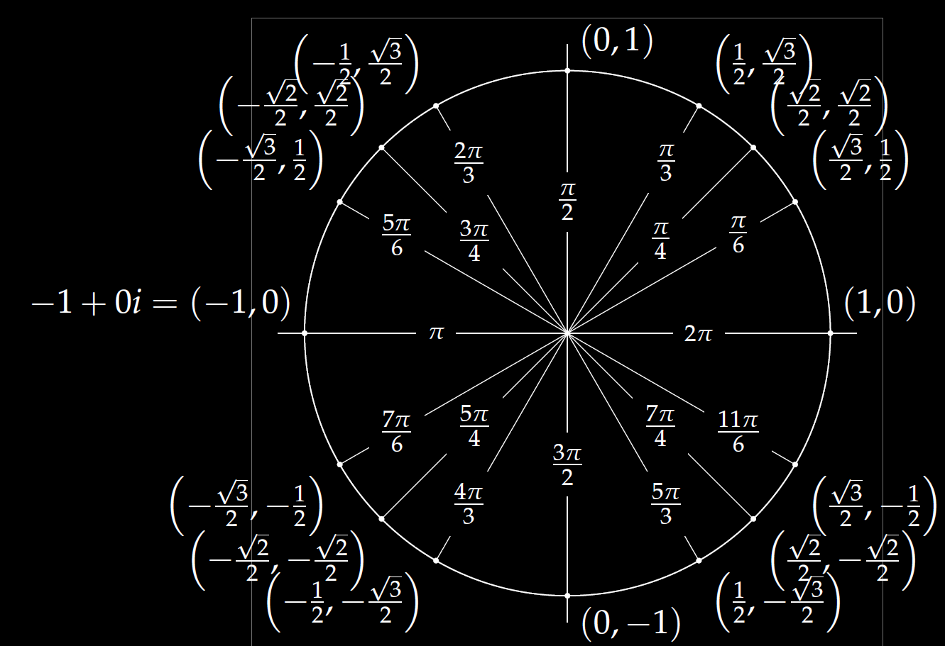
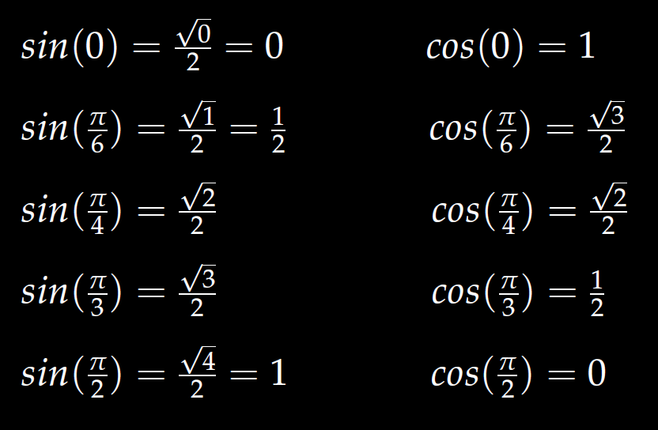
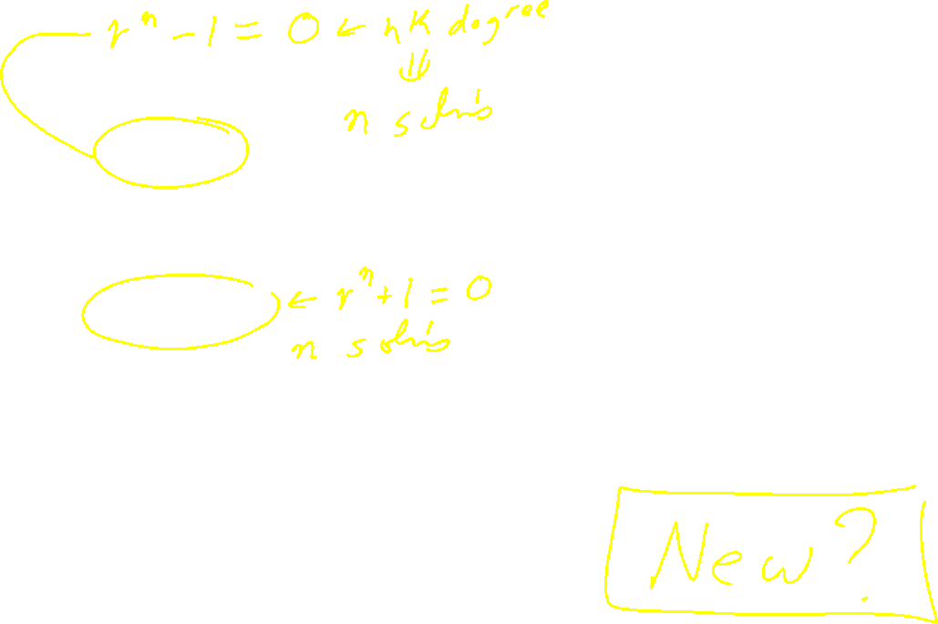
In special cases, you can use the unit circle.
Roots of unity
r^{n} = 1
We will also solve
r^{n} = -1

Slide 15
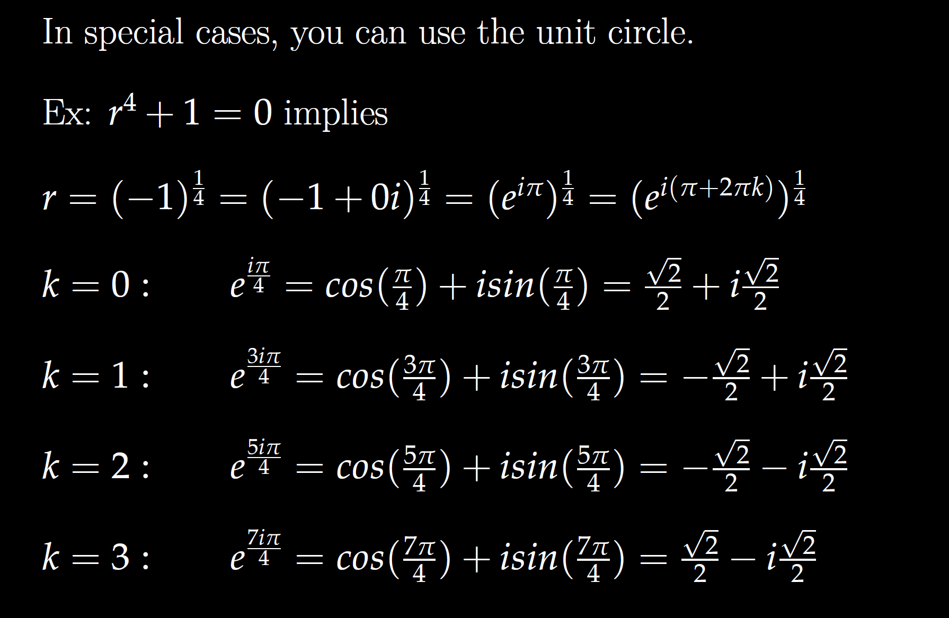
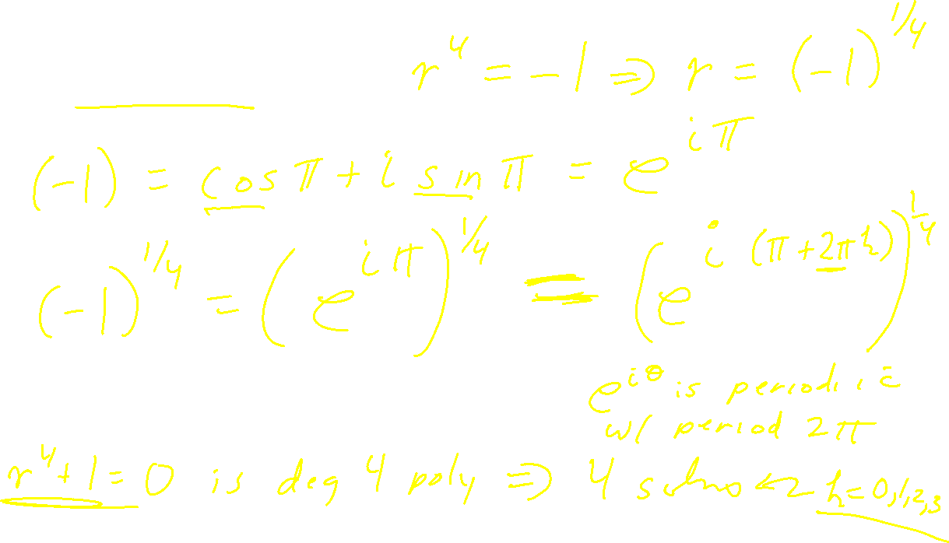

Slide 16


Slide 17
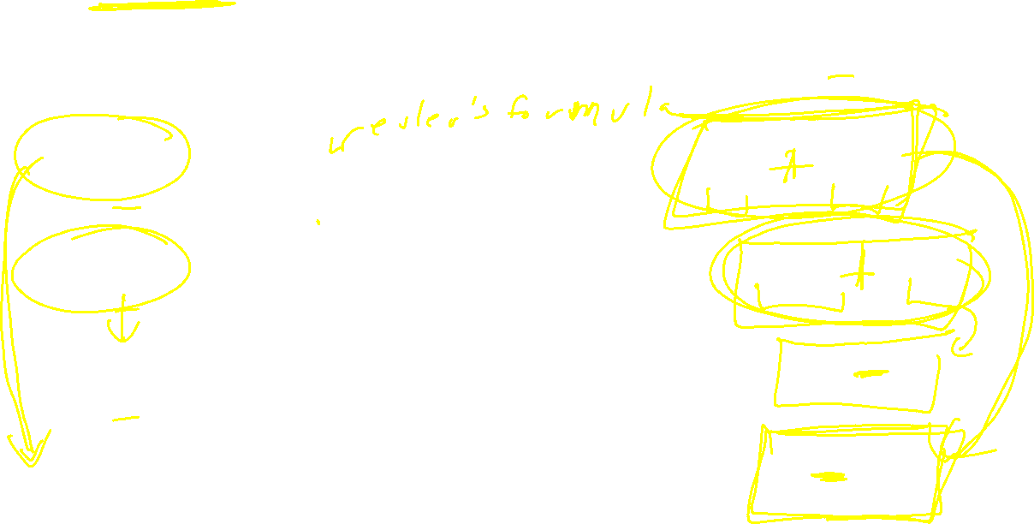

Slide 18
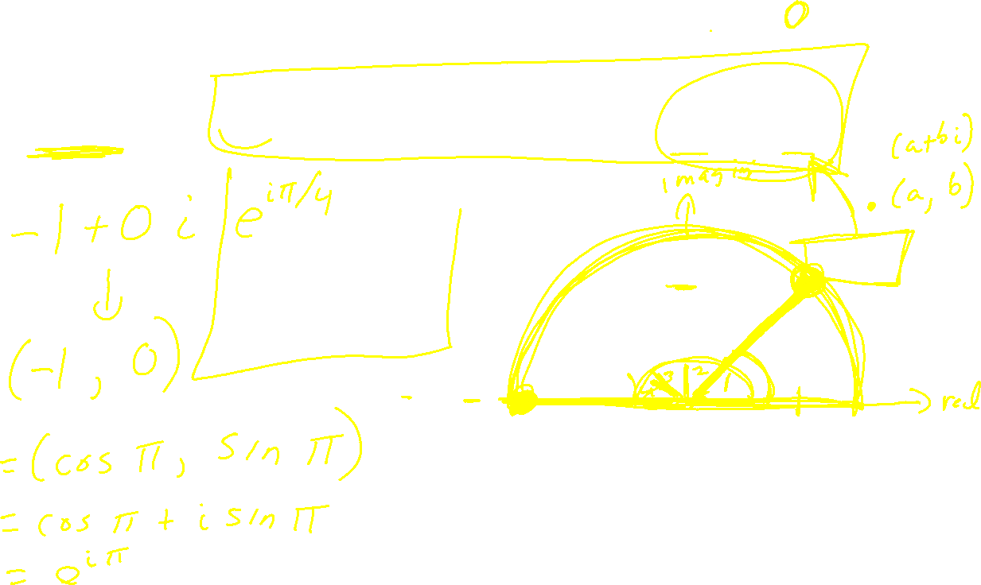

Slide 19
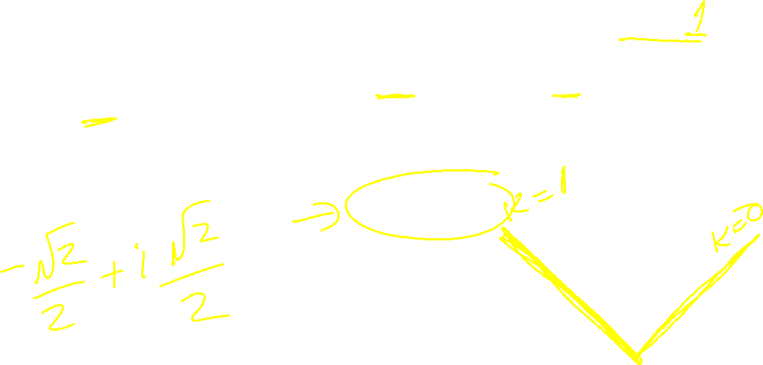

Slide 20


Slide 21


Slide 22
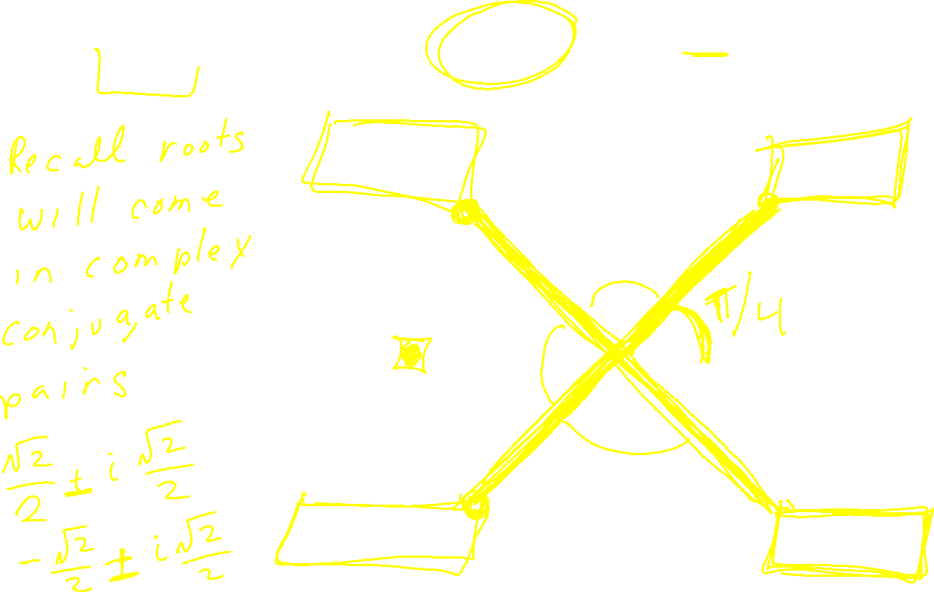

Slide 23


Slide 24
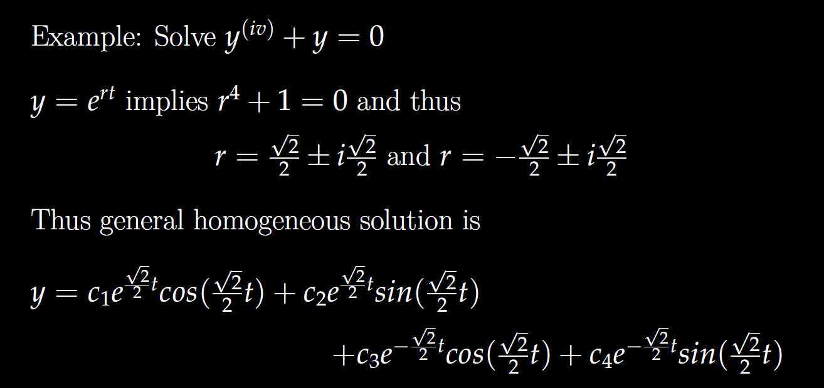
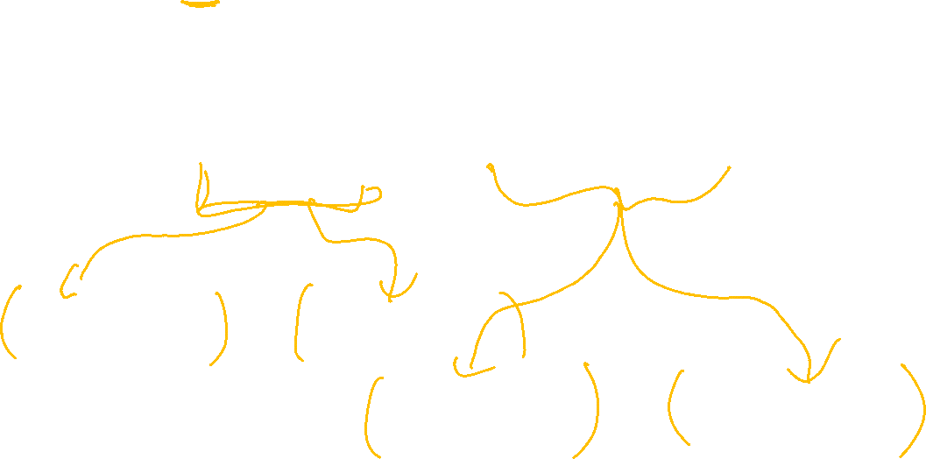

Slide 25
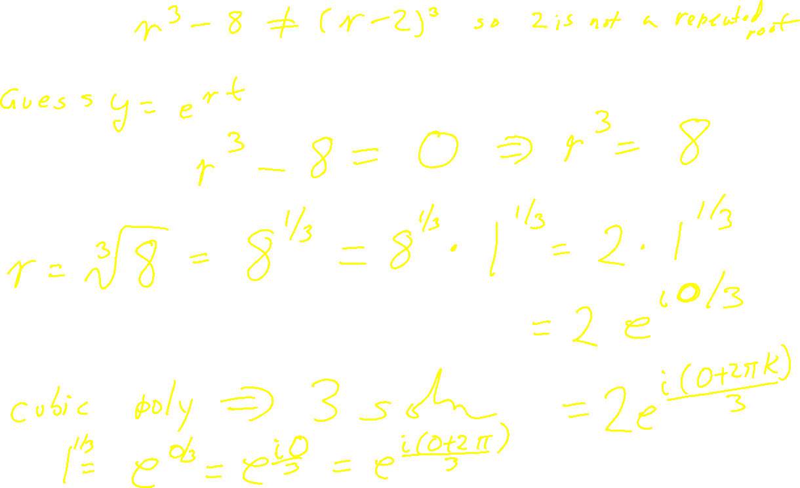

Slide 26
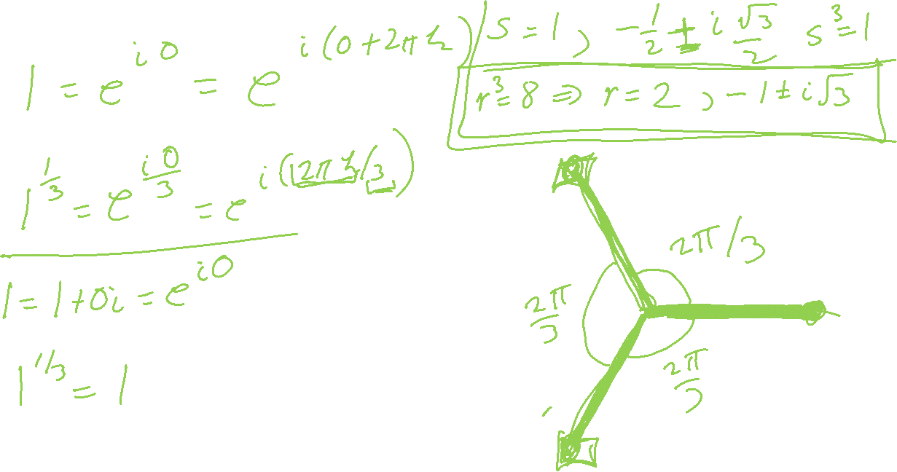

Slide 28
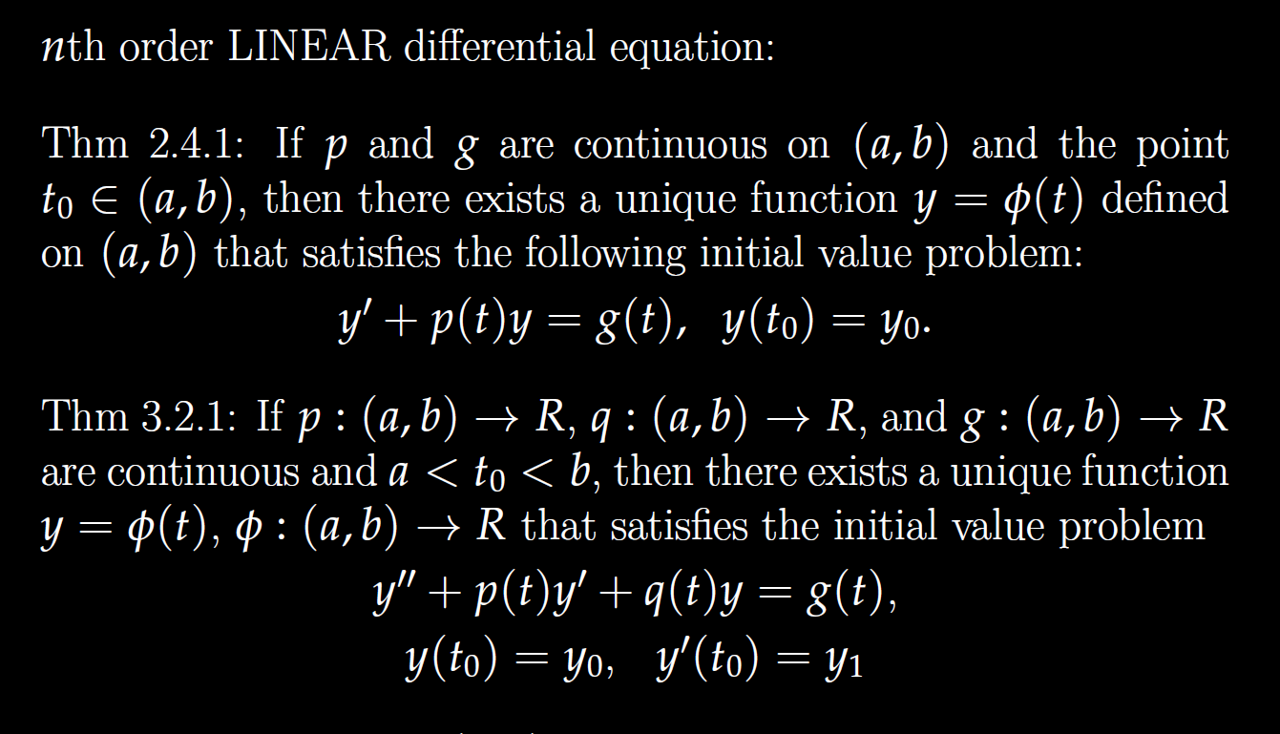


Slide 29
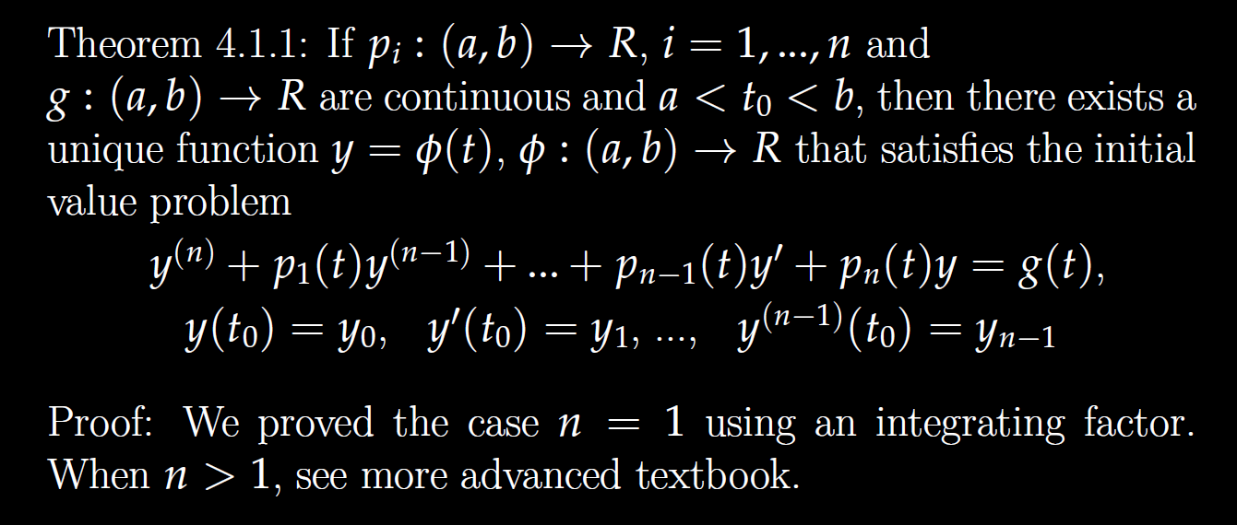
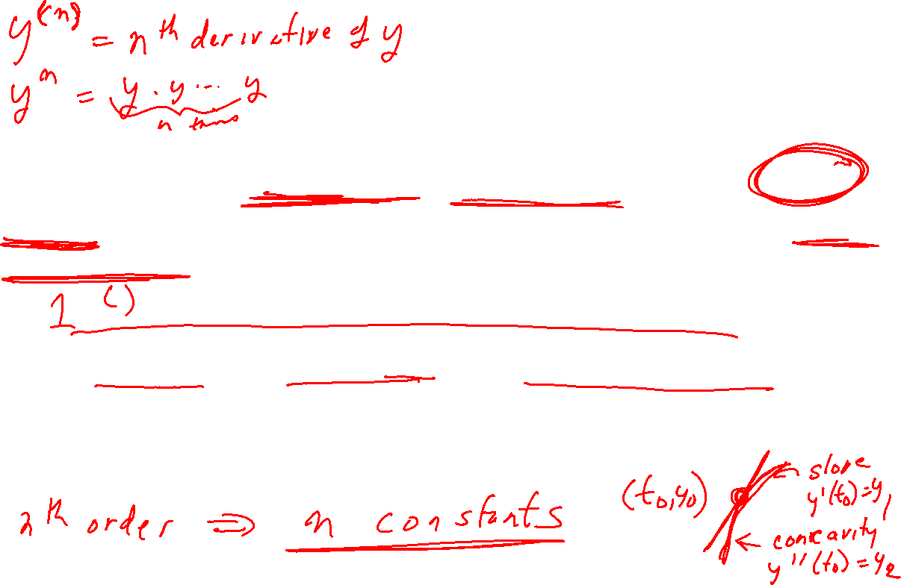

Slide 30
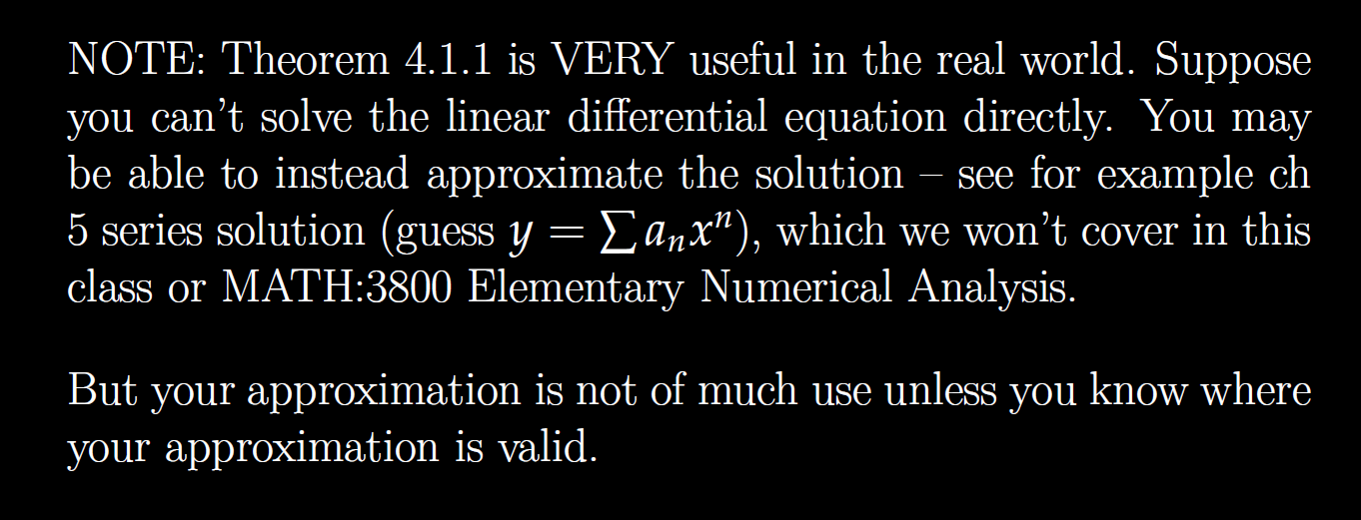


Slide 31
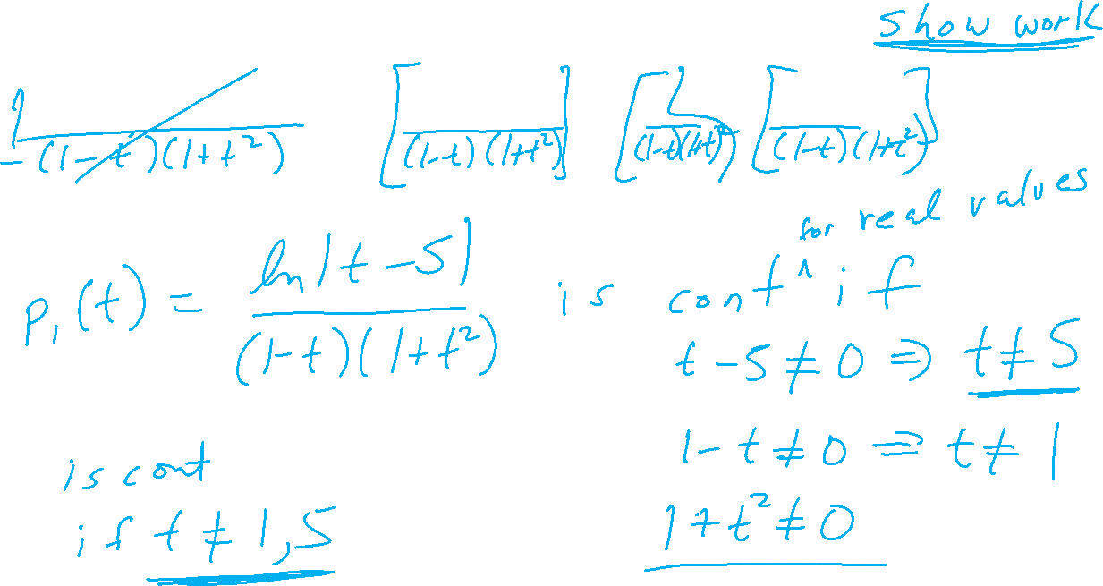
Determine (without solving the problem) an interval in which the solution of the given initial value problem is certain to exist and be unique.
$$\left(1 − t\right)\left(1 + t^{2}\right)y^{′′′}+\ln\left|t − 5\right|y^{′}+2y = \sqrt{t+4} y(0) = 3$$

Slide 32
Determine (without solving the problem) an interval in which the solution of the given initial value problem is certain to exist and be unique.
$$\left(1 − t\right)\left(1 + t^{2}\right)y^{′′′}+\ln\left|t − 5\right|y^{′}+2y = \sqrt{t+4} y(0) = 3$$

