Slide 1

Exam 2 is next Wednesday March 31, covering Ch 3, Ch 4, and finding eigenvalues for 2 x 2 matrices. Format will be similar to last exam.
If you wish me to postpone some material to exam 3, please let me know by 10am Friday. For other feedback, anonymous survey is still available on ICON.
NOTE: We will use concepts from Ch 3 and 4 thru the rest of the semester, so please overstudy for this exam. It will make the rest of this course much easier
I will submit midterm D/F grades today. However, we are dropping your lowest midterm grade, so even if you get a midterm report, you can still earn an A/B in this class. In pre-pandemic times, I have seen many students improve their exam grade significantly.
HW/quizzes: Wednesdays are a soft deadline. HW grader will grade over weekend, so on rare occasions, you can submit your HW by Friday with no penalty.

Slide 2
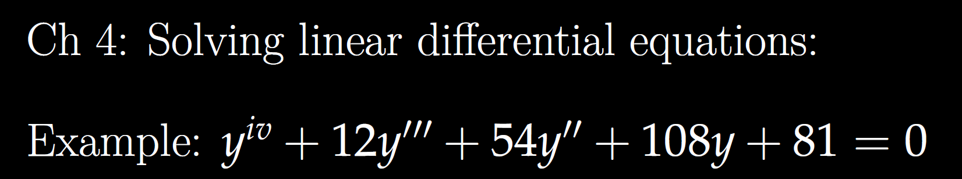

Slide 3
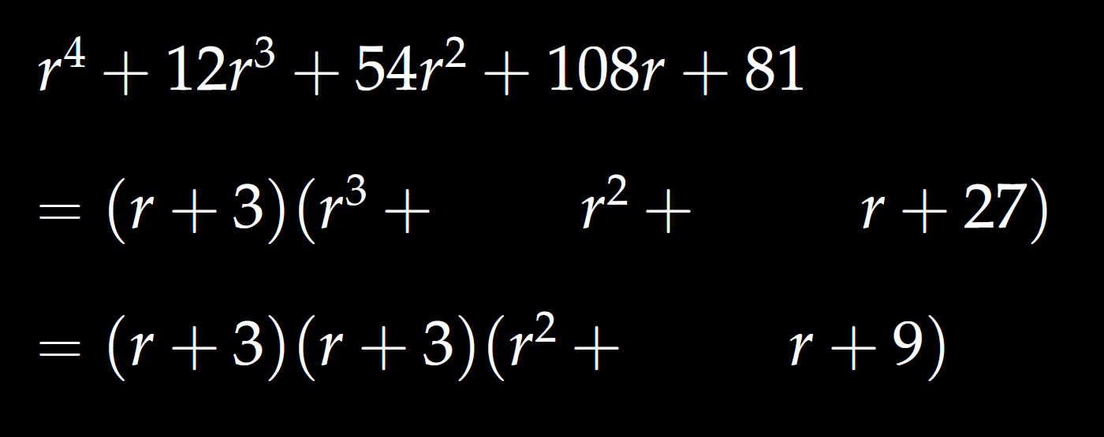

Slide 4
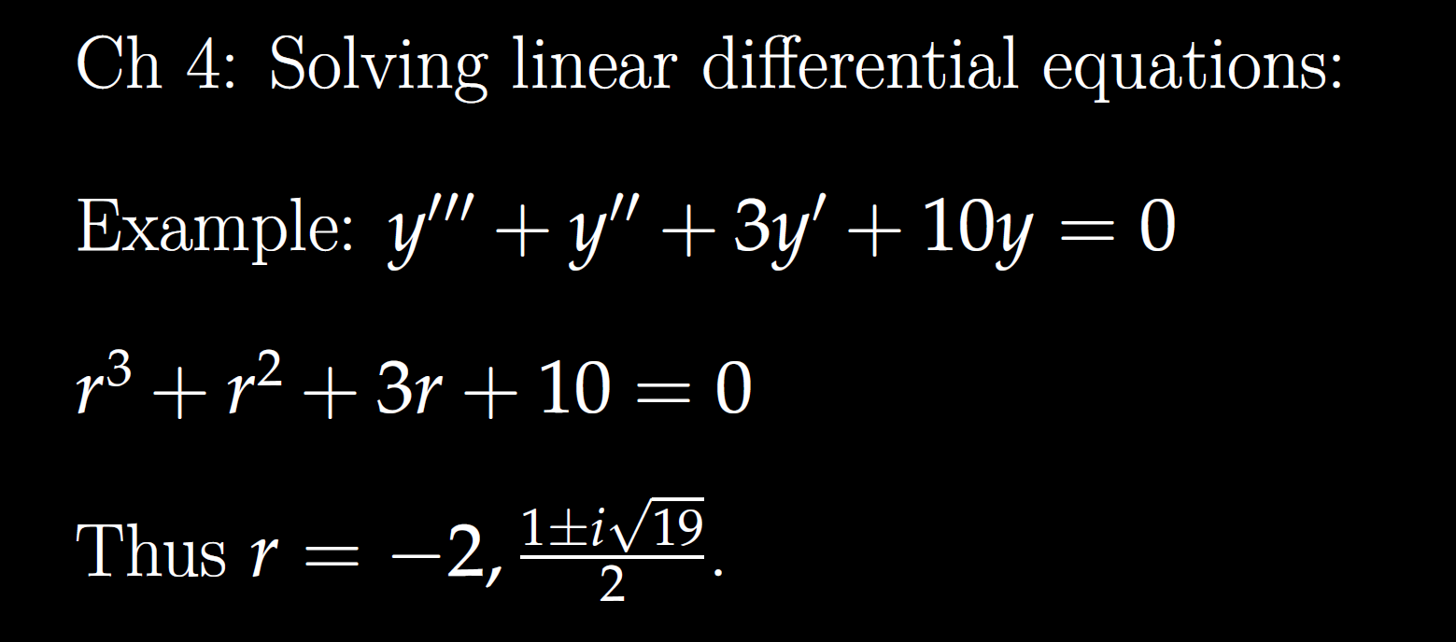

Slide 5
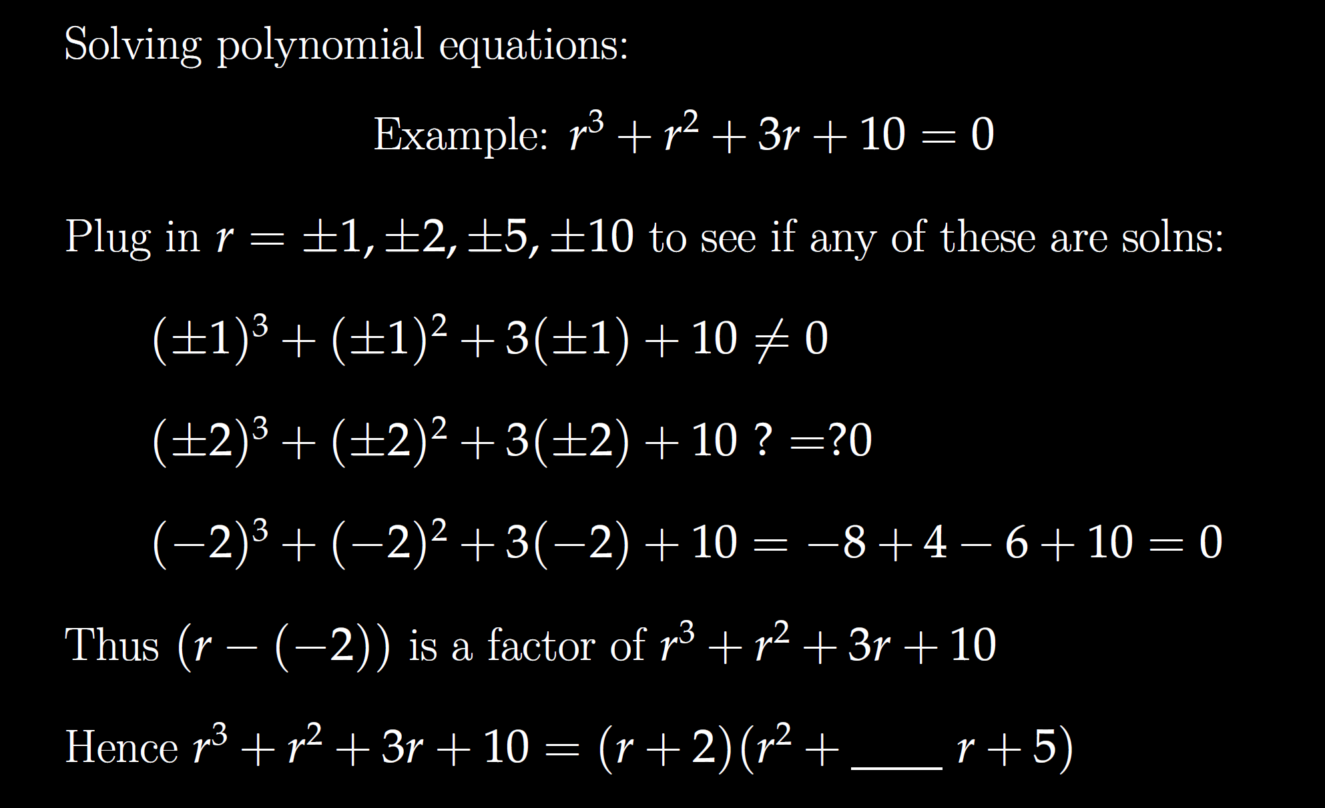

Slide 7
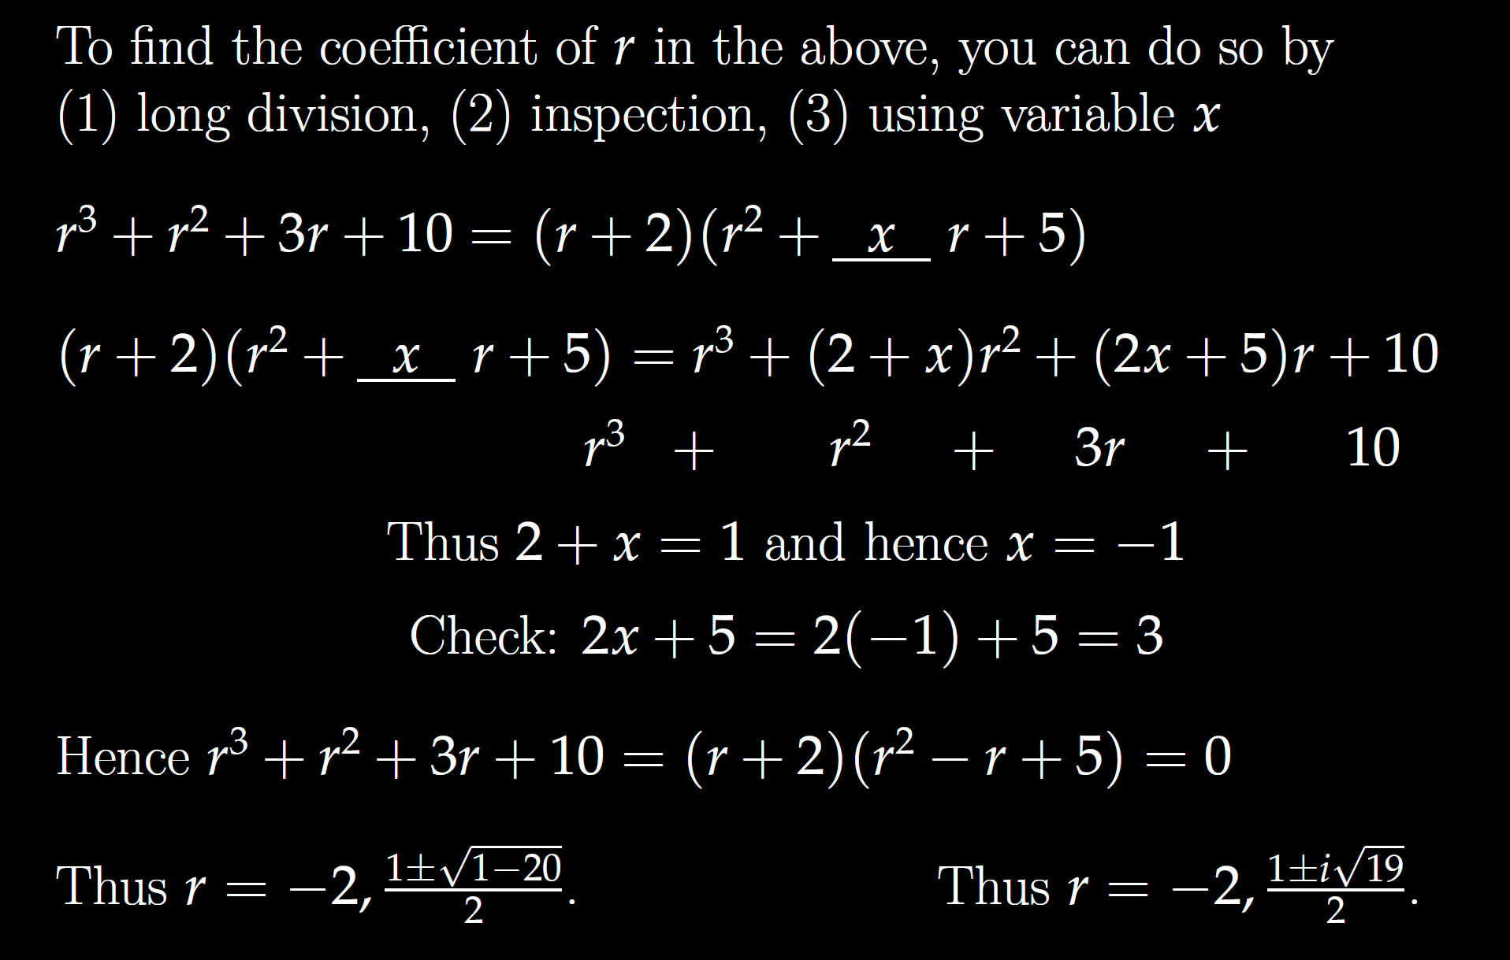

Slide 9
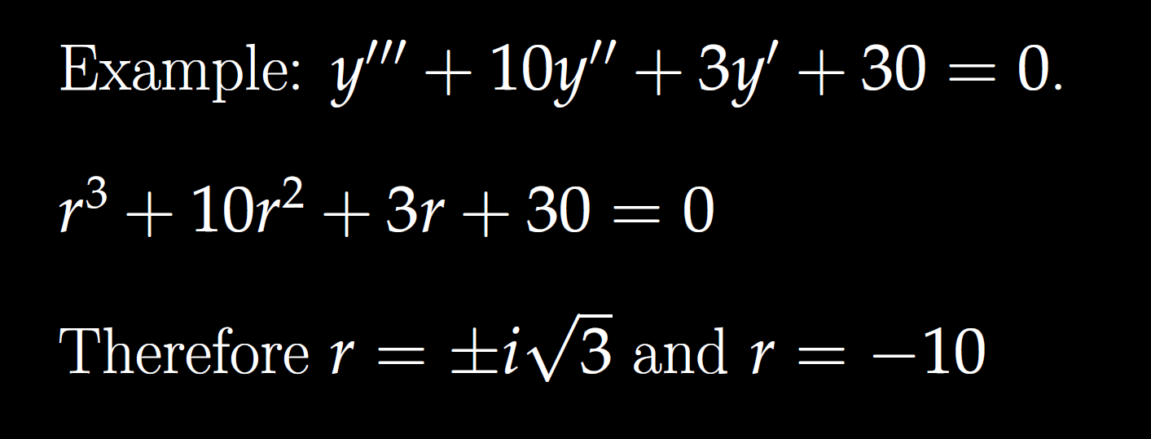

Slide 10
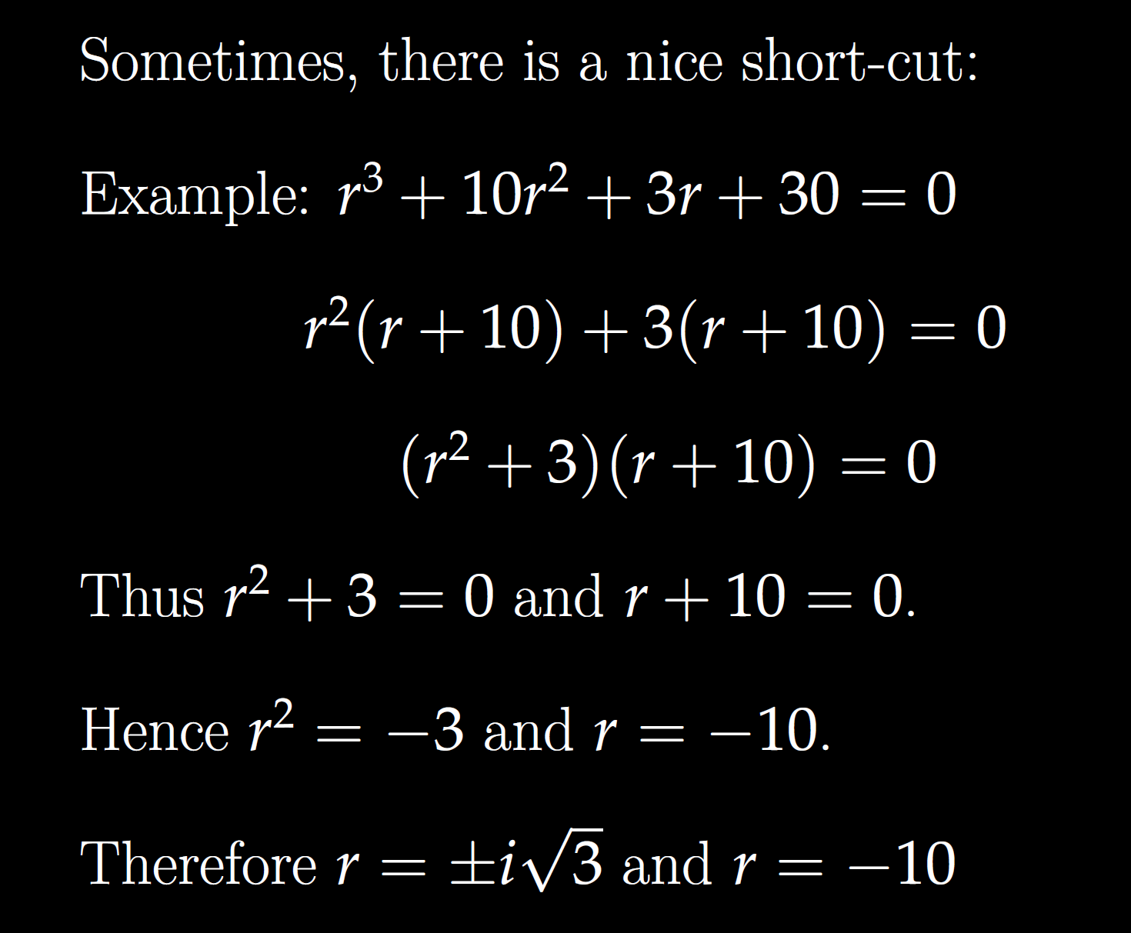

Slide 14
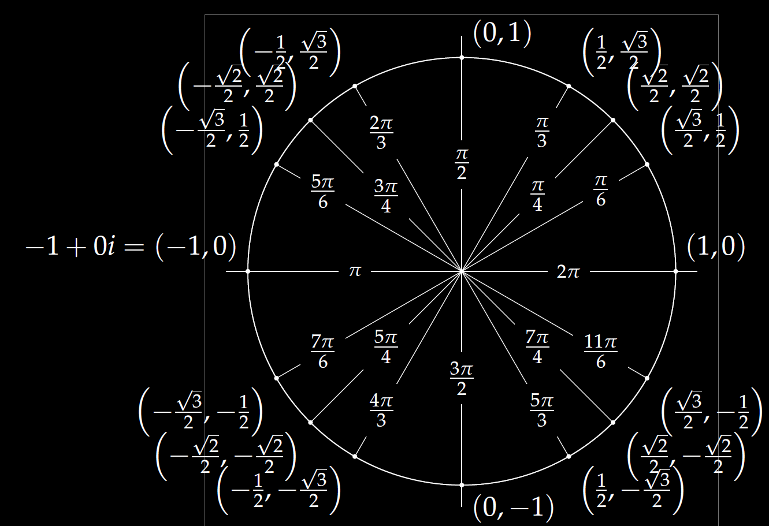
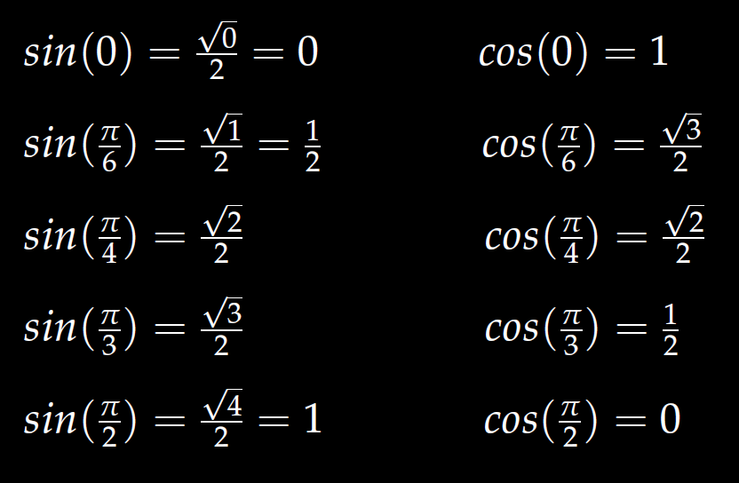
In special cases, you can use the unit circle.
Roots of unity
r^{n} = 1
We will also solve
r^{n} = -1

Slide 15
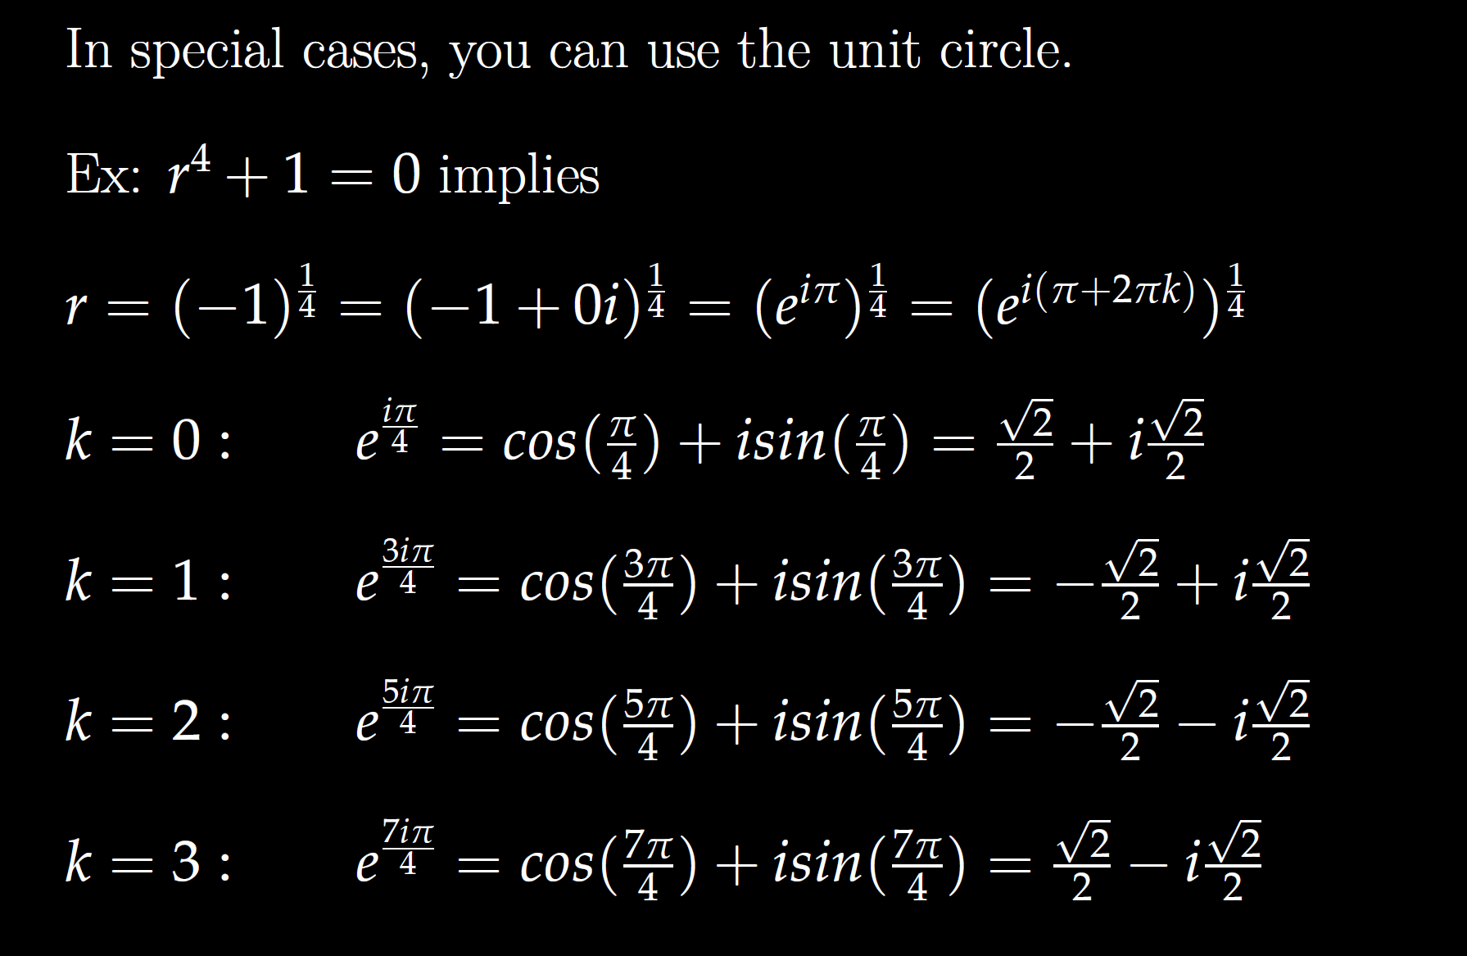

Slide 24
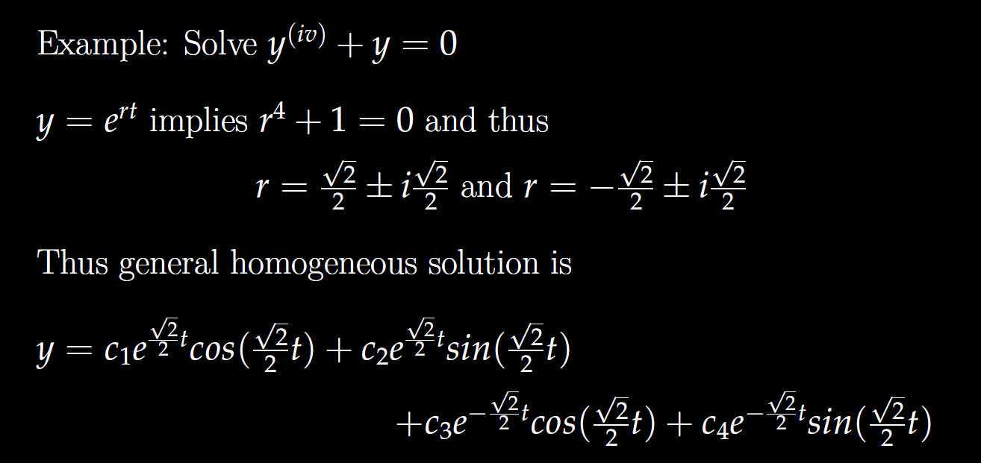

Slide 30
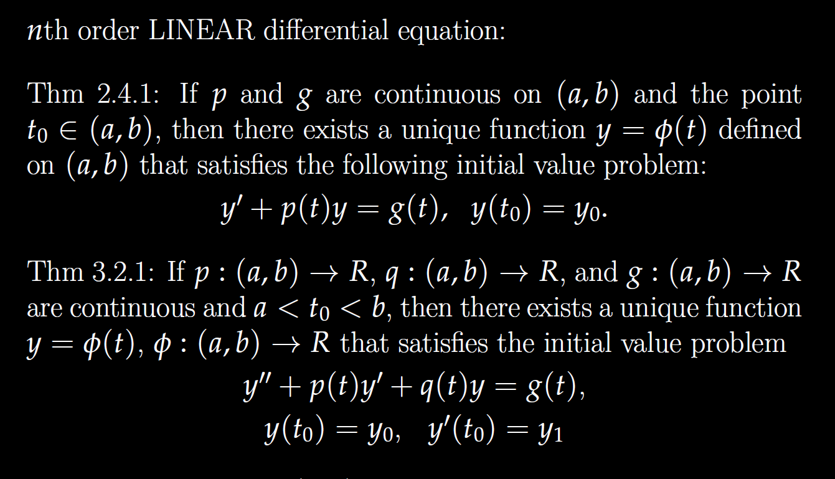

Slide 31
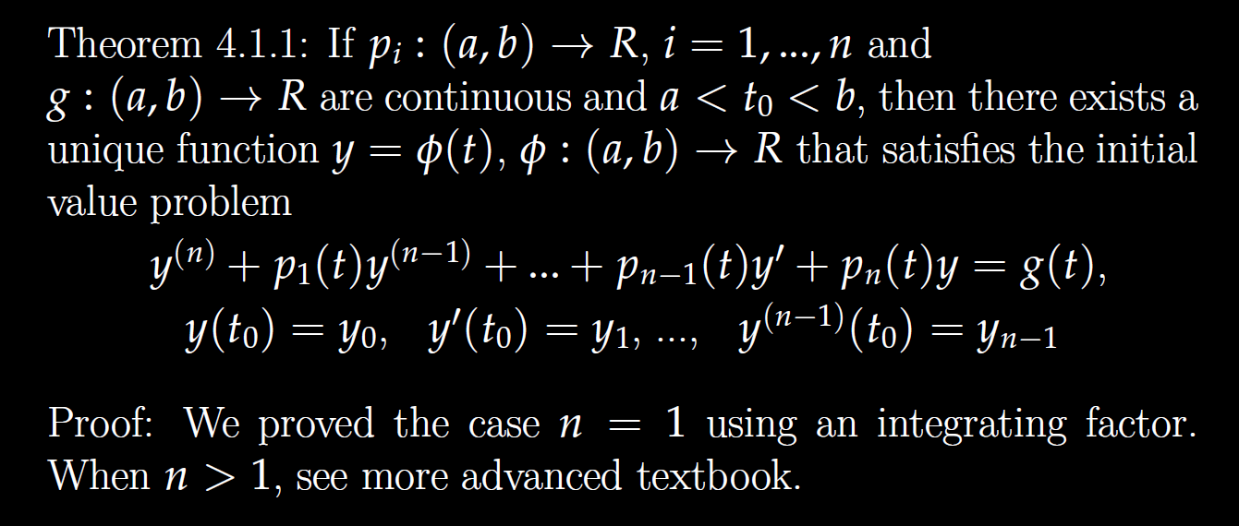

Slide 32
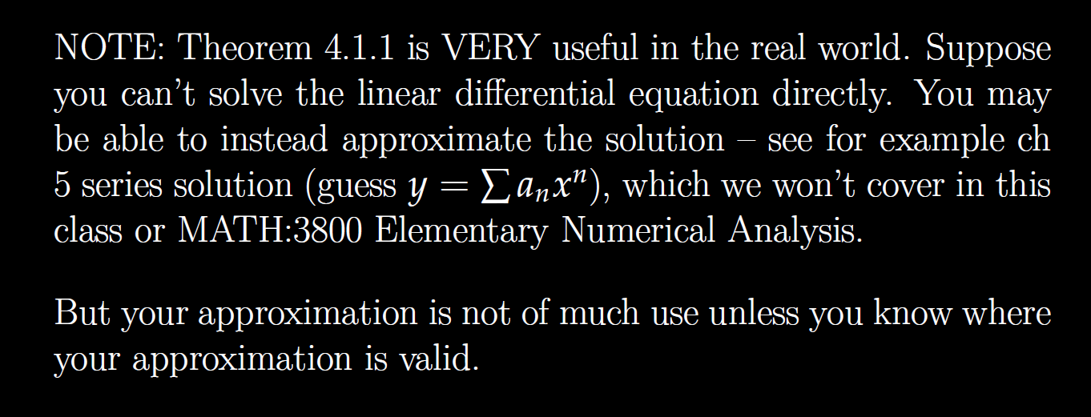

Slide 33
Determine (without solving the problem) an interval in which the solution of the given initial value problem is certain to exist and be unique.
$$\left(1 − t\right)\left(1 + t^{2}\right)y^{′′′}+\ln\left|t − 5\right|y^{′}+2y = \sqrt{t+4} y(0) = 3$$

Slide 34
Determine (without solving the problem) an interval in which the solution of the given initial value problem is certain to exist and be unique.
$$\left(1 − t\right)\left(1 + t^{2}\right)y^{′′′}+\ln\left|t − 5\right|y^{′}+2y = \sqrt{t+4} y(0) = 3$$

Slide 35
Determine (without solving the problem) an interval in which the solution of the given initial value problem is certain to exist and be unique.
$$\left(1 − t\right)\left(1 + t^{2}\right)y^{′′′}+\ln\left|t − 5\right|y^{′}+2y = \sqrt{t+4} y(0) = 3$$

Slide 36
Determine (without solving the problem) an interval in which the solution of the given initial value problem is certain to exist and be unique.
$$\left(1 − t\right)\left(1 + t^{2}\right)y^{′′′}+\ln\left|t − 5\right|y^{′}+2y = \sqrt{t+4} y(0) = 3$$

Slide 37
Determine (without solving the problem) an interval in which the solution of the given initial value problem is certain to exist and be unique.
$$\left(1 − t\right)\left(1 + t^{2}\right)y^{′′′}+\ln\left|t − 5\right|y^{′}+2y = \sqrt{t+4} y(0) = 3$$

Slide 38
Determine (without solving the problem) an interval in which the solution of the given initial value problem is certain to exist and be unique.
$$\left(1 − t\right)\left(1 + t^{2}\right)y^{′′′}+\ln\left|t − 5\right|y^{′}+2y = \sqrt{t+4} y(0) = 3$$

Slide 39
Determine (without solving the problem) an interval in which the solution of the given initial value problem is certain to exist and be unique.
$$\left(1 − t\right)\left(1 + t^{2}\right)y^{′′′}+\ln\left|t − 5\right|y^{′}+2y = \sqrt{t+4} y(0) = 3$$
( )( )(
-4 1 5

Slide 40
Determine (without solving the problem) an interval in which the solution of the given initial value problem is certain to exist and be unique.
$$\left(1 − t\right)\left(1 + t^{2}\right)y^{′′′}+\ln\left|t − 5\right|y^{′}+2y = \sqrt{t+4} y(0) = 3$$
( )( )(
-4 1 5

Slide 41
Determine (without solving the problem) an interval in which the solution of the given initial value problem is certain to exist and be unique.
$$\left(1 − t\right)\left(1 + t^{2}\right)y^{′′′}+\ln\left|t − 5\right|y^{′}+2y = \sqrt{t+4} y(0) = 3$$
( )( )(
-4 1 5

Slide 42
Determine (without solving the problem) an interval in which the solution of the given initial value problem is certain to exist and be unique.
$$\left(1 − t\right)\left(1 + t^{2}\right)y^{′′′}+\ln\left|t − 5\right|y^{′}+2y = \sqrt{t+4} y(0) = 3$$
( )( )(
-4 1 5

Slide 45
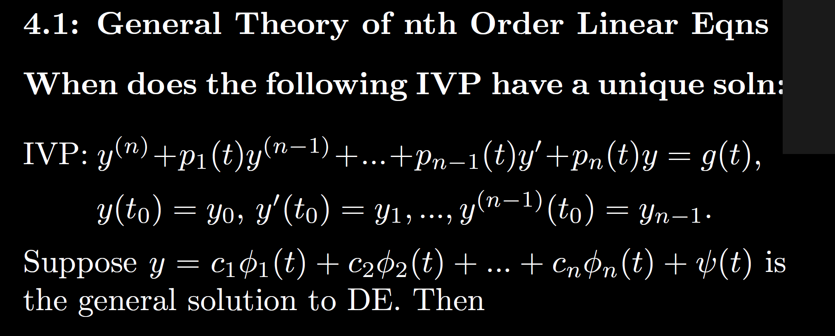

Slide 46
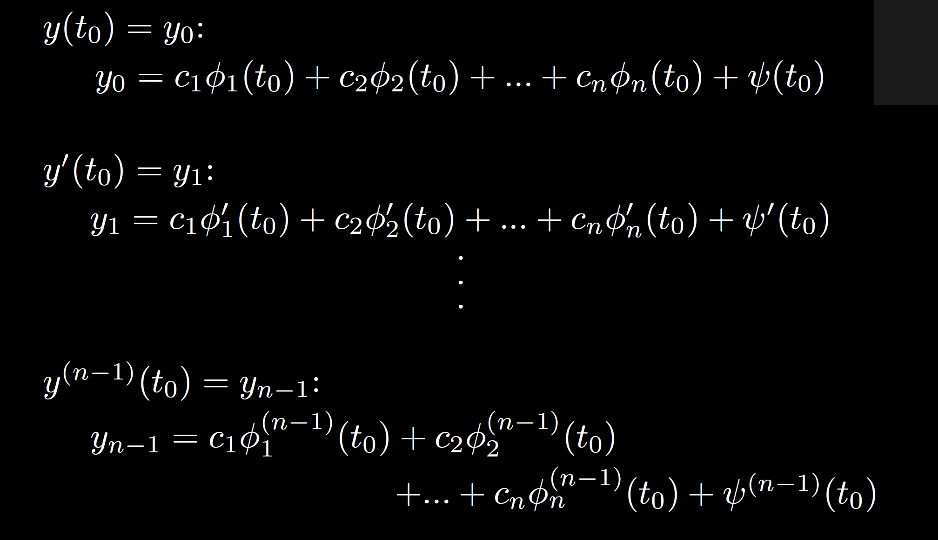

Slide 47
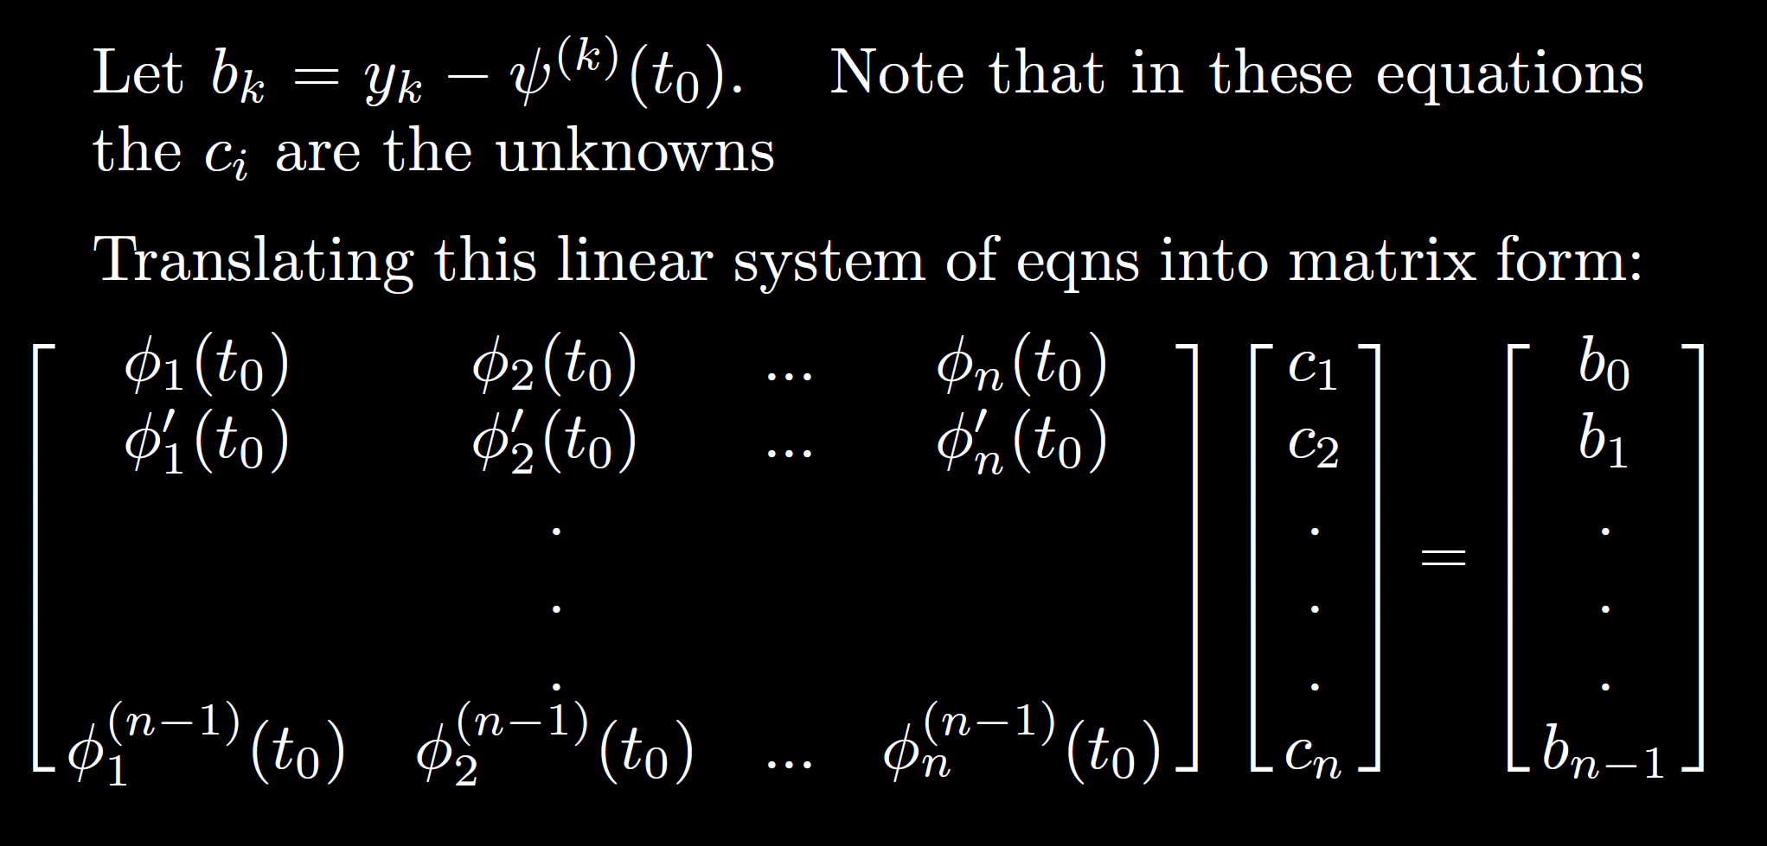

Slide 48
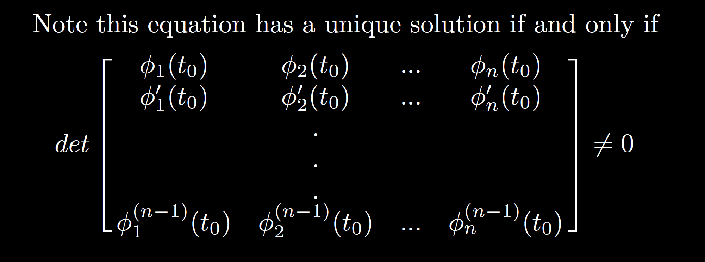

Slide 49
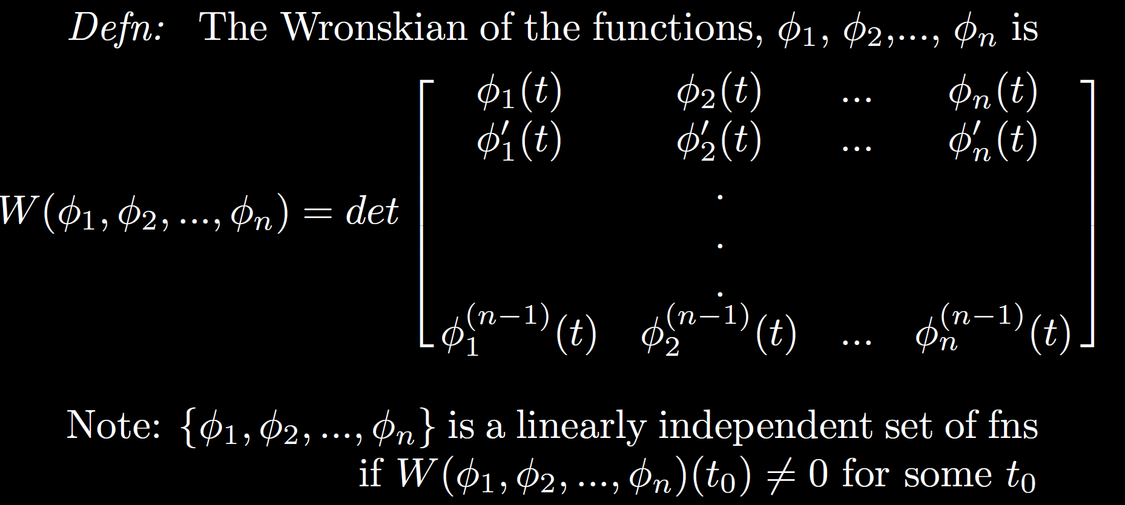

Slide 50
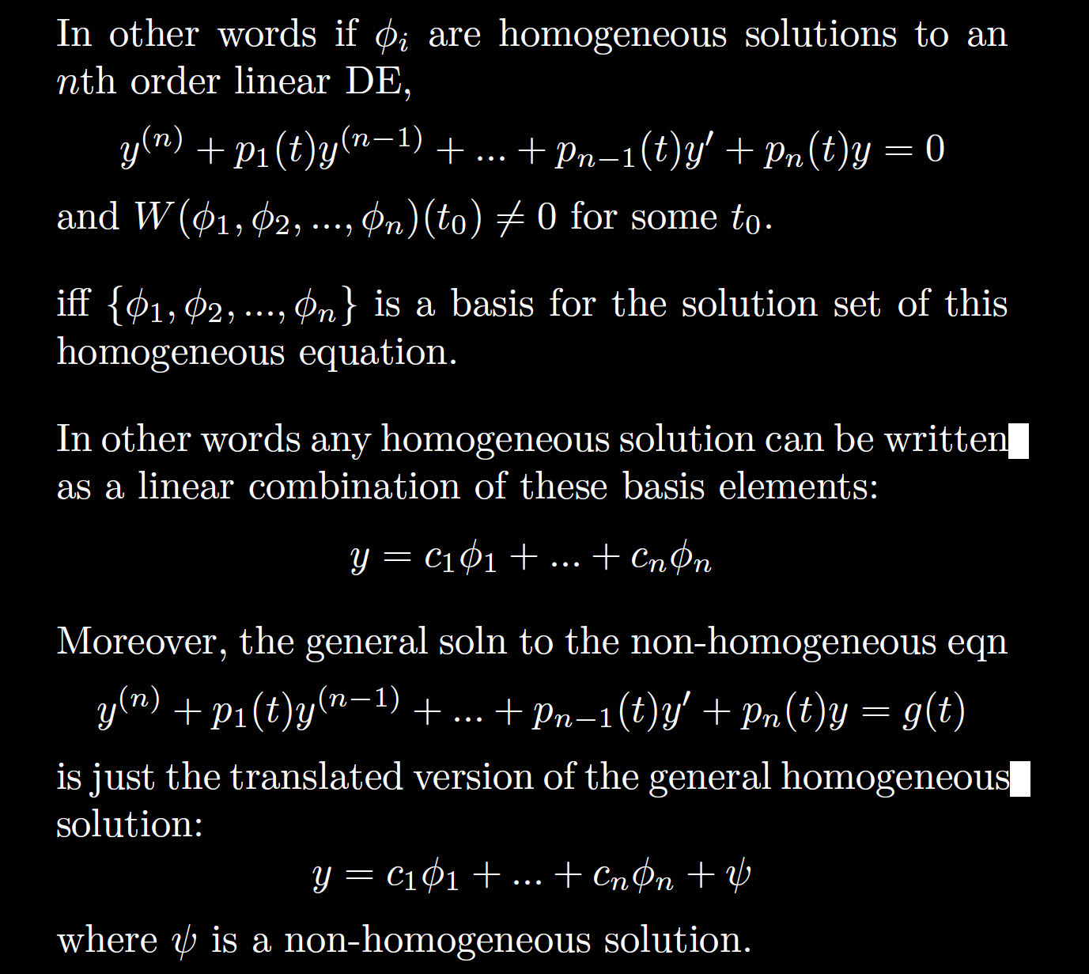

Slide 53
Linear Independence and the Wronskian

Slide 54
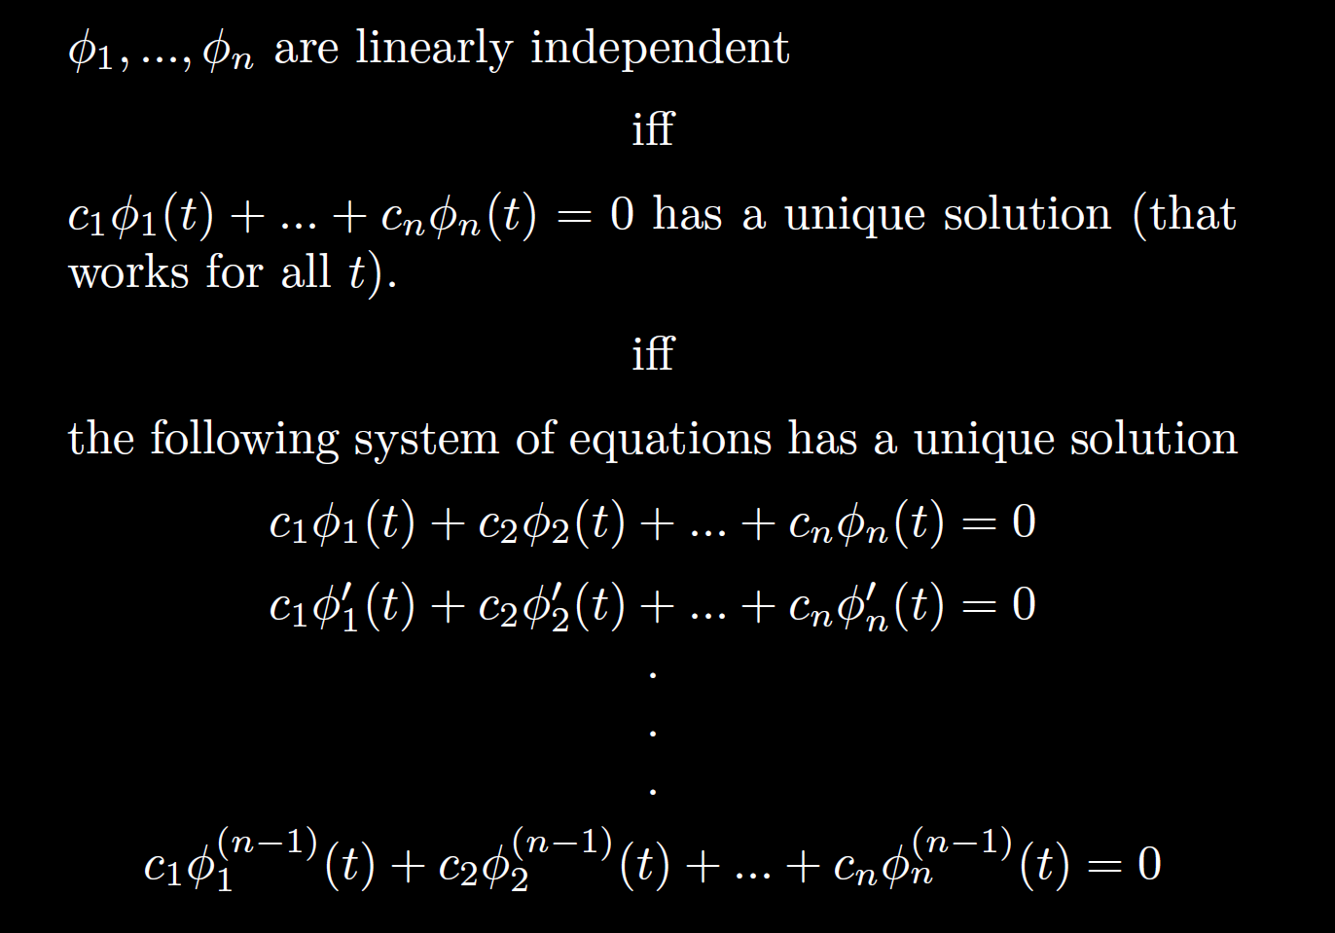

Slide 55
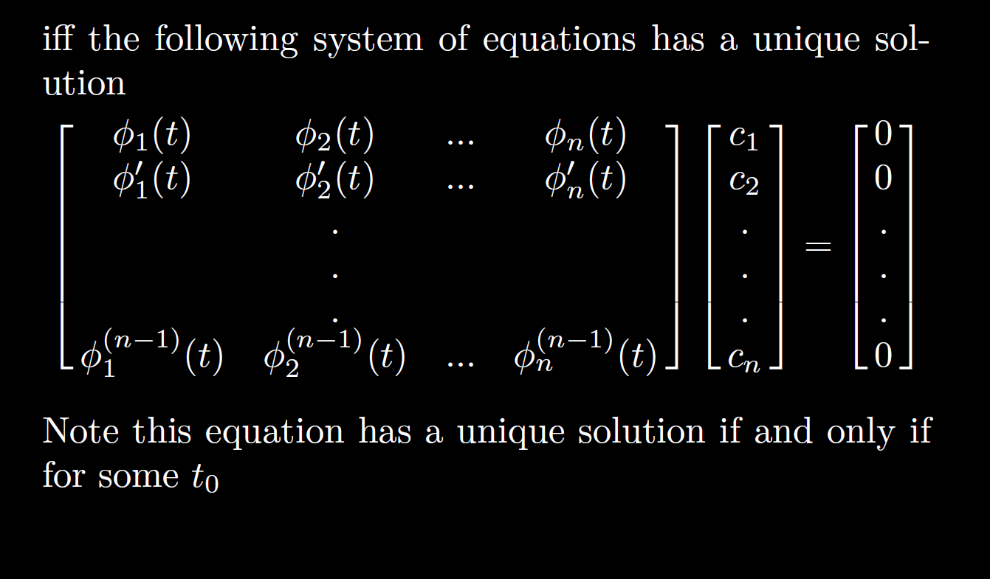

Slide 56
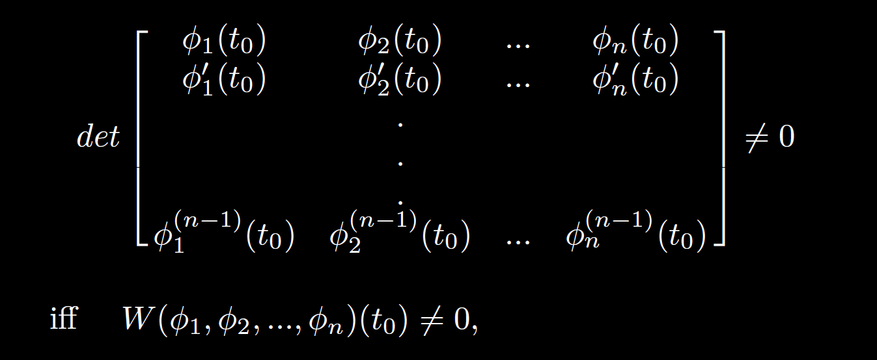

Slide 58
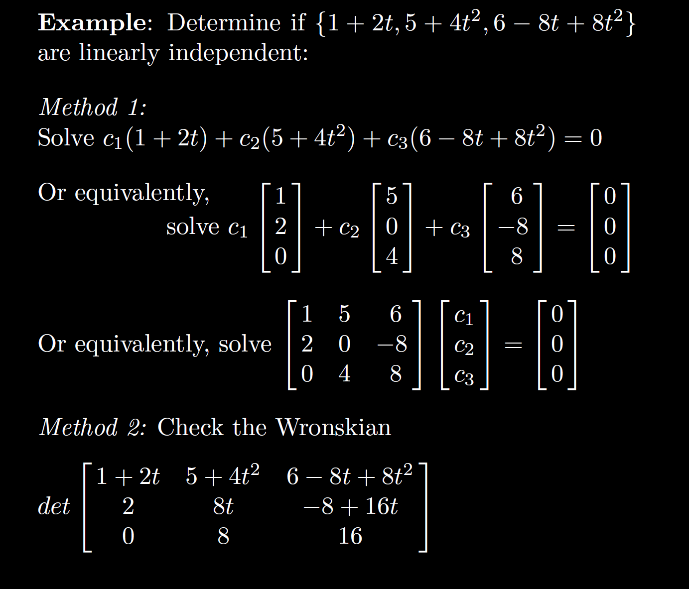

Slide 63
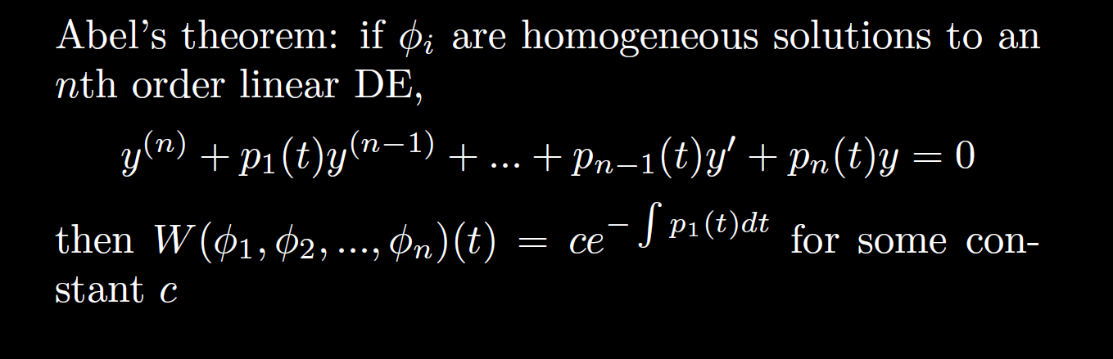

Slide 64
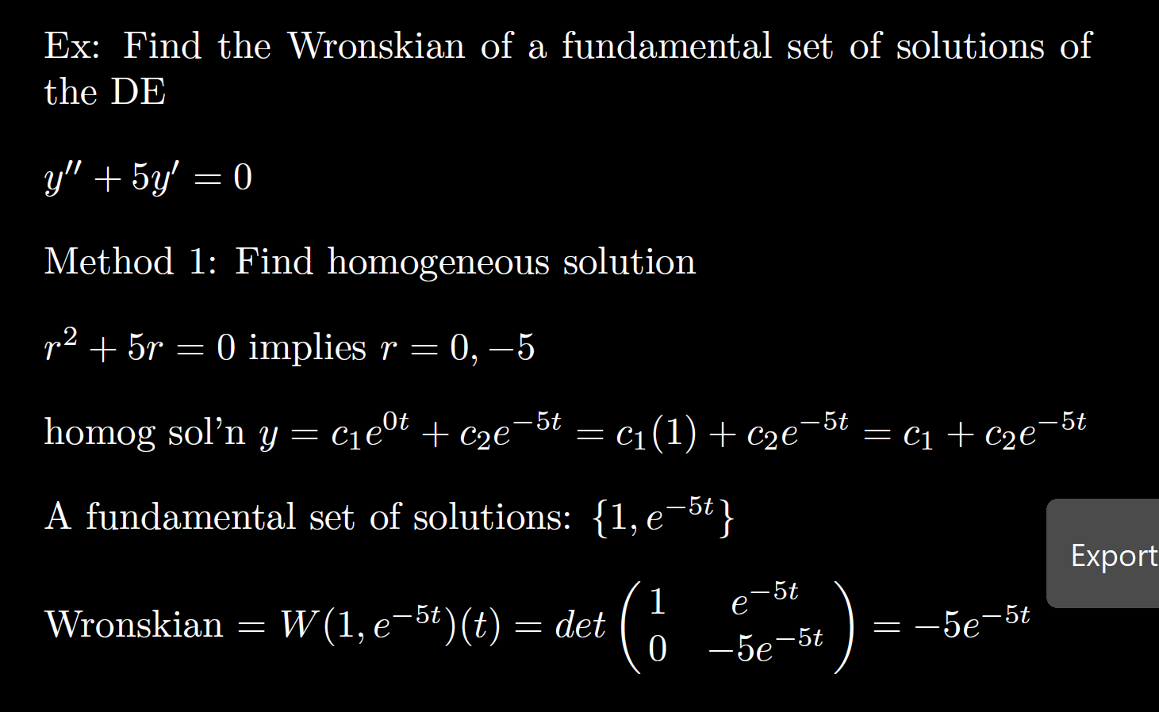

Slide 65
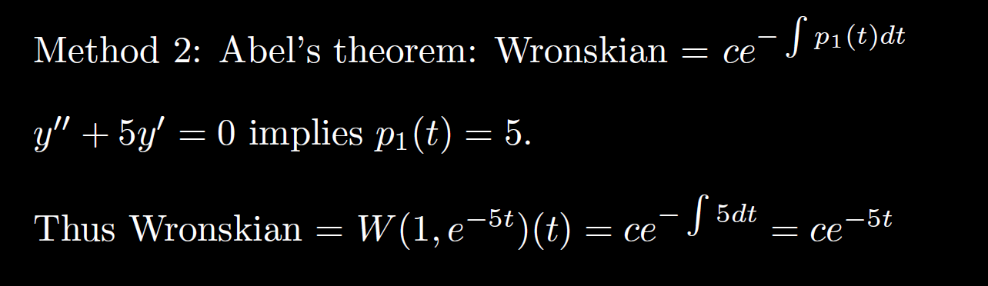

Slide 71
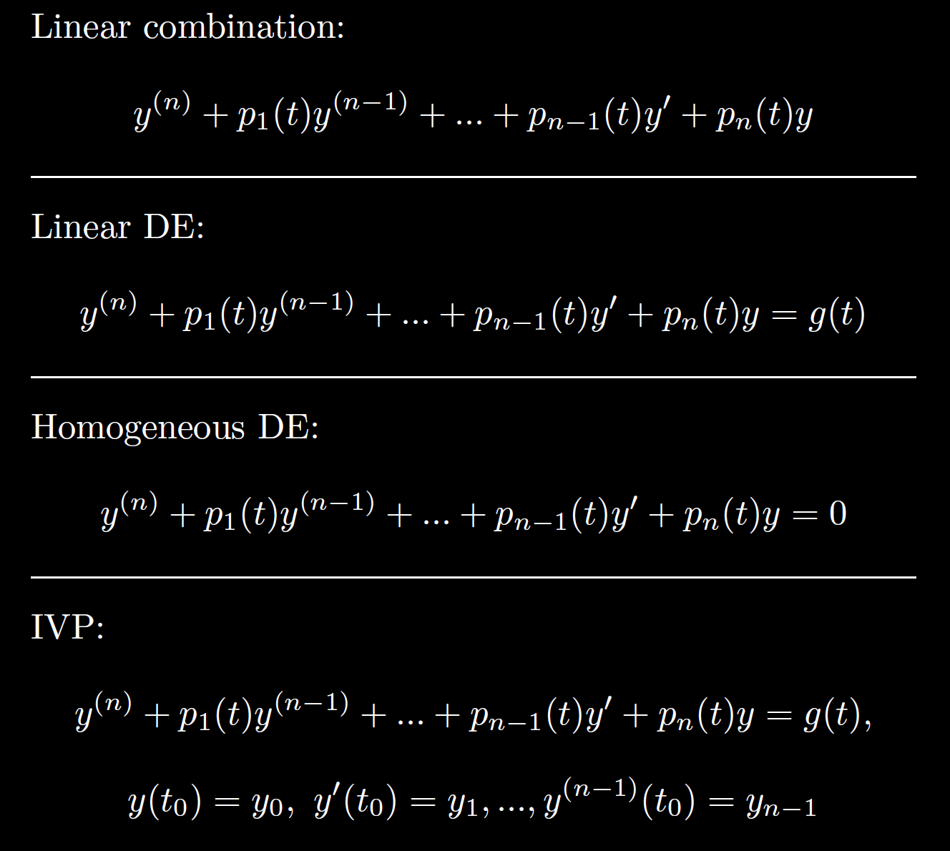

Slide 72
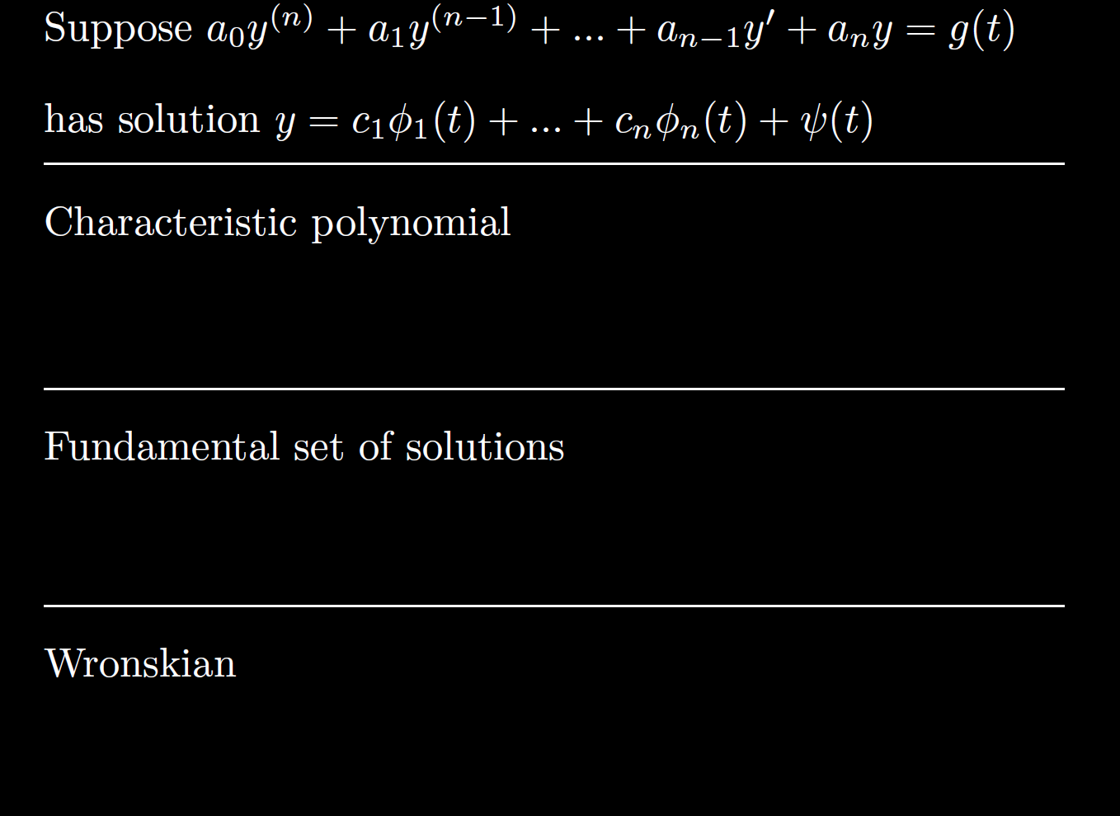

Slide 73


Slide 75
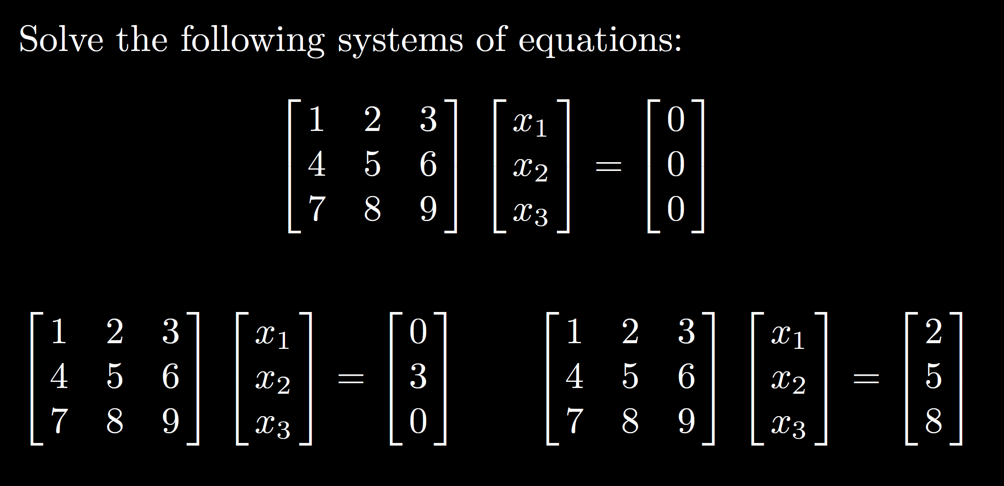

Slide 76
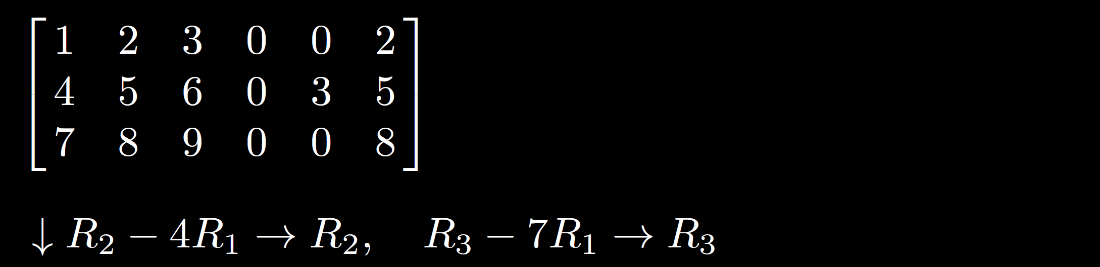
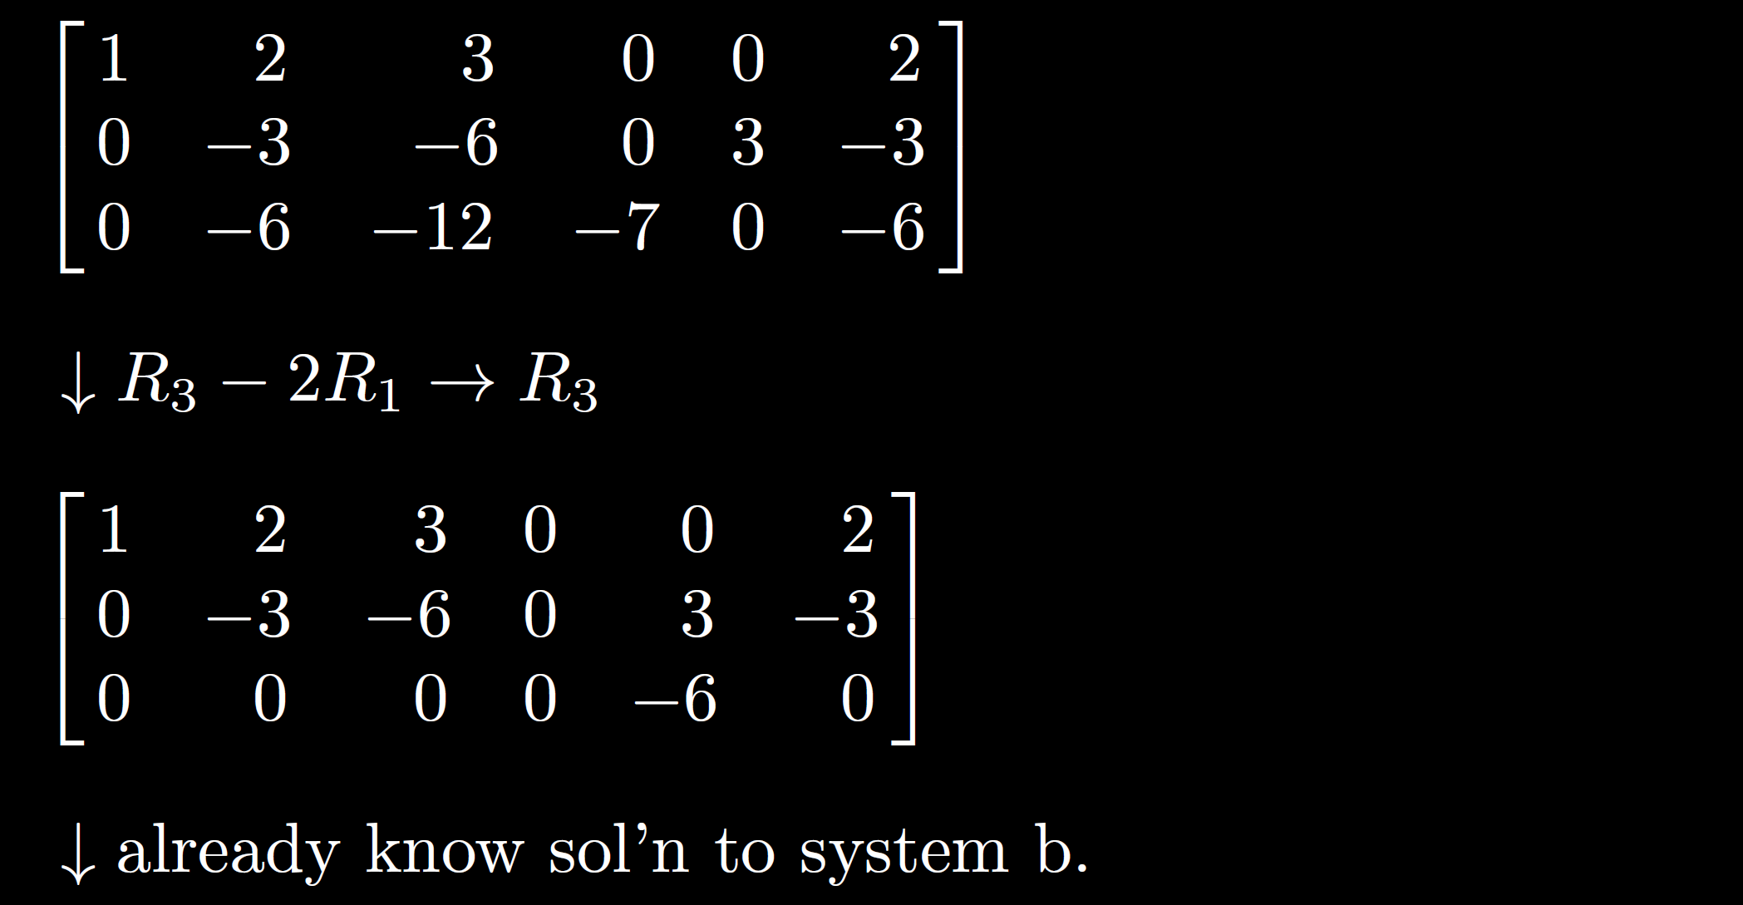

Slide 77
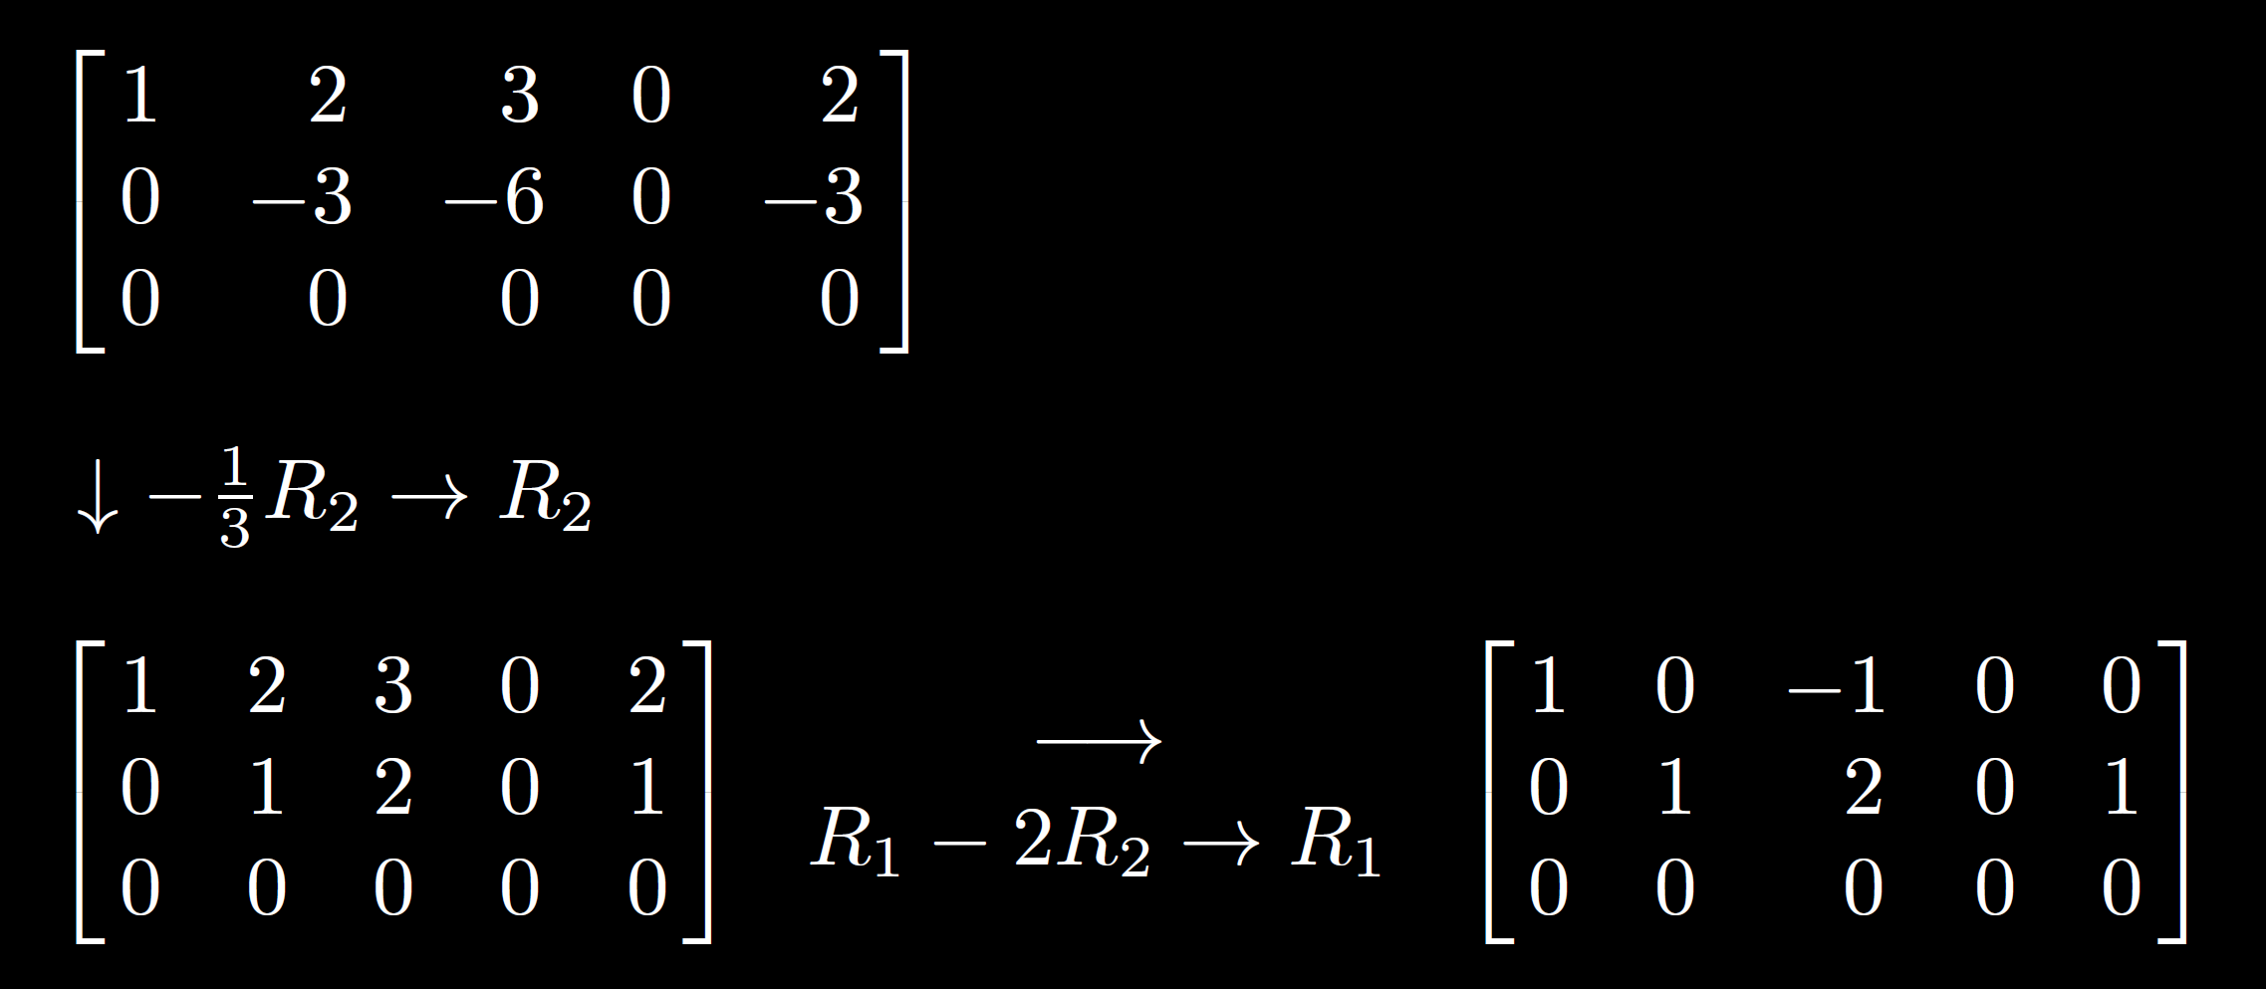

Slide 78
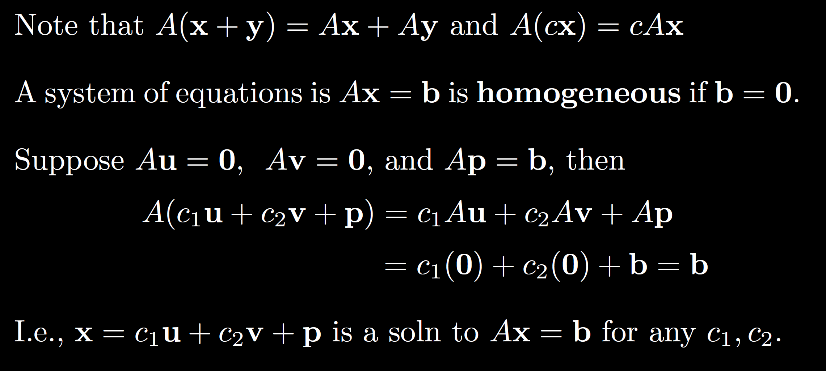

Slide 79
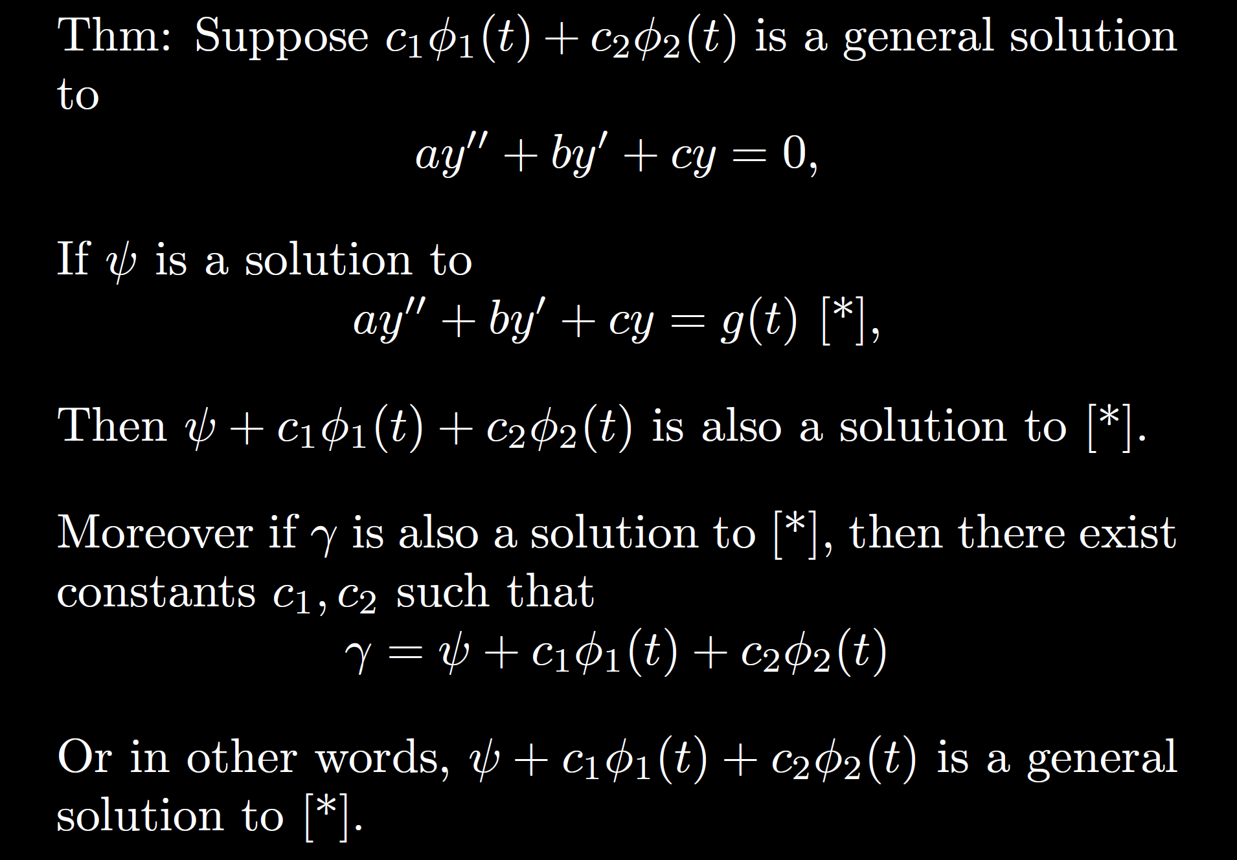

Slide 80
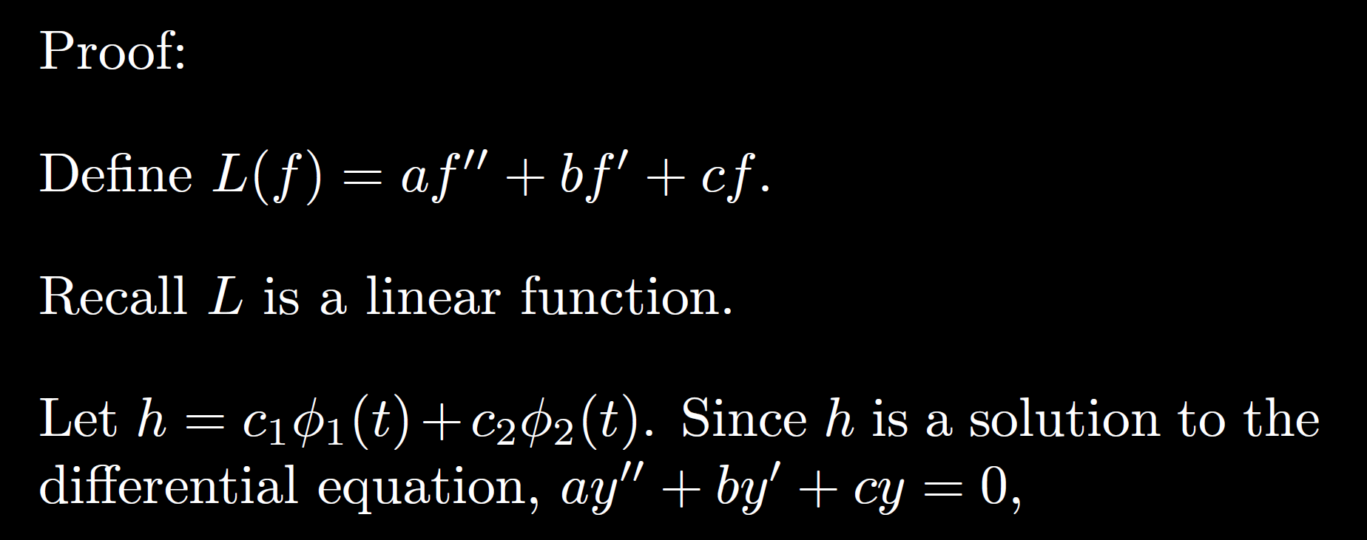

Slide 81
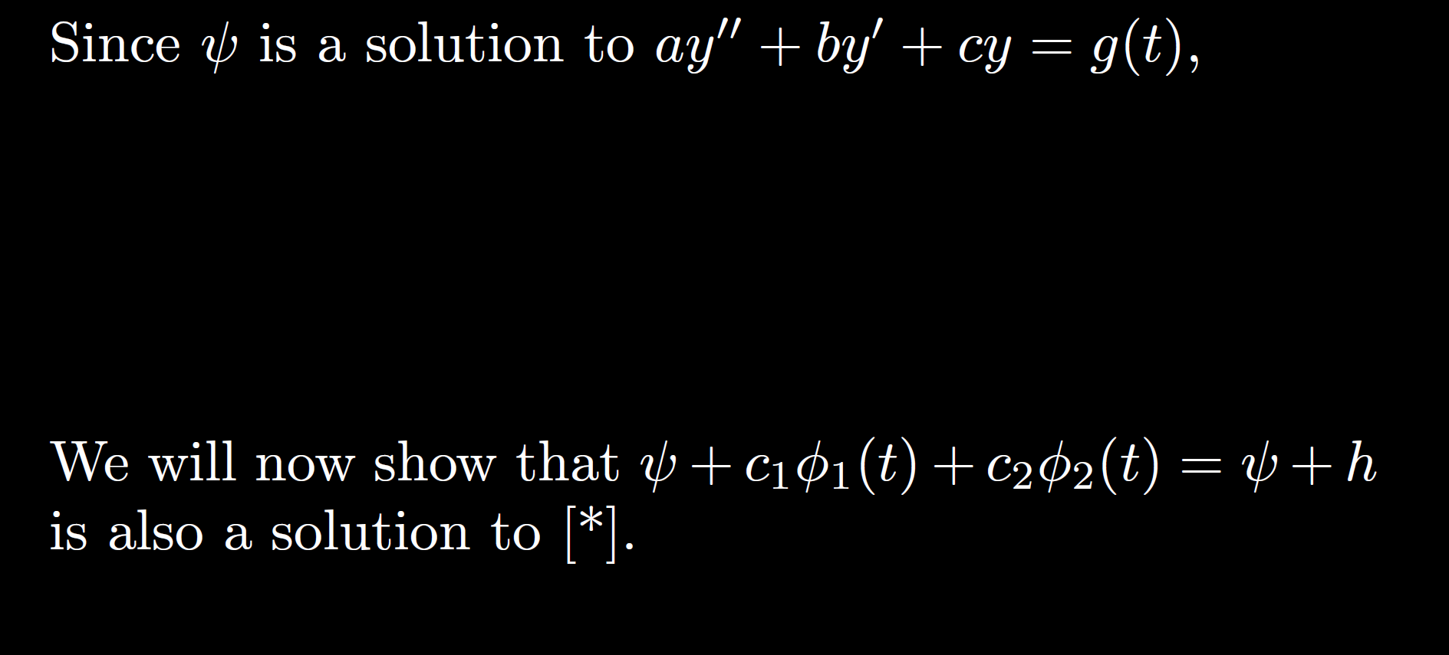

Slide 82
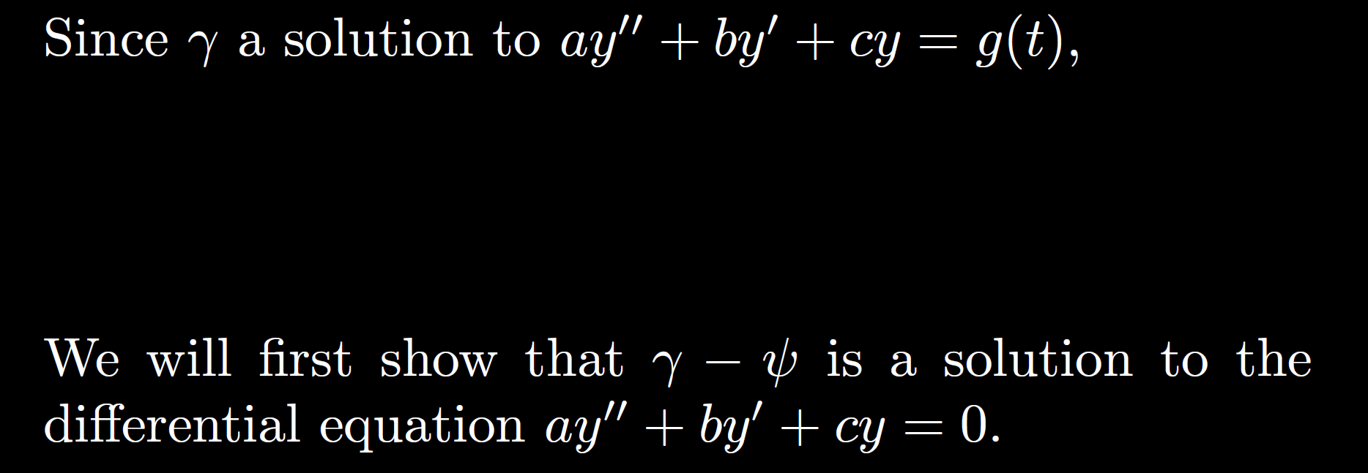

Slide 83
