Slide 4
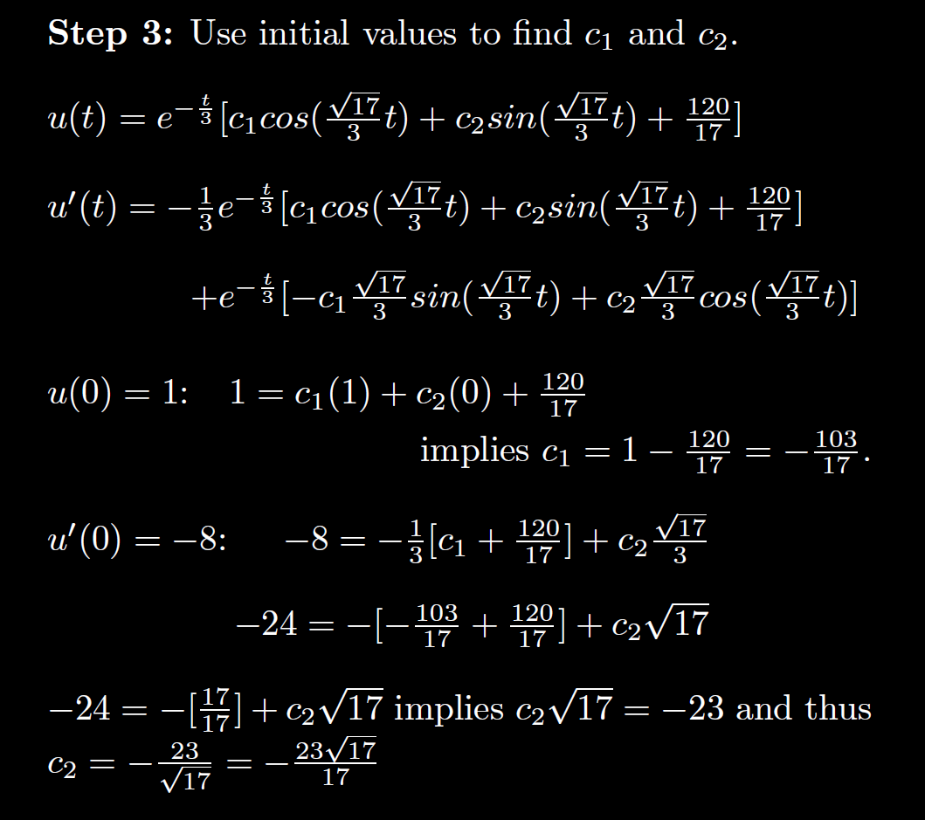

Slide 9
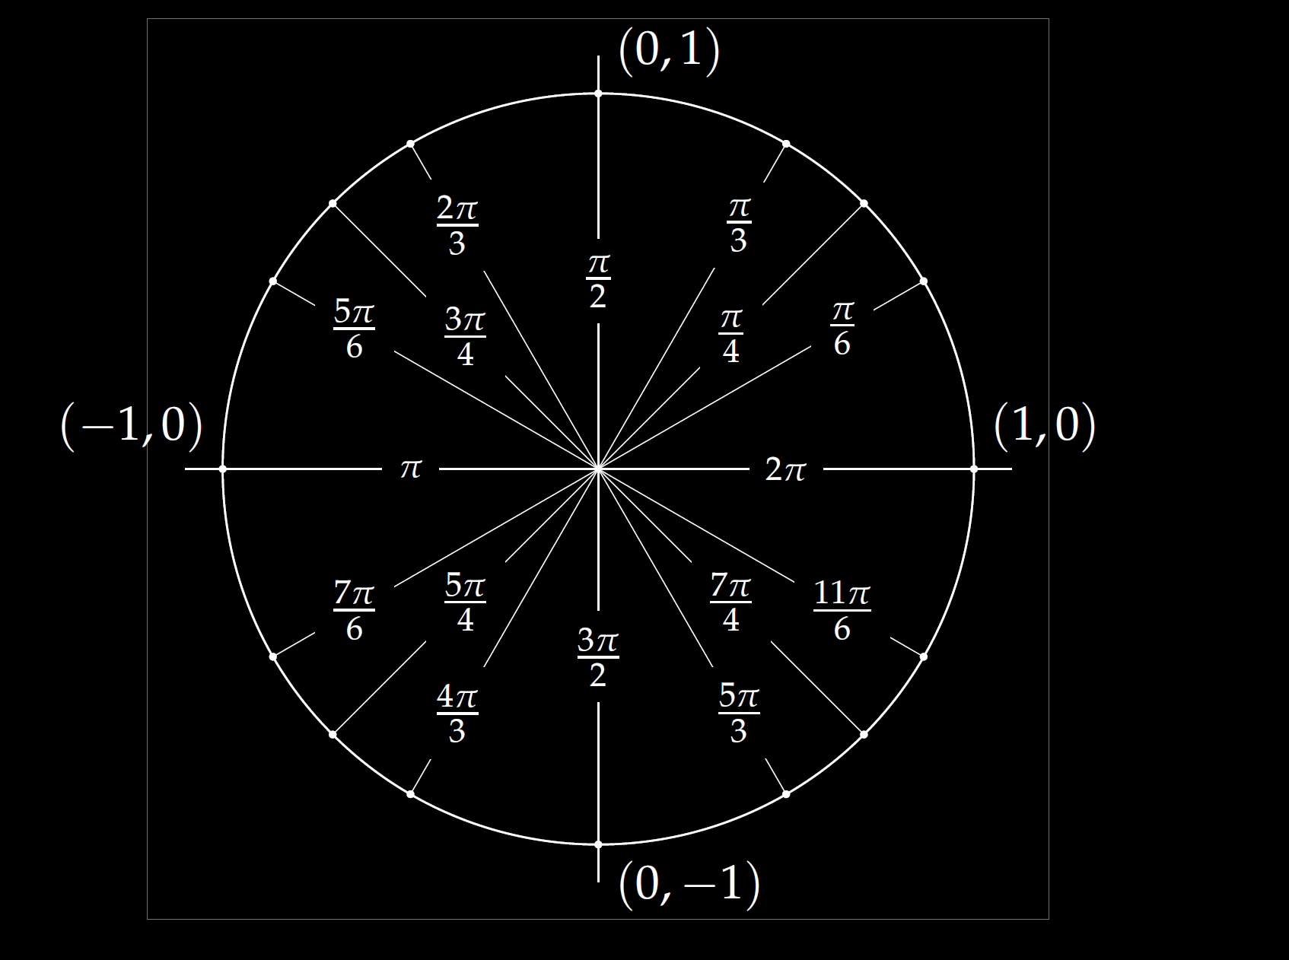

Slide 12
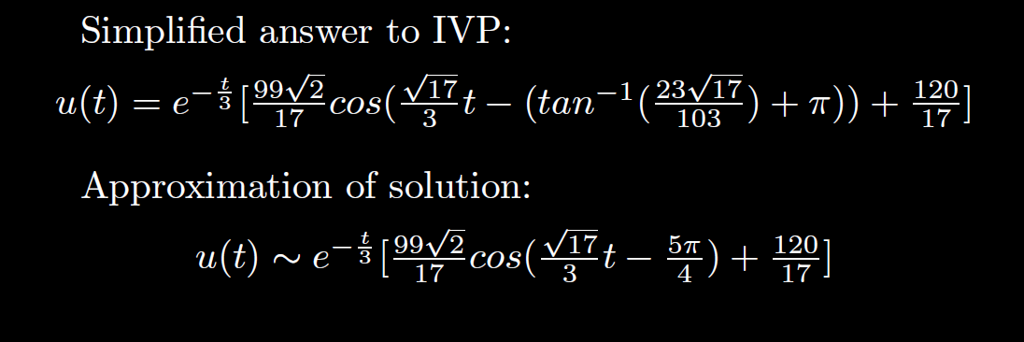

Slide 17
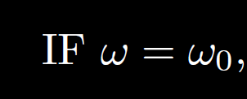

Slide 22
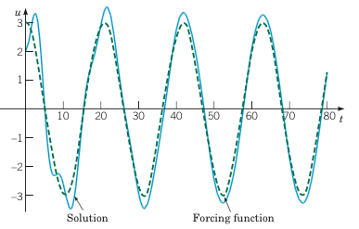
Example 2: Forced Vibrations with Damping (2 of 4)
Graphs of the solution, along with the graph of the ratios Rk/F vs. for .
Boyce/DiPrima/Meade 11th ed, Ch 3.8: Forced Periodic Vibrations

Slide 23
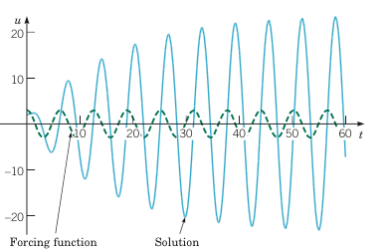
Example 2: Forced Vibrations with Damping (3 of 4)
Graphs of the solution, along with the graph of the ratios Rk/F vs. for .
Boyce/DiPrima/Meade 11th ed, Ch 3.8: Forced Periodic Vibrations

Slide 24
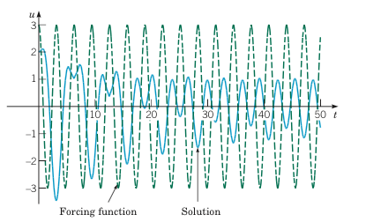
Example 2: Forced Vibrations with Damping (4 of 4)
Graphs of the solution, along with the graph of the ratios Rk/F vs. for .
Boyce/DiPrima/Meade 11th ed, Ch 3.8: Forced Periodic Vibrations

Slide 32
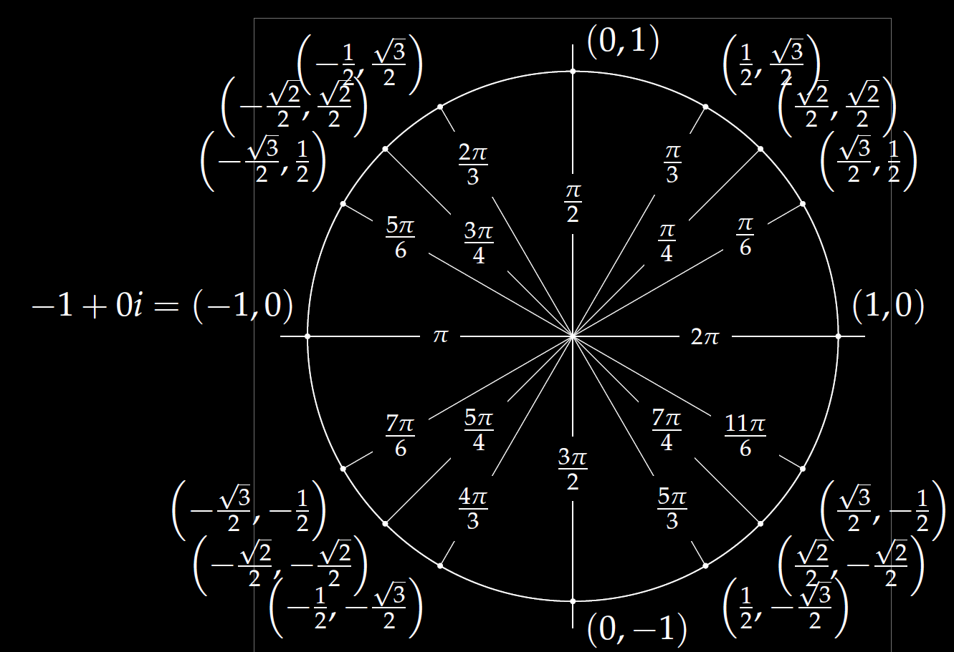
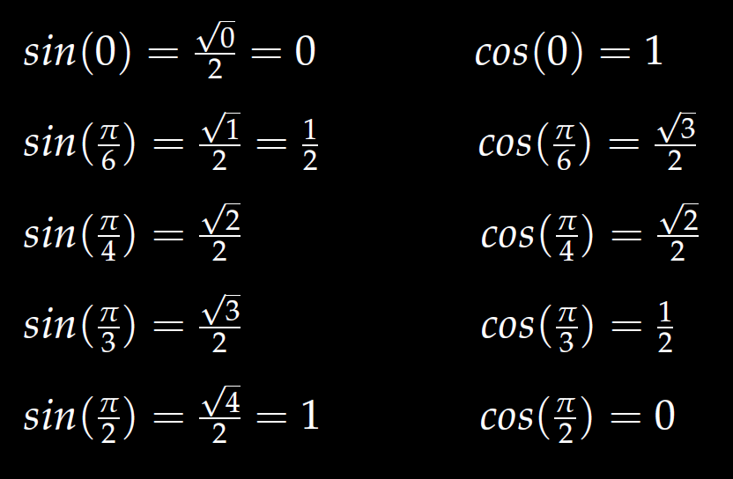
In special cases, you can use the unit circle.

Slide 49
Determine (without solving the problem) an interval in which the solution of the given initial value problem is certain to exist and be unique.
$$\left(1 − t\right)\left(1 + t^{2}\right)y^{′′′}+\ln\left|t − 5\right|y^{′}+2y = \sqrt{t+4} y(0) = 3$$

Slide 62
Linear Independence and the Wronskian

Slide 65
