Slide 1
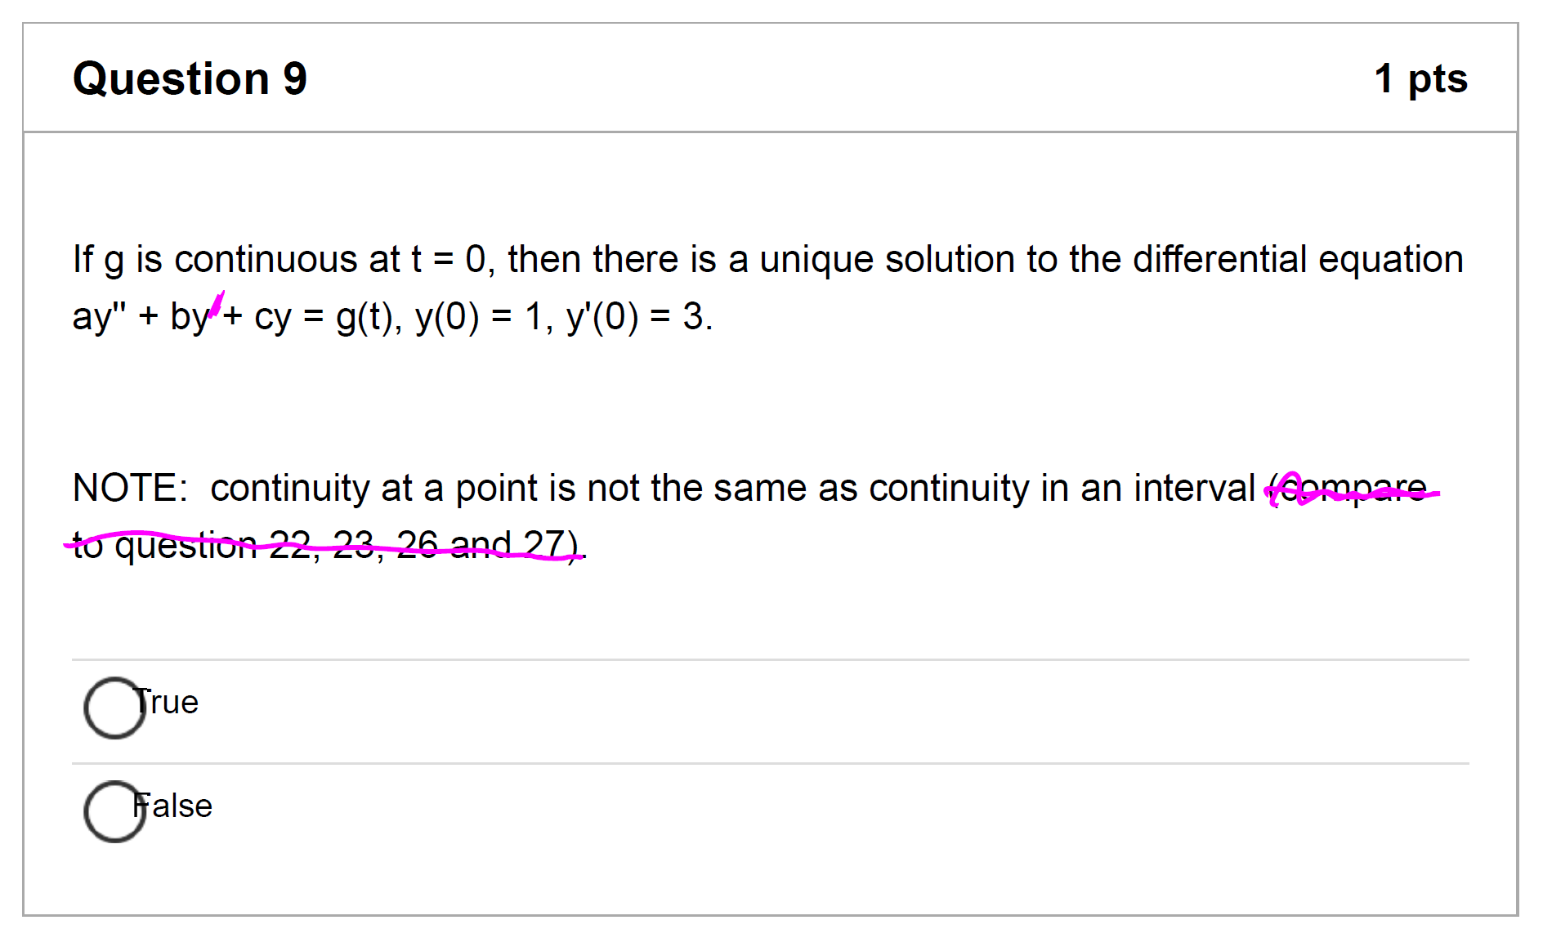
Typos on LS Quiz 5
Due Mar 24
See course announcement for pdf showing typos
plus a nicer multiple choice review with answers.

Slide 3
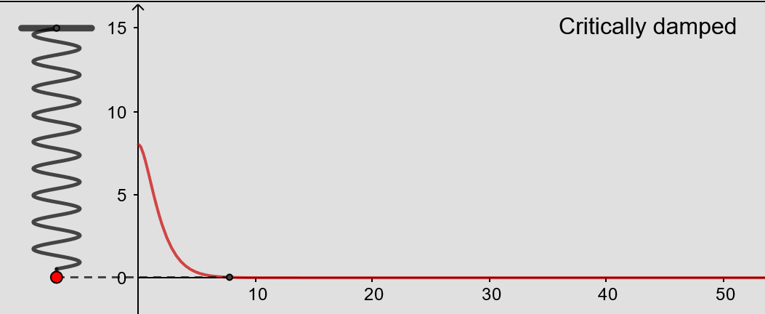
From https://www.geogebra.org/m/ZzKbkvnz
Note: Sign convention is opposite our convention

Slide 4
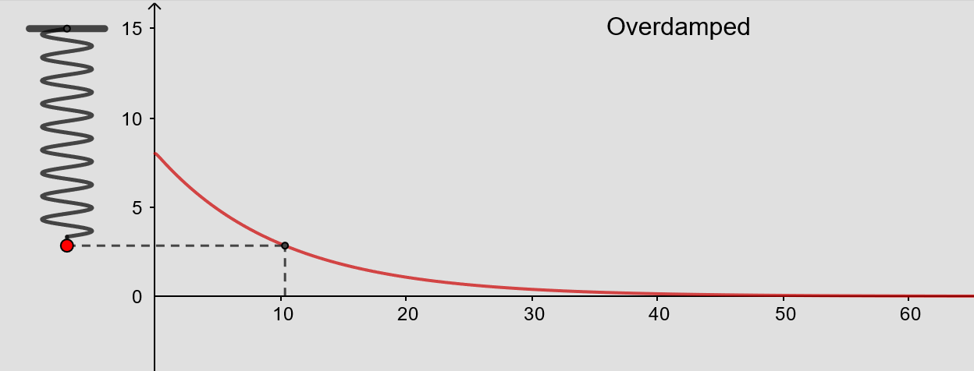
From https://www.geogebra.org/m/ZzKbkvnz
Note: Sign convention is opposite our convention

Slide 5
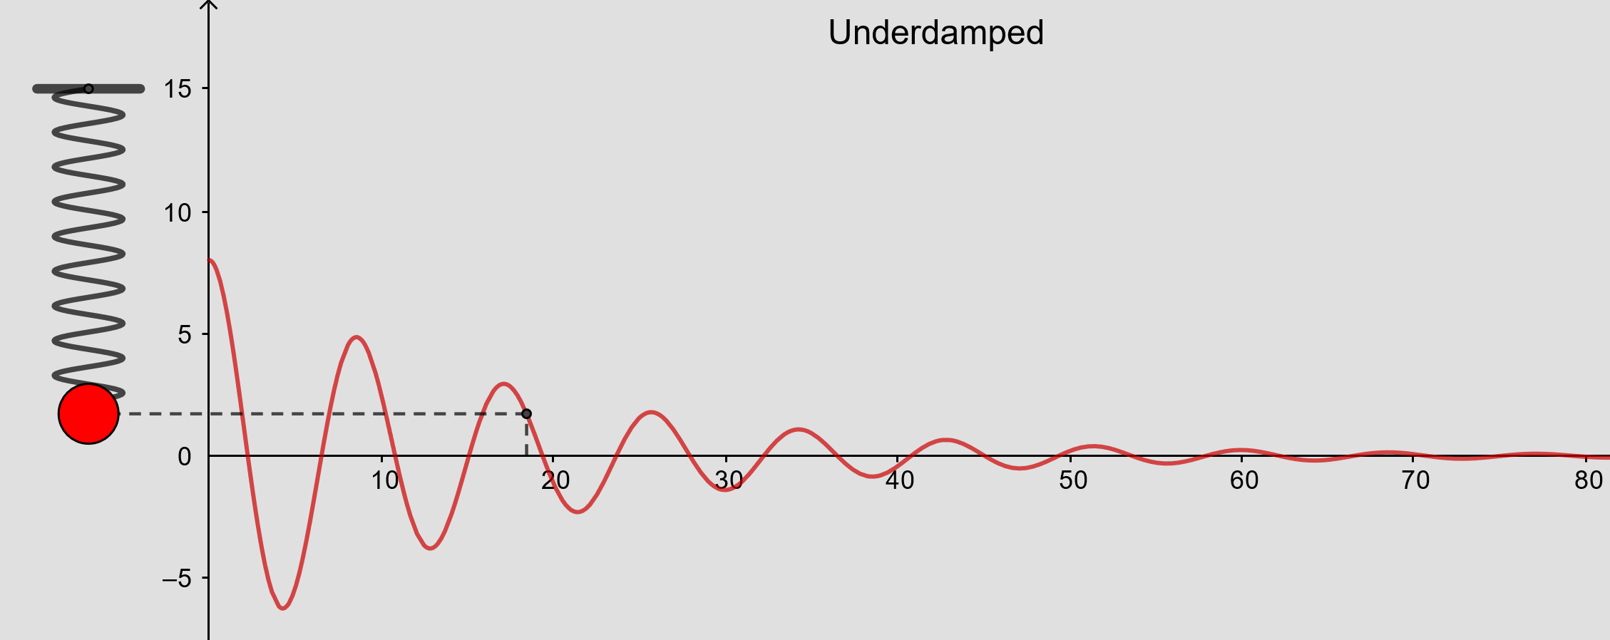
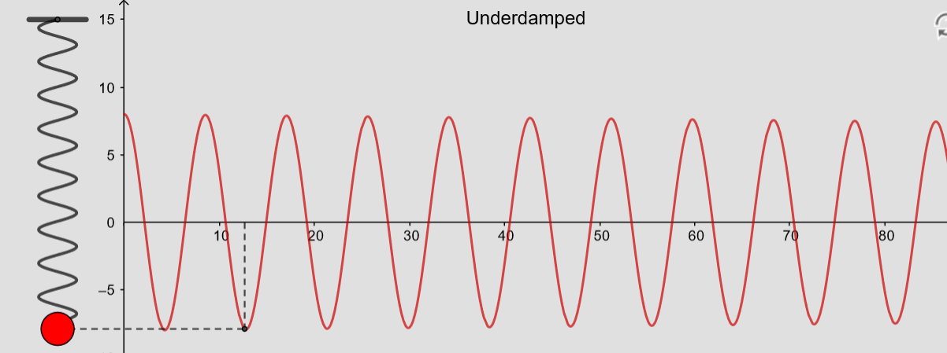
From https://www.geogebra.org/m/ZzKbkvnz
Note: Sign convention is opposite our convention

Slide 6
From https://www.geogebra.org/m/ZzKbkvnz
Note: Sign convention is opposite our convention

Slide 7
From https://www.geogebra.org/m/ZzKbkvnz
Note: Sign convention is opposite our convention
From https://www.geogebra.org/m/ZzKbkvnz
Note: Sign convention is opposite our convention

Slide 9
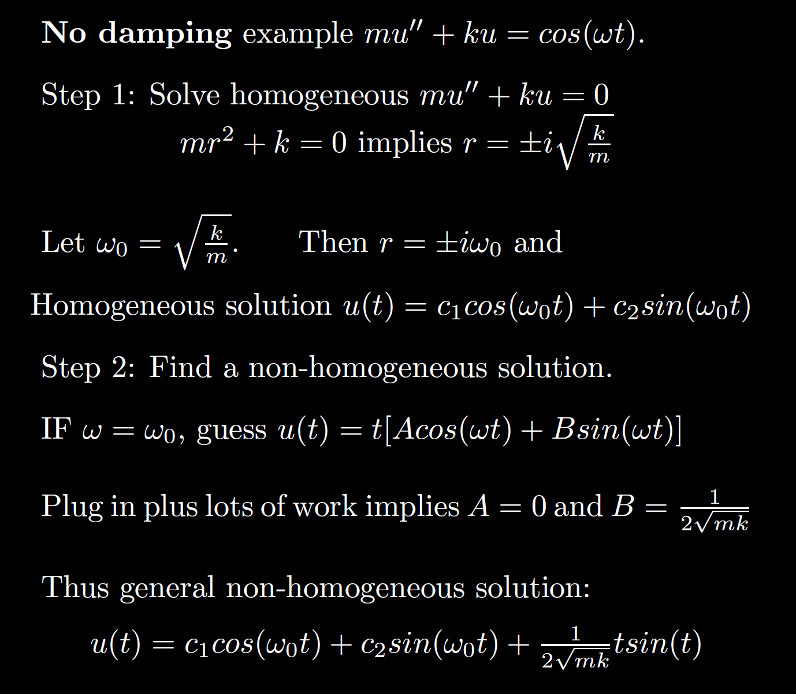
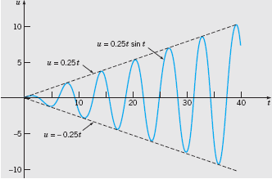
Boyce/DiPrima/Meade 11th ed, Ch 3.8: Forced Periodic Vibrations

Slide 14
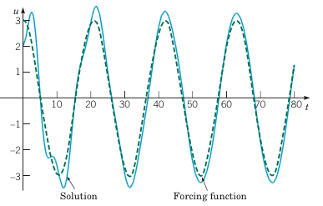
Example 2: Forced Vibrations with Damping (2 of 4)
Graphs of the solution and external force for .
Boyce/DiPrima/Meade 11th ed, Ch 3.8: Forced Periodic Vibrations

Slide 15
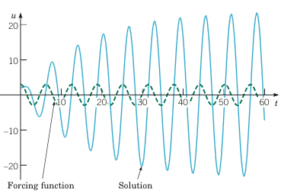
Example 2: Forced Vibrations with Damping (3 of 4)
Graphs of the solution and external force for
Boyce/DiPrima/Meade 11th ed, Ch 3.8: Forced Periodic Vibrations

Slide 16
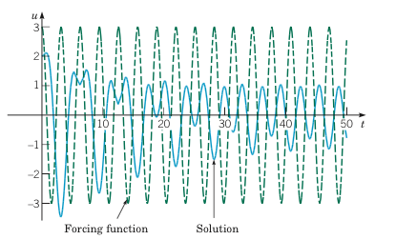
Example 2: Forced Vibrations with Damping (4 of 4)
Graphs of the solution and external force for
Boyce/DiPrima/Meade 11th ed, Ch 3.8: Forced Periodic Vibrations

