Slide 1
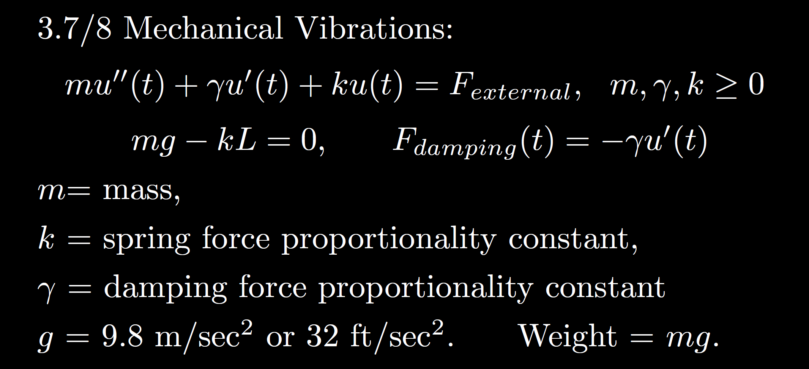
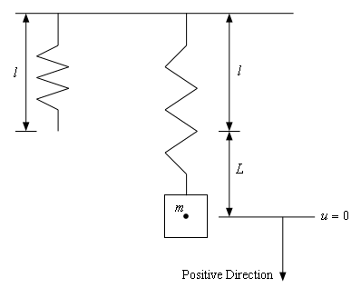
https://tutorial.math.lamar.edu/Classes/DE/Vibrations.aspx

Slide 12
