Slide 1
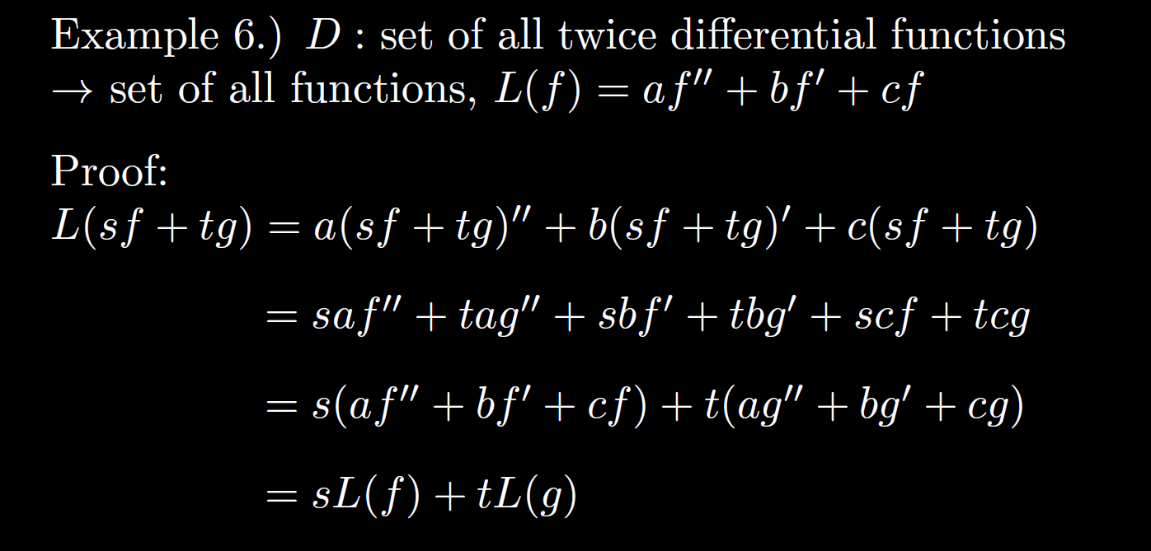

Slide 2
Office hours after class MWF. Zoom link available on ICON.
Tuesday office hours this week 1:30 – 2:25pm (will send zoom link.
You might get video quiz replacement points by
answering/asking questions via chat (if I can get python script to work).
LS and video quizzes will be graded based on “effort” with most earning 100%. One type of effort might be to answer/asking questions via chat.

Slide 4
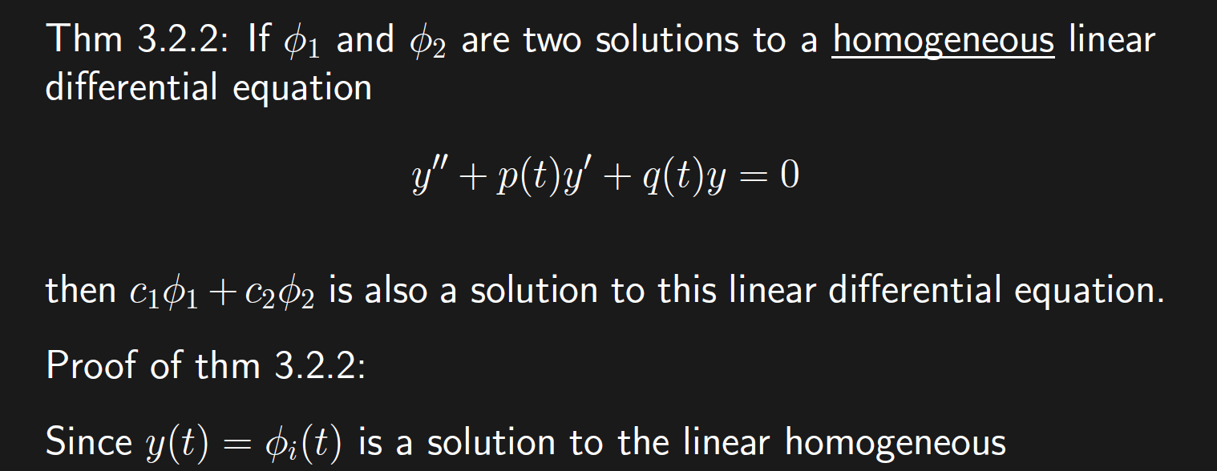

Slide 5
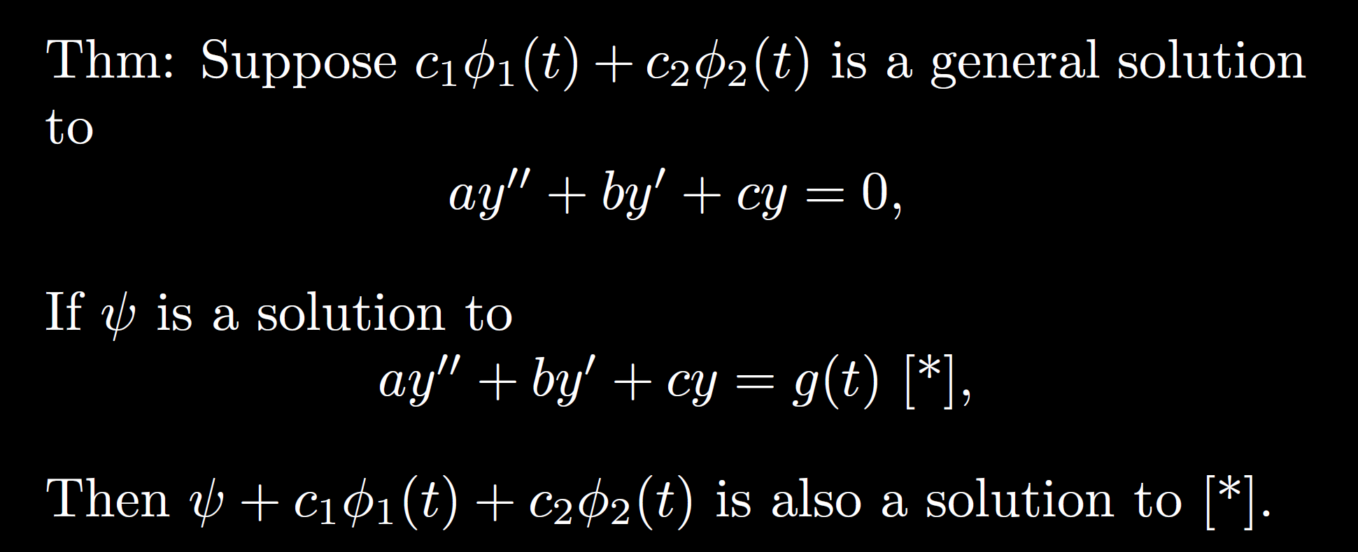

Slide 6
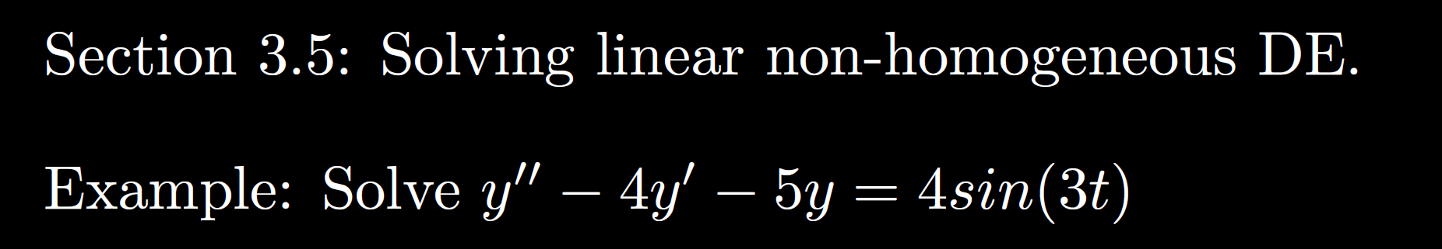
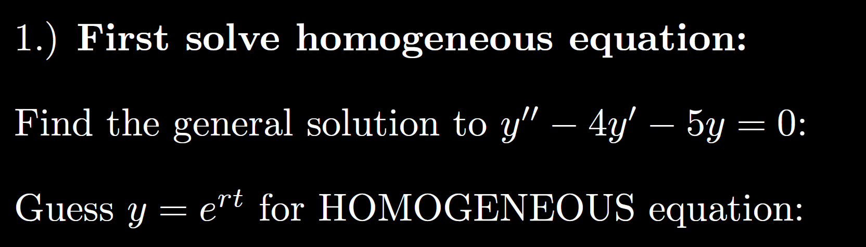

Slide 7
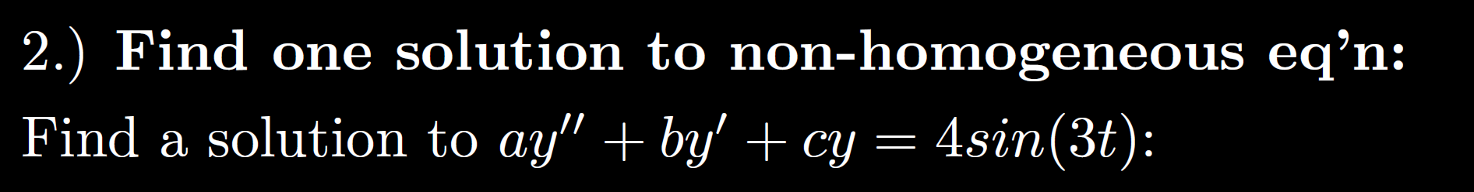

Slide 9
Possible exam question: Explain why y = Asin(3t) is a “bad” guess.
For partial credit, plug in.

Slide 10
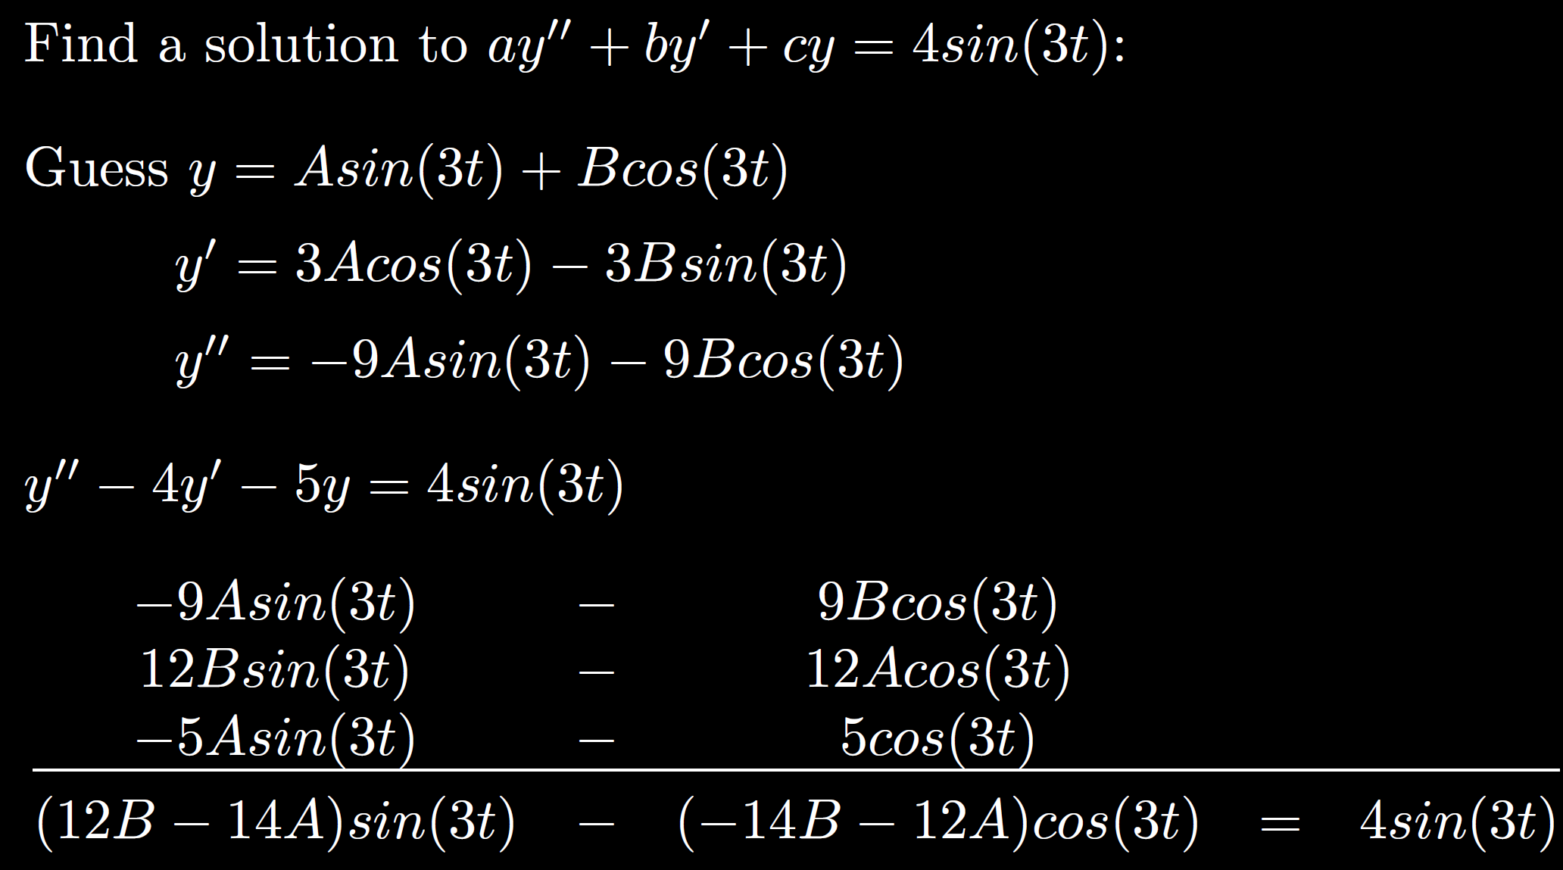

Slide 11
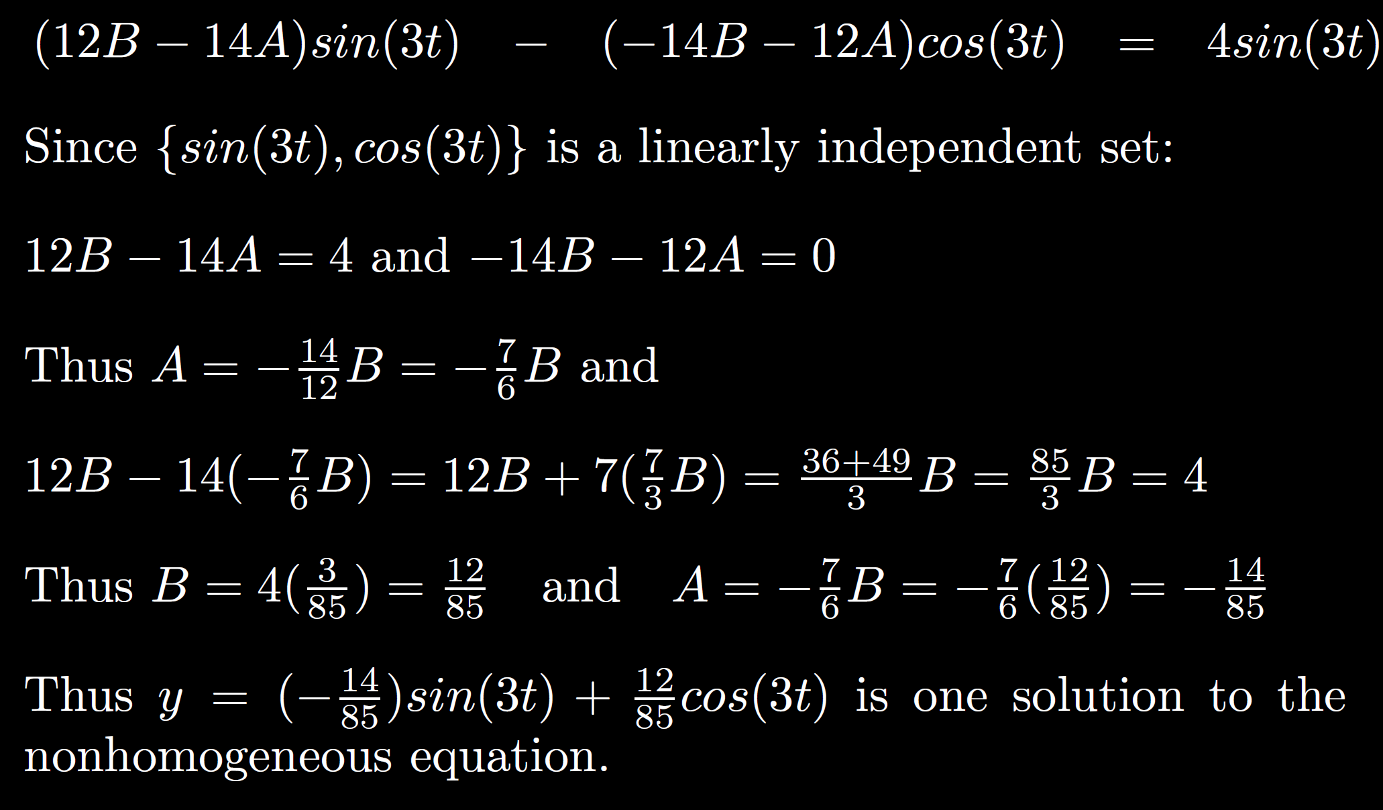

Slide 12
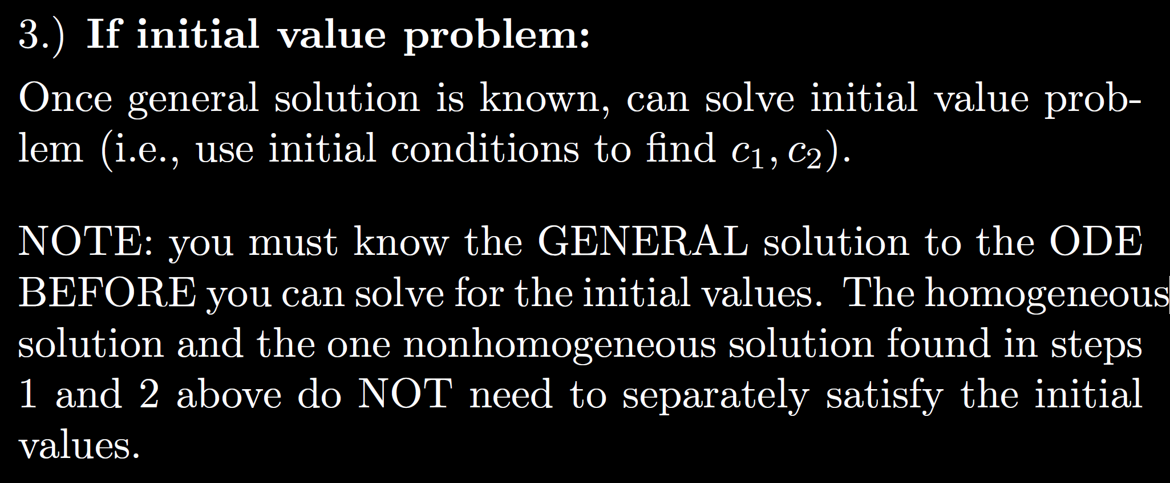

Slide 13
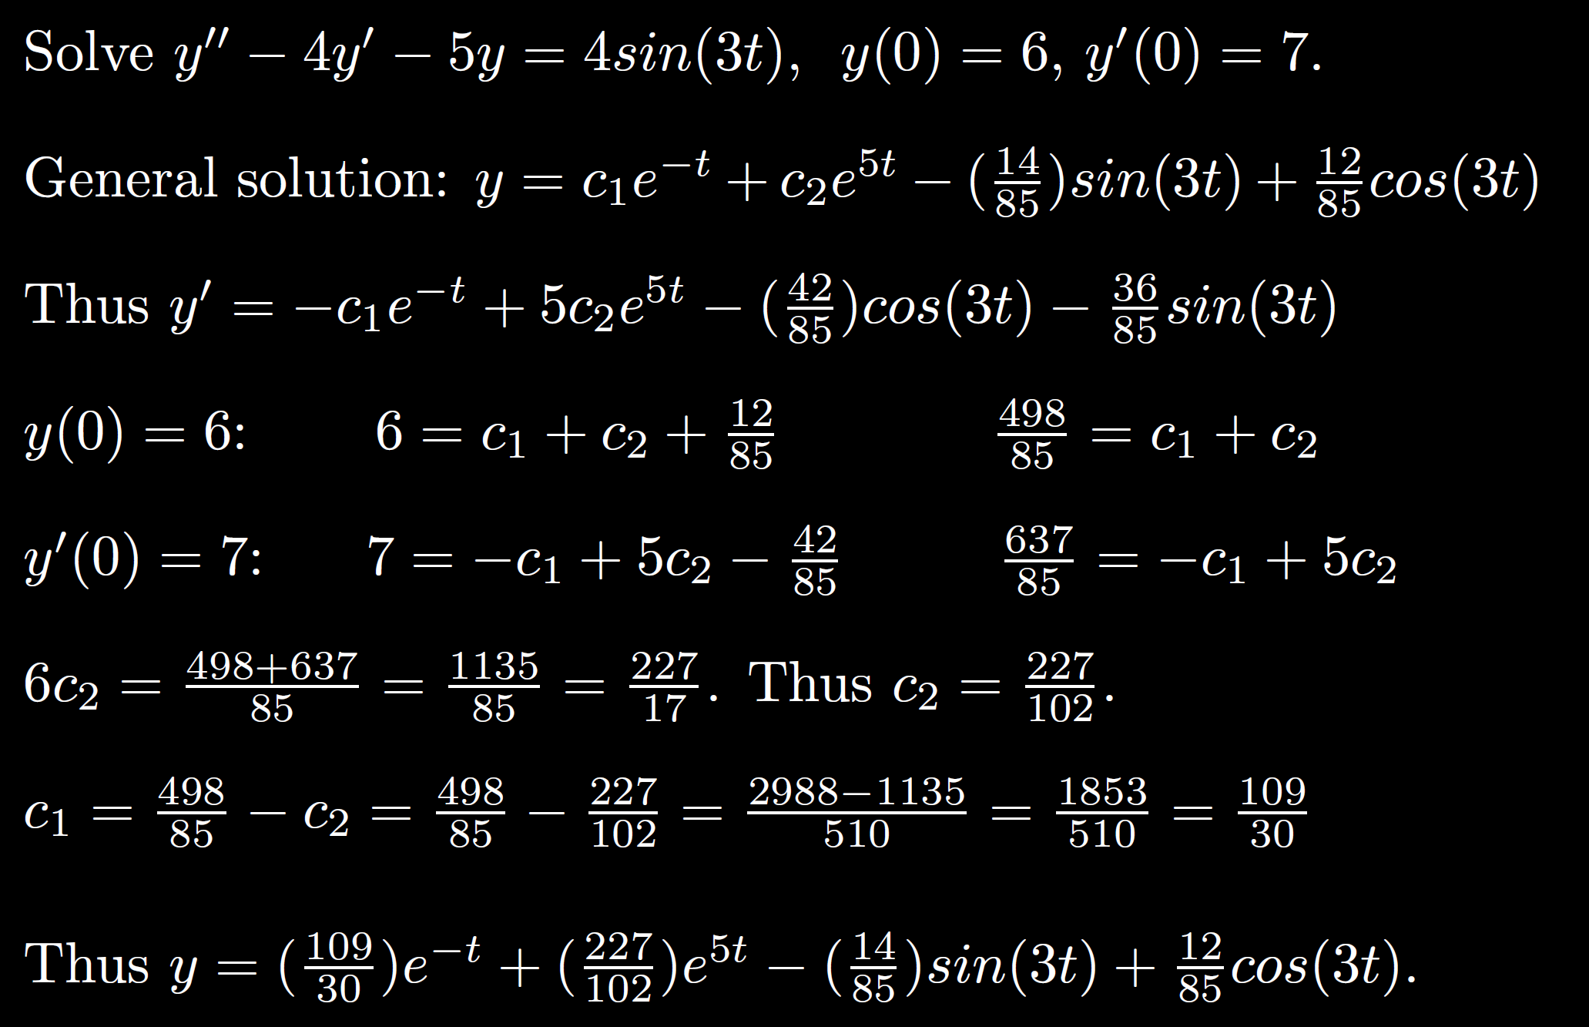

Slide 14
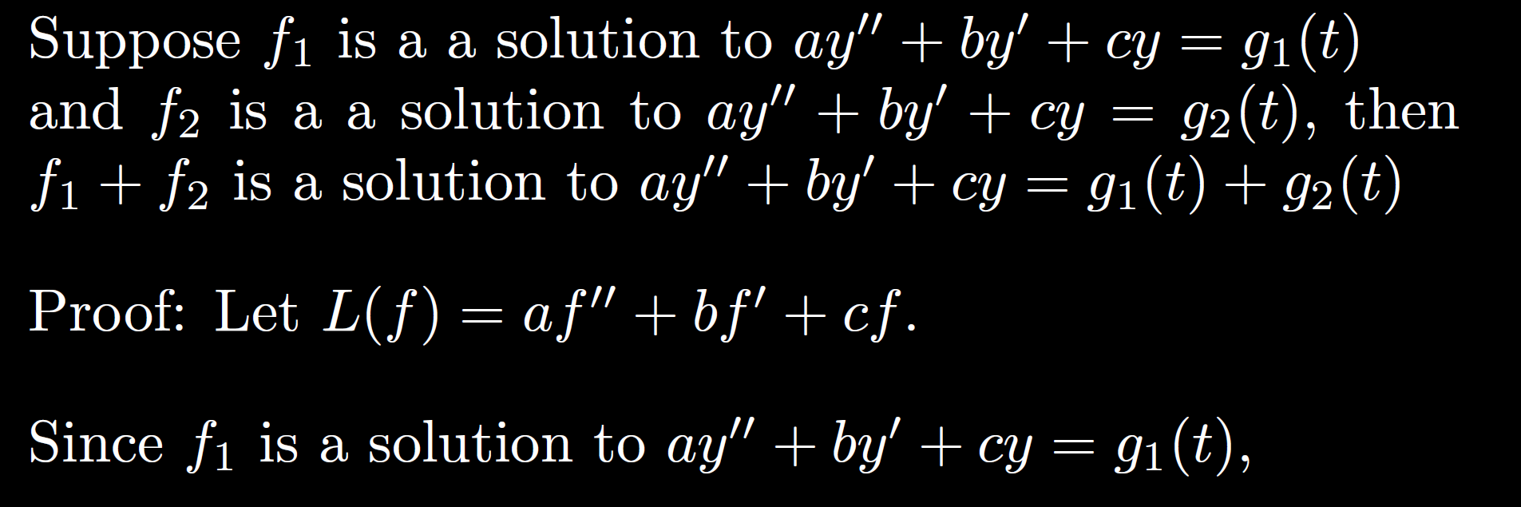
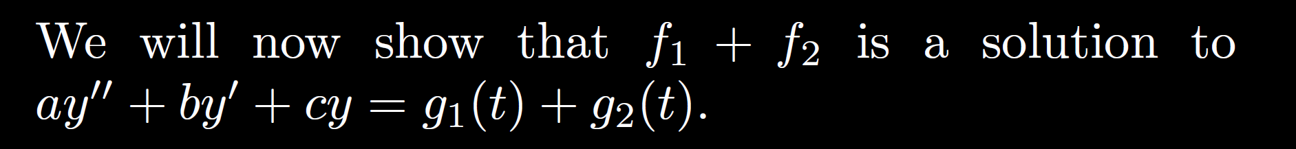

Slide 15
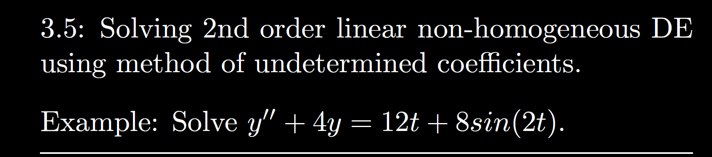
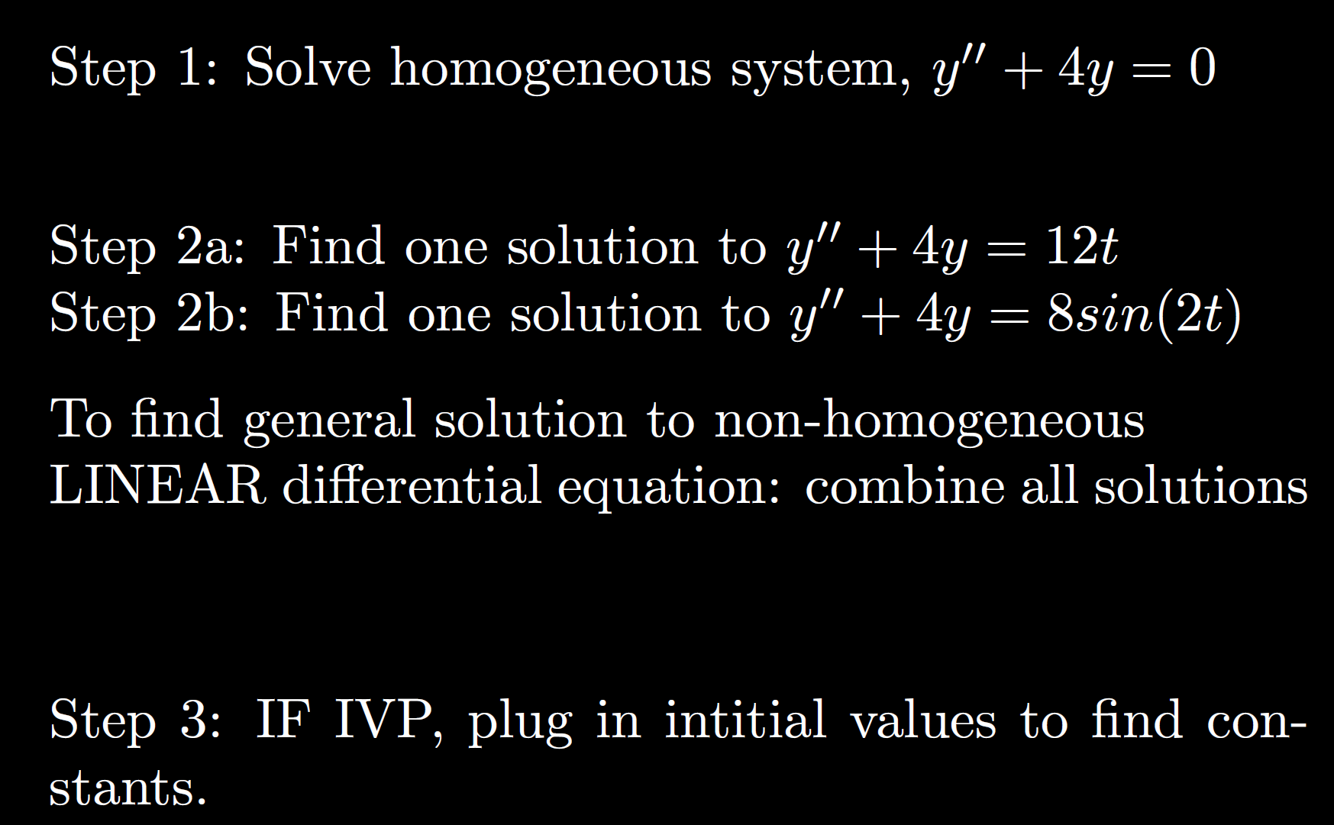

Slide 17
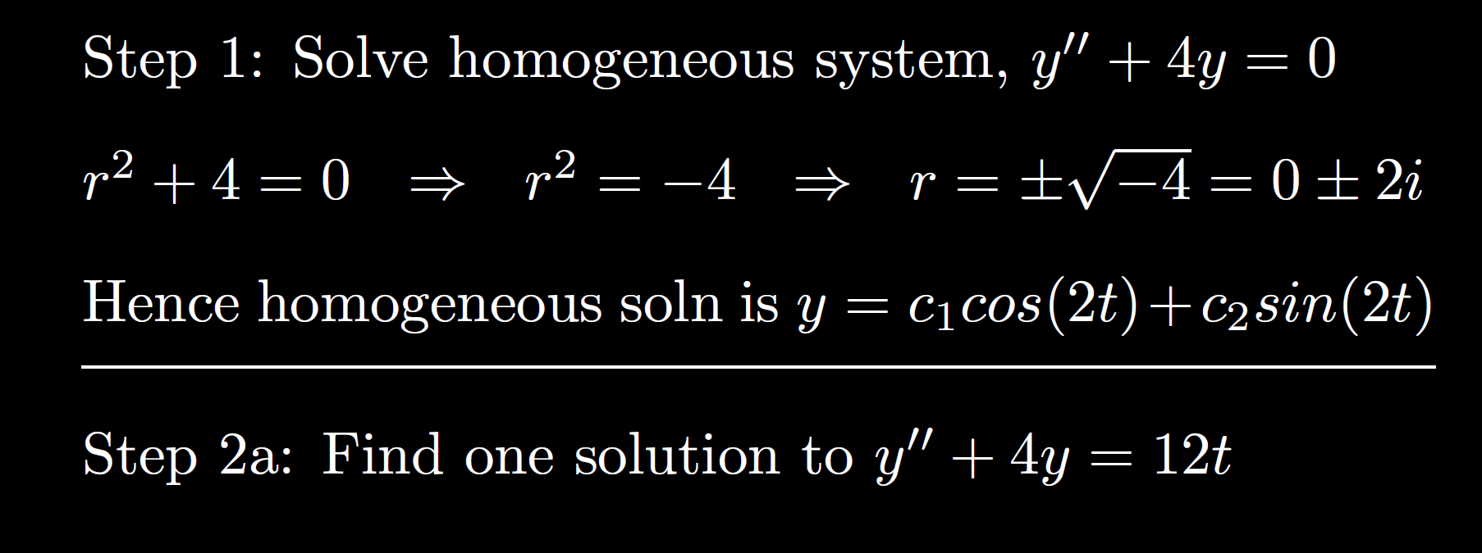

Slide 19
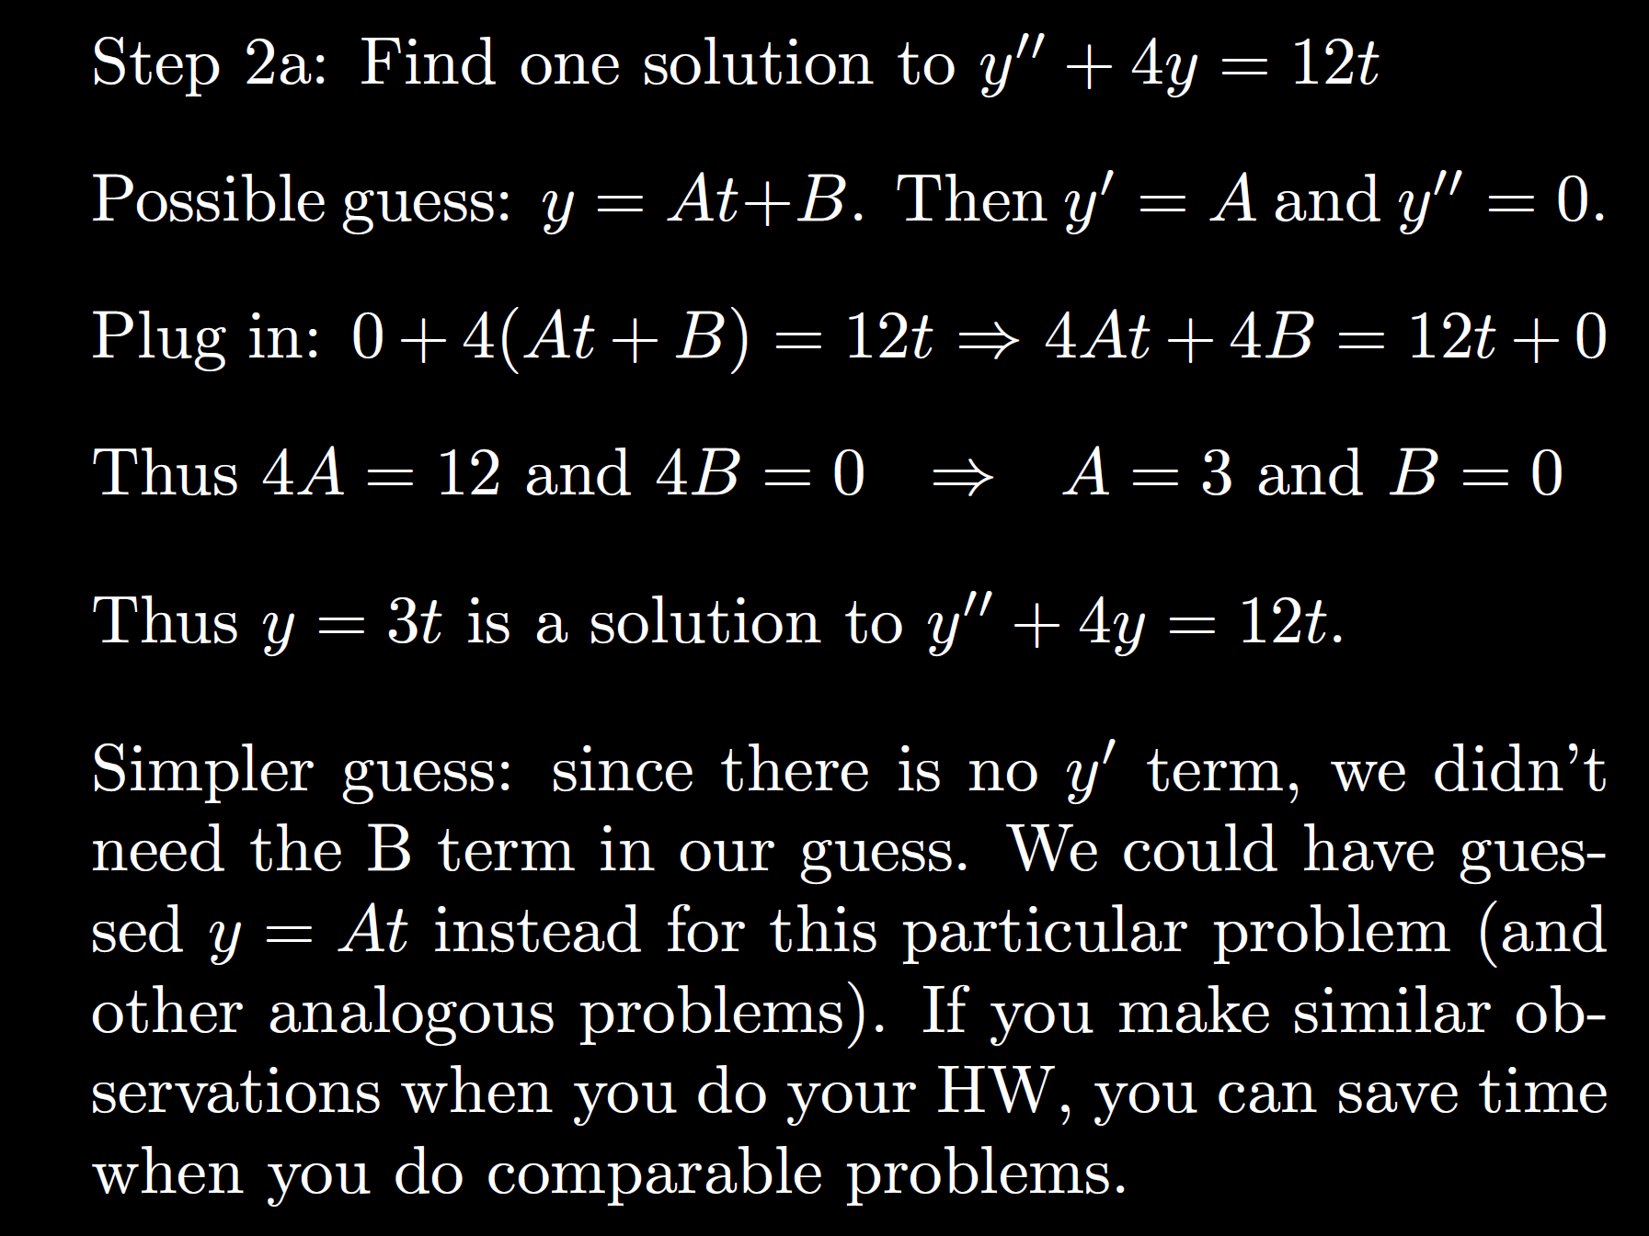

Slide 20
Possible exam question: Explain why you don’t need constant term.
For partial credit, plug in y = At + B and/or y = At.
Explain difference for full credit.

Slide 21
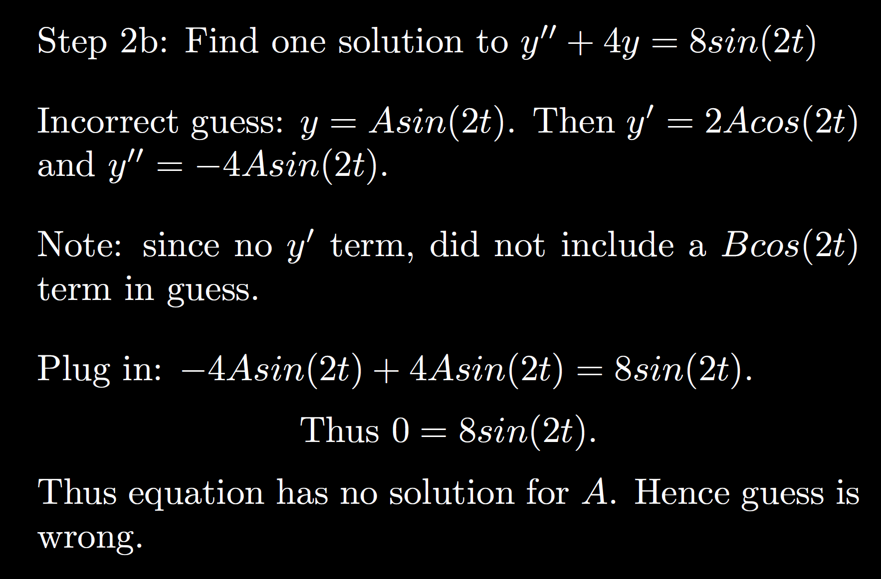

Slide 22
Possible exam question: Explain why

Slide 23
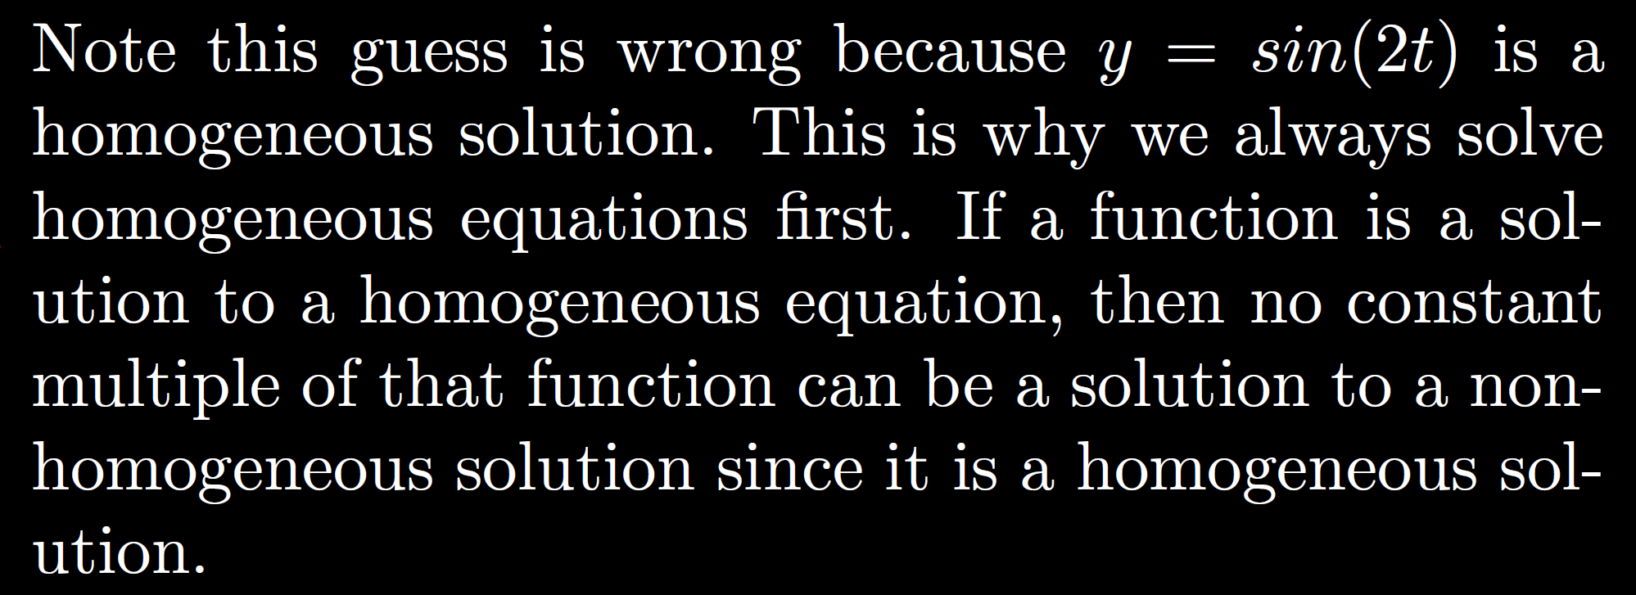

Slide 25
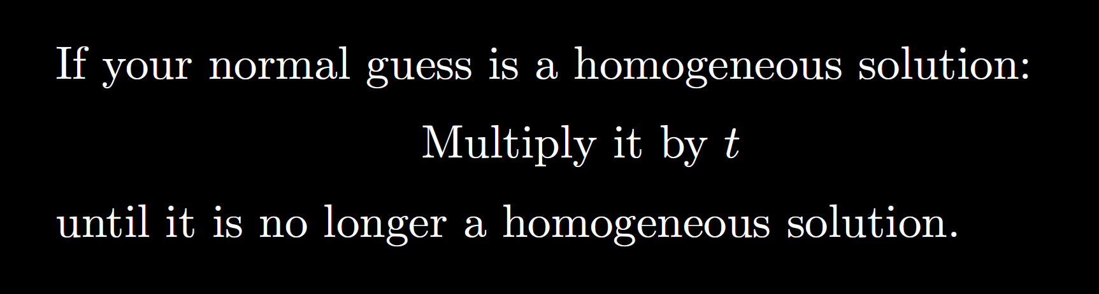

Slide 27
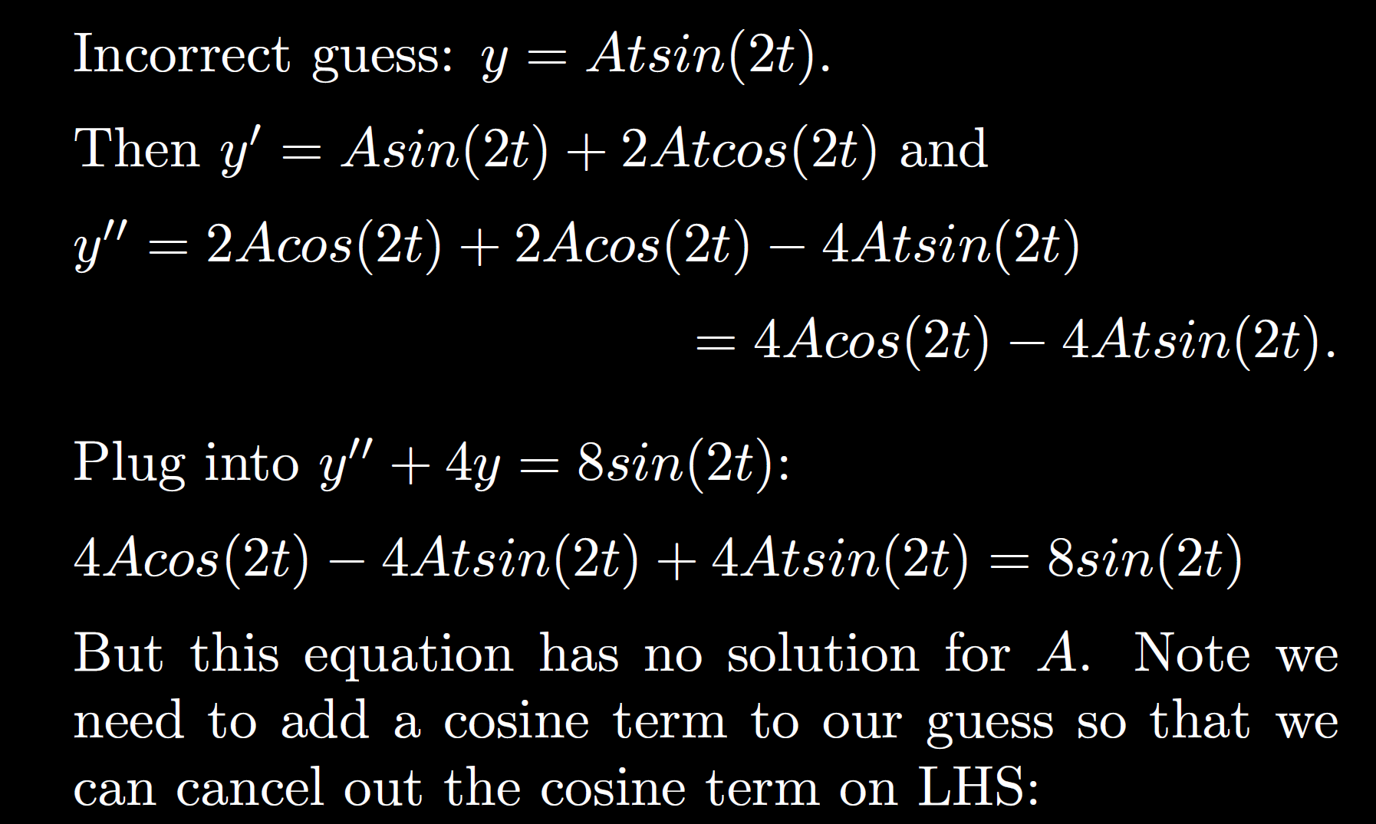

Slide 29
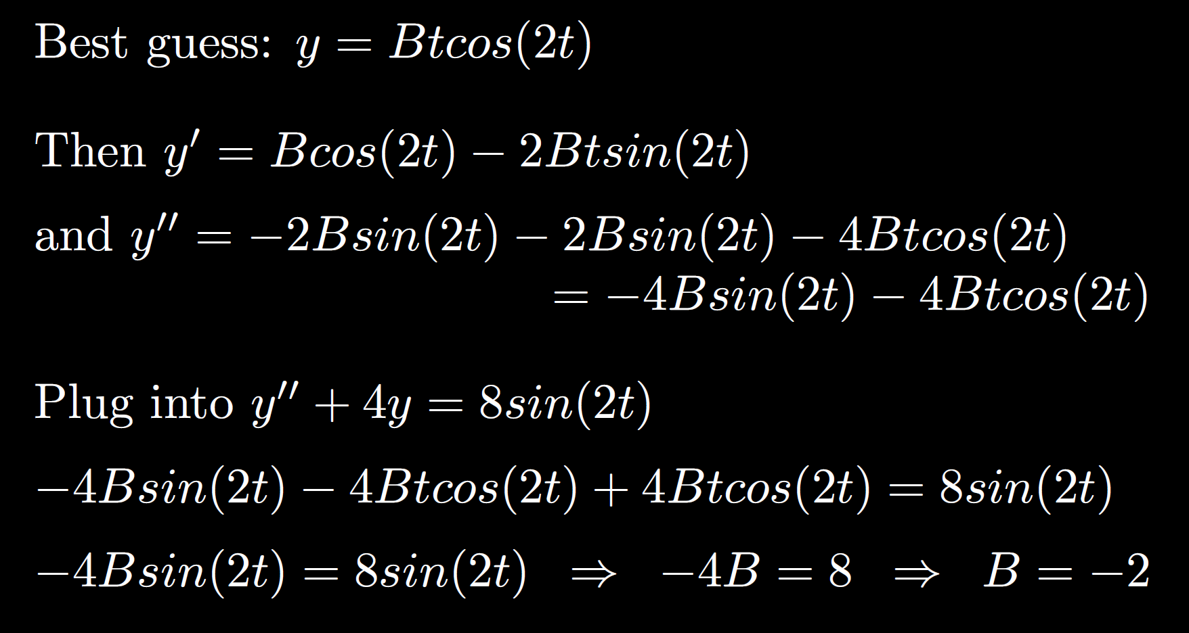

Slide 30
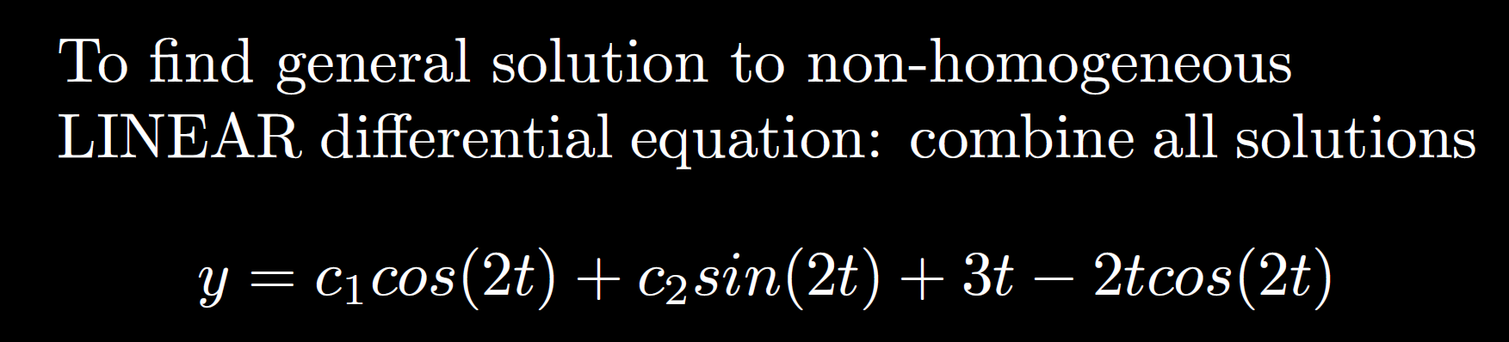

Slide 31
