Slide 20
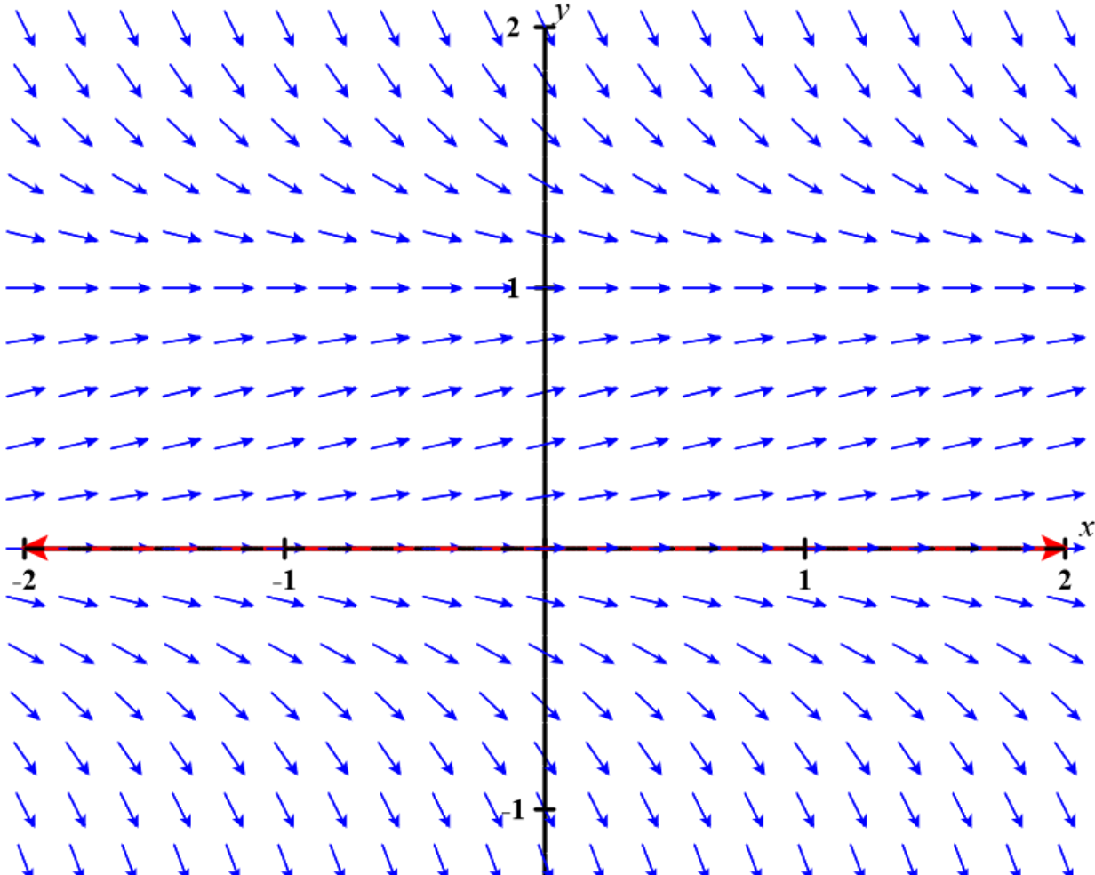
https://c3d.libretexts.org/DirectionField/index.html

Slide 21
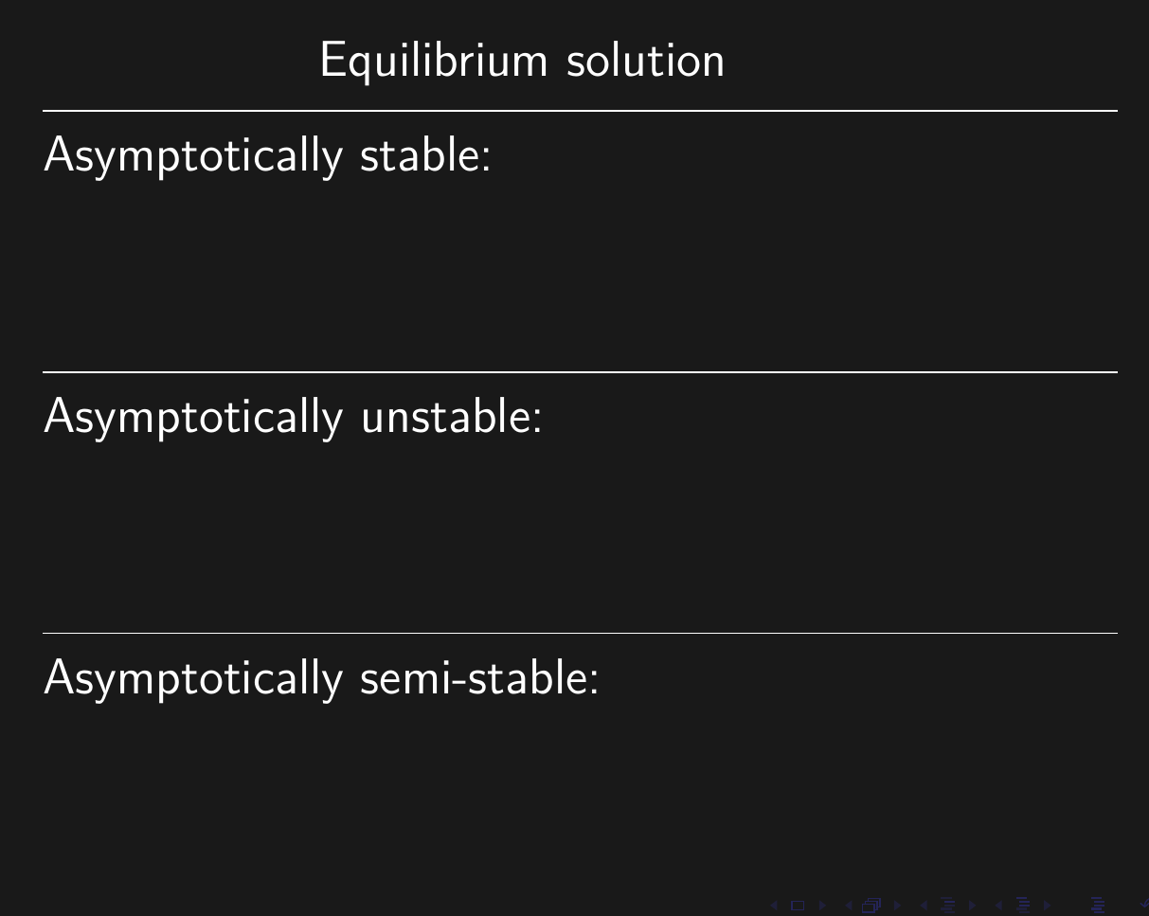

Slide 22
https://c3d.libretexts.org/DirectionField/index.html

