Slide 1
As discussed in class on Monday, several people would like to move the exam 1 date. Thus please fill out the survey at the link below to determine if we should change the exam 1 date, and if we change it, what day(s) work for you: See e-mail for URL Please submit the survey by Thursday night, so that I can announce the results on Friday.
All exams will be held during our normally scheduled time. Exams 1 - 3 should take 50 minutes or less to take and scan in your answers (if you have scanning issues, please let me know). If you have any questions, concerns, suggestions, etc. please let me know.

Slide 2
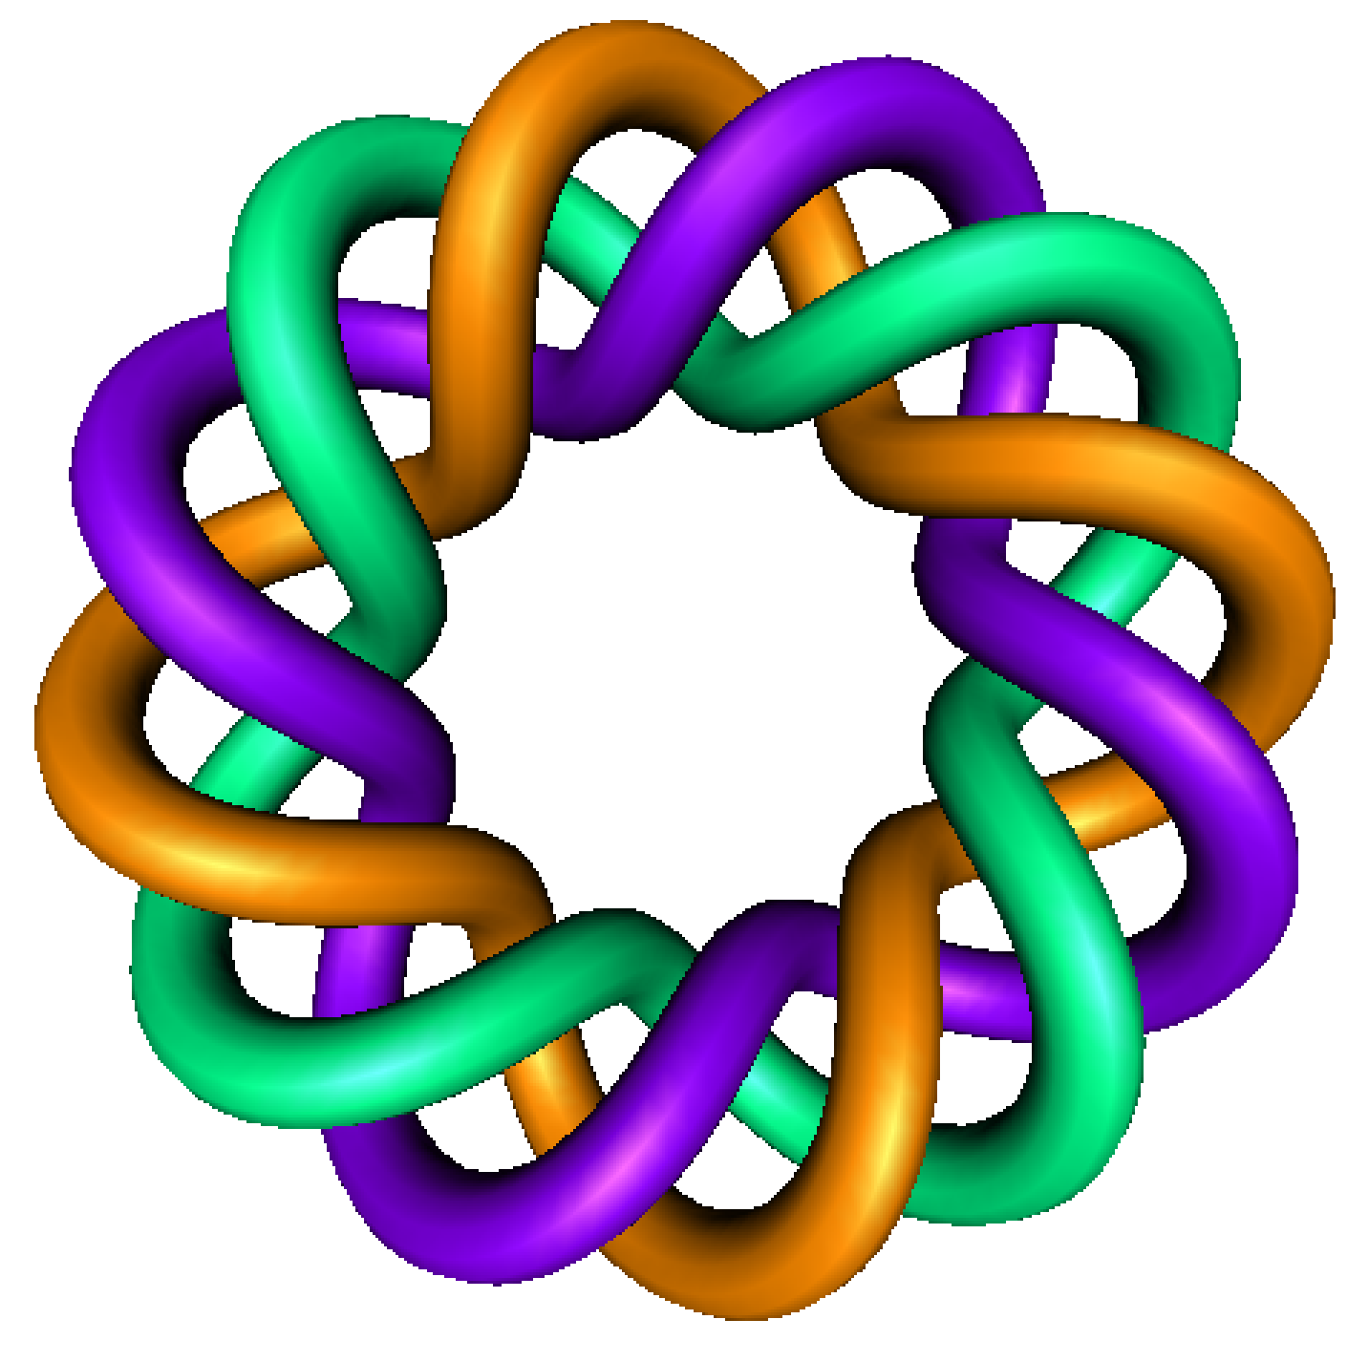
Existence and Uniqueness
By Dr. Isabel Darcy,
Dept of Mathematics and AMCS,
University of Iowa

Slide 7
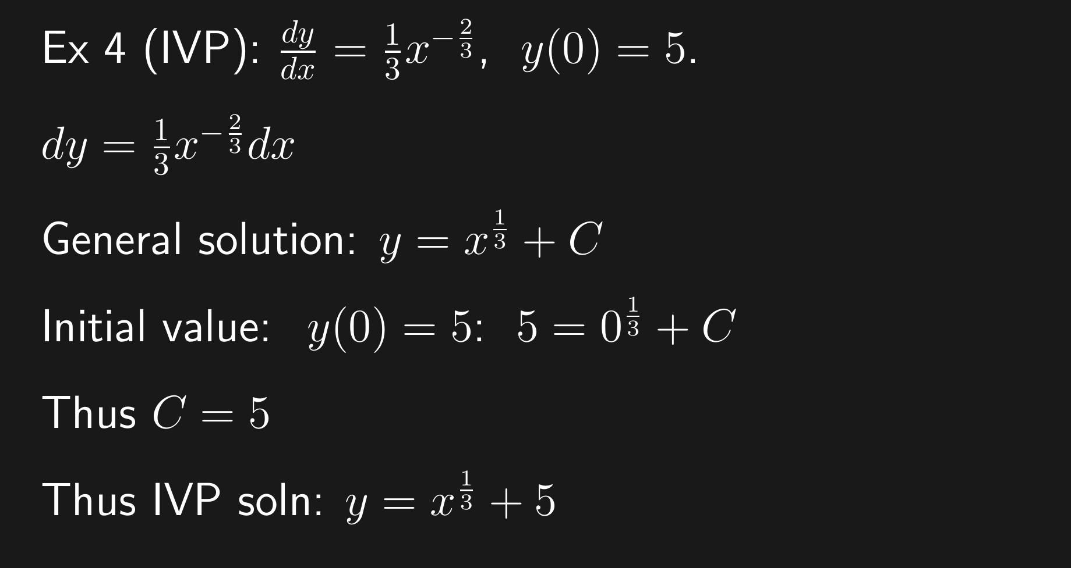

Slide 20
Special cases:
When do we know a unique solution exists?

Slide 21
Calculus 1 problem:

