Slide 1
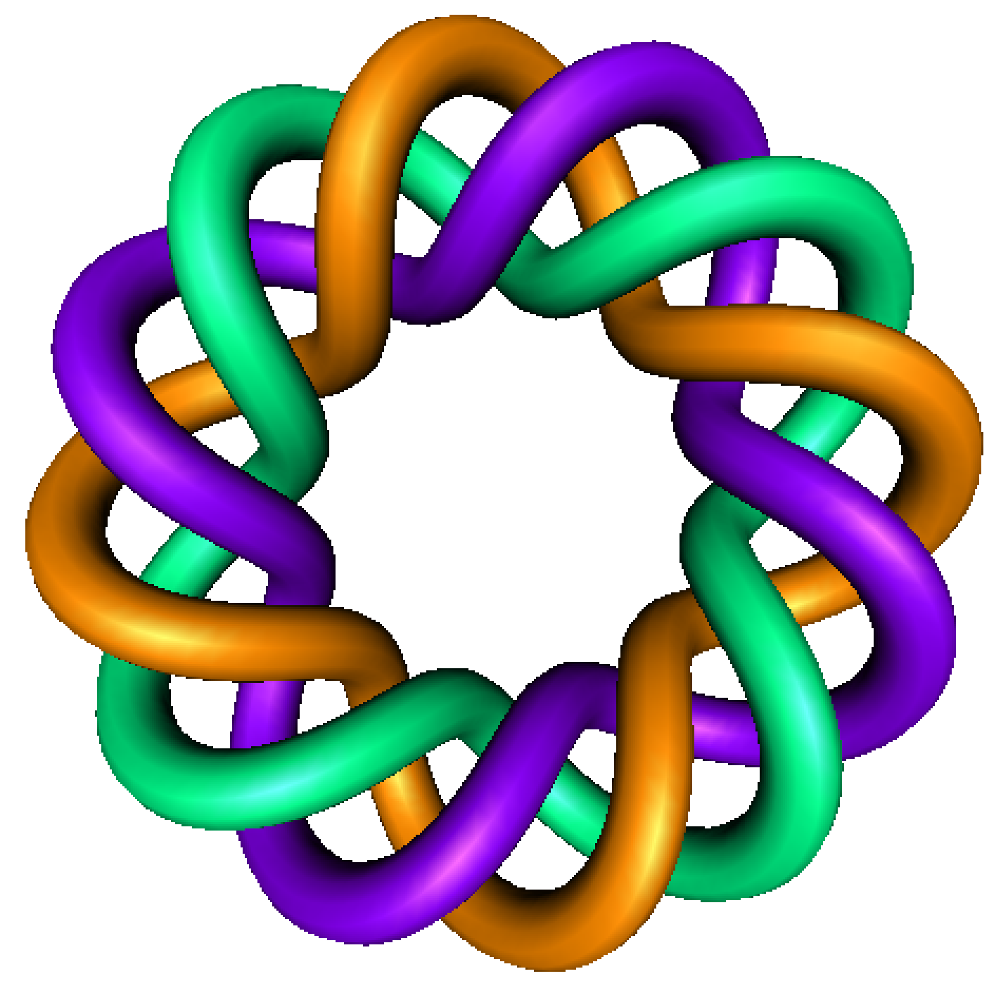
Slope Field Review
By Dr. Isabel Darcy,
Dept of Mathematics and AMCS,
University of Iowa

Slide 4
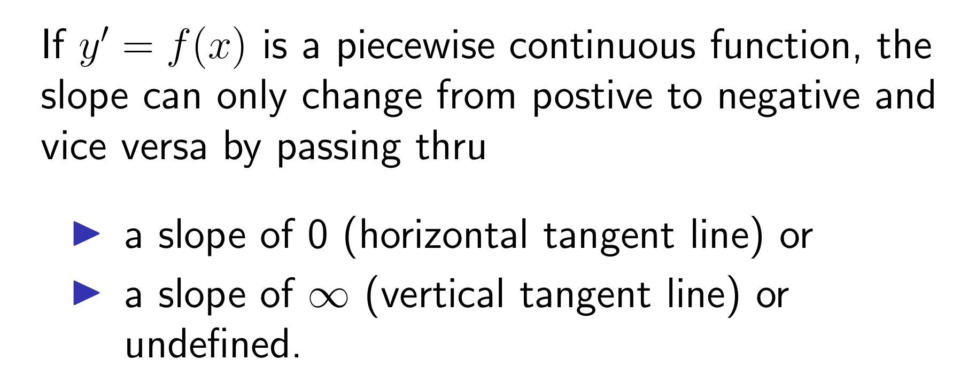
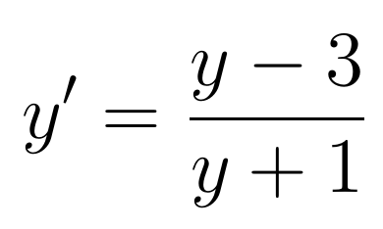
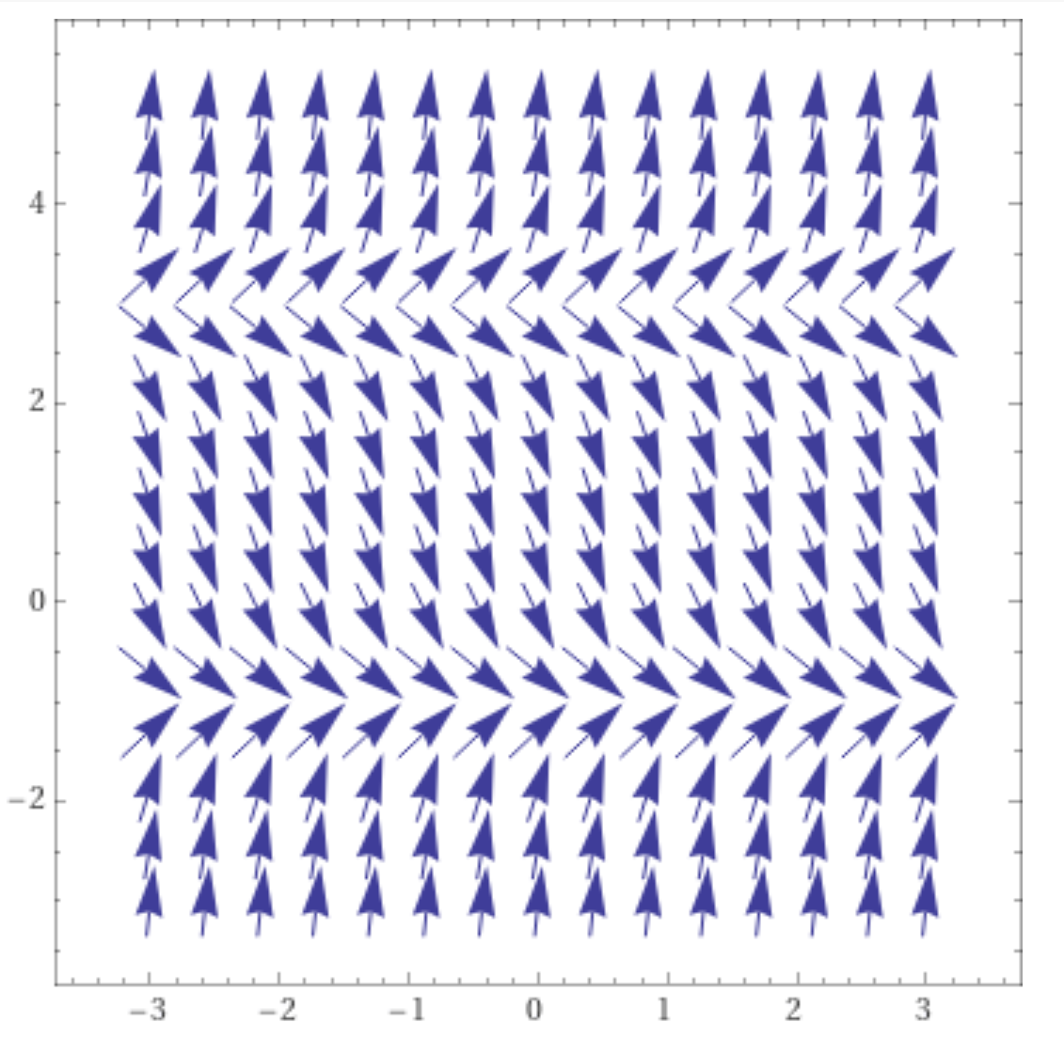
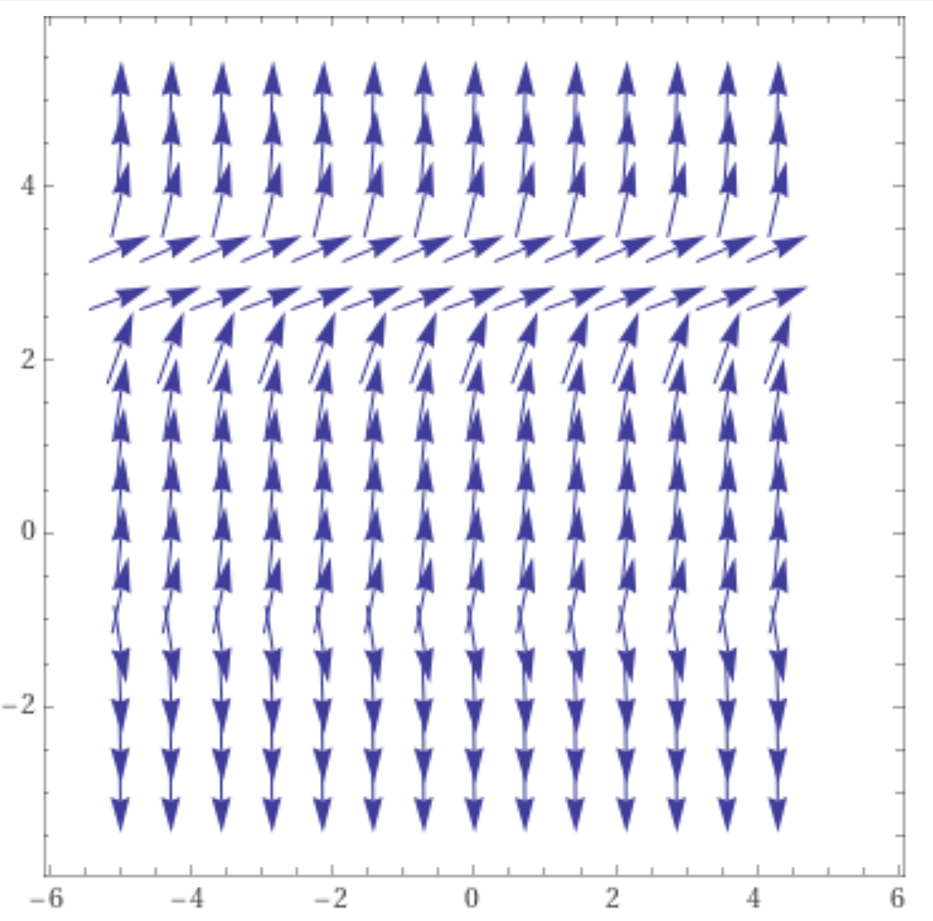
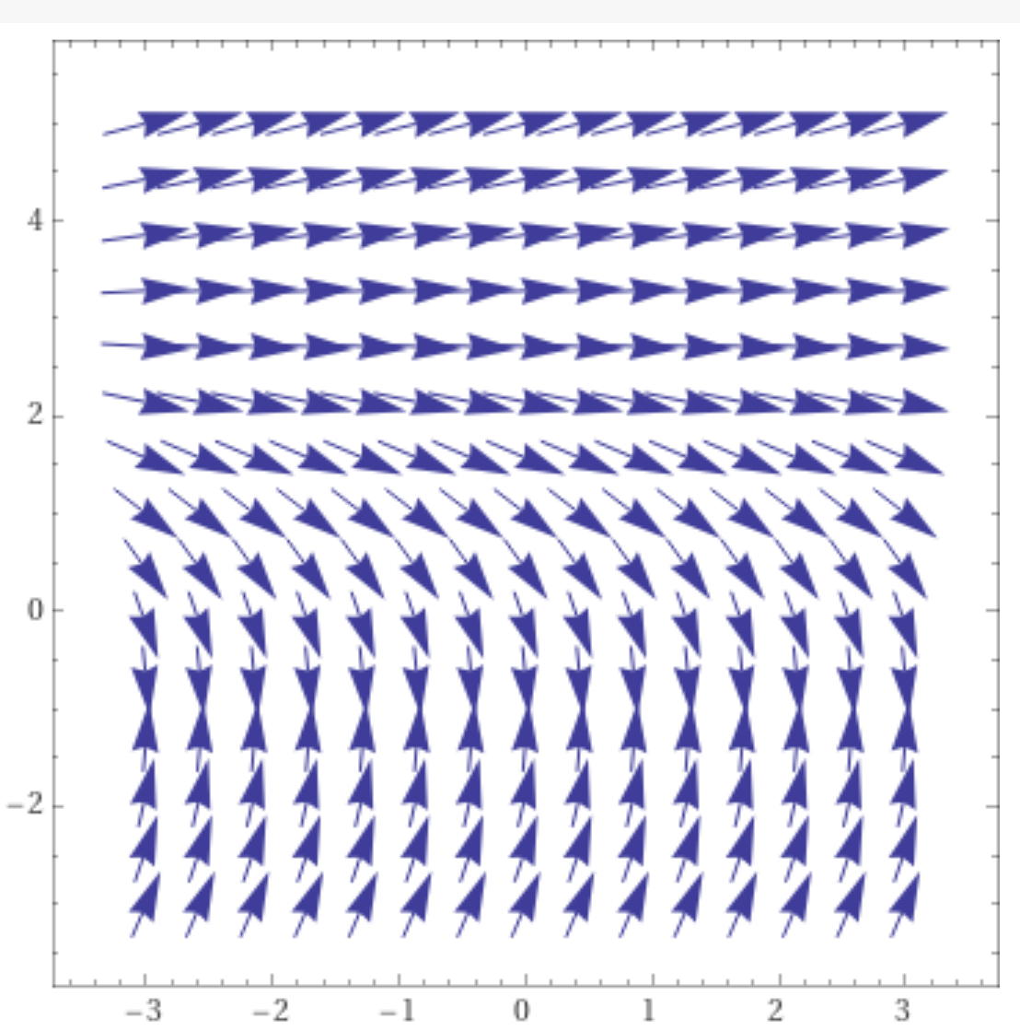
https://www.wolframalpha.com/input/?i=slope%20field

Slide 5
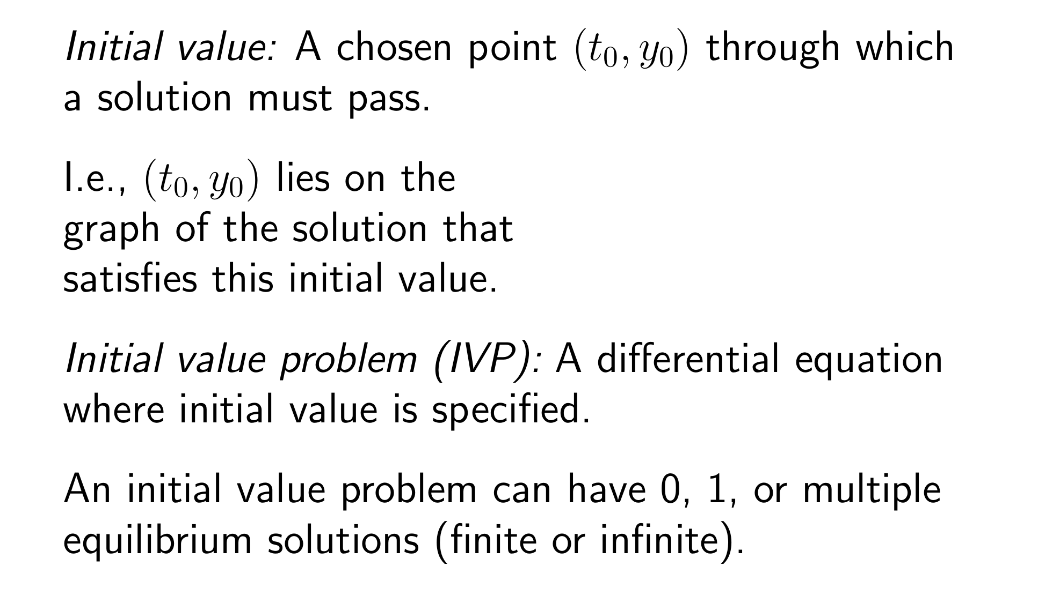
https://www.wolframalpha.com/input/?i=slope%20field

Slide 6
https://www.wolframalpha.com/input/?i=slope%20field

Slide 7
https://www.wolframalpha.com/input/?i=slope%20field

Slide 9
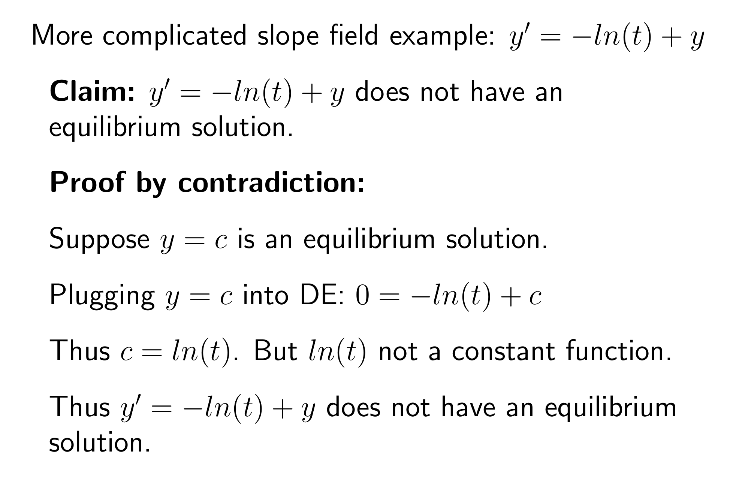

Slide 11
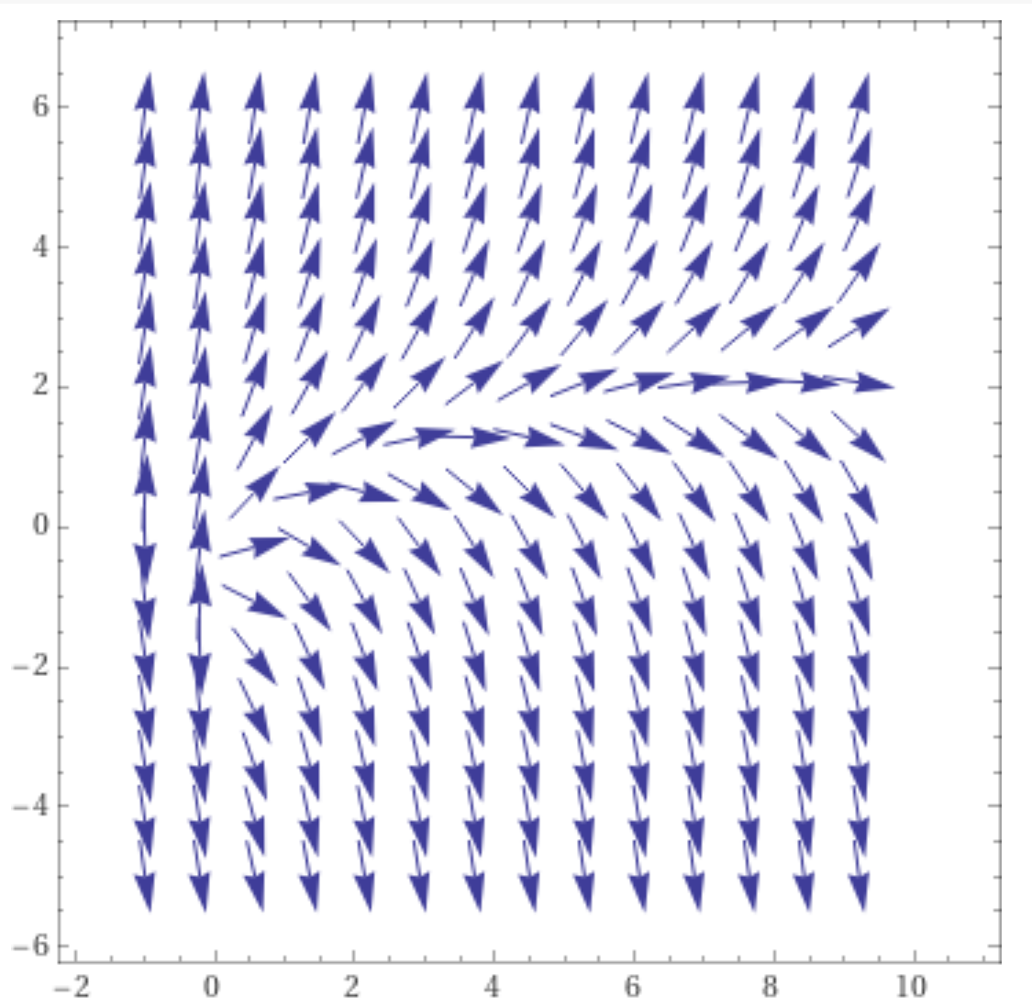
https://www.wolframalpha.com/input/?i=slope%20field

Slide 17
Slope field created with Maple

Slide 18
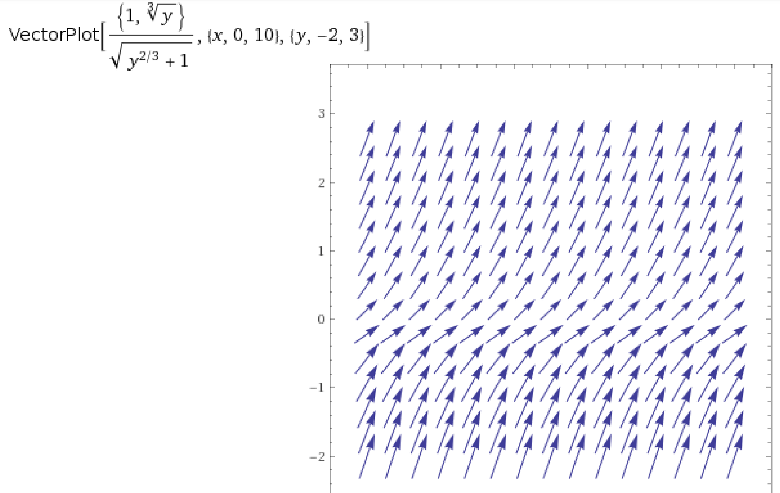
Slope field from wolframalpha.com
Note: slope is drawn incorrectly. Slope should be negative if y < 0

