Slide 1
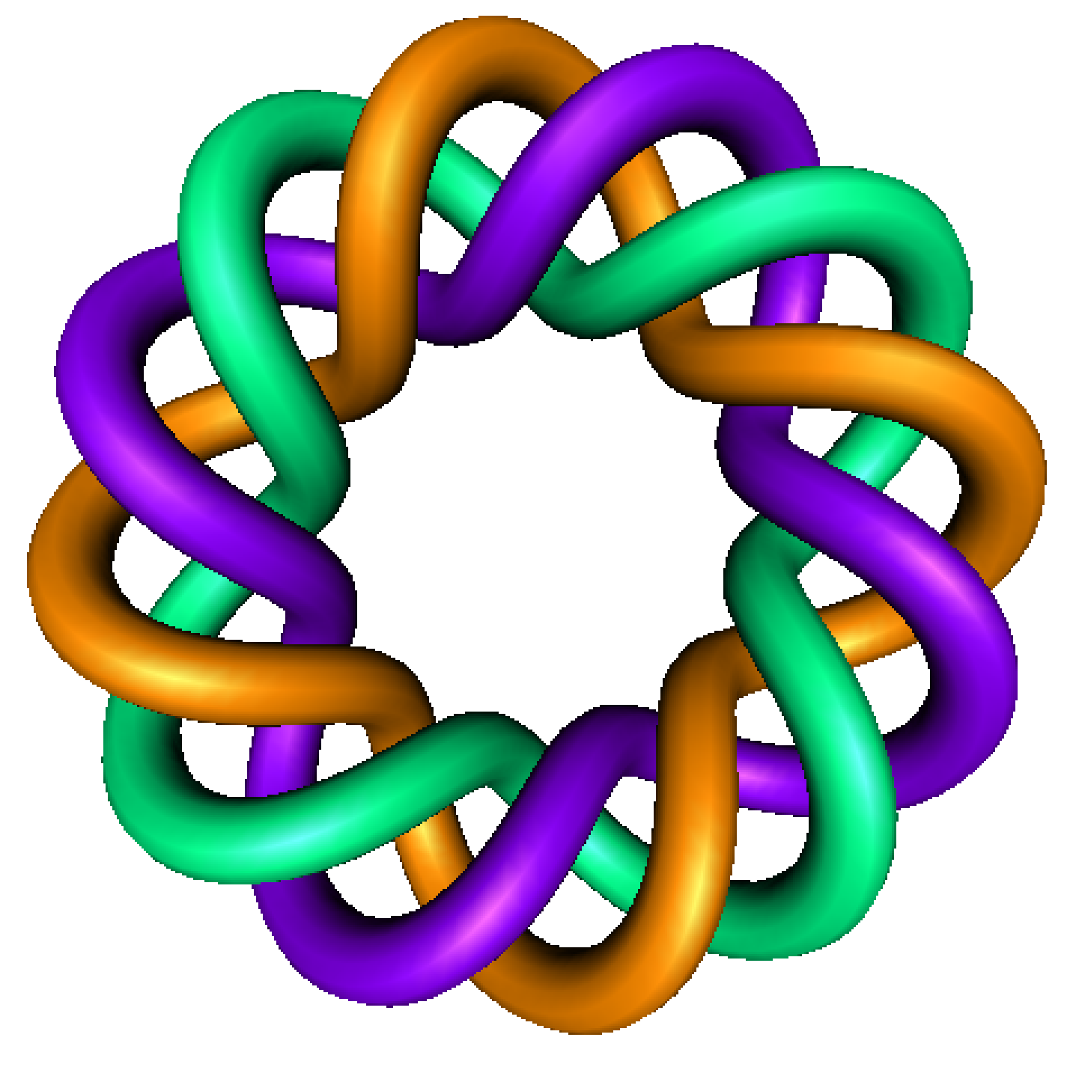
Existence and Uniqueness
+
Precalculus: Finding domain
By Dr. Isabel Darcy,
Dept of Mathematics and AMCS,
University of Iowa

Slide 4
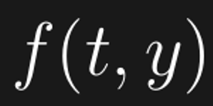

Slide 9
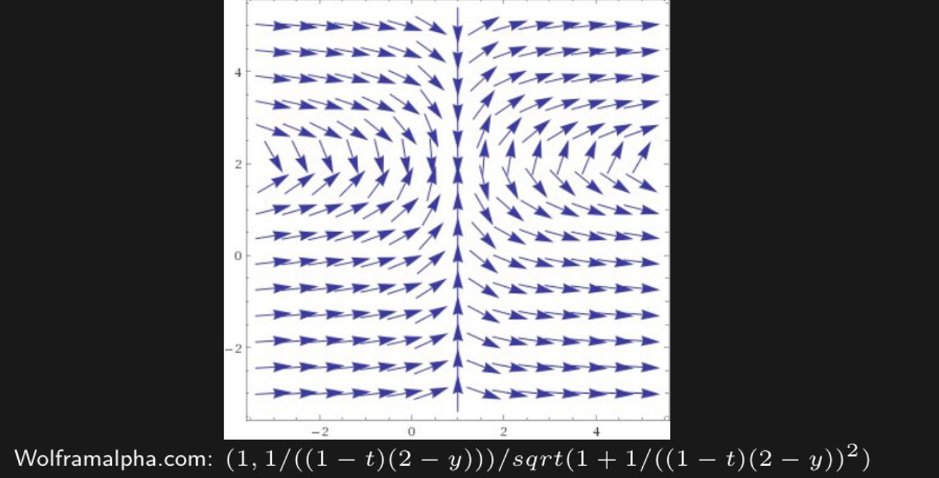
Thm 2.4.2 implies

Slide 10
Thm 2.4.2 implies
But what else can we say about this DE?

