Slide 1
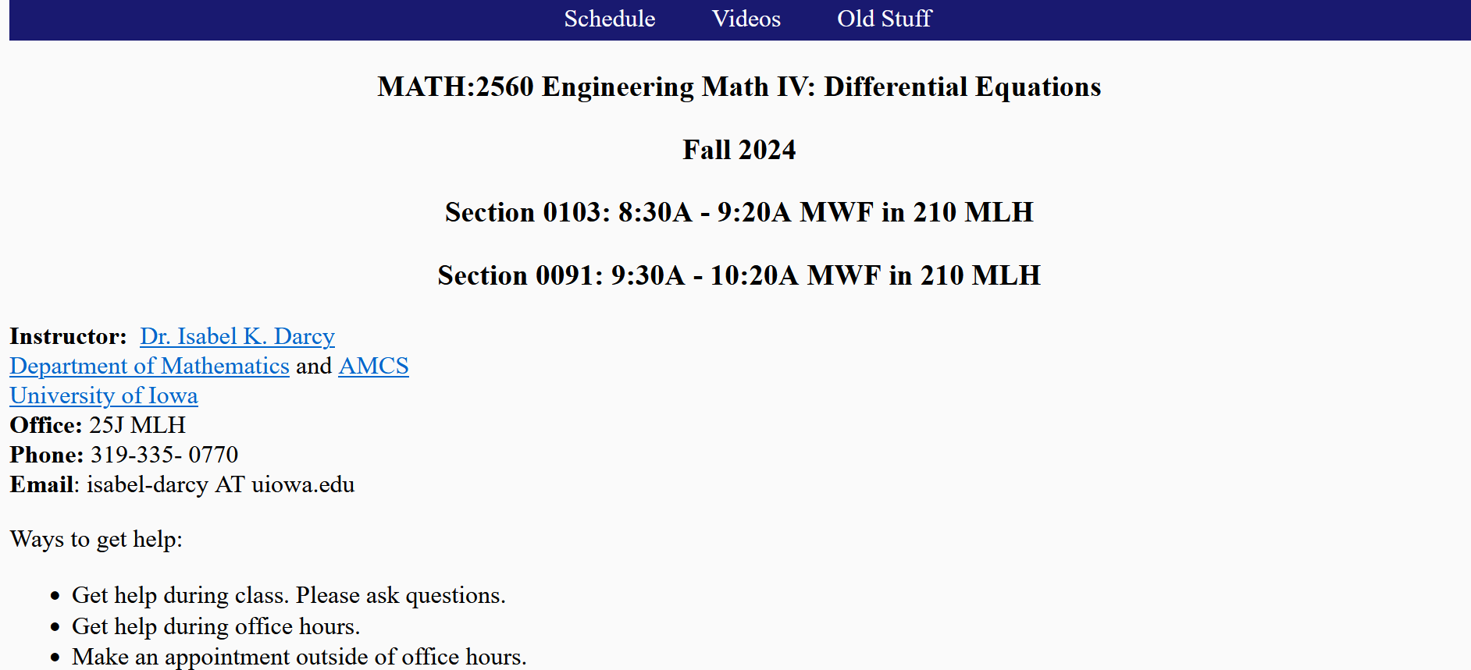
“The goal of this course is to offer a meaningful, rigorous, and rewarding experience to every student; you will build that rich experience by devoting your strongest available effort to the class. You will be challenged and supported. Please be prepared to take an active, patient, and generous role in your learning and that of your classmates.”
Federico Ardila https://www.ams.org/journals/notices/202308/noti2752/noti2752.html
https://homepage.math.uiowa.edu/~idarcy/COURSES/100/FALL24/2560.html

Slide 2
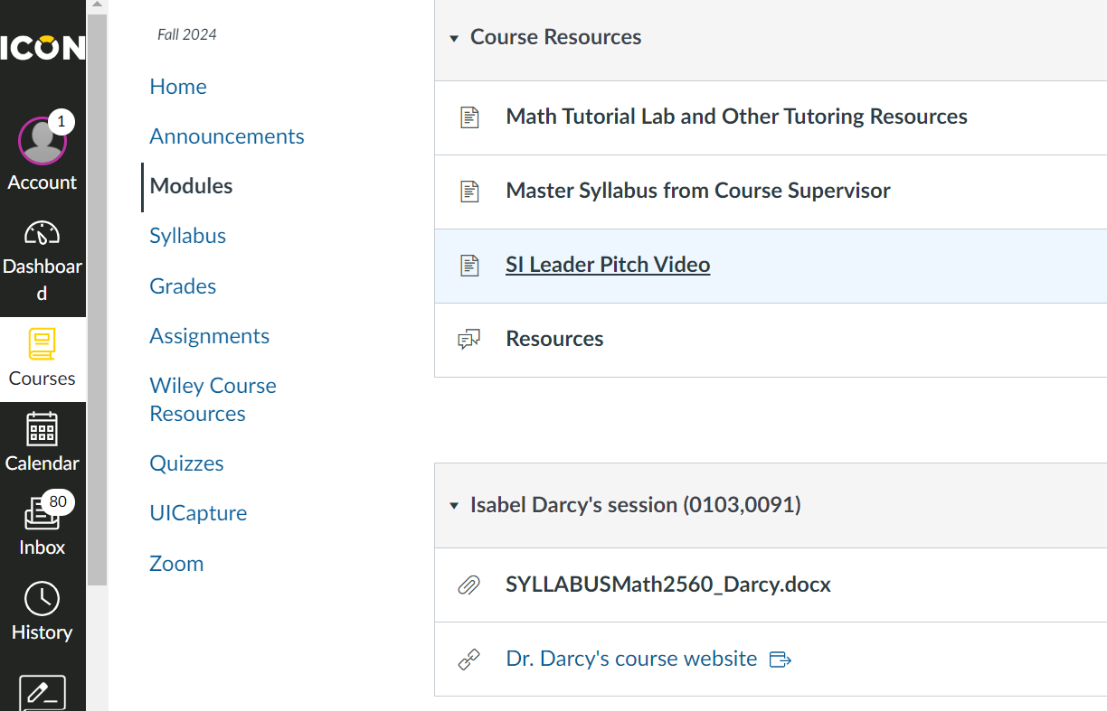

Slide 3
Hi, my name is Ronan and I'm the SI leader for differential equations this semester.
My times are 3:30 to 4:20 on Mondays, 11 to 11:50 on Tuesdays and 5 to 5:50 on Thursdays.
And they're all held in room 3124, in the Seaman Center.
For those of you who don't know, SI is a free and optional resource for students to work collaboratively with their peers to better understand course concepts.
I hope to see you all there.
Begins Tuesday, September 3rd
Active Learning
Form study groups

Slide 4
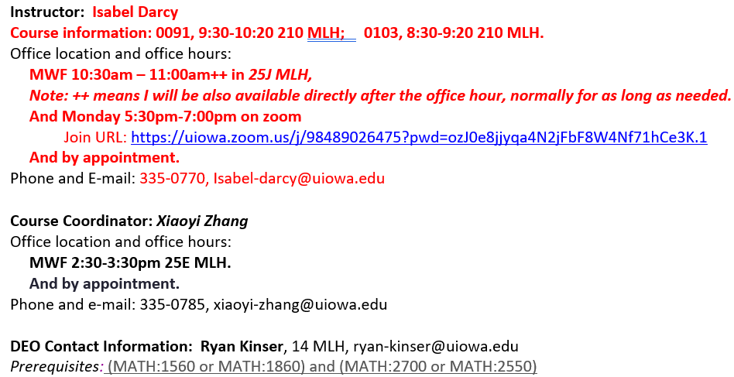
When e-mailing me, please include Math 2560 in your subject line.

Slide 5
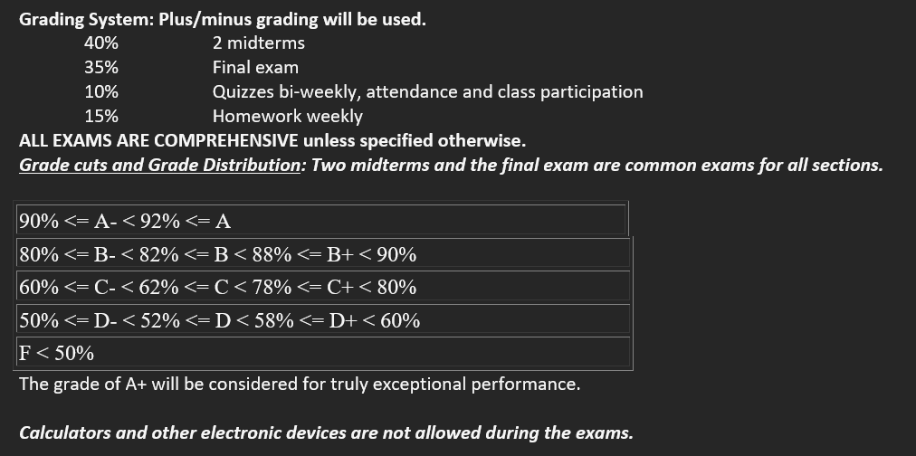
MIDTERM 1: 6:30PM - 8:00PM 10/03/2024 Thu in 100 PH
MIDTERM 2: 6:30PM - 8:00PM 11/14/2024 Thu in PC C20

Slide 6
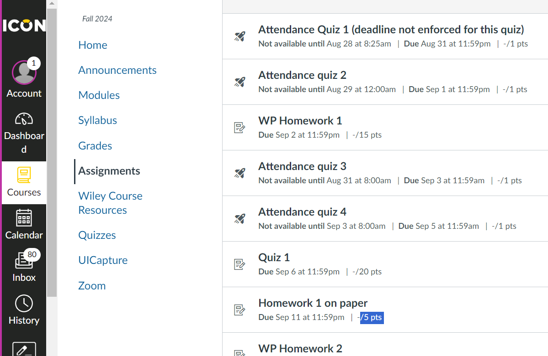
WilyPlus HW due Mondays
4
In-class quiz next week on Friday

Slide 8
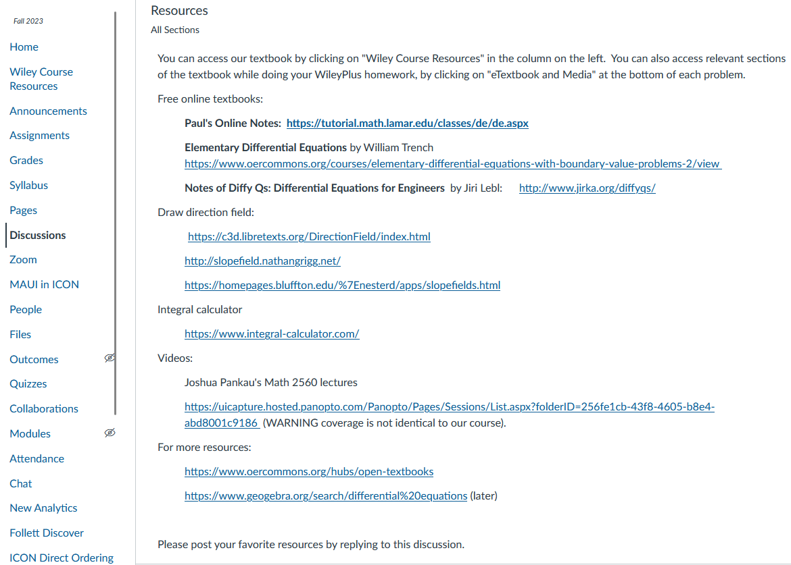

Slide 9
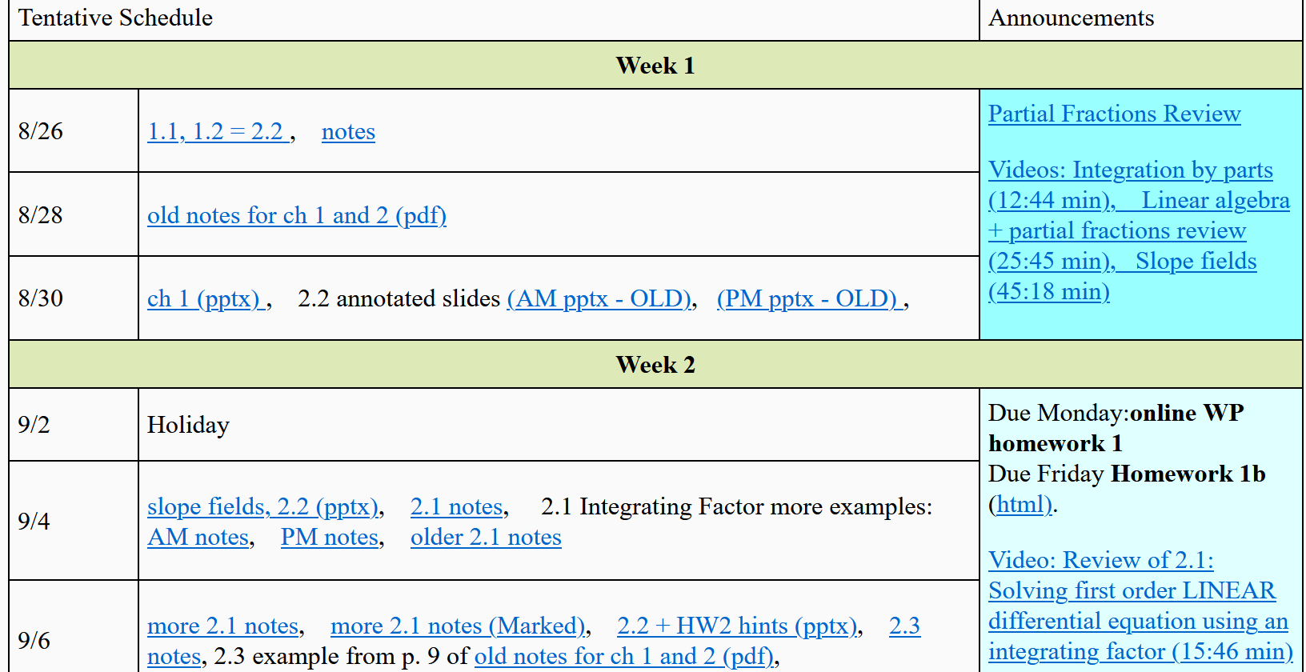
https://homepage.divms.uiowa.edu/~idarcy/COURSES/100/FALL24/2560.html

Slide 10
Wait
NOW

Slide 11
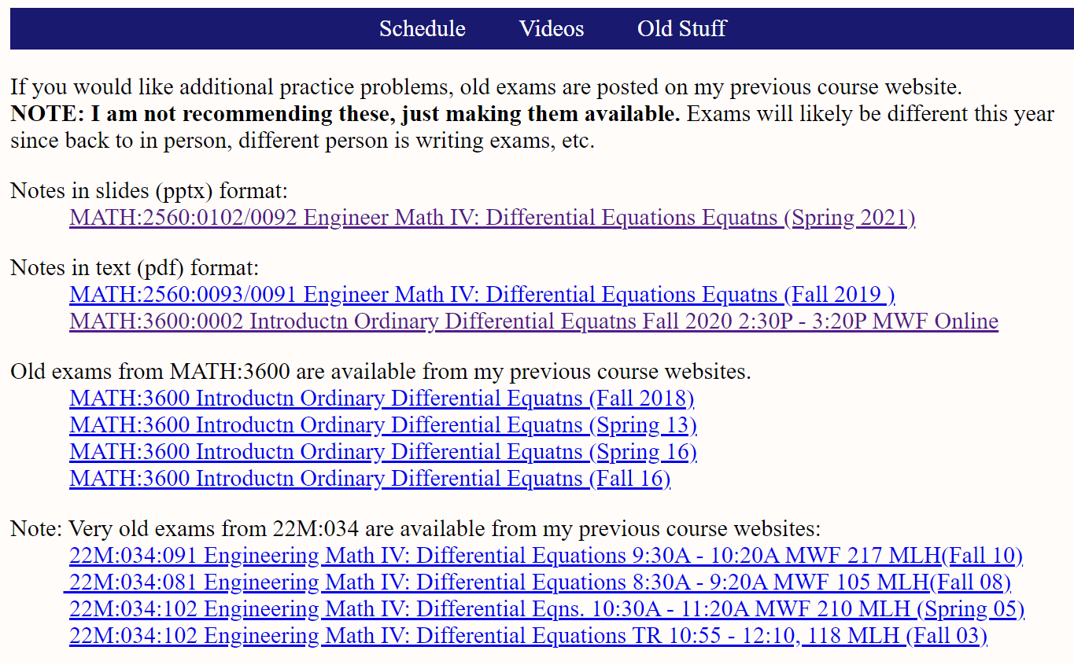

Slide 12
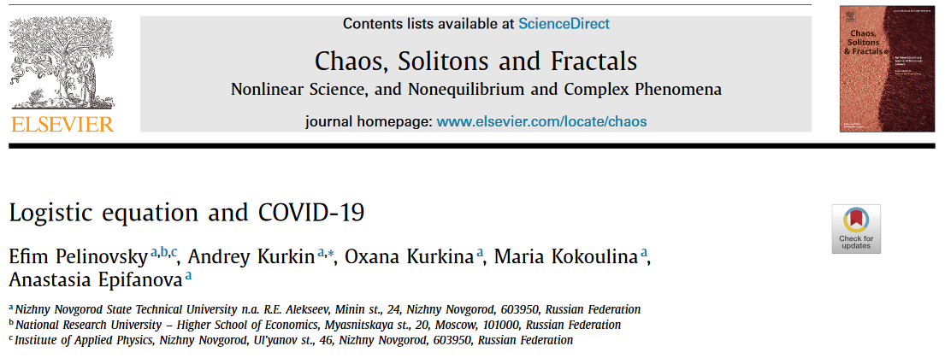
Differential equations and Covid:
Section 2.5: https://www.ncbi.nlm.nih.gov/pmc/articles/PMC7444956/

Slide 13
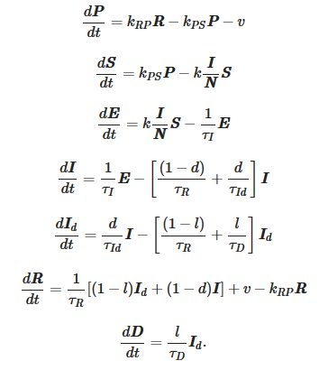
Differential equations and Covid:
Ch 7 and 9: https://www.nature.com/articles/s41598-021-95494-6
Systems of differential equations:

Slide 14
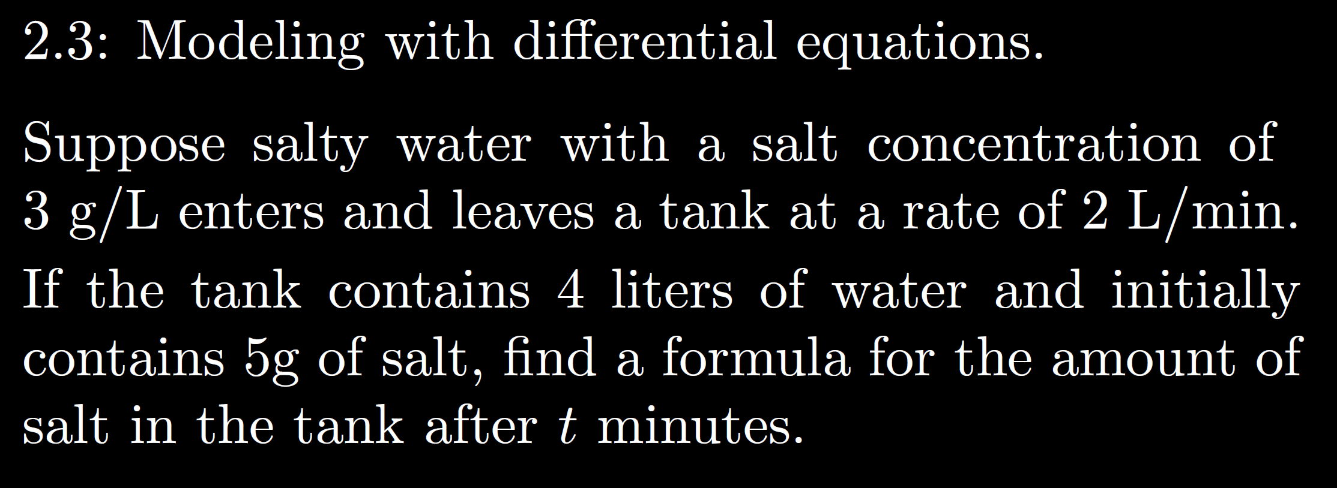

Slide 18
A constant as it does not depend on Q = the amount of salt in the tank, since the rate of salt entering the tank does not depend on the amount of salt in the tank.
A function of Q as the rate of salt exiting the tank depends on
Q = the amount of salt in the tank.
In this case, the rate out is proportional to Q.

Slide 21
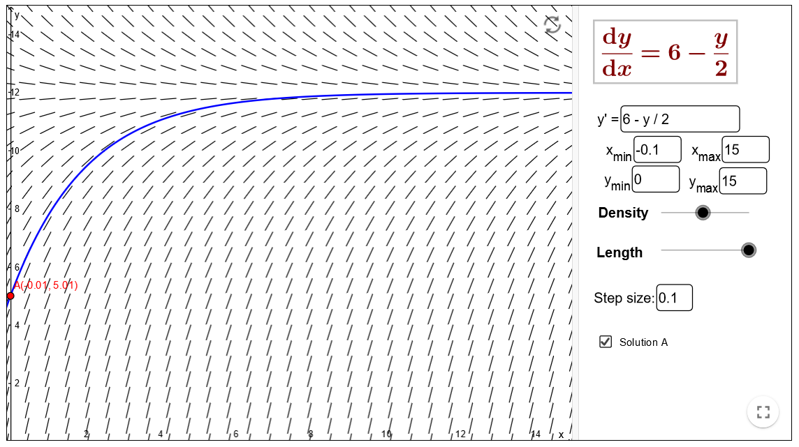
https://www.geogebra.org/m/Pd4Hn4BR

Slide 34
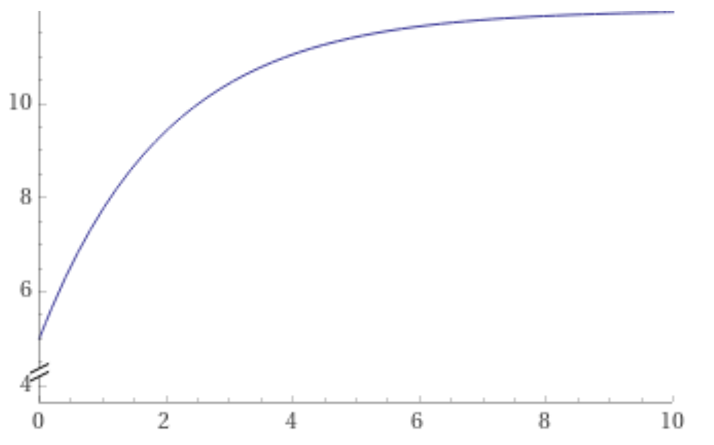
https://www.wolframalpha.com/input/?i=plot+-7+e%5E%7B-x%2F2%7D+%2B+12+from+x%3D0+to+10

Slide 38
