Slide 1
Lecture 1: The Euler characteristic
of a series of preparatory lectures for the Fall 2013 online course MATH:7450 (22M:305) Topics in Topology: Scientific and Engineering Applications of Algebraic Topology
Target Audience: Anyone interested in topological data analysis including graduate students, faculty, industrial researchers in bioinformatics, biology, computer science, cosmology, engineering, imaging, mathematics, neurology, physics, statistics, etc.
Isabel K. Darcy
Mathematics Department/Applied Mathematical & Computational Sciences
University of Iowa
http://www.math.uiowa.edu/~idarcy/AppliedTopology.html

Slide 2
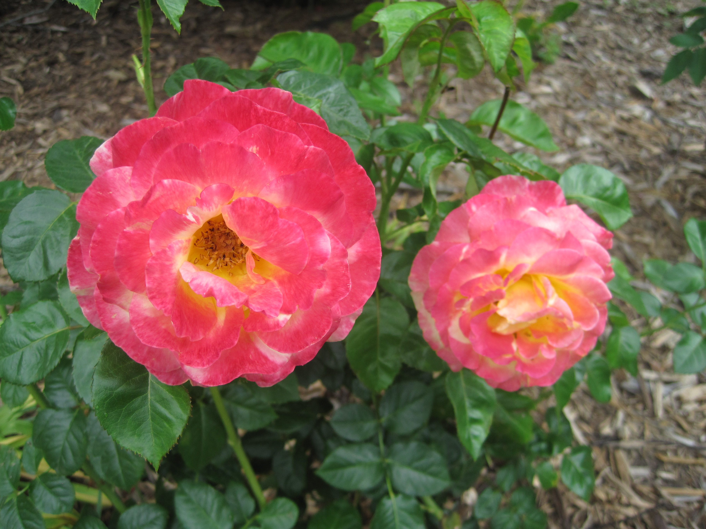
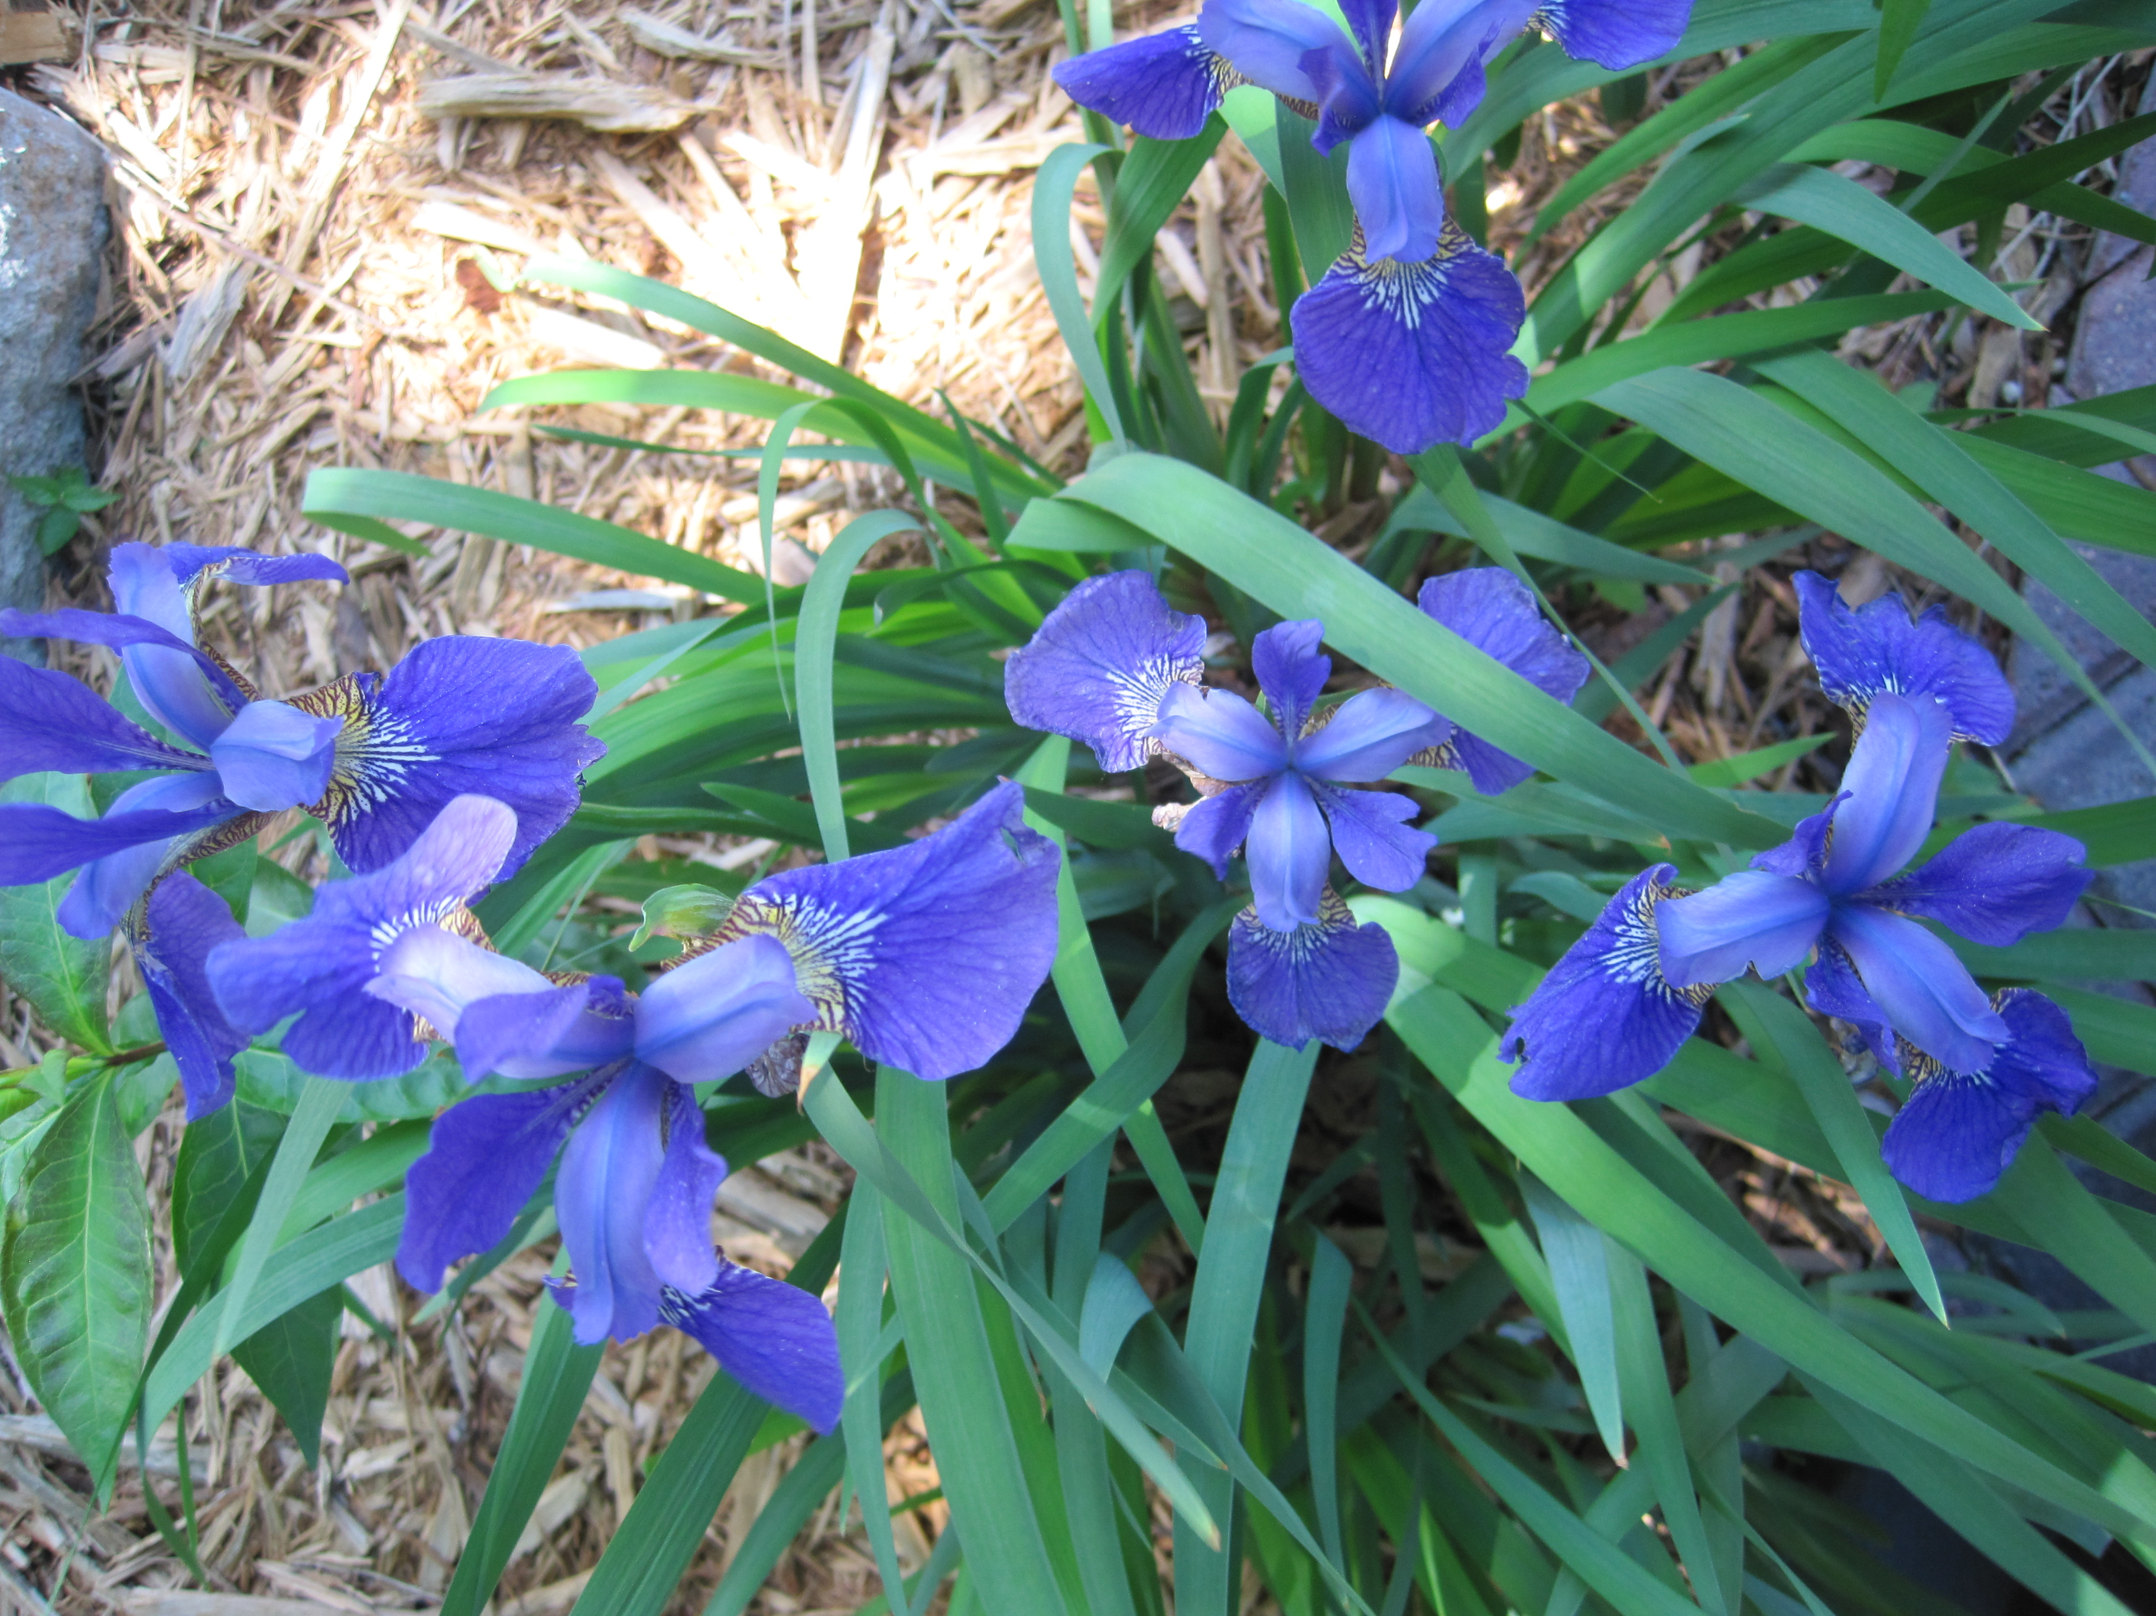
1
Counting
1
2
4
5
2
3

Slide 3
We wish to count:
Example:
vertex
edge
7 vertices,
9 edges,
2 faces.
face

Slide 4
3 vertices,
3 edges,
1 face.
6 vertices,
9 edges,
4 faces.

Slide 5
The formula:
Euler characteristic

Slide 6
Euler characteristic (simple form):
= number of vertices – number of edges + number of faces
Or in short-hand,
= |V| - |E| + |F|
where V = set of vertices
E = set of edges
F = set of faces
& the notation |X| = the number of elements in the set X.

Slide 7
3 vertices,
3 edges,
1 face.
6 vertices,
9 edges,
4 faces.
= |V| – |E| + |F| =
3 – 3 + 1 = 1
= |V| – |E| + |F| =
6 – 9 + 4 = 1
Note: 3 – 3 + 1 = 1 = 6 – 9 + 4

Slide 8
3 vertices,
3 edges,
1 face.
6 vertices,
9 edges,
4 faces.
= |V| – |E| + |F| =
3 – 3 + 1 = 1
= |V| – |E| + |F| =
6 – 9 + 4 = 1
Note: 3 – 3 + 1 = 1 = 6 – 9 + 4

Slide 9
3 vertices,
3 edges,
1 face.
6 vertices,
9 edges,
4 faces.
= |V| – |E| + |F| =
3 – 3 + 1 = 1
= |V| – |E| + |F| =
6 – 9 + 4 = 1
Note: 3 – 3 + 1 = 1 = 6 – 9 + 4

Slide 10
3 vertices,
3 edges,
1 face.
6 vertices,
9 edges,
4 faces.
= |V| – |E| + |F| =
3 – 3 + 1 = 1
= |V| – |E| + |F| =
6 – 9 + 4 = 1
Note: 3 – 3 + 1 = 1 = 6 – 9 + 4

Slide 11
3 vertices,
3 edges,
1 face.
6 vertices,
9 edges,
4 faces.
= |V| – |E| + |F| =
3 – 3 + 1 = 1
= |V| – |E| + |F| =
6 – 9 + 4 = 1
Note: 3 – 3 + 1 = 1 = 6 – 9 + 4

Slide 12
= 3 – 3 + 1 = 1
= 6 – 9 + 4 = 1
= 7 – 11 + 5 = 1
= |V| – |E| + |F|

Slide 13
= 3 – 3 + 1 = 1
= 6 – 9 + 4 = 1
= 7 – 11 + 5 = 1
= |V| – |E| + |F|

Slide 14
Geometry
=
=

Slide 15
Topology
=
=

Slide 16
Video Insert illustrating topology
Note a coffee cup is topologically equivalent to a donut
gif from https://en.wikipedia.org/wiki/
File:Mug_and_Torus_morph.gif

Slide 17
Topology
=
=

Slide 18
= 3 – 3 + 1 = 1
= 6 – 9 + 4 = 1
= 7 – 11 + 5 = 1
= |V| – |E| + |F|

Slide 19
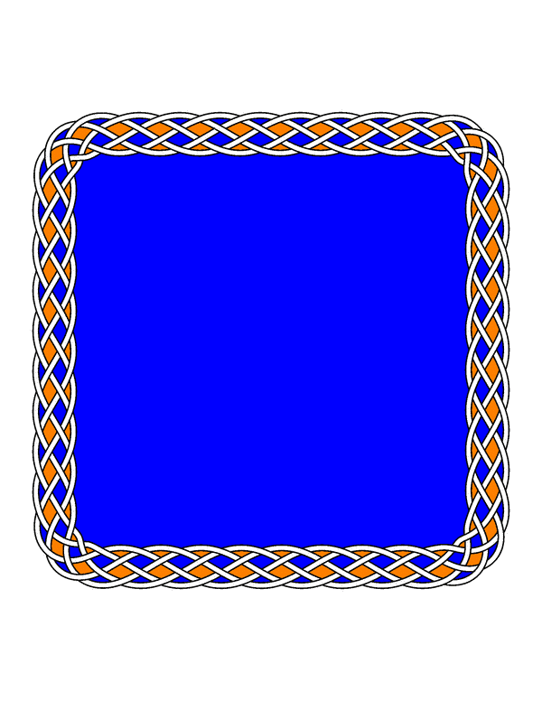
The Euler characteristic is a topological invariant
That means that if two objects are topologically the same, they have the same Euler characteristic.

Slide 20
= 1
= 1
= 1

Slide 21
= 1
= 1
= 1
= 1

Slide 22
The Euler characteristic is a topological invariant
That means that if two objects are topologically the same, they have the same Euler characteristic.
Example:
= 1
= 1

Slide 23
Euler characteristic
sphere
= { x in R³ : ||x || = 1 }
2
1
ball
= { x in R³ : ||x || ≤ 1 }
disk
= { x in R² : ||x || ≤ 1 }
closed interval
= { x in R : ||x || ≤ 1 }

Slide 24
The Euler characteristic is a topological invariant
That means that if two objects are topologically the same, they have the same Euler characteristic.
But objects with the same Euler characteristic need not be topologically equivalent.
≠
≠
= 1

Slide 25
Let R be a subset of X
A deformation retract of X onto R is a continuous map F: X × [0, 1] → X, F(x, t) = f_{t}(x) such that
f₀ is the identity map,
f₁(X) = R, and
f_{t}(r) = r for all r in R.
If R is a deformation retract of X, then (R) = (X).

Slide 26
Let R be a subset of X
A deformation retract of X onto R is a continuous map F: X × [0, 1] → X, F(x, t) = f_{t}(x) such that f₀ is the identity map,
f₁(X) = R, and
f_{t}(r) = r for all r in R.
If R is a deformation retract of X, then (R) = (X).

Slide 27
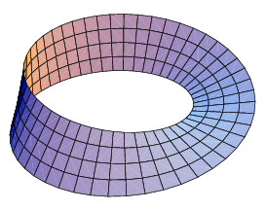
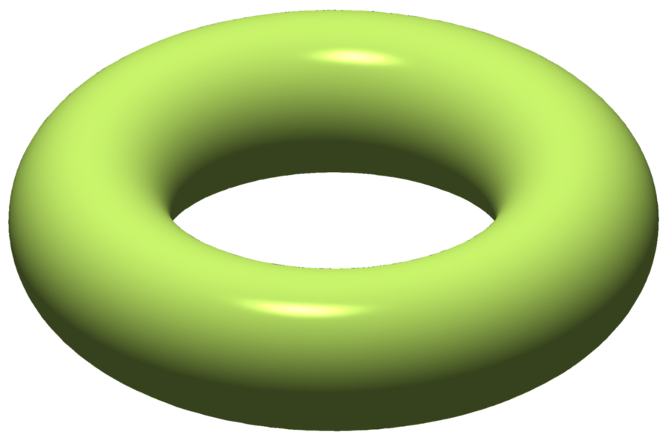
Euler characteristic
S¹ = circle
= { x in R² : ||x || = 1 }
Annulus
Mobius band
Solid torus = S¹ x disk
Torus = S¹ x S¹
0
Mobius band and torus images from https://en.wikipedia.org/wiki/Euler_characteristic

Slide 28
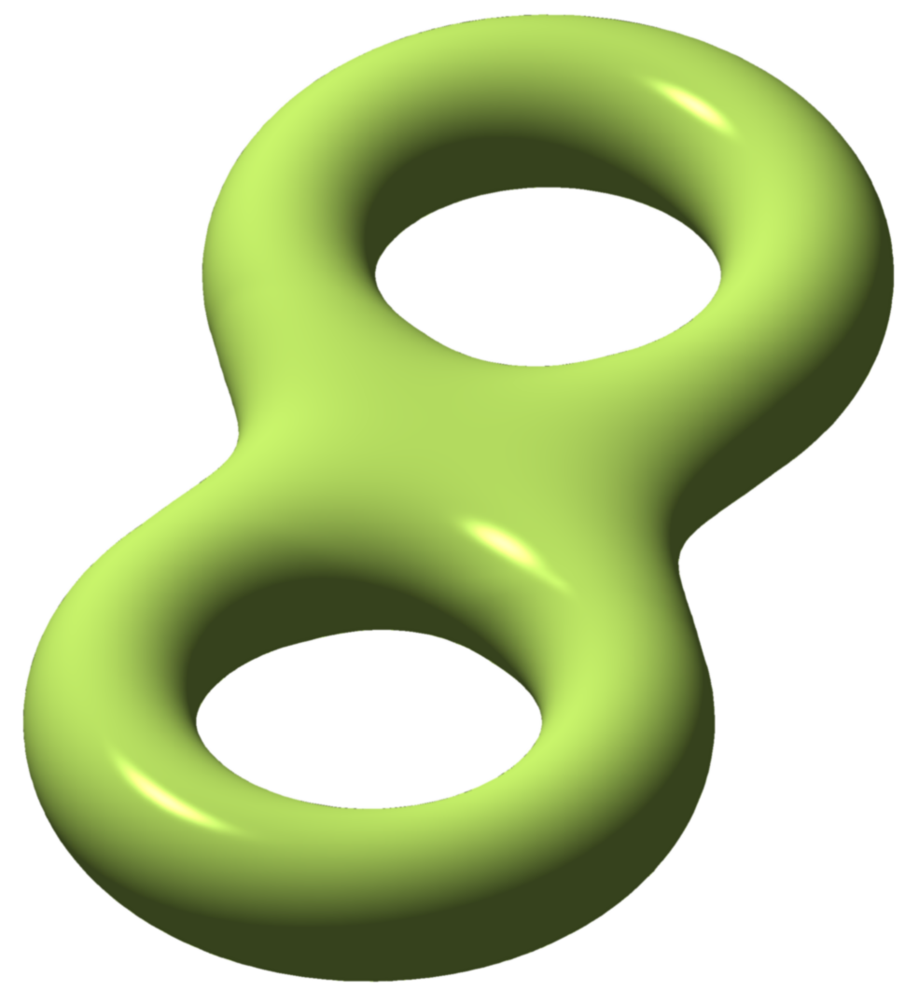
Euler characteristic
-1
-2
Solid double torus
The graph:
Double torus =
genus 2 torus =
boundary of solid
double torus
Genus n tori images from https://en.wikipedia.org/wiki/Euler_characteristic

Slide 29
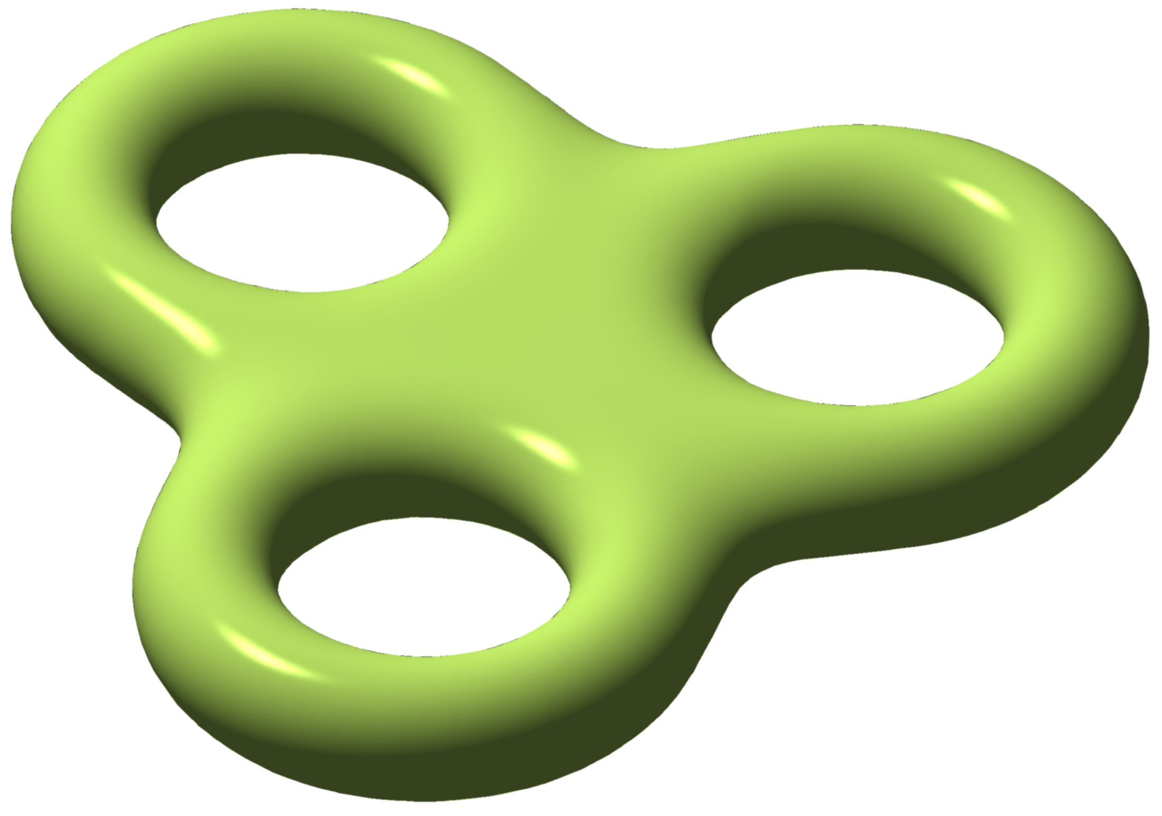
Euler 2-dimensional orientable surface characteristic without boundary
2
0
-2
-4
sphere
S¹ x S¹ = torus
genus 2 torus
genus 3 torus
Genus n tori images from https://en.wikipedia.org/wiki/Euler_characteristic

Slide 30
Graphs: Identifying Trees
Defn: A tree is a connected graph that does not contain a cycle
= 8 – 7 = 1 = 8 – 8 = 0 = 8 – 9 = -1

Slide 31
= |V| – |E| + |F|
= 2

Slide 32
= |V| – |E| + |F|
= 2 – 1 = 1

Slide 33
= |V| – |E| + |F|
= 3 – 1 = 2

Slide 34
= |V| – |E| + |F|
= 3 – 2 = 1

Slide 35
= |V| – |E| + |F|
= 4 – 3 = 1

Slide 36
= |V| – |E| + |F|
= 5 – 4 = 1

Slide 37
= |V| – |E| + |F|
= 8 – 7 = 1

Slide 38
= |V| – |E| + |F|
= 8 – 8 = 0

Slide 39
= |V| – |E| + |F|
= 8 – 9 = -1

