Slide 1
Distributed Mutual Exclusion

Slide 2
Distributed Mutual Exclusion
p0
CS
CS
p1
p2
CS
CS
p3

Slide 3
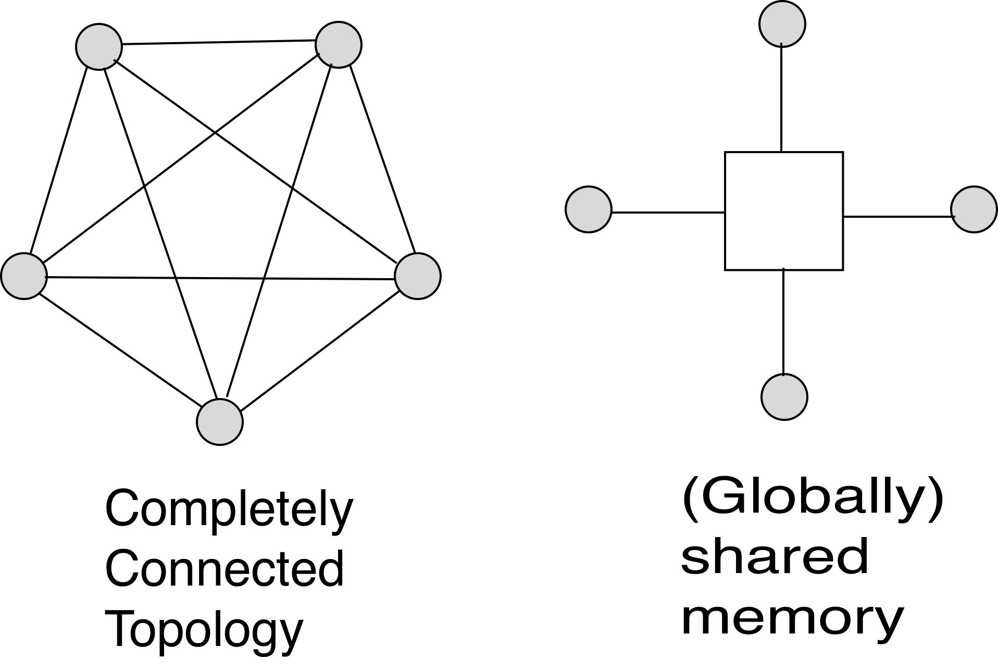
Distributed Mutual Exclusion
Distributed mutual exclusion
Classical mutual exclusion

Slide 4
Why mutual exclusion?
Some applications are:
Resource sharing
Avoiding concurrent update on shared data
Implementing atomic operations
Medium Access Control in Ethernet
Collision avoidance in wireless broadcasts

Slide 5
Mutual Exclusion Problem Specifications
ME1. At most one process in the CS. (Safety property)
ME2. No deadlock. (Safety property)
ME3. Every process trying to enter its CS must eventually succeed.
This is called progress. (Liveness property)
Progress is quantified by the criterion of bounded waiting. It measures
a form of fairness by answering the question:
Between two consecutive CS trips by one process, how many times
other processes can enter the CS?
There are many solutions, both on the shared memory model and on the
message-passing model. We first focus on the message-passing model.

Slide 6
Client-server based solution
Using message passing model
CLIENT
repeat
Send request and wait for reply;
Enter CS;
Send release and exit CS
forever
SERVER
repeat request ∧ ￢busy → send reply; busy:= true
[] request ∧ busy → enqueue sender
[] release ∧ queue is empty → busy:= false
[] release ∧ queue not empty → send reply to head of queue
forever
busy
server
client

Slide 7
Comments
- Centralized solution is simple.
- But the central server is a single point of failure. This is BAD.
- ME1-ME3 is satisfied, but FIFO fairness is not guaranteed. Why?
Can we do without a central server? Yes!

Slide 8
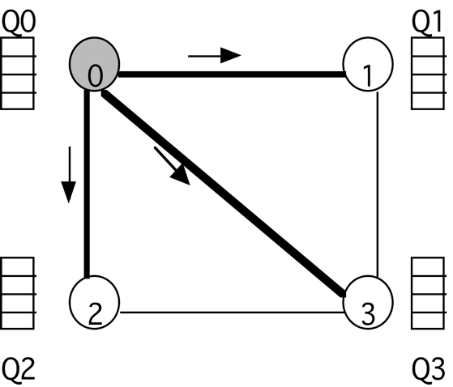
Decentralized solution 1
Lamport’s algorithm
1. Broadcast a timestamped request to all.
2. Request received → enqueue it in local Q. Not in CS → send ack, else postpone sending ack until exit from CS.
3. Enter CS, when
(i) You are at the “head” of your Q
(ii) You have received ack from all
4. To exit from the CS,
(i) Delete the request from your Q, and
(ii) Broadcast a timestamped release
5. When a process receives a release message, it removes the sender from its Q.
Completely connected topology

Slide 9
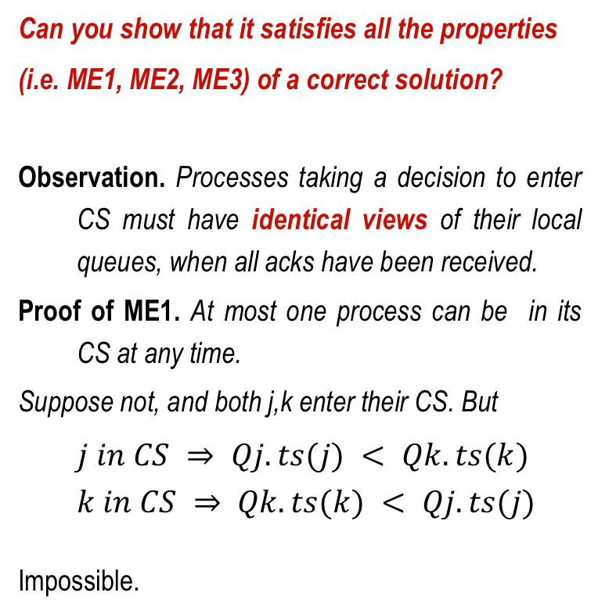
Analysis of Lamport’s algorithm

Slide 10
Analysis of Lamport’s algorithm
Proof of ME2. (No deadlock)
The waiting chain is acyclic.
i waits for j ⇒i is behind j in all queues
(or j is already in its CS)
⇒j does not wait for i
Proof of ME3. (progress)
New requests join the end of the queues,
so new requests do not pass the old ones.

Slide 11
Analysis of Lamport’s algorithm
FIFO fairness.
timestamp (j) < timestamp (k) ⇒ j enters its CS before k does so
Does it hold?
FIFO guarantee does not hold.
See the example to the right. Here, k (timestamp 30) enters its CS
before j (timestamp 20). How? Since k did not yet receive j’s request.
But k received the ack from j for its own request . This is possible when
the channel is not FIFO, but impossible if the channels are FIFO.
.
Message complexity = 3(N-1) (per trip to CS)
(N-1 requests + N-1 ack + N-1 release)
Req (30)
k
j
ack
Req
(20)

Slide 12
Decentralized algorithm 2
Ricart & Agrawala’s algorithm
What is new?
1. Broadcast a timestamped request to all.
2. Upon receiving a request, send ack if
-You do not want to enter your CS, or
-You are trying to enter your CS, but your timestamp is larger than that of the sender.
(If you are already in CS or your request has a smaller timestamp, then buffer the request)
3. Enter CS, when you receive ack from all.
4. Upon exit from CS, send ack to each buffered request
before making a new request.
(No release message is necessary)
ts=10
ts=20
ts=27
ts=30

Slide 13
Ricart & Agrawala’s algorithm
Ricart & Agrawala’s algorithm
ME1. Prove that at most one process can be in CS.
ME2. Prove that deadlock is not possible.
ME3. Prove that FIFO fairness holds even if
channels are not FIFO
Message complexity = 2(N-1)
(N-1 requests + N-1 acks - no release message)
TS(j) < TS(k)
Req(k)
Ack(j)
k
j
Req(j)

Slide 14
Unbounded timestamps
Timestamps grow in an unbounded manner.
This makes real implementations impossible.
Can we somehow use bounded timestamps?
Think about it.

Slide 15
Decentralized algorithm 3
{Maekawa’s algorithm}
- First solution with a sublinear O(sqrt N) message complexity.
- “Close to” Ricart-Agrawala’s solution, but each process is required to obtain permission from only a subset of peers

Slide 16
Maekawa’s algorithm
With each process i, associate a subset S_{i}. Divide the set of processes into subsets that satisfy the following two conditions:
i ∈ S_{i}
∀i,j : 0≤i,j ≤ n-1 | S_{i} ⋂ S_{j} ≠ ∅
Main idea. Each process i is required to receive permission from S_{i} only. Correctness requires that multiple processes will never receive permission from all members of their respective subsets.
S₀
S₁
0,1,2
1,3,5
2,4,5
S₂

Slide 17
Maekawa’s algorithm
Example. Let there be seven processes 0, 1, 2, 3, 4, 5, 6
S₀ = {0, 1, 2}
S₁ = {1, 3, 5}
S₂ = {2, 4, 5}
S₃ = {0, 3, 4}
S₄ = {1, 4, 6}
S₅ = {0, 5, 6}
S₆ = {2, 3, 6}

Slide 18
Maekawa’s algorithm
Version 1 {Life of process I}
1. Send timestamped request to each process in S_{i}.
2. Request received → send ack to process with the lowest timestamp. Thereafter, "lock" (i.e. commit) yourself to that process, and keep others waiting.
3. Enter CS if you receive an ack from each member in S_{i}.
4. To exit CS, send release to every process in S_{i}.
5. Release received → unlock yourself. Then send ack to the next process with the lowest timestamp.
S₀ = {0, 1, 2}
S₁ = {1, 3, 5}
S₂ = {2, 4, 5}
S₃ = {0, 3, 4}
S₄ = {1, 4, 6}
S₅ = {0, 5, 6}
S₆ = {2, 3, 6}

Slide 19
Maekawa’s algorithm-version 1
ME1. At most one process can enter its critical section at any time.
Let i and j attempt to enter their Critical Sections
S_{i} ∩ S_{j} ≠ ∅ implies there is a process k ∊ S_{i} ⋂ S_{j}
Process k will never send ack to both.
So it will act as the arbitrator and establishes ME1
S₀ = {0, 1, 2}
S₁ = {1, 3, 5}
S₂ = {2, 4, 5}
S₃ = {0, 3, 4}
S₄ = {1, 4, 6}
S₅ = {0, 5, 6}
S₆ = {2, 3, 6}

Slide 20
Maekawa’s algorithm-version 1
ME2. No deadlock. Unfortunately deadlock is possible! Assume 0, 1, 2 want to enter their critical sections.
From S₀= {0,1,2}, 0,2 send ack to 0, but 1 sends ack to 1;
From S₁= {1,3,5}, 1,3 send ack to 1, but 5 sends ack to 2;
From S₂= {2,4,5}, 4,5 send ack to 2, but 2 sends ack to 0;
Now, 0 waits for 1 (to send a release), 1 waits for 2 (to send a release), , and 2 waits for 0 (to send a release), . So deadlock is possible!
S₀ = {0, 1, 2}
S₁ = {1, 3, 5}
S₂ = {2, 4, 5}
S₃ = {0, 3, 4}
S₄ = {1, 4, 6}
S₅ = {0, 5, 6}
S₆ = {2, 3, 6}

Slide 21
Maekawa’s algorithm-Version 2
Avoiding deadlock
If processes always receive messages in increasing order of timestamp, then deadlock “could be” avoided. But this is too strong an assumption.
Version 2 uses three additional messages:
- failed
- inquire
- relinquish
S₀ = {0, 1, 2}
S₁ = {1, 3, 5}
S₂ = {2, 4, 5}
S₃ = {0, 3, 4}
S₄ = {1, 4, 6}
S₅ = {0, 5, 6}
S₆ = {2, 3, 6}

Slide 22
Maekawa’s algorithm-Version 2
New features in version 2
Send ack and set lock as usual.
If lock is set and a request with a larger timestamp arrives, send failed (you have no chance). If the incoming request has a lower timestamp, then send inquire (are you in CS?) to the locked process.
- Receive inquire and at least one failed message → send relinquish. The recipient resets the lock.
S₀ = {0, 1, 2}
S₁ = {1, 3, 5}
S₂ = {2, 4, 5}
S₃ = {0, 3, 4}
S₄ = {1, 4, 6}
S₅ = {0, 5, 6}
S₆ = {2, 3, 6}

Slide 23
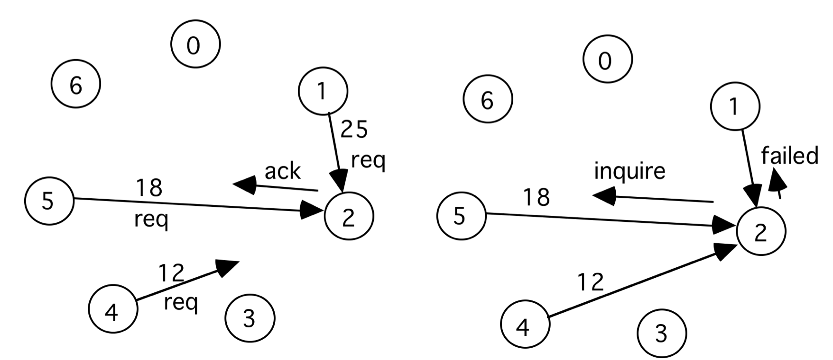
Maekawa’s algorithm-Version 2

Slide 24
Comments
Let K = |S_{i}|. Let each process be a member of D subsets. When N = 7, K = D = 3. When K=D, N = K(K-1)+1. So K =O(√N)
- The message complexity of Version 1 is 3√N. Maekawa’s analysis of Version 2 reveals a complexity of 7√N
Sanders identified a bug in version 2 …

Slide 25
Token-passing Algorithms for mutual exclusion
Suzuki-Kasami algorithm
For a completely connected network of processes
The Main idea
There is one token in the network. The holder of the token has the permission to enter CS.
Any other process trying to enter CS must acquire that token. Thus the token will move from one process to another based on demand.
I want to enter CS
I want to enter CS
(See the textbook for details)

Slide 26
Mutual Exclusion in Shared Memory Model
M
0
1
2
N

Slide 27
First attempt
program peterson;
define flag[0], flag[1] : shared boolean;
initially flag[0] = false, flag[1] = false
{program for process 0}
do true →
flag[0] = true;
do flag[1] → skip od
critical section;
flag[0] = false;
non-critical section codes;
od
{program for process 1}
do true →
flag[1] = true;
do flag[0] → skip od;
critical section;
flag[1] = false;
non-critical section codes;
od
Does it work?

Slide 28
Petersen’s algorithm
program peterson;
define flag[0], flag[1] : shared boolean;
turn: shared integer
initially flag[0] = false, flag[1] = false, turn = 0 or 1
{program for process 0}
do true →
flag[0] = true;
turn = 0;
do (flag[1] ⋀ turn =0) → skip od
critical section;
flag[0] = false;
non-critical section codes;
od
{program for process 1}
do true →
flag[1] = true;
turn = 1;
do (flag[0] ⋀ turn = 1) → skip od;
critical section;
flag[1] = false;
non-critical section codes;
od
Simplest 2-process
mutex algorithm

