Slide 1
Time and Clock

Slide 2
Time and Clock
Primary standard of time = rotation of earth
De facto primary standard = atomic clock
(1 atomic second = 9,192,631,770 orbital transitions of Cesium ¹³³ atom.
86400 atomic sec = 1 solar day – approximately 2 ms (Match up with solar day or astronomical time requires occasional leap second correction)
Coordinated Universal Time (UTC) does the adjustment for leap seconds = GMT ± number of hours in your time zone. It is thus kept within 1 second from the mean solar time (UT1) at 0 degree longitude

Slide 3

Global Positioning system: GPS
Location and precise time
computed by triangulation
Right now GPS time is 18 seconds ahead of UTC, since it does not use leap sec. correction
Per the theory of relativity, an
additional correction is needed.
Locally compensated by the
receivers.
A system of 32 satellites broadcast accurate spatial
coordinates and time maintained by atomic clocks

Slide 4
Physical clock synchronization
Question 1. Why is physical clock synchronization important?
Question 2. With the price of atomic clocks or GPS coming down, should we care about physical clock synchronization?

Slide 5
Classification
Types of Synchronization
External Synchronization
Internal Synchronization
Phase Synchronization
Types of clocks
Unbounded 0, 1, 2, 3, . . .
Bounded 0,1, 2, . . . M-1, 0, 1, . . .
Unbounded clocks are not realistic, but are easier to
deal with in the design of algorithms. Real clocks are
always bounded.

Slide 6
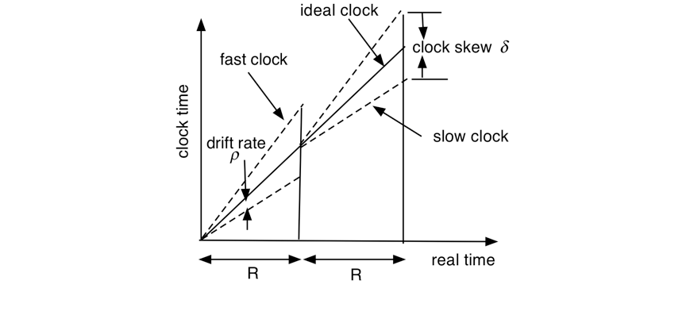
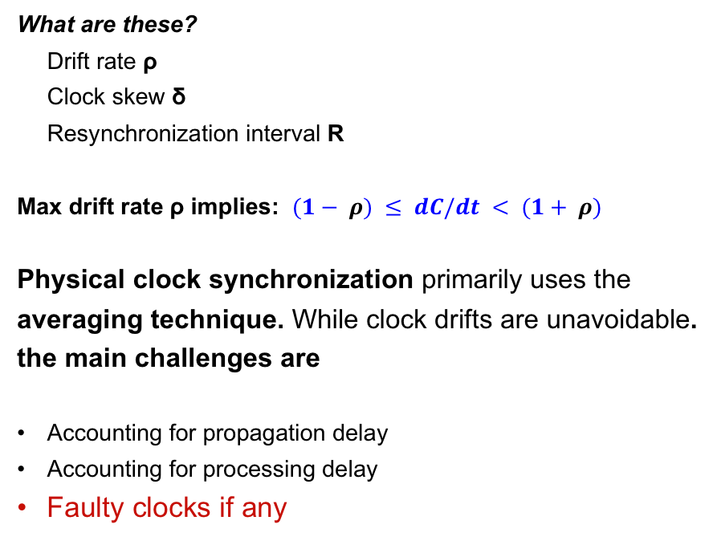
Terminologies
What are these?
Drift rate ρ
Clock skew δ
Resynchronization interval R
Max drift rate ρ implies: $(1− ρ) ≤ dC/dt < (1+ ρ)$
Physical clock synchronization primarily uses the
averaging technique. While clock drifts are unavoidable.
the main challenges are
Accounting for propagation delay
Accounting for processing delay
Faulty clocks if any

Slide 7
Internal synchronization
Berkeley Algorithm
A simple averaging algorithm
that guarantees mutual
consistency |c(i) - c(j)| < δ.
The participants elect a leader
The leader coordinates the synchronization
Step 1. Leader reads every clock in the system.
Step 2. Discard outliers and substitute them by the value of the local clock.
Step 3. Computes the average, and sends the needed adjustment to the participating clocks
Resynchronization interval R will depend on the drift rate.

Slide 8
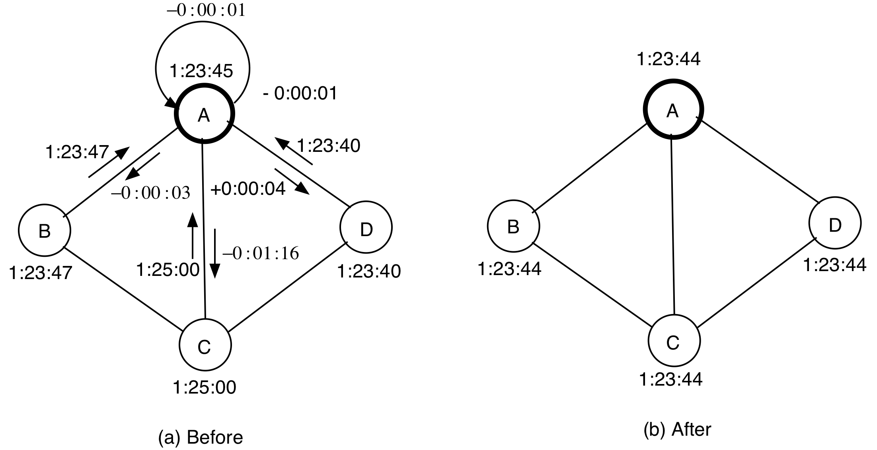
Berkeley algorithm

Slide 9
Internal synchronization with byzantine clocks
Lamport and Melliar-Smith’s
averaging algorithm handles
byzantine clocks too
Assume n clocks, at most t are faulty
Step 1. Read every clock in the system.
Step 2. Discard outliers and substitute them by the value of the local clock.
Step 3. Update the clock using the average of these values.
Synchronization is maintained if n > 3t
Why?
Bad clock
A faulty clocks exhibits 2-faced or byzantine behavior

Slide 10
Internal synchronization
Lamport & Melliar-Smith’s algorithm (continued)
The maximum difference between
the averages computed by two
non-faulty nodes is (3tδ / n)
To keep the clocks synchronized,
3tδ / n < δ
So, 3t < n
B a d c l o c k s

Slide 11
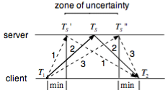
Cristian’s method
External Synchronization
Time
server
Client pulls data from a time server
every R unit of time, where R < δ / 2ρ. (why?)
For accuracy, clients must compute the round trip time (RTT), and compensate for this delay while adjusting their own clocks. (Too large RTT’s are rejected)

Slide 12
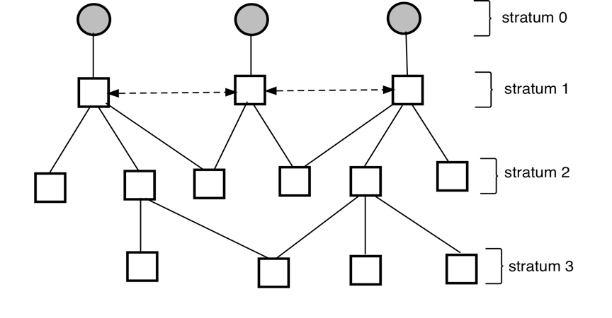
Network Time Protocol (NTP)
Cesium clocks or GPS based clocks
Broadcast mode
- least accurate
Procedure call
- medium accuracy
Peer-to-peer mode
upper level servers use
this for max accuracy
A computer will try to synchronize its clock with several servers, and accept the best
results to set its time. Accordingly, the synchronization subnet is dynamic.

Slide 13
Peer-to-peer mode of NTP
Let Q’s time be ahead of P’s time by δ. Then
T2 = T1 + T_{PQ} + δ
T4 = T3 + T_{QP} - δ
y = T_{PQ} + T_{QP} = T2 +T4 -T1 -T3 (RTT)
δ = (T2 -T4 -T1 +T3) / 2 - (T_{PQ} - T_{QP}) / 2
T2
T3
Q
P
T1
T4
x
Between y/2 and -y/2
So, x- y/2 ≤ δ ≤ x+ y/2
Ping several times, and obtain the smallest value of y. Use it to calculate δ

Slide 14
Problems with Clock adjustment
1. What problems can occur when a clock value is advanced from 171 to 174?
2. What problems can occur when a clock value is moved back from 180 to 175?

Slide 15
Sequential and Concurrent events
Sequential = Totally ordered in time.
Total ordering is feasible in a single process that has
only one clock. This is not true in a distributed system, since clocks are never perfectly synchronized.
Can we define sequential and concurrent events without using physical clocks, since physical clocks are not be perfectly synchronized?

Slide 16
What does “concurrent” mean?
Simultaneous? Happening at the same time? NO.
There is nothing called simultaneous in the physical world.
Alice
Explosion 2
Explosion 1
Bob

Slide 17
Causality
Causality helps identify sequential and concurrent
events without using physical clocks.
Joke  Re: joke ( implies causally ordered before or happened before)
Message sent  message received
Local ordering: a  b  c (based on the local clock)

Slide 18
Defining causal relationship
Rule 1. If a, b are two events in a single process P, and the time of a is less than the time of b then a  b.
Rule 2. If a = sending a message, and b = receipt of that message, then a  b.
Rule 3. (a  b) ∧ (b  c) ⇒ a  c

Slide 19
Example of causality
a  d since(a  b ∧ b  c ∧ c  d)
e  d since (e  f ∧ f  d)
(Here  defines a PARTIAL order).
Is g f or f g?
NO, they are concurrent.
.
Concurrency = absence of causal order

Slide 20
Logical clocks
Each process maintains its logical clock as follows:
LC1. Each time a local event takes place, increment LC.
LC2. Append the value of LC to outgoing messages.
LC3. When receiving a message, set LC to
1 + max (local LC, message LC)
LC is a counter. Its value respects causal ordering as follows
a  b ⇒ LC(a) < LC(b)
But LC(a) < LC(b) does NOT imply a  b.

Slide 21
Total order in a distributed system
Total order is important for some applications like scheduling (first-come first served). But total order does not exist! What can we do?
Strengthen the causal order  to define a total order (<<) among events. Use LC to define total order (in case two LC’s are equal, process id’s will be used to break the tie).
Let a, b be events in processes i and j respectively. Then
a << b iff
-- LC(a) < LC(b) OR
-- LC(a) = LC(b) and i < j
a  b ⇒ a << b, but the converse is not true.
The value of LC of an event is called its timestamp.

Slide 22
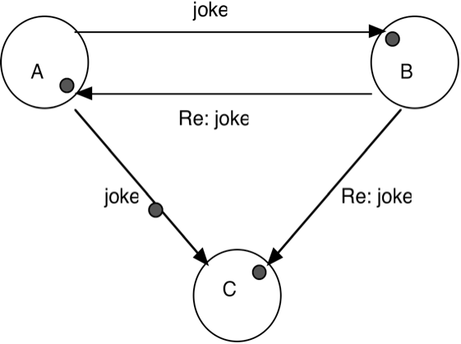
Vector clock
Causality detection can be an important issue in applications like group communication.
Logical clocks do not detect causal ordering. Vector clocks do.
a  b ⇔ VC(a) < VC(b)
C may receive Re:joke
before joke, which is bad!
(What does < mean?)

Slide 23
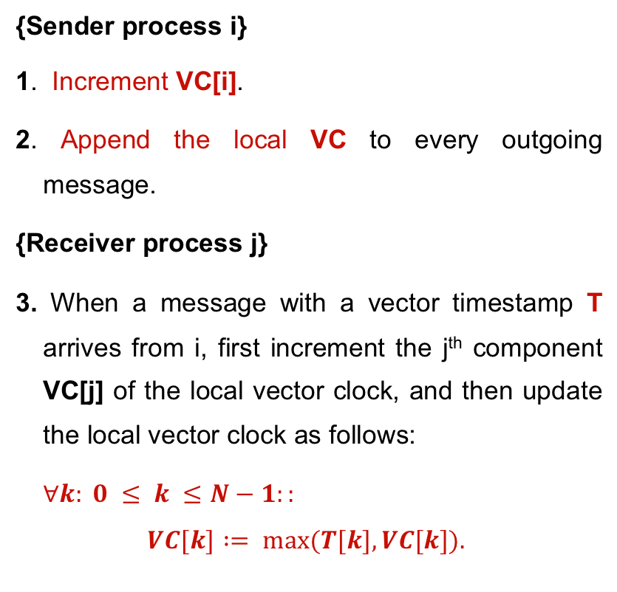
Implementing VC
i^{th} component of VC
{Sender process i}
1. Increment VC[i].
2. Append the local VC to every outgoing message.
{Receiver process j}
3. When a message with a vector timestamp T arrives from i, first increment the j^{th} component VC[j] of the local vector clock, and then update the local vector clock as follows:
$∀k: 0 ≤ k ≤N−1::$
$$VC[k] := max⁡(T[k], VC[k]).$$

Slide 24
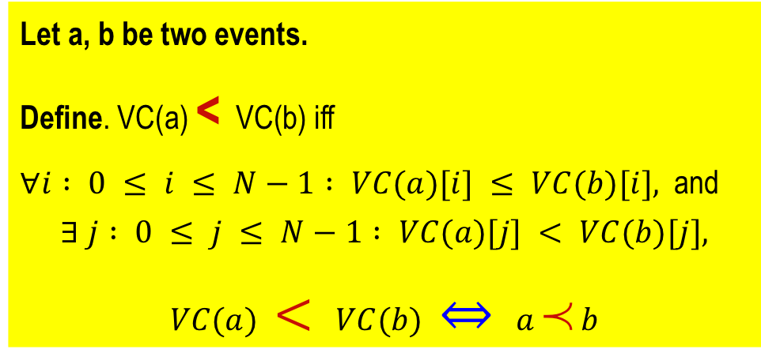
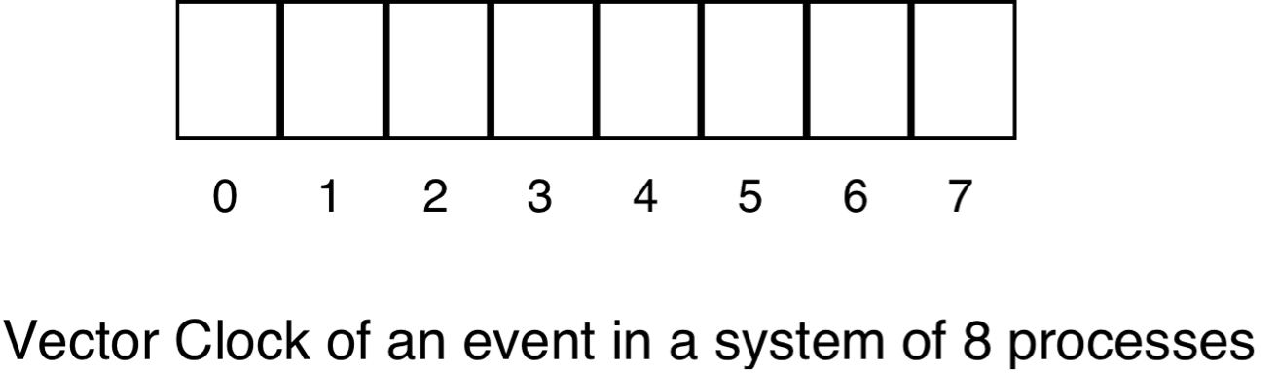
Vector clocks
Example
[3, 3, 4, 5, 3, 2, 1, 4] <
[3, 3, 4, 5, 3, 2, 2, 5]
But,
[3, 3, 4, 5, 3, 2, 1, 4] and
[3, 3, 4, 5, 3, 2, 2, 3]
are not comparable
Let a, b be two events.
Define. VC(a) < VC(b) iff
$∀i : 0 ≤ i ≤ N−1 : VC(a)[i] ≤ VC(b)[i],$and
$$∃ j : 0 ≤ j ≤ N−1 : VC(a)[j] < VC(b)[j],$$
$$VC(a) < VC(b) ⇔ a  b$$
Causality detection

