Slide 1

Algorithmic Nuggets in Content Delivery
Presenter: Sikder Huq

Slide 2
Content distribution networks
challenge: how to distribute web contents to hundreds of thousands of simultaneous users?
option 1: single, large “mega-server”
single point of failure
point of network congestion
long path to distant clients
multiple copies of content sent over outgoing links
….quite simply: this solution doesn’t scale

Slide 3
Content distribution networks
challenge: how to distribute web contents to hundreds of thousands of simultaneous users?
option 2: store/serve multiple copies of videos at multiple geographically distributed sites (CDN)
enter deep: push CDN servers deep into many access networks
close to users
used by Akamai, 1700 locations, 170K+ edge servers
bring home: smaller number (10’s) of larger clusters in POPs near (but not within) access networks
used by Limelight

Slide 4





Content Distribution Networks (CDNs)
CDN: stores copies of content at CDN nodes
e.g. Netflix stores copies of MadMen
subscriber requests content from CDN
directed to nearby copy, retrieves content
may choose different copy if network path congested
…
…
…
manifest file
…
where’s Madmen?
…
…
Notes:
4
Akamai: 100,000+ servers in 1000+ clusters in 1000+ networks in 70+ countries serving trillions of requests a day.
How many people use Netflix?

Slide 5
Content Distribution Networks (CDNs)
“over the top”
…
…
Internet host-host communication as a service
…
challenges: coping with a congested Internet
from which CDN node to retrieve content?
viewer behavior in presence of congestion?
what content to place in which CDN node?
…
…
…
Notes:
5
peak load: 7million viewers, 2 Tbytes via

Slide 6


CDN content access: a closer look
Bob (client) requests video http://netcinema.com/6Y7B23V
video stored in CDN at http://KingCDN.com/NetC6y&B23V
1. Bob gets URL for video http://netcinema.com/6Y7B23V
from netcinema.com web page
2. resolve http://netcinema.com/6Y7B23V
via Bob’s local DNS
1
2
6. request video from
KINGCDN server,
streamed via HTTP
5
Bob’s
local DNS
server
netcinema.com
3. netcinema’s DNS returns URL
http://KingCDN.com/NetC6y&B23V
4&5. Resolve
http://KingCDN.com/NetC6y&B23
via KingCDN’s authoritative DNS,
which returns IP address of KingCDN
server with video
4
3
netcinema’s
authoratative DNS
KingCDN.com
KingCDN
authoritative DNS

Slide 7
Case study: Netflix
Amazon cloud
upload copies of multiple versions of video to CDN servers
CDN
server
Netflix registration,
accounting servers
3. Manifest file
returned for
requested video
2. Bob browses
Netflix video
CDN
server
2
3
1
1. Bob manages Netflix account
CDN
server
4. Streaming

Slide 8
Embedded Image Delivery (e.g., Yahoo!)
Embedded URLs are Converted to ARLs (Akamai)
<html>
<head>
<title>Welcome to xyz.com!</title>
</head>
<body>
<img src=“
<img src=“
<h1>Welcome to our Web site!</h1>
<a href=“page2.html”>Click here to enter</a>
</body>
</html>
ak
http://www.xyz.com/logos/logo.gif”>
http://www.xyz.com/jpgs/navbar1.jpg”>
Notes:
Very simple process.

Slide 9
CDN objectives
High reliability
Fast and consistent service
Low cost

Slide 10
Algorithms used in CDN
Stable marriage with tree constraints
Global/cluster level load balancing
Consistent hashing
Local/server level load balancing
Bloom filters
To decide what contents to cache in servers
Overlay routing
To route contents from origin to edge servers
Leader election
For fault-tolerant decision-making
Survey paper:
Algorithmic Nuggets in Content Delivery
Authors: Bruce Maggs and Ramesh Sitaraman
(Thanks to the authors for sending me slides on request)

Slide 11
In this talk…
Stable marriage with tree constraints
Global/cluster level load balancing
Consistent hashing
Local/server level load balancing
Bloom filters
To decide what contents to cache in servers
Overlay routing
To route contents from origin to edge servers
Leader election
For fault-tolerant decision-making

Slide 12
Hashing
Universe U of all possible objects, set B of buckets.
object: set of web objects with same serial number
bucket: web server
Hash function h: U → B
Assigns objects to buckets
E.g., h(x) = (((a x + b) mod P) mod |B|) , where
P is prime, P > |U|
a,b chosen uniformly at random from Z_{P}
x is a serial number

Slide 13
Difficulty changing number of buckets
4
3
2
1
0
bucket
5 7 10 11 27 29 36 38 40 43
object
f(d) = d + 1 mod 5
f(d) = d + 1 mod 4

Slide 14
Consistent Hashing
A ring based hash space (consistent hashing)
K
B
Object a
H(a)
A
C
J
Hash function
H
Served by D
D
Object b
H(b)
I
L
Hash function
F
Served by G
E
G

Slide 15
Consistent Hashing
Idea: Map both objects and buckets to unit circle.
Object
Bucket/server
new bucket
Assign object to next bucket on circle in clockwise order.

Slide 16
Properties of Consistent Hashing
Balance: Objects are assigned to buckets “randomly”.
Monotonicity: When a bucket is added/removed, the only objects affected are those that are/were mapped to the bucket.
Load: Objects are assigned to buckets evenly, even over a set of views.
-- can be improved by mapping each bucket to multiple places on unit circle (virtual nodes)
Spread: An object should be mapped to a small number of buckets over a set of views.

Slide 17
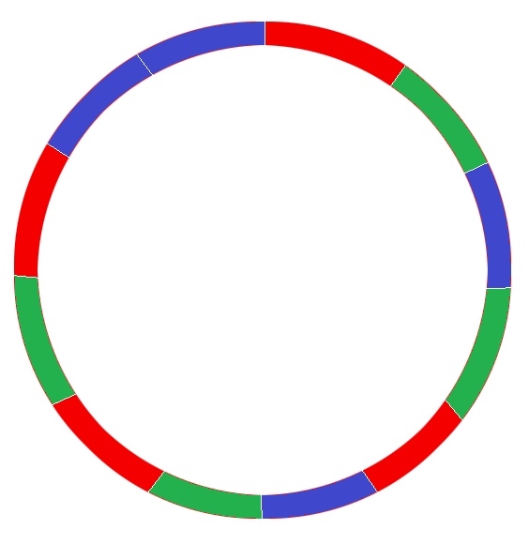
Virtual nodes
Multiple presence of a server in hash space
3 servers: A, B and C
Each server has 4 positions in the ring
Why?
Load-balancing for server addition/removal
Heterogeneity
C3
C1
B4
B2
A2
Hash space of server A
A4
C2
B3
A1
A3
B1
C4

Slide 18
Actual low level load-balancing algorithm
a212: 10.10.10.1 10.10.10.4 10.10.10.3 10.10.10.2
a213: 10.10.10.3 10.10.10.4 10.10.10.2 10.10.10.1
a214: 10.10.10.1 10.10.10.2 10.10.10.3 10.10.10.4
a215: 10.10.10.2 10.10.10.1 10.10.10.4 10.10.10.3
random permutations of servers
Why? To spread load for one serial number.

Slide 19
Leader Election Example
All low-level name servers for a cluster compute the hash table.
One is elected leader and distributes its table to the others.

Slide 20
Stable Marriages
Assignment of men and women
Each man ranks each woman and vice versa
Marriage stable if no pair (m,w) unmatched where m prefers w to his “wife” and w prefers m to her “husband”
3
2
2
4

Slide 21
Residents-Hospitals Extension
Residents-Hospitals
results + algorithm extends to case in which hospital j can accept c(j) residents
In use since 1951 by National Intern Matching Program

Slide 22
Multi-Dimensional Load
Not a single constraining resource!
Can be:
Bandwidth
CPU usage (e.g. key signing for https)
Disk usage (e.g. for cache misses, auction sites)
Memory (e.g. EdgeJava)
Threads (e.g. EdgeJava)
Number of licenses in RealAudio

Slide 23
Stable Allocations With Tree Constraints
[G ’00]:
resources 1,…,k
Supply item j has rooted tree T(j) of constraints
V(T(j))={1,…,k}
Every node v of T has capacity c(j,v)
Demand item i has basic resource b(i) and demand d(i)
When x units mapped to supply j, uses x units of each resource on path in T(j) from b(i) to root of T(j)
Stability as before

Slide 24
Instance of Problem
Demand items: (groups of IPs, rule for mapping)
m=hundreds of thousands
Supply items: cluster of servers
n=thousands
(Incomplete) preference lists for demands based on performance + contract rules
(Implicit) preference lists for supplies based on alternate choices, contract rules, …
Tree of constraints model various resource constraints

Slide 25
Algorithm for Tree Constraints
[0,12]
[2,12]
[5,12]
[12,12]
[10,12]
[12,12]
[12,12]
[10,12]
Demand items request unassigned demands in order of preference
When demand i requests x units from j, repeat:
Find lowest (in tree) tight constraint, say node v
Dispose demands (up to x) of lower preference than i and using resources in subtree rooted at v
[8,12]
Demand =
8
2
5
3
[0,9]
[2,9]
[7,9]
[5,9]
[9,9]
[9,9]
[7,9]
3
[0,5]
[3,5]
[0,9]
[2,9]
[4,9]
[4,9]
[8,9]
[2,9]
5
1
[0,7]
[5,7]
[1,7]
2
4
[load,cap]
2
8
[0,8]
[2,8]
[0,6]
[4,8]
[2,6]
[8,8]
[0,6]

Slide 26
Acknowledgement
Many of the slides are taken from the following sources:
Computer Networking – A Top-Down Approach (Kurose and Ross)
Slides on Key Algorithms in Content Delivery System by professor Maggs

Slide 27
Questions?
Thanks for your attention!
Presenter:
Sikder Huq
PhD Candidate (Computer Science)
The University of Iowa
e-mail: sikderrezwanul-huq@uiowa.edu

