Slide 1
Pastry
Peter Druschel, Rice University
Antony Rowstron, Microsoft Research UK
Some slides are taken from the authors original presentation

Slide 2

What is Pastry?
Pastry is a structured P2P network

Slide 3
What is Pastry
Self-organizing overlay network
Lookup/insert object in < log₁₆ N routing steps (expected)
O(log N) per-node state (for routing table)
Network proximity routing

Slide 4
Pastry: Object distribution
2¹²⁸-1
O
Consistent hashing [Karger et al. ‘97]
128 bit circular id space
nodeIds (uniform random)
objIds (uniform random)
Invariant: node with numerically closest nodeId maintains object
objId
nodeIds

Slide 5
Pastry: Routing
0x | 1x | 2x | 3x | 4x | 5x |  | 7x | 8x | 9x | ax | bx | cx | dx | ex | fx
60x | 61x | 62x | 63x | 64x |  | 66x | 67x | 68x | 69x | 6ax | 6bx | 6cx | 6dx | 6ex | 6fx
650x | 651x | 652x | 653x | 654x | 655x | 656x | 657x | 658x | 659x |  | 65bx | 65cx | 65dx | 65ex | 65fx
Log ₁₆ N
rows
Leaf set
Routing table for node 65a1fc (b=4, so 2^{b} = 16)

Slide 6
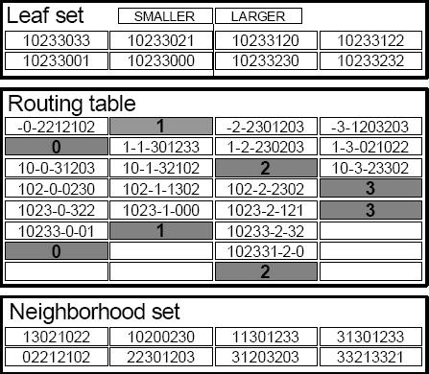
Pastry Node State
State of node 10233102
Set of nodes with |L|/2
smaller and |L|/2 larger
numerically closest NodeIds
Prefix-based routing entries
|M| “physically” closest
nodes

Slide 7
Pastry: Routing
d471f1
d467c4
d462ba
d46a1c
d4213f
Route(d46a1c)
d13da3
Properties
log₁₆N steps to search
O(log N) size of routing table
65a1fc

Slide 8
Pastry: Leaf sets
Each node maintains IP addresses of the nodes with the L/2 numerically closest larger and smaller nodeIds, respectively.
routing efficiency/robustness
fault detection (keep-alive)
application-specific local coordination

Slide 9
Pastry: Routing procedure
if (destination is “within range of our leaf set”)
forward to numerically closest member
else
let l = length of shared prefix
let d = value of l-th digit in D’s address
if (R_{l}^{d} exists) forward to R_{l}^{d}
(R_{l}^{d} = l^{th} row & d^{th} col of routing table)
else forward to a known node that
(a) shares at least as long a prefix, and
(b) is numerically closer than this node
[Prefix routing]

Slide 10
Pastry: Performance
Integrity of overlay/ message delivery:
guaranteed unless L/2 simultaneous failures of nodes with adjacent nodeIds occur
Number of routing hops:
No failures: < log₁₆ N expected
O(N) worst case (why?), average case much better

Slide 11
Pastry: Self-organization
Initializing and maintaining routing tables and leaf sets
Node addition
Node departure (failure)

Slide 12
Pastry: Node addition
d471f1
d467c4
d462ba
d46a1c
New node X: d46a1c
d4213f
The new node X asks
node 65a1fc to route
a message to it. Nodes
in the route share their
routing tables with X
Route(d46a1c)
d13da3
65a1fc
host

Slide 13
Node departure (failure)
Leaf set members exchange heartbeat messages
Leaf set repair (eager): request set from farthest live node in set
Routing table repair (lazy): get table from peers in the same row, then higher rows

Slide 14
Node departure (failure)
Leaf set members exchange heartbeat
Leaf set repair (eager): request the set from farthest live node
Routing table repair (lazy): get table from peers in the same row, then higher rows

Slide 15
Pastry: Average # of hops
L=16, 100k random queries

Slide 16
Pastry: Proximity routing
Proximity metric = time delay estimated by a ping
A node can probe distance to any other node
Each routing table entry uses a node close to the local node (in the proximity space), among all nodes with the appropriate node Id prefix.

Slide 17

Pastry: Routes in proximity space
d467c4
d471f1
d467c4
Proximity space
d462ba
d46a1c
d4213f
Route(d46a1c)
d13da3
d4213f
65a1fc
65a1fc
NodeId space
d462ba
d13da3

Slide 18
Pastry: Distance traveled
L=16, 100k random queries, Euclidean proximity space

Slide 19
PAST: File storage
k=4
Storage Invariant:
File “replicas” are
stored on k nodes
with nodeIds
closest to fileId
(k is bounded by the leaf set size)
fileId
Insert fileId

Slide 20
PAST: File Retrieval
C
k replicas
Lookup
fileId
file located in log₁₆ N steps (expected)
usually locates replica nearest to client C

Slide 21
PAST API
Insert - store replica of a file at k diverse storage nodes
Lookup - retrieve file from a nearby live storage node that holds a copy
Reclaim - free storage associated with a file
Files are immutable

Slide 22
SCRIBE: Large-scale, decentralized multicast
Infrastructure to support topic-based publish-subscribe applications
Scalable: large numbers of topics, subscribers, wide range of subscribers/topic
Efficient: low delay, low link stress, low node overhead

