Slide 1
CS:5810 Formal Methods in
Software Engineering
Case Study: Hotel Lock System
Copyright 2007-17 Laurence Pilard, and Cesare Tinelli.
Produced by Cesare Tinelli from notes originally written by Laurence Pilard at the University of Iowa. These notes are copyrighted materials and may not be used in other course settings outside of the University of Iowa in their current form or modified form without the express written permission of one of the copyright holders. During this course, students are prohibited from selling notes to or being paid for taking notes by any person or commercial firm without the express written permission of one of the copyright holder.
Notes:
<number>

Slide 2
Acknowledgments
These notes are based on an Alloy
example in the following book:
[Jack06] Daniel Jackson. Software abstractions – Logic, Language, and Analysis. The MIT press, 2006.
CS:5810 -- Formal Methods in Software Engineering Fall 2019
<number>
Notes:
<number>

Slide 3
The Task
Model in Alloy the disposable card key system used in most hotels for locking and unlocking guest rooms
The system uses recordable locks, which prevent previous guests from entering a room once its has been re-assigned
We will model both static and dynamic aspects of the system
CS:5810 -- Formal Methods in Software Engineering Fall 2017
<number>

Slide 4
Problem Description [Jack06]
“[…] the hotel issues a new key to the next occupant, which recodes the lock, so that previous keys will no longer work.
The lock is a simple, stand-alone unit […] with a memory holding the current key combination.
A hardware device […] [within the lock] generates a sequence of pseudorandom numbers.”
CS:5810 -- Formal Methods in Software Engineering Fall 2017
<number>

Slide 5
Problem Description [Jack06]
“The lock is opened either by the current key combination, or by its successor;
if a key with the successor is inserted, the successor is made to be the current combination, so that the old combination will no longer be accepted.
This scheme requires no communication between the front desk and the door lock.”
CS:5810 -- Formal Methods in Software Engineering Fall 2017
<number>

Slide 6
Problem Description [Jack06]
“By synchronizing the front desk and the door locks initially, and by using the same pseudorandom generator,
the front desk can keep its records of the current combinations in step with the doors themselves.”
CS:5810 -- Formal Methods in Software Engineering Fall 2017
<number>

Slide 7
Signatures and Fields
Signatures: Time, Key, Room, Guest, FrontDesk
Key refers to the key combination stored in the magnetic strip of the card
FrontDesk stores at any time a mapping
between each room and its most recent key combination (if any), and
between each room and its current guest
CS:5810 -- Formal Methods in Software Engineering Fall 2017
<number>

Slide 8
Signatures and Fields
Room refers to the room lock
Each room (lock) has
an associated set of possible keys, and
exactly one current key at a time
Each key belongs to at most one room
Each guest has zero or more keys at any time
CS:5810 -- Formal Methods in Software Engineering Fall 2017
<number>

Slide 9
Signatures and Fields
module hotel
open util/ordering [Time] as TO
open util/ordering [Key] as KO
}
CS:5810 -- Formal Methods in Software Engineering Fall 2017
<number>

Slide 10
Signatures and Fields
module hotel
open util/ordering [Time] as TO
open util/ordering [Key] as KO
sig Key {}
sig Time {}
sig Room {
keys: set Key,
currentKey: Key one -> Time
}
sig Guest {
keys: Key -> Time
}
one sig FrontDesk {
lastKey: (Room -> lone Key) -> Time,
occupant: Room -> Guest -> Time
}
CS:5810 -- Formal Methods in Software Engineering Fall 2017
<number>

Slide 11
Room Constraint
Each key belongs to at most one room
fact {
all k: Key | lone keys.k
}
CS:5810 -- Formal Methods in Software Engineering Fall 2017
<number>

Slide 12
New Key Generation
Given a key k and a set ks of keys, the function nextKey returns the smallest key (in the key ordering) in ks that follows k.
fun nextKey [k: Key, ks: set Key]: set Key
{
KO/min [KO/nexts[k] & ks]
}
CS:5810 -- Formal Methods in Software Engineering Fall 2017
<number>

Slide 13
Initial State
module examples/hotel
open util/ordering [Time] as TO
open util/ordering [Key] as KO
sig Key {}
sig Time {}
sig Room {
keys: set Key,
currentKey: Key one -> Time
}
sig Guest {
keys: Key -> Time
}
one sig FrontDesk {
lastKey: (Room -> lone Key) -> Time,
occupant: Room -> Guest -> Time
}
No constraints
the record of each room’s key at the front desk is synchronized with the current combination of the lock itself
No guests have keys
No rooms are occupied
CS:5810 -- Formal Methods in Software Engineering Fall 2017
<number>

Slide 14
Hotel Operations: Initial State
pred init [t: Time] {
-- no guests have keys
no Guest.keys.t
-- the roster at the front desk shows
-- no room as occupied
no FrontDesk.occupant.t
-- the record of each room’s key at the
-- front desk is synchronized with the
-- current combination of the lock itself
all r: Room |
r.(FrontDesk.lastKey.t) = r.currentKey.t
}
CS:5810 -- Formal Methods in Software Engineering Fall 2017
<number>

Slide 15
Hotel Operations: Guest Entry
pred entry [ g: Guest, r: Room, k: Key,
t, t': Time ]
Preconditions:
The key used to open the lock is one of the keys the guest is holding
Pre and Post Conditions:
The key on the card
either matches the lock’s current key, and the lock remains unchanged (not a new guest), or
matches its successor, and the lock is advanced (new guest)
Frame conditions:
no changes to the state of other rooms, or to the set of keys held by guests, or to the records at the front desk
CS:5810 -- Formal Methods in Software Engineering Fall 2017
<number>

Slide 16
Hotel Operations: Guest Entry
pred entry[ g:Guest, r:Room, k:Key, t,t’:Time ] {
-- the key used to open the lock is one of
-- the keys the guest is holding
k in g.keys.t
-- pre and post conditions
let ck = r.currentKey |
-- not a new guest
(k = ck.t and ck.t' = ck.t) or
-- new guest
(k = nextKey[ck.t, r.keys] and ck.t' = k)
-- frame conditions
noFrontDeskChange[t, t’]
noRoomChangeExcept[r, t, t’]
noGuestChangeExcept[none, t, t’]
}
CS:5810 -- Formal Methods in Software Engineering Fall 2017
<number>

Slide 17
Frame Condition Predicates
pred noFrontDeskChange [t,t': Time]
{
FrontDesk.lastKey.t = FrontDesk.lastKey.t'
FrontDesk.occupant.t = FrontDesk.occupant.t'
}
pred noRoomChangeExcept [rs: set Room, t,t': Time]
{
all r: Room - rs |
r.currentKey.t = r.currentKey.t'
}
pred noGuestChangeExcept [gs: set Guest, t,t': Time]
{
all g: Guest - gs | g.keys.t = g.keys.t'
}
CS:5810 -- Formal Methods in Software Engineering Fall 2017
<number>

Slide 18
Hotel Operations: Check-out
pred checkout [ g: Guest, t,t': Time ]
Preconditions:
the guest occupies one or more rooms
Postconditions:
the guest’s rooms become available
Frame conditions:
Nothing changes but the occupant relation
CS:5810 -- Formal Methods in Software Engineering Fall 2017
<number>

Slide 19
Hotel Operations: Check-out
one sig FrontDesk {
lastKey: (Room -> lone Key) -> Time,
occupant: Room -> Guest -> Time
}
pred checkout [ g: Guest, t,t': Time ]
{
let occ = FrontDesk.occupant | {
-- the guest occupies one or more rooms
some (occ.t).g
-- the guest’s rooms become available
occ.t' = occ.t – (Room -> g)
}
-- frame condition
FrontDesk.lastKey.t = FrontDesk.lastKey.t'
noRoomChangeExcept[none, t, t’]
noGuestChangeExcept[none, t, t’]
}
CS:5810 -- Formal Methods in Software Engineering Fall 2017
<number>

Slide 20
Hotel Operations: Check-in
pred checkin [ g: Guest, r: Room, k: Key
t, t': Time ]
Preconditions:
the room is available
the input key is the successor of the last key in the sequence associated to the room
Postconditions:
the guest holds the input key and becomes the new occupant of the room
the input key becomes the room’s current key
Frame conditions:
Nothing changes but the occupant relation and the guest’s relations
CS:5810 -- Formal Methods in Software Engineering Fall 2017
<number>

Slide 21
Hotel Operations: Check-in
pred checkin [ g: Guest, r: Room, k: Key, t,t': Time ] {
let occ = FrontDesk.occupant |
let lk = FrontDesk.lastKey | {
-- the room has no current occupant
no r.occ.t
-- the input key is the successor of the last key in
-- the sequence associated to the room
k = nextKey[r.lk.t, r.keys]
-- the guest becomes the new occupant of the room
occ.t' = occ.t + r->g
-- the guest holds the input key
g.keys.t' = g.keys.t + k
-- the input key becomes the room’s current key
lk.t' = lk.t ++ r->k
}
noRoomChangeExcept[none, t, t’]
noGuestChangeExcept[g, t, t’]
}
CS:5810 -- Formal Methods in Software Engineering Fall 2017
<number>

Slide 22
Trace generation
The first time step satisfies the initialization conditions
Any pair of consecutive time steps are related by
an entry operation, or
a check-in operation, or
a check-out operation
CS:5810 -- Formal Methods in Software Engineering Fall 2017
<number>

Slide 23
Trace generation
pred trans[t,t’: Time] {
some g: Guest, r: Room, k: Key |
entry[g, r, k, t, t’] or
checkin[g, r, k, t, t’] or
checkout[g, t, t’]
}
fact Traces {
init[TO/first]
all t: Time - TO/last |
let t' = TO/next[t] |
trans[t, t’]
}
CS:5810 -- Formal Methods in Software Engineering Fall 2017
<number>

Slide 24
Analysis
Let’s check if unauthorized entries are possible:
If a guest g enters room r at time t, and the front desk records show r as occupied at that time, then g must be a recorded occupant of r.
assert noBadEntry {
all t: Time, r: Room, g: Guest, k: Key | let t' = TO/next[t] |
let o = r.FrontDesk.occupant.t |
(entry[g, r, k, t, t’] and some o)
implies g in o
}
CS:5810 -- Formal Methods in Software Engineering Fall 2017
<number>

Slide 25
Analysis
check noBadEntry for 3
but 2 Room, 2 Guest, 5 Time
It is enough to check for problem already with just 2 guests and 2 rooms
Time’s scope must be at least 5 because at least 4 time steps are needed to execute each operation once.
There is a counter-example (see file hotel1.als
CS:5810 -- Formal Methods in Software Engineering Fall 2017
<number>

Slide 26
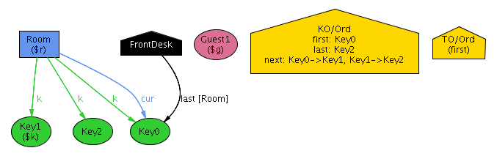
T0: Initial State
Initially, the current key of Room is Key0, which is also reflected in the front desk’s record
CS:5810 -- Formal Methods in Software Engineering Fall 2017
<number>

Slide 27
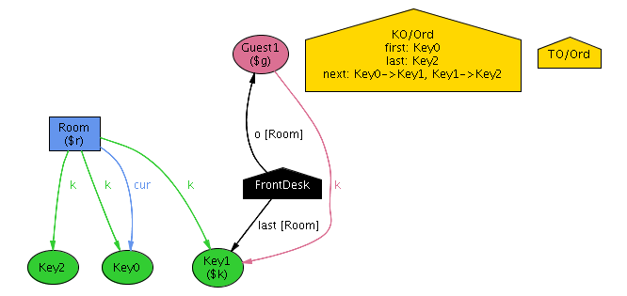
T1: Checkin Operation
Guest1 checks in to Room and receives key Key1; the occupancy roster at the front desk is updated accordingly; Key1 is recorded as the last key assigned to Room
CS:5810 -- Formal Methods in Software Engineering Fall 2017
<number>

Slide 28
T2: Checkout Operation
Guest1 checks out, and the occupancy roster is cleared
CS:5810 -- Formal Methods in Software Engineering Fall 2017
<number>

Slide 29
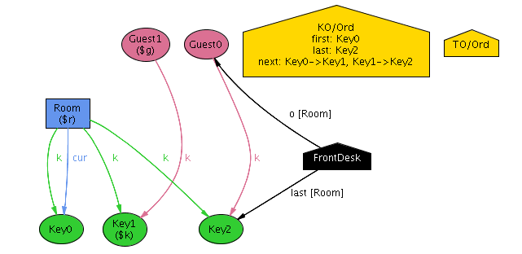
T3: Checkin Operation
Guest0 checks in to Room and receives key Key2; the occupancy roster at the front desk is updated accordingly; Key2 is recorder as the last key assigned to Room
CS:5810 -- Formal Methods in Software Engineering Fall 2017
<number>

Slide 30
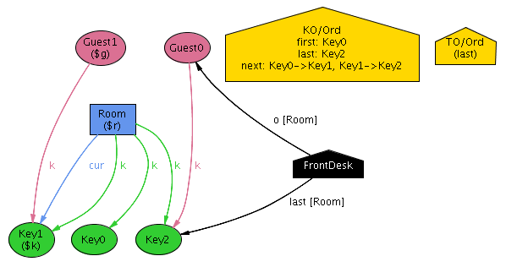
T4: Enter Operation
Guest1 presents Key1 to the lock of Room, and is admitted
CS:5810 -- Formal Methods in Software Engineering Fall 2017
<number>

Slide 31
Necessary Restriction
There must be no intervening operation between a guest’s check-in and room entry.
fact noIntervening {
all t: Time - TO/last |
let t’ = TO/next [t] |
let t’’ = TO/next [t’] |
all g: Guest, r: Room, k: Key |
checkin[g, r, k, t, t’] implies
(
entry[g, r, k, t’, t’’] or
no t’’
)
}
CS:5810 -- Formal Methods in Software Engineering Fall 2017
<number>

Slide 32
Analysis
We check once again:
check noBadEntry for 3
but 2 Room, 2 Guest, 5 Time
No counter-example (see file hotel2.als)
For greater confidence, we increase the scope:
check noBadEntry for 5
but 3 Room, 3 Guest, 9 Time
No counter-examples
CS:5810 -- Formal Methods in Software Engineering Fall 2017
<number>

