Slide 1
Note below is a suggested breakdown for the draft due this week. Note the point value includes the 25 points from last week plus the 25 points for this week. Please upload a pdf using 12 point font, preferably double spaced. If you have questions, please let me know.
Intro: 3+ points
At this stage, have at least a short paragraph introducing what you plan to do for your project. It can be vague for this draft.
Background: 35+ points
Clear description of TDA mapper algorithm
Good use of figures
Helpful figure captions
Discussion of benefits of TDA mapper algorithm
Discussion of limitations of TDA mapper algorithm
Creativity

Slide 2
Creativity
  Note creativity should make ideas clearer (so be careful of being overly creative and unfocused).
  Creativity can include making your own figures to illustrate how TDA mapper works as opposed to using (and citing) other people’s figures.
  Creativity can also include discussing benefits and limitations that we have not covered in class (though what we covered in class can also be included).
Acknowledgement 2+ points
2 points for having this section even if it states “Acknowledgement: none”
I will however give additional points if you specify how someone helped you improve your paper/project. In other words, talk to other students in this class and acknowledge their ideas.
Author contribution 3+ points
Clearly state each author’s contribution.
Funding sources and conflicts of interest 2 points
References (5+ points):
Include original references to any ideas, figures, software, etc. that you use. Also include citations within the text.
  If you are using Microsoft word, consider using Endnote (available for free student use at http://helpdesk.its.uiowa.edu/software/signin.htm).
  If you are using latex, you should use bibtex (if you need assistance, please ask)
If you prefer to not use a reference management software, we won’t check formatting closely, but your formatting should look somewhat decent, similar to
https://www.wctc.edu/current-students/library/apa-citing.pdf

Slide 3
Topology

Slide 4
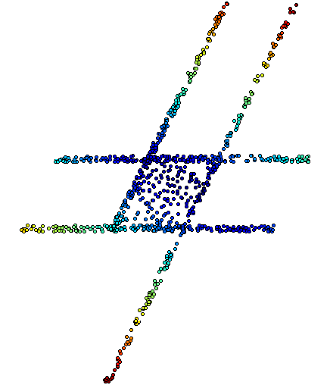
The idea is to provide another tool for a generalized notion of coordinatization for high dimensional data sets. Coordinatization can of course refer to a choice of real valued coordinate functions on a data set,
The graph/simplicial complex created by Mapper can be thought of as a partial coordinization of the data set.
BUT keep in mind that the output is an abstract graph/simplicial complex

Slide 5
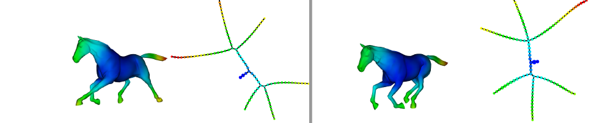
Topological Data Analysis (TDA): Three key ideas of topology that make extracting of patterns via shape possible.
2.) invariant under “small” deformations.
less sensitive to noise
Topological Methods for the Analysis of High Dimensional
Data Sets and 3D Object Recognition, Singh, Mémoli, Carlsson
Figure from http://comptop.stanford.edu/u/preprints/mapperPBG.pdf
http://www.nature.com/srep/2013/130207/srep01236/full/srep01236.html

Slide 6
Geometry
=
=

Slide 7
Topology
=
=

Slide 8
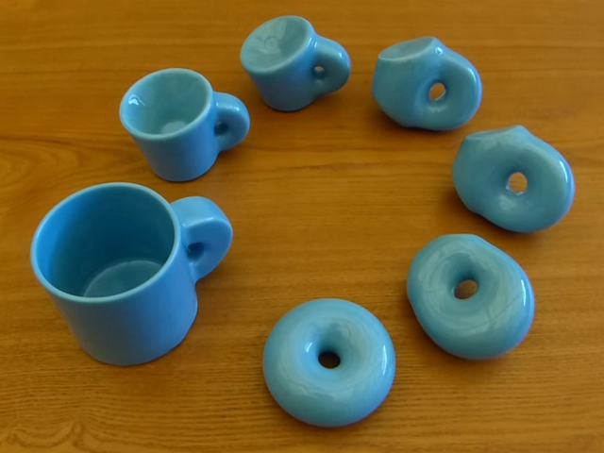

http://images.gmanews.tv/webpics/2016/10/Untitled_2016_10_05_15_45_40.png
http://2.bp.blogspot.com/-SGwFwBjFnBs/ThBqTV1TVUI/AAAAAAAAARw/F1ftHB0teJE/s1600/coffee+cup+as+donut.png

Slide 9
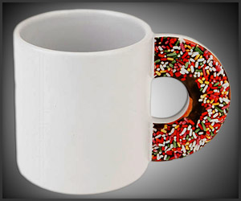
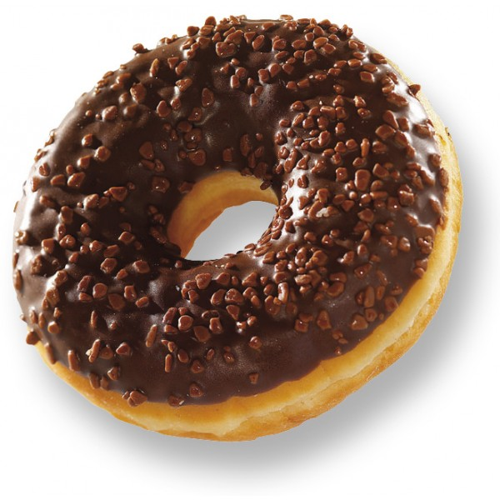
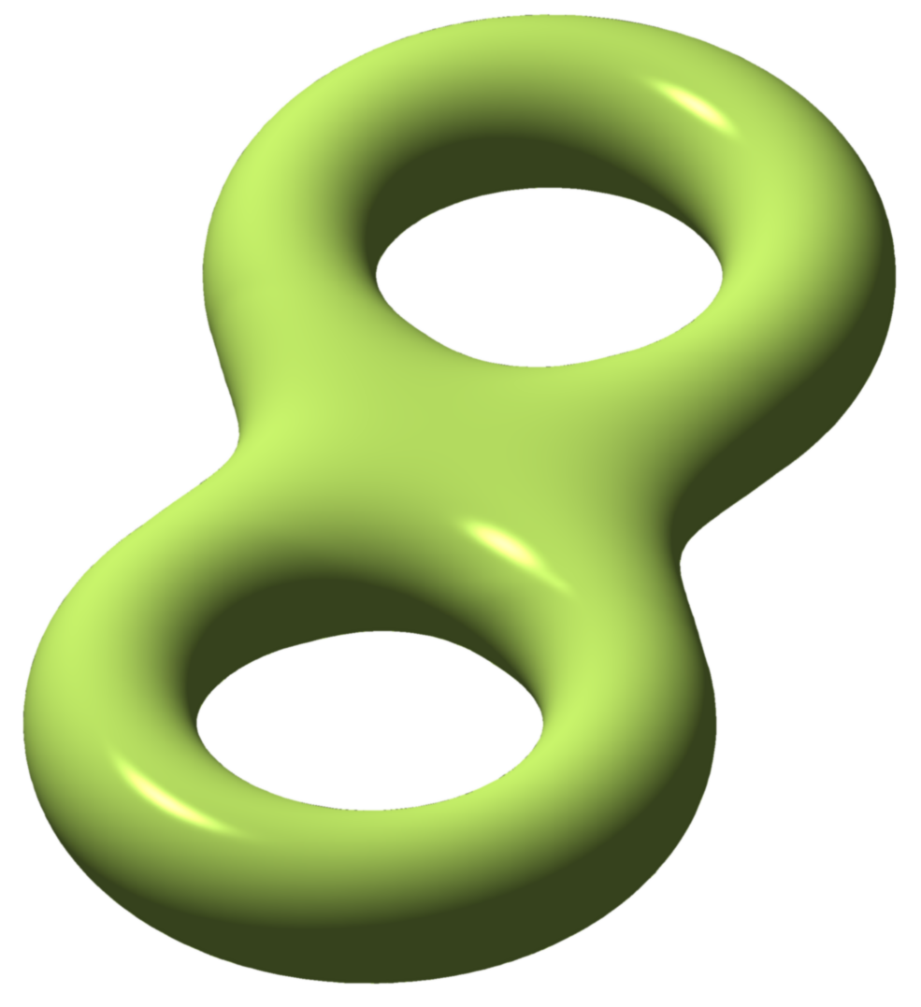
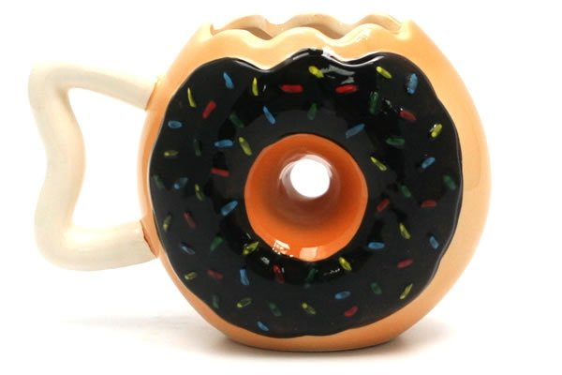
http://images.gmanews.tv/webpics/2016/10/Untitled_2016_10_05_15_45_40.png
http://2.bp.blogspot.com/-SGwFwBjFnBs/ThBqTV1TVUI/AAAAAAAAARw/F1ftHB0teJE/s1600/coffee+cup+as+donut.png
https://www.geekalerts.com/u/Donut-Mug.jpg
torus = donut
http://www.prevogel.fr/156-thickbox_default/donut-chocolat-surgel%C3%A9-vandermoortele.jpg
Not a donut (ie not a torus)
=
http://www.yellowoctopus.com.au/media/catalog/product/y/e/yellow-octopus-donutmug.jpg
https://en.wikipedia.org/wiki/Euler_characteristic

Slide 10
We propose a method which can be used to reduce high dimensional data sets into simplicial complexes with far fewer points which can capture topological and geometric information at a specified resolution.
http://cs233.stanford.edu/ReferencedPapers/mapperPBG.pdf

Slide 11
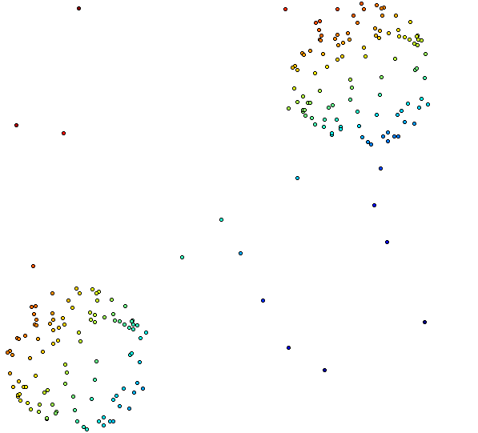
Distance Matrix Eigenvector, Mean Centered Distance Matrix
Order of eigenvector: 1
20 intervals, 80% Overlap

Slide 12
Building blocks for a simplicial complex
0-simplex = vertex = v
1-simplex = edge = {v₁, v₂}
Note that the boundary of this edge is v₂ + v₁
v₁
v₂
e
2-simplex = triangle = {v₁, v₂, v₃}
v₂
Note that the boundary
of this triangle is the cycle
e₁ + e₂ + e₃
= {v₁, v₂} + {v₂, v₃} + {v₁, v₃}
e₁
e₂
v₁
v₃
e₃
Notes:
The building blocks for a simplicial complex consist of zero simplices which are zero dimensional vertices, one simplices which are one-dimensional edges, and 2-simplices which are two dimensional triangles,

Slide 13
Creating a simplicial complex
1.) Next add 1-dimensional edges (1-simplices).
Note: These edges must connect two vertices.
I.e., the boundary of an edge is two vertices

Slide 14
Creating a simplicial complex
1.) Next add 1-dimensional edges (1-simplices).
Note: These edges must connect two vertices.
I.e., the boundary of an edge is two vertices

Slide 15
Creating a simplicial complex
n.) Add n-dimensional n-simplices, {v₁, v₂, …, v_{n+1}}.
Boundary of a n-simplex
= a cycle consisting of (n-1)-simplices.
Notes:
In step n, we can add n-simplices, but only if its boundary, a sum of (n-1) dimensional simplices was created in the previous step, the n-1 step where we added n-1 - simplices.
In our example, the highest dimensional simplex is a 3-simplex, this solid tetrahedron, so we have a 3-dimensional simplicial complex.
This partitioning of an object into 0-simplices, 1-simplices, 2-simplices, etc. is called a triangulation of the object. An object is called a simplicial complex if it has a triangulation.
Let us now triangulate a couple of familiar examples.

Slide 16
Example: Triangulating the disk.
disk = { x in R² : ||x || ≤ 1 }
=
Notes:
Recall that a triangle is topologically equivalent to a circular disk. So as long as I have 3 edges forming a triangle, I can add a 2-dimensional face.

Slide 17

Example: Triangulating the disk.
disk = { x in R² : ||x || ≤ 1 }
Fist image from http://openclipart.org/detail/1000/a-raised-fist-by-liftarn
Notes:
I now get to punch my topological triangle in order to form the bottom hemisphere.

Slide 18
Example: Triangulating the sphere.
sphere = { x in R³ : ||x || = 1 }
Notes:
And finally, we fill in the topological triangles with two dimensional faces, We fill in this front face with a triangle. We fill in this side face with the triangle, as well as this back face. The bottom hemisphere is also a topological triangle. It’s boundary consists of three edges so we can also fill it in with a face. In case you don’t see that,

Slide 19
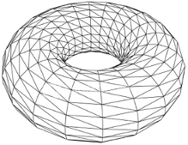
Triangulation of a torus
http://mangrovetds.sourceforge.net/documentation/html/torus_complex.png

Slide 20
Distance Matrix Eigenvector, Mean Centered Distance Matrix
Order of eigenvector: 1
20 intervals, 80% Overlap

Slide 21
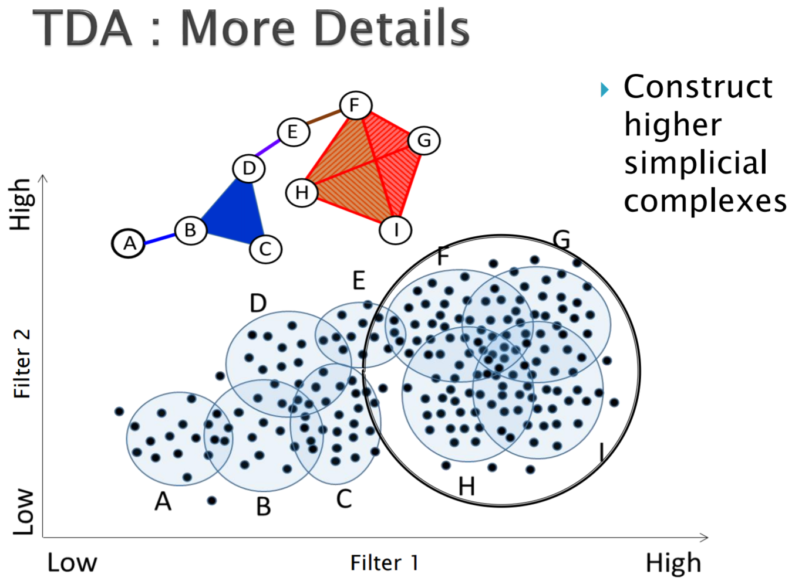
http://www.math.wsu.edu/math/faculty/bkrishna/AbsAlgTopo_PSB2016/Slides_Topology.pdf

Slide 22
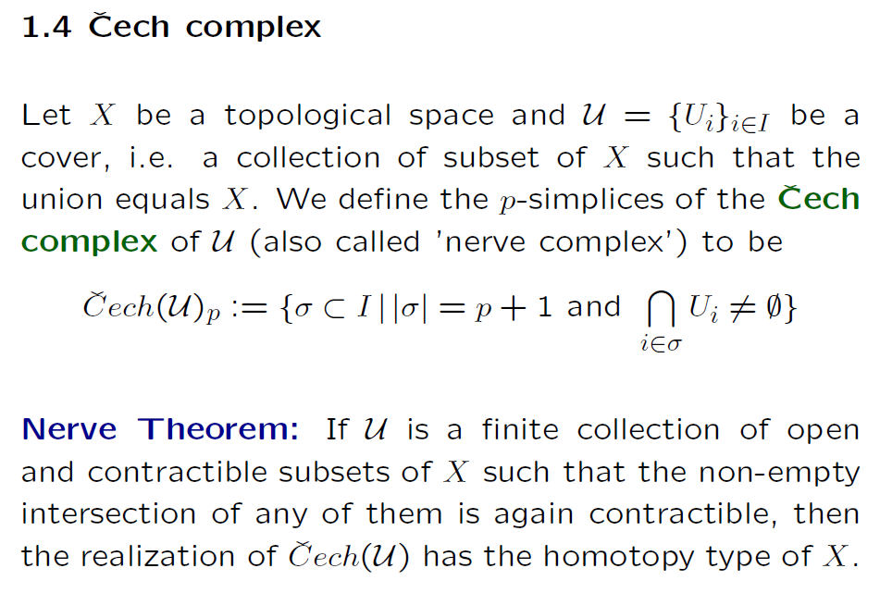
https://people.maths.ox.ac.uk/tillmann/CAT2016lectures.pdf

Slide 23
http://www.math.wsu.edu/math/faculty/bkrishna/AbsAlgTopo_PSB2016/Slides_Topology.pdf

Slide 24
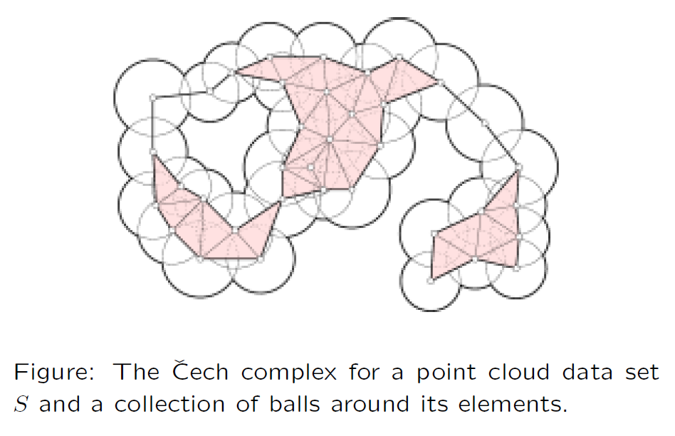
https://people.maths.ox.ac.uk/tillmann/CAT2016lectures.pdf

Slide 25
Creating the Čech simplicial complex
1.) B₁ … B_{k+1} ≠ ⁄ , create k-simplex {v₁, ... , v_{k+1}}.
U
U
0
Notes:
Thus we now have the Vietoris Rips simplicial complex. Note we get the same simplex by adding one dimension at a time

Slide 26
Creating the Čech simplicial complex
1.) B₁ … B_{k+1} ≠ ⁄ , create k-simplex {v₁, ... , v_{k+1}}.
U
U
0
Notes:
Thus we now have the Vietoris Rips simplicial complex. Note we get the same simplex by adding one dimension at a time

Slide 27
Creating the Vietoris Rips simplicial complex
1.) Adding 1-dimensional edges (1-simplices)
Notes:
In step 1 Adding 1-simplices connecting data points that are “close”.

Slide 28
Creating the Vietoris Rips simplicial complex
2.) Add all possible simplices of dimensional > 1.
Notes:
And then adding an n-simplex whenever we have n+1 points that are close.
Thus we now have the Vietoris Rips simplicial complex. Note we get the same simplex by adding one dimension at a time.
What if I increase my threshold?

Slide 29
Vietoris Rips complex = flag complex = clique complex
2.) Add all possible simplices of dimensional > 1.
Notes:
Thus we now have the Vietoris Rips simplicial complex. Note we get the same simplex by adding one dimension at a time

Slide 30
Creating the Čech simplicial complex
1.) B₁ … B_{k+1} ≠ ⁄ , create k-simplex {v₁, ... , v_{k+1}}.
U
U
0
Notes:
Thus we now have the Vietoris Rips simplicial complex. Note we get the same simplex by adding one dimension at a time

Slide 31
Creating the Čech simplicial complex
1.) B₁ … B_{k+1} ≠ ⁄ , create k-simplex {v₁, ... , v_{k+1}}.
U
U
0
Notes:
Thus we now have the Vietoris Rips simplicial complex. Note we get the same simplex by adding one dimension at a time

Slide 32
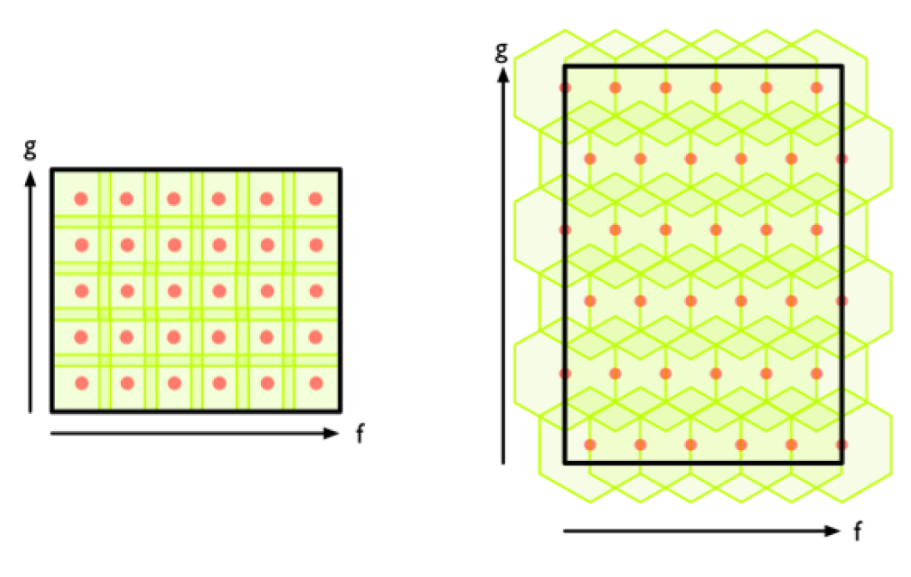
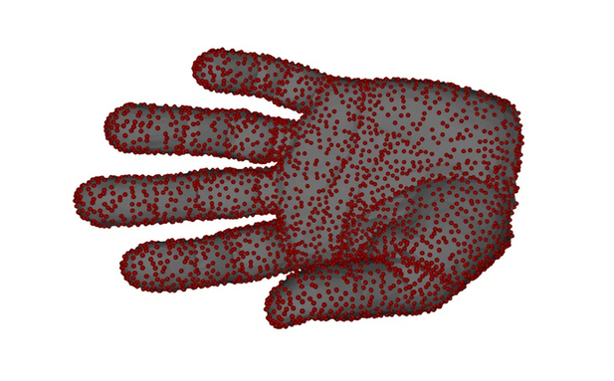
Create overlapping bins:
http://www.nature.com/srep/2013/130207/srep01236/full/srep01236.html

Slide 33
Create overlapping bins:
http://www.nature.com/srep/2013/130207/srep01236/full/srep01236.html

Slide 34
Distance Matrix Eigenvector, Mean Centered Distance Matrix
Order of eigenvector: 1
20 intervals, 80% Overlap
More than 50% overlap is usually a bad idea!

Slide 35
Coloring

Slide 36
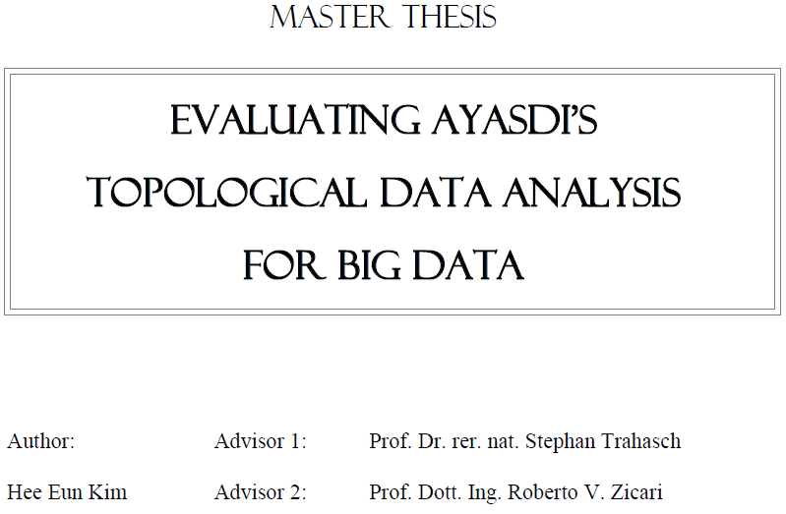


http://www.bigdata.uni-frankfurt.de/wp-content/uploads/2015/10/
Evaluating-Ayasdi’s-Topological-Data-Analysis-For-Big-Data_HKim2015.pdf

Slide 37
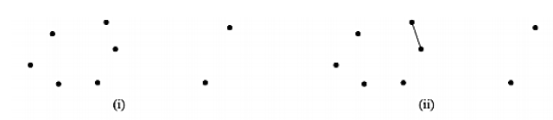
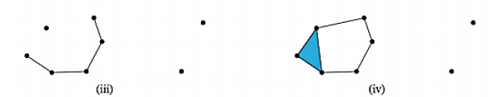
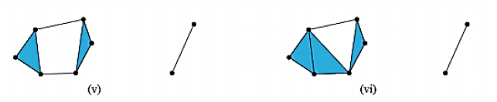
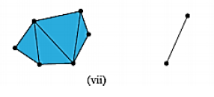

We are not (currently) covering persistent homology including barcodes

Slide 38

“The given topological network are extracted from the data set that contains the information of Titanic passengers consists of 891 samples with eight numerical attributes including a label. The label discriminates either the passenger that survived or died.”
Analyze your data

Slide 39
“Color ranges over red to blue and it has different meanings, depending on the type of attributes. For the continuous values, color represents an average of value. A red node contains data samples that have higher average values. In contrast, a blue node contains lower average values. In contrast, for the categorical values, color represents a value concentration.”
Analyze your data

Slide 40
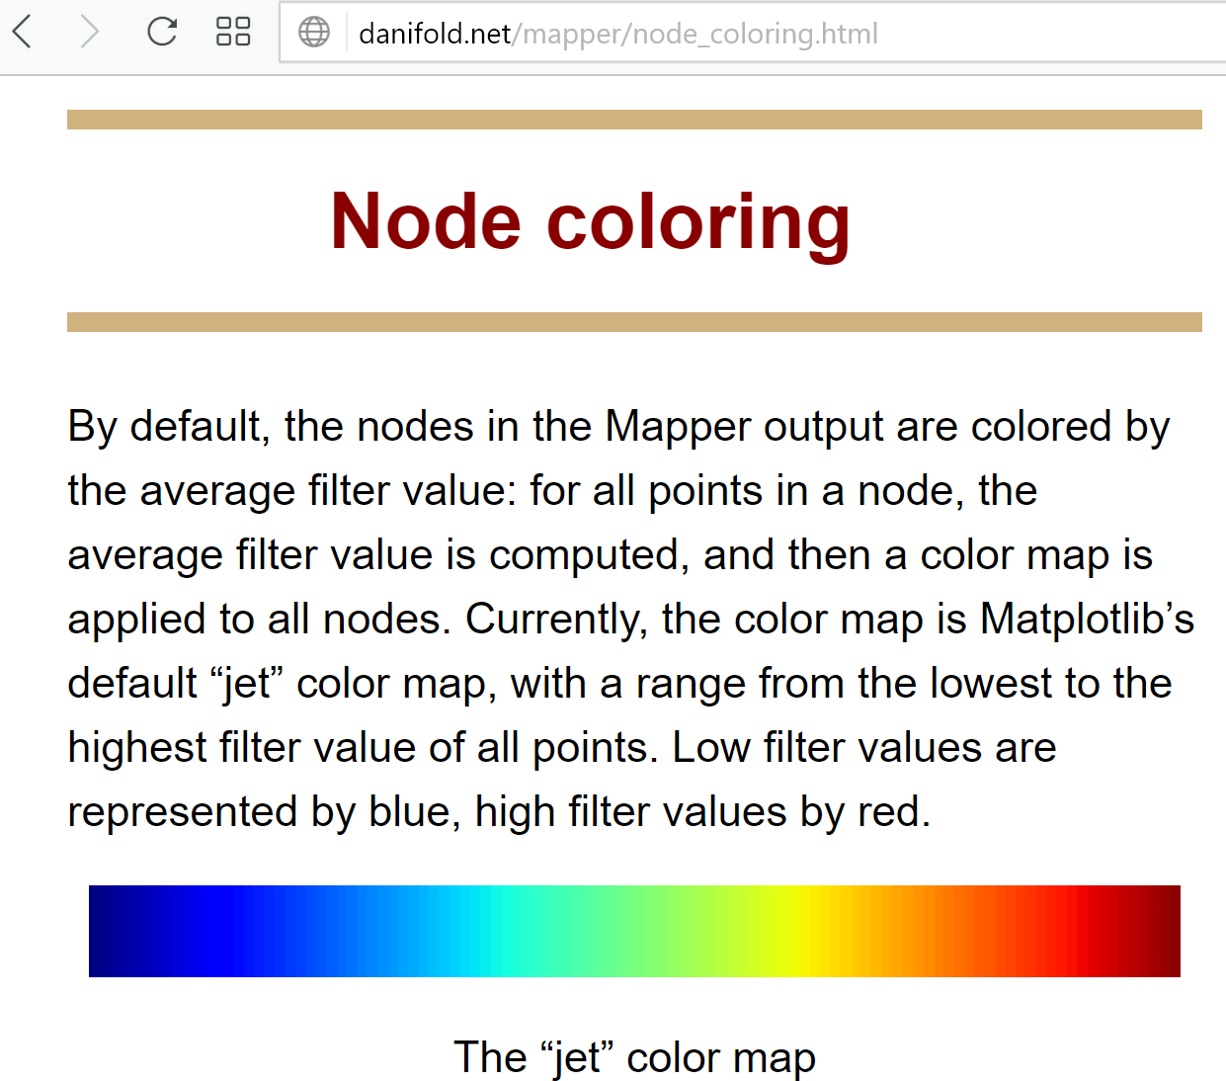

Slide 41
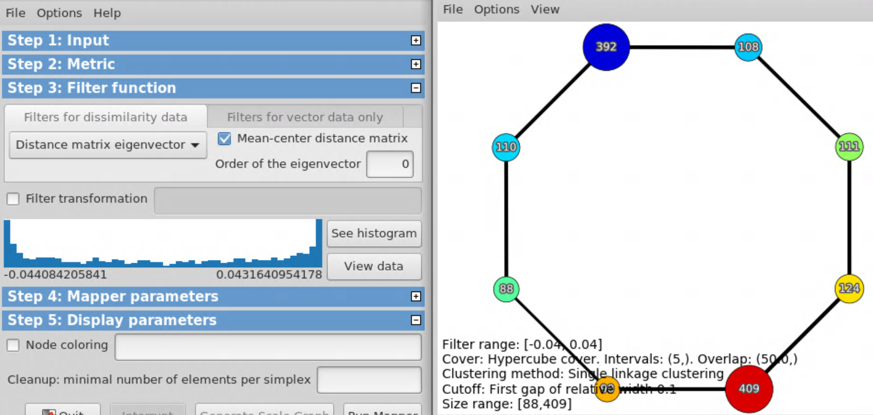
Default coloring is average filter value

Slide 42
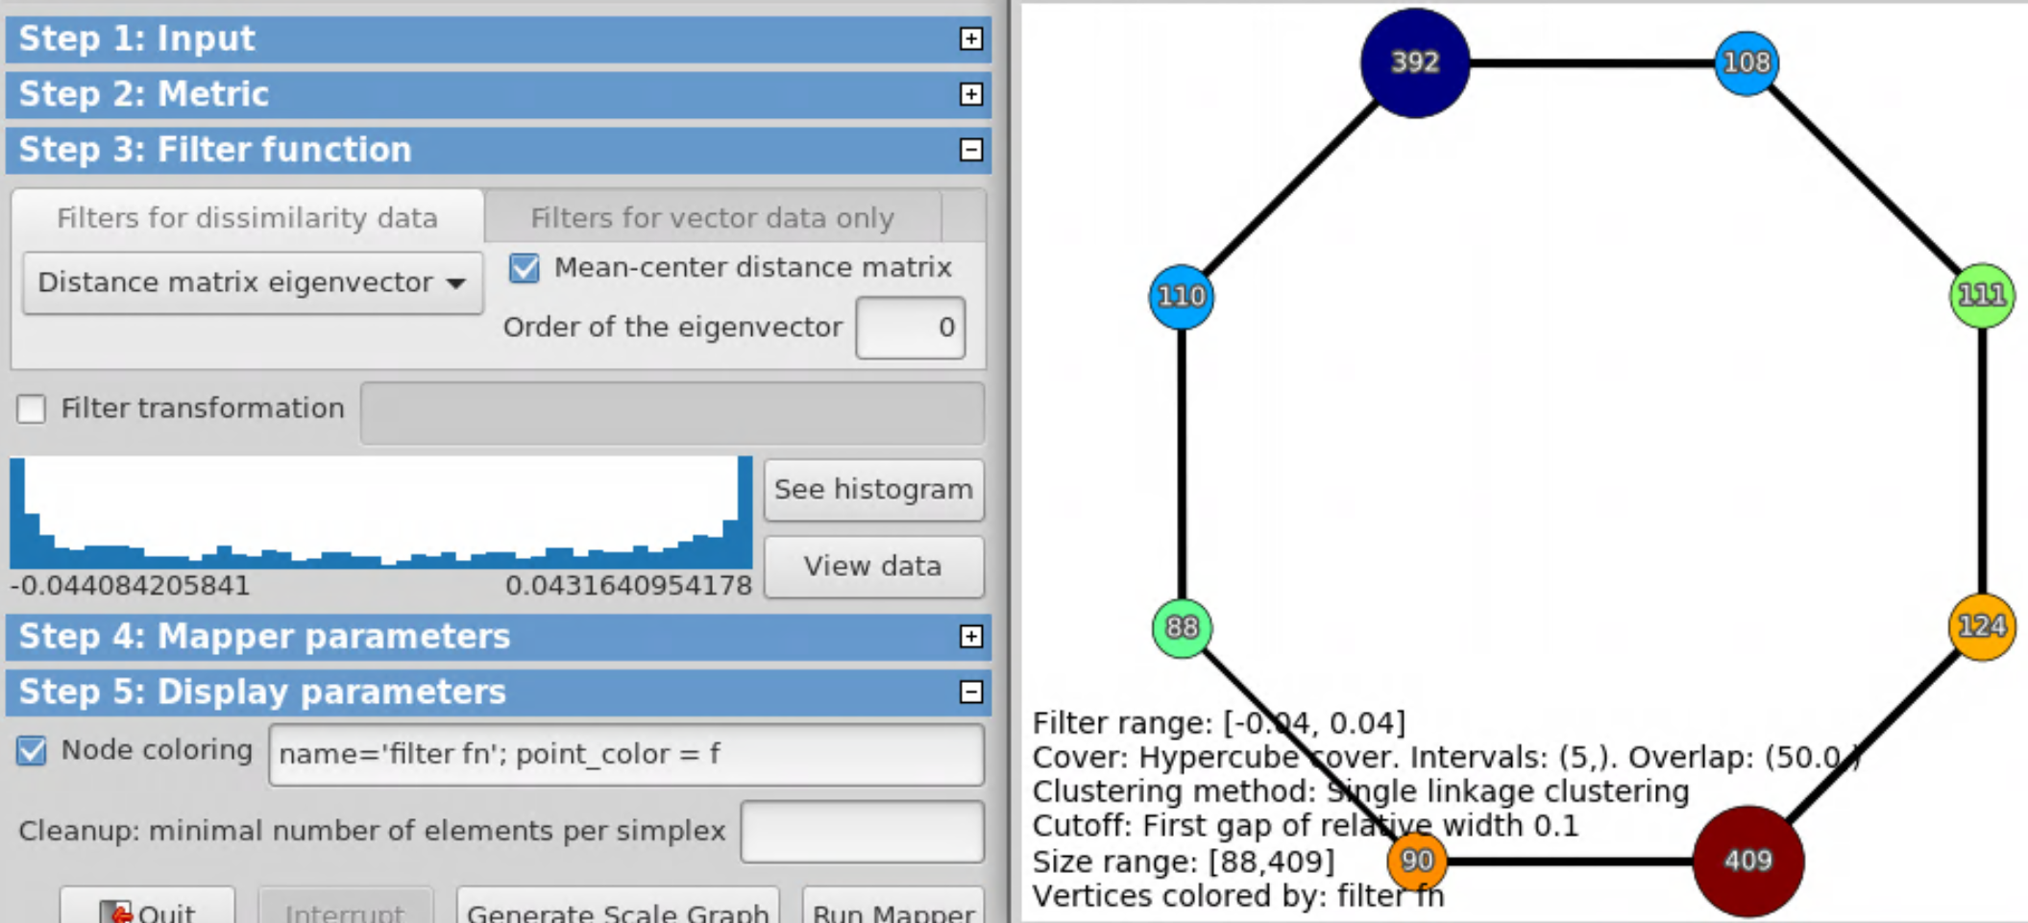
Can also specify color by filter function via
point_color = f

Slide 43
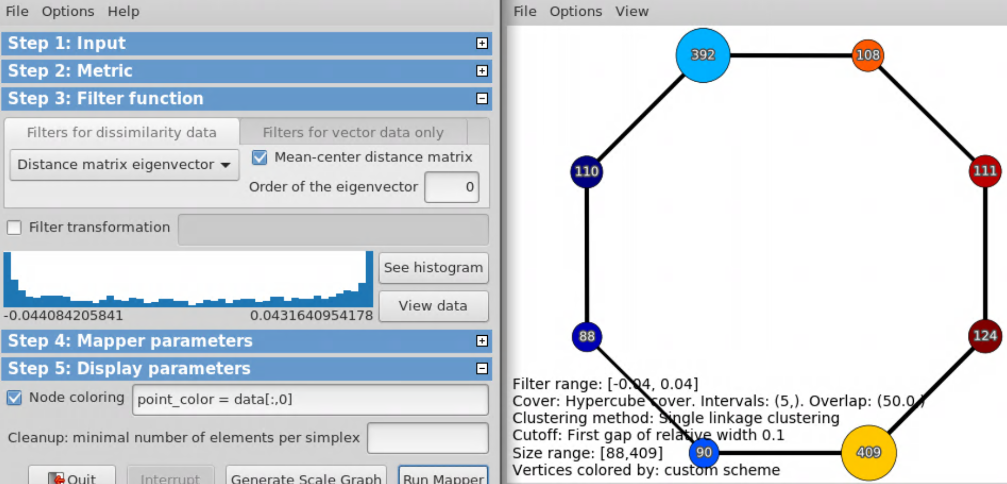
point_color = data[:,0]

Slide 44
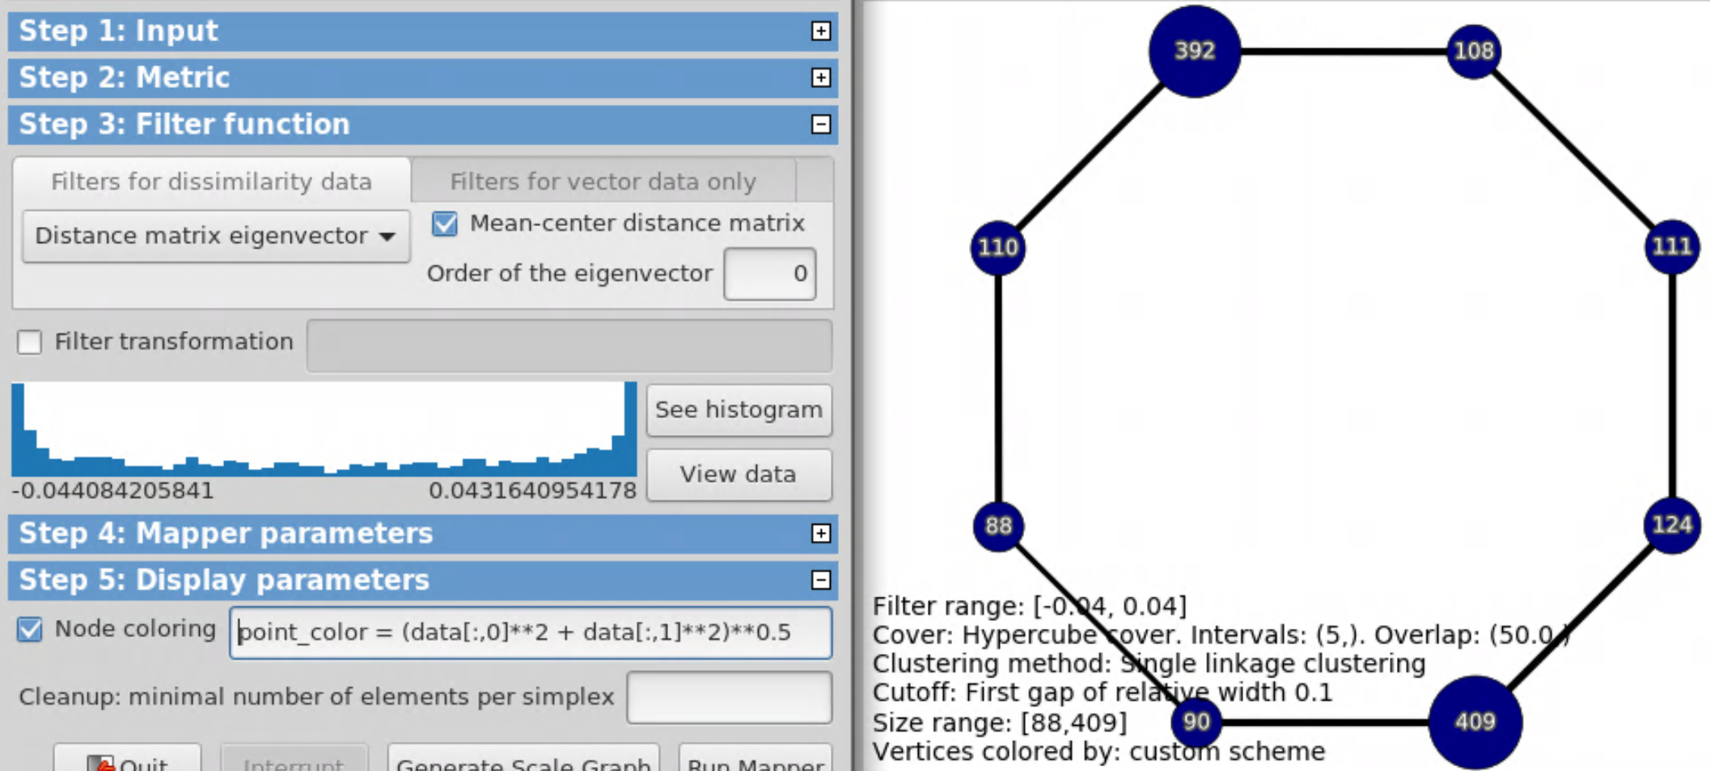
point_color = (data[:,0]**2 + data[:,1]**2)**0.5

Slide 45
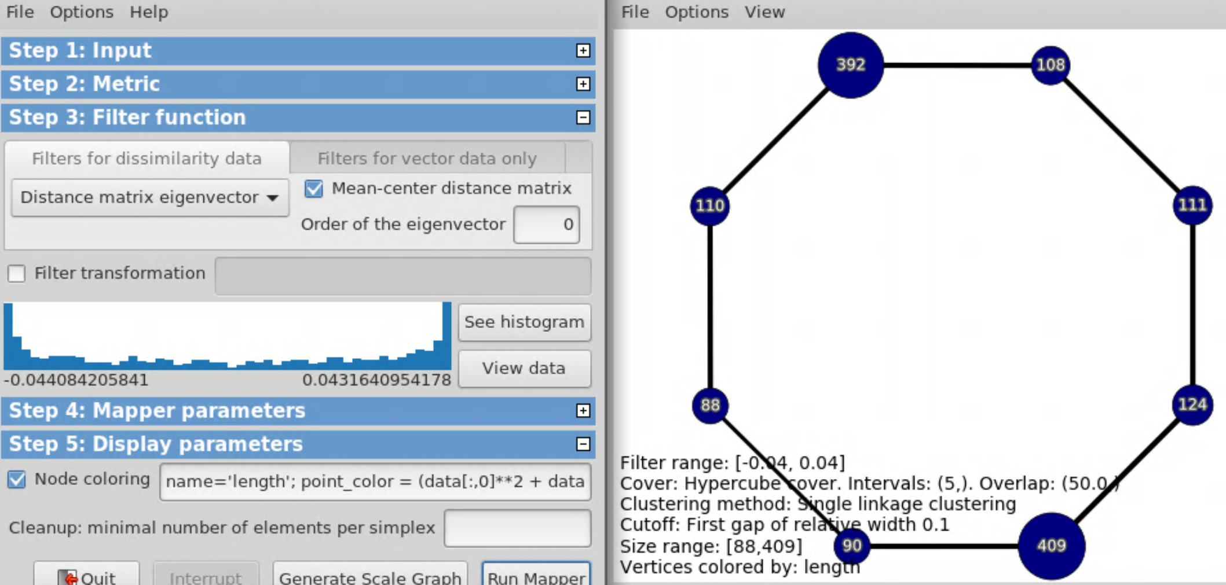
name = ‘length’;
point_color = (data[:,0]**2 + data[:,1]**2)**0.5

Slide 46
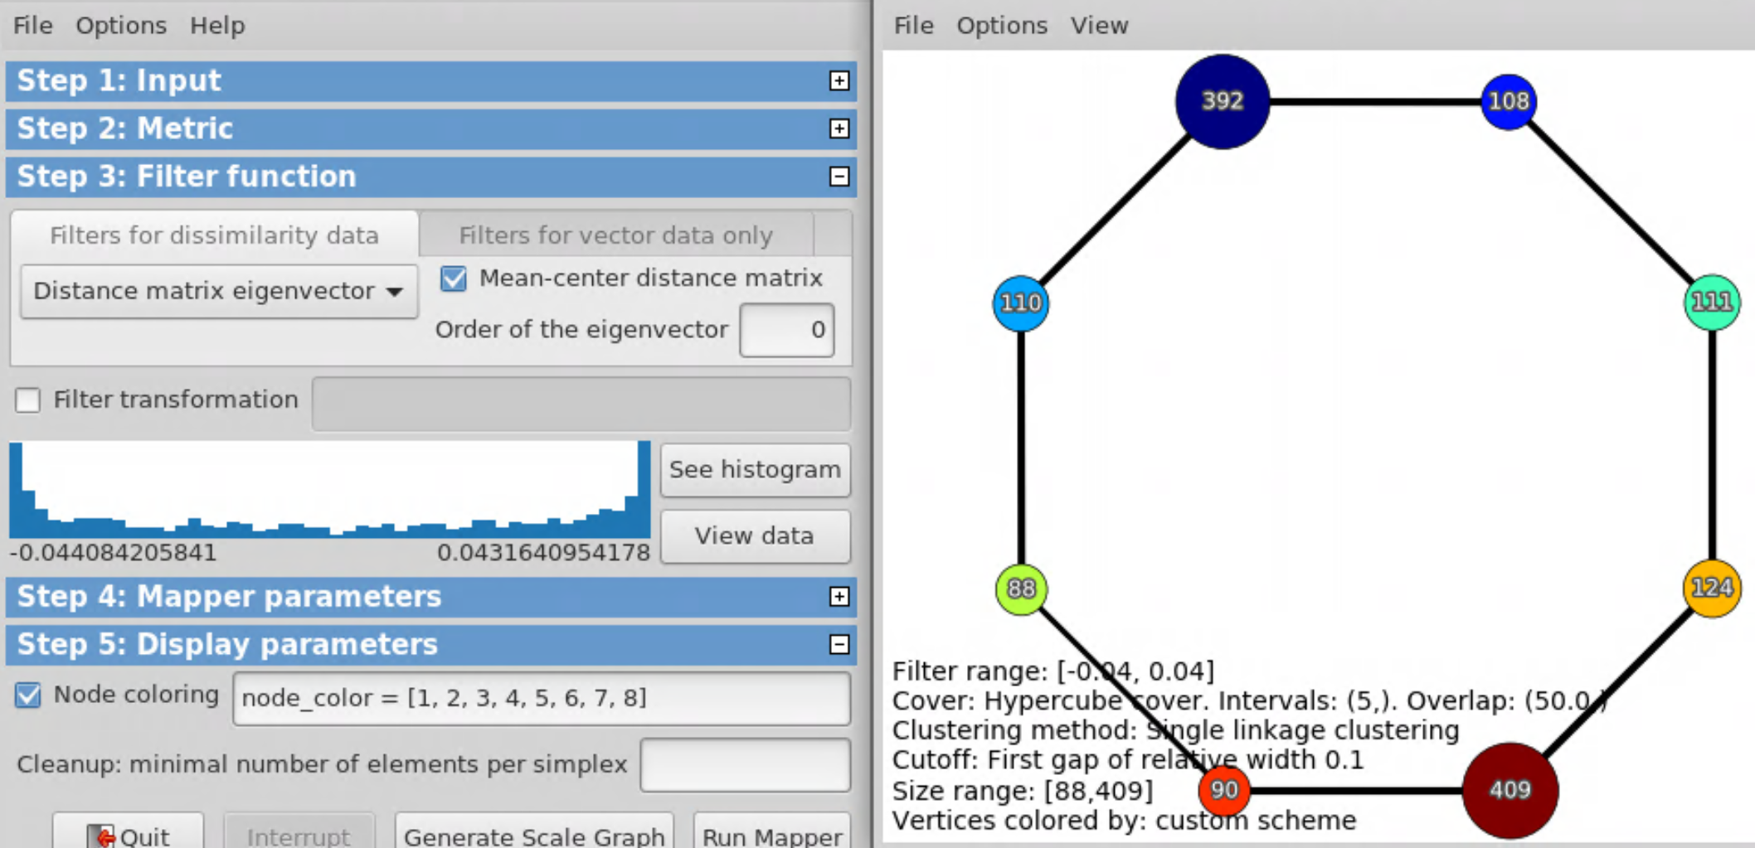
Alternatively, can specify node color
node_color = [1, 2, 3, 4, 5, 6, 7, 8]

Slide 47
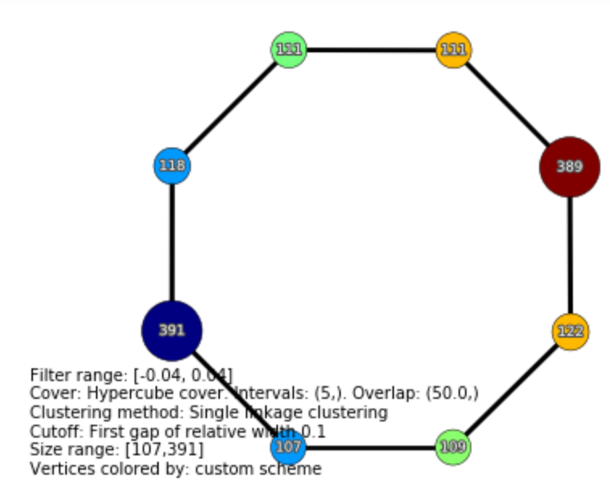
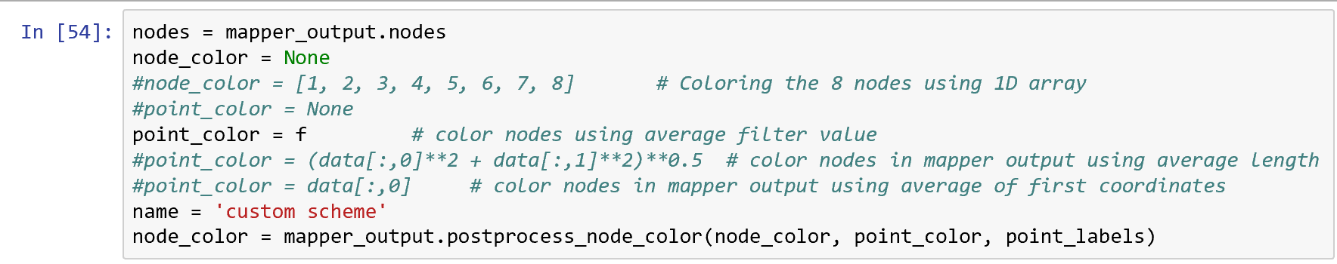
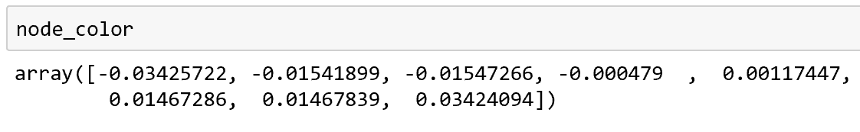
In Jupyter notebook
Choose how to color vertices in TDA mapper graph
Output the color code for each node in TDA mapper graph

Slide 48
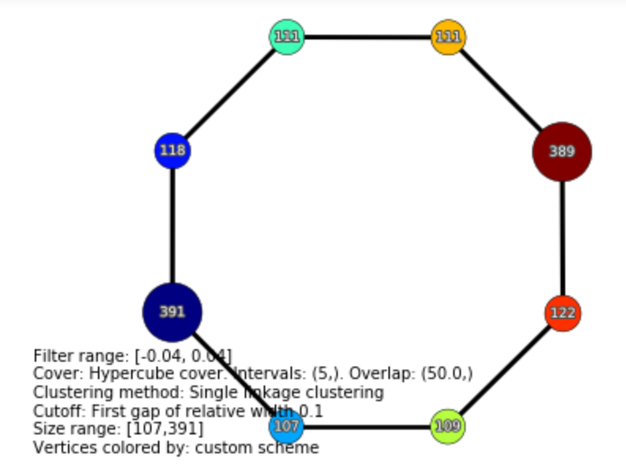
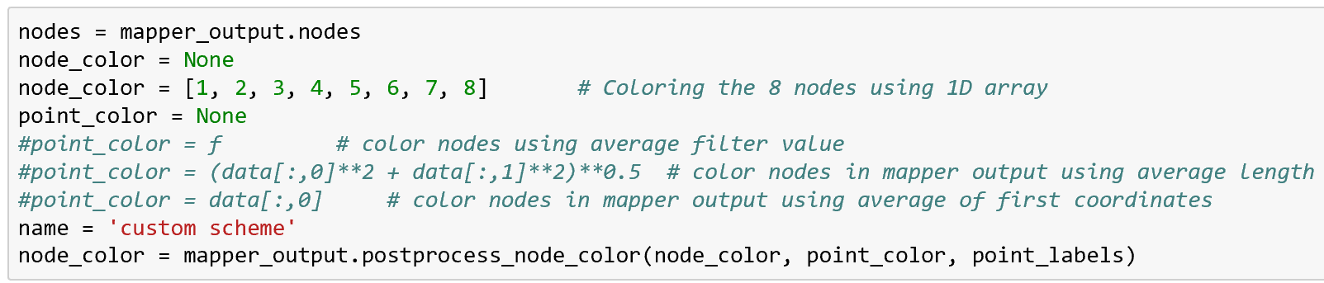
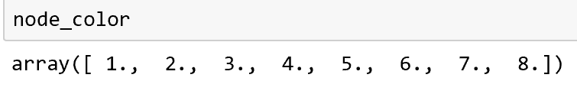
In Jupyter notebook
Choose how to color vertices in TDA mapper graph
Output the color code for each node in TDA mapper graph

Slide 49
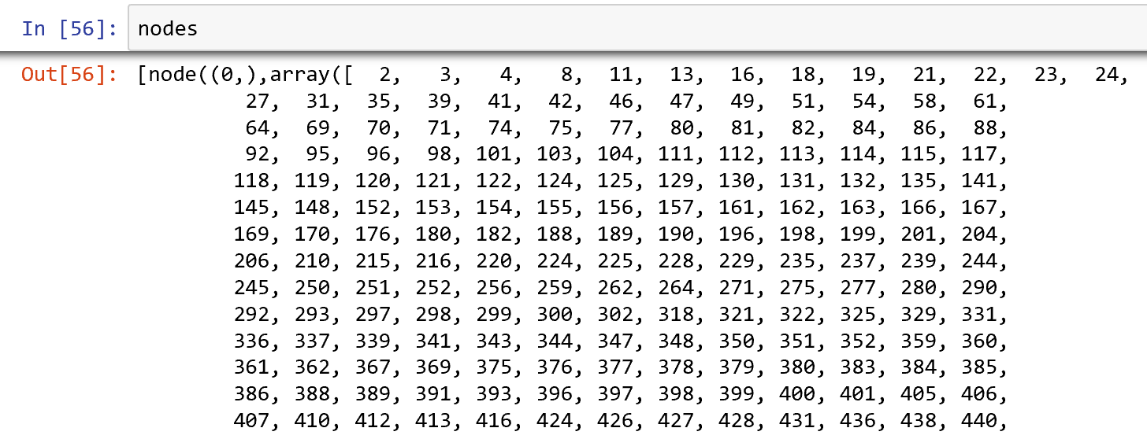

Slide 50
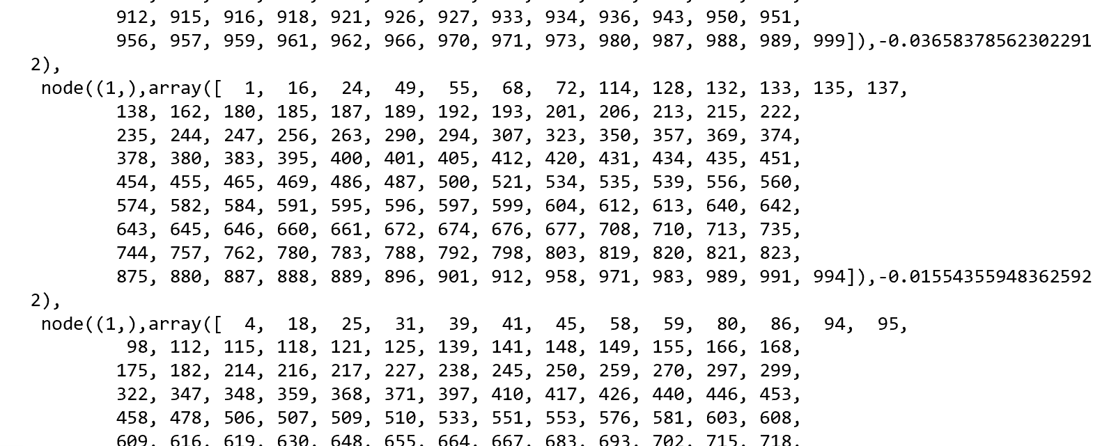

Slide 51
Kolmogorov-Smirnov Test

Slide 52
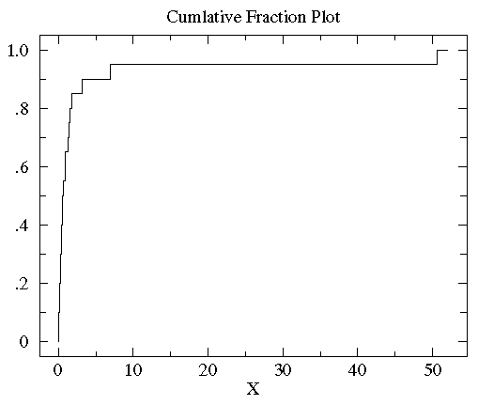
http://www.physics.csbsju.edu/stats/KS-test.html
Sorted controlB={0.08, 0.10, 0.15, 0.17, 0.24, 0.34, 0.38, 0.42, 0.49, 0.50, 0.70, 0.94, 0.95, 1.26, 1.37, 1.55, 1.75, 3.20, 6.98, 50.57}

Slide 53
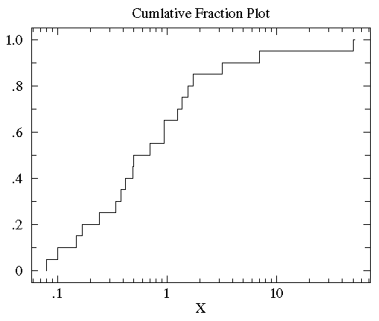
http://www.physics.csbsju.edu/stats/KS-test.html
Sorted controlB={0.08, 0.10, 0.15, 0.17, 0.24, 0.34, 0.38, 0.42, 0.49, 0.50, 0.70, 0.94, 0.95, 1.26, 1.37, 1.55, 1.75, 3.20, 6.98, 50.57}

Slide 54
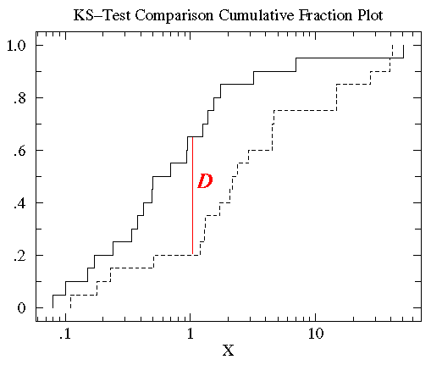
http://www.physics.csbsju.edu/stats/KS-test.html
treatmentB= {2.37, 2.16, 14.82, 1.73, 41.04, 0.23, 1.32, 2.91, 39.41, 0.11, 27.44, 4.51, 0.51, 4.50, 0.18, 14.68, 4.66, 1.30, 2.06, 1.19}

Slide 55
http://www.physics.csbsju.edu/stats/KS-test.html
treatmentB= {0.11, 0.18, 0.23, 0.51, 1.19, 1.30, 1.32, 1.73, 2.06, 2.16, 2.37, 2.91, 4.50, 4.51, 4.66, 14.68, 14.82, 27.44, 39.41, 41.04}

Slide 56
http://www.physics.csbsju.edu/stats/KS-test.html
The KS-test uses the maximum vertical deviation between the two curves as the statistic D. In this case the maximum deviation occurs near x=1 and has D=.45. (The fraction of the treatment group that is less then one is 0.2 (4 out of the 20 values); the fraction of the control group that is less than one is 0.65 (13 out of the 20 values). Thus the maximum difference in cumulative fraction is D=.45.)

Slide 57
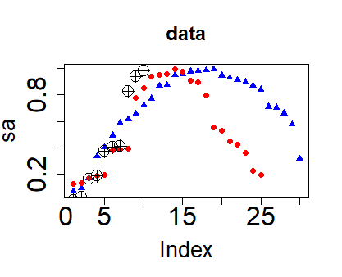
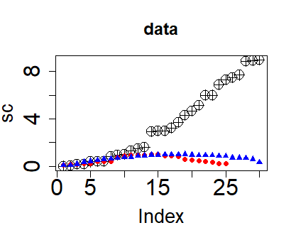
a <- sort(runif(30, 0,3))
sa <-sin(a)
b <- sort(runif(25, 0,3))
sb <-sin(b)
c <- sort(runif(30, 0,3))
sc <- c^2
plot(sa, main = "data", col="blue", pch = 17,
cex.main = 1.5, cex.lab = 1.7, cex.axis = 2)
points(sb, col="red", pch = 19)
points(sc, pch = 10, cex=2)
plot(sc, main = "data", pch = 10,
cex=2, cex.main = 1.5,
cex.lab = 1.7, cex.axis = 2)
points(sb, col="red", pch = 19)
points(sa, col="blue", pch = 17)

Slide 58
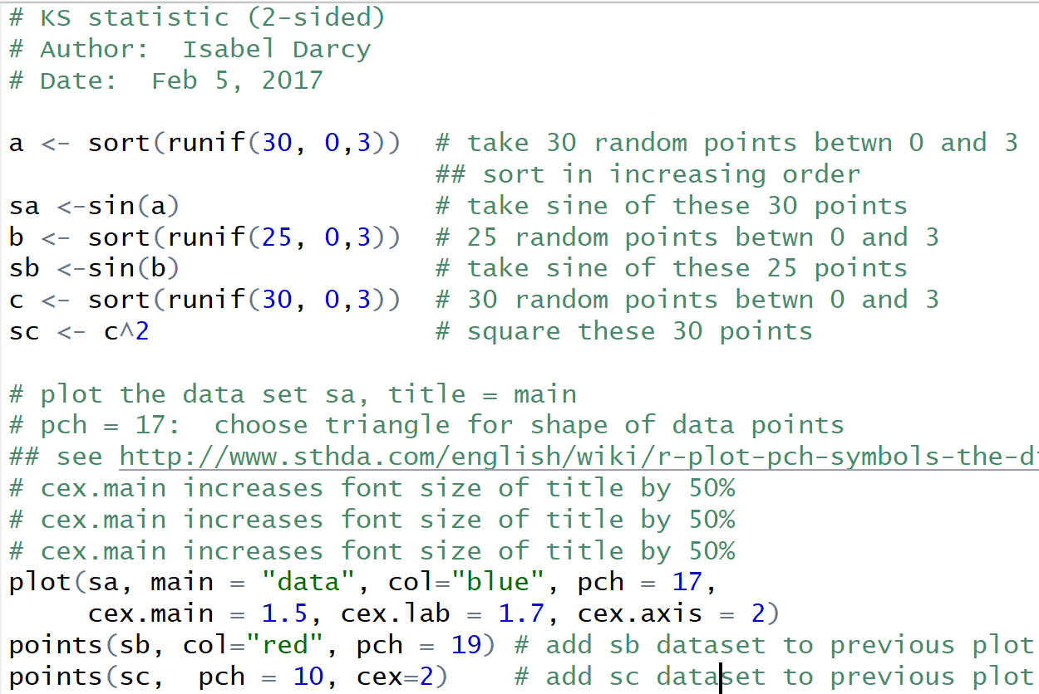
ks.r

Slide 59
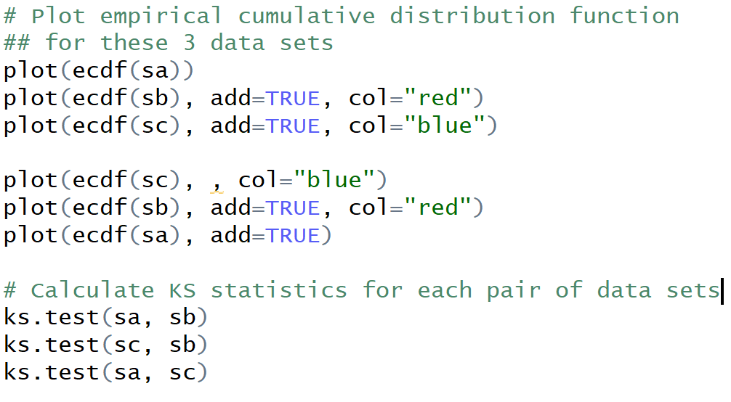
ks.r (cont.)

Slide 60
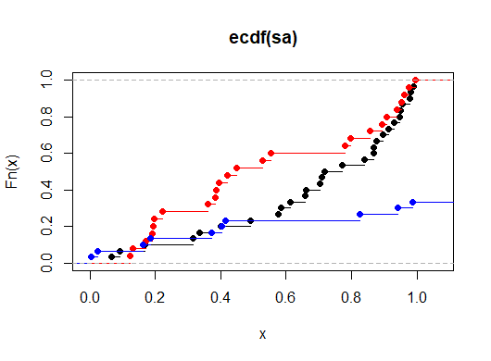
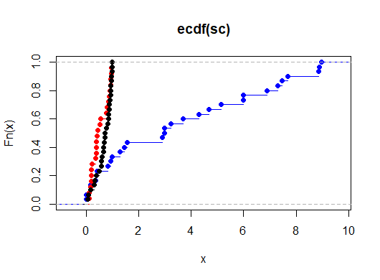
# Plot empirical cumulative
## distribution function
## for these 3 data sets
plot(ecdf(sa))
plot(ecdf(sb), add=TRUE,
col="red")
plot(ecdf(sc), add=TRUE,
col="blue")
plot(ecdf(sc), , col="blue")
plot(ecdf(sb), add=TRUE,
col="red")
plot(ecdf(sa), add=TRUE)

Slide 61
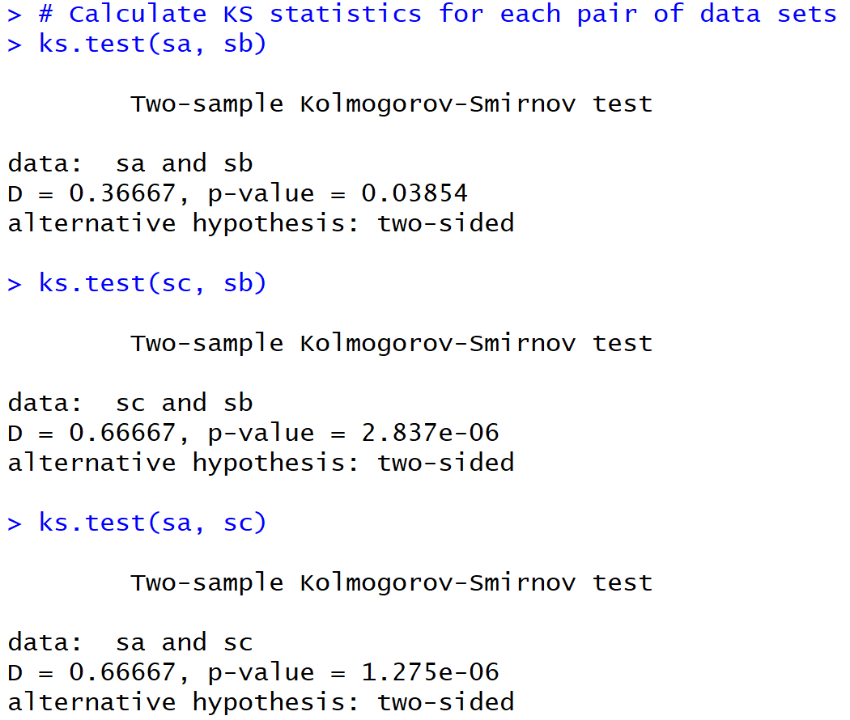

Slide 62
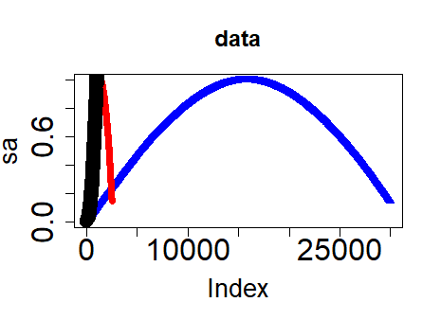
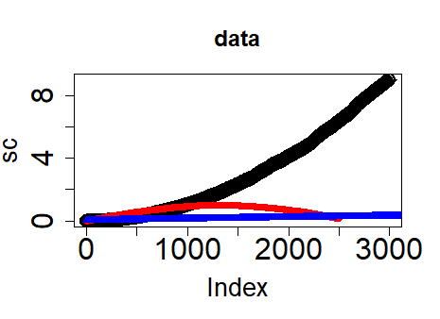
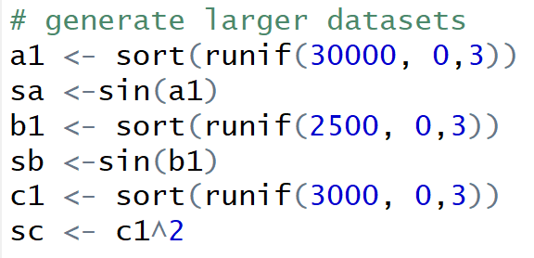

Slide 63
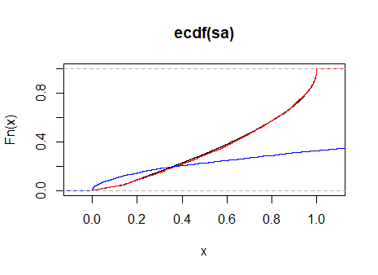
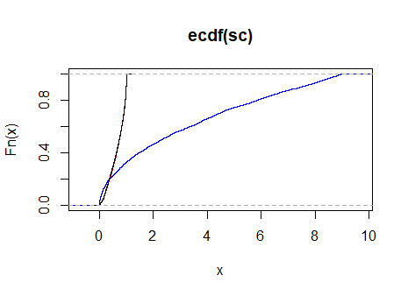

Slide 64
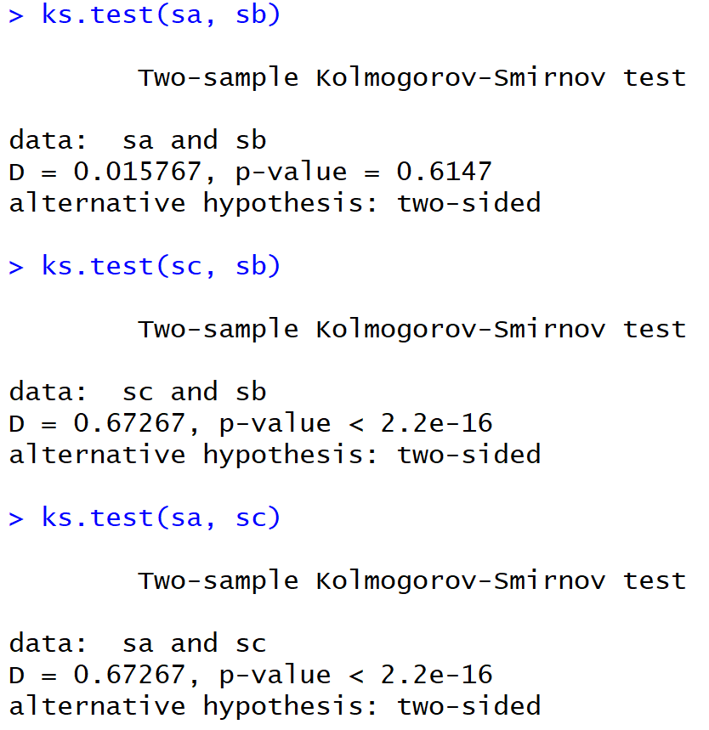
For large dataset

Slide 65
For smaller dataset

Slide 66


Slide 67


Slide 68


Slide 69


Slide 70


Slide 71


Slide 72
For smaller dataset

Slide 73
http://www.bigdata.uni-frankfurt.de/wp-content/uploads/2015/10/
Evaluating-Ayasdi’s-Topological-Data-Analysis-For-Big-Data_HKim2015.pdf

Slide 74
“Color ranges over red to blue and it has different meanings, depending on the type of attributes. For the continuous values, color represents an average of value. A red node contains data samples that have higher average values. In contrast, a blue node contains lower average values. In contrast, for the categorical values, color represents a value concentration.”
Analyze your data

Slide 75

3.2.2.2 Insight by Ranked Variables
Going back to the Titanic example, the result of the KS-statistic show, that the variable “Sex” is the most strongly related to passengers death. We could generally assume that men conceded the places in lifeboats to women. Furthermore, it is feasible to deduct the subtle reasons of the death of each group. The passengers in group A died because of two reasons: they were man and the cabin class type was low. The passengers in the group B died because they were man. Finally, the passengers in the group C died because they were staying at third class even though most of them were women.

Slide 76
“Color ranges over red to blue and it has different meanings, depending on the type of attributes. For the continuous values, color represents an average of value. A red node contains data samples that have higher average values. In contrast, a blue node contains lower average values. In contrast, for the categorical values, color represents a value concentration.”
1 node is orange
But maybe all the red nodes consist of 90% 3rd class and 10% first class
Analyze your data

Slide 77
3.2.2.2 Insight by Ranked Variables
Going back to the Titanic example, the result of the KS-statistic show, that the variable “Sex” is the most strongly related to passengers death. We could generally assume that men conceded the places in lifeboats to women. Furthermore, it is feasible to deduct the subtle reasons of the death of each group. The passengers in group A died because of two reasons: they were man and the cabin class type was low. The passengers in the group B died because they were man. Finally, the passengers in the group C died because they were staying at third class even though most of them were women.

Slide 78
Note for titanic analysis, only the affects of individual variables was analyzed.
One could also study how linear combinations of these variables affect survival.
For example, the analysis could be redone using principal components or machine learning or clustering.

Slide 79
“Color ranges over red to blue and it has different meanings, depending on the type of attributes. For the continuous values, color represents an average of value. A red node contains data samples that have higher average values. In contrast, a blue node contains lower average values. In contrast, for the categorical values, color represents a value concentration.”
Analyze your data

Slide 80
3.2.2.2 Insight by Ranked Variables
Going back to the Titanic example, the result of the KS-statistic show, that the variable “Sex” is the most strongly related to passengers death. We could generally assume that men conceded the places in lifeboats to women. Furthermore, it is feasible to deduct the subtle reasons of the death of each group. The passengers in group A died because of two reasons: they were man and the cabin class type was low. The passengers in the group B died because they were man. Finally, the passengers in the group C died because they were staying at third class even though most of them were women.

